Slide 1
The Long-Distance Teacher: Navigating Mental Health and Well-being in Global Education

Slide 2

My Journey as a Global Educator
Two Countries
Five Schools
8 Years of Traditional Teaching

Slide 3
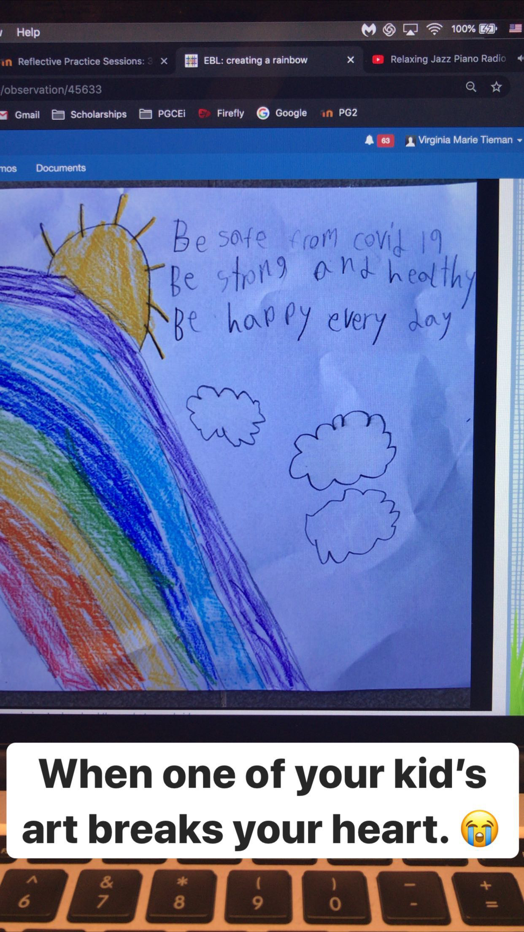
The Shifts in Education and Mental Health Impacts

Slide 4
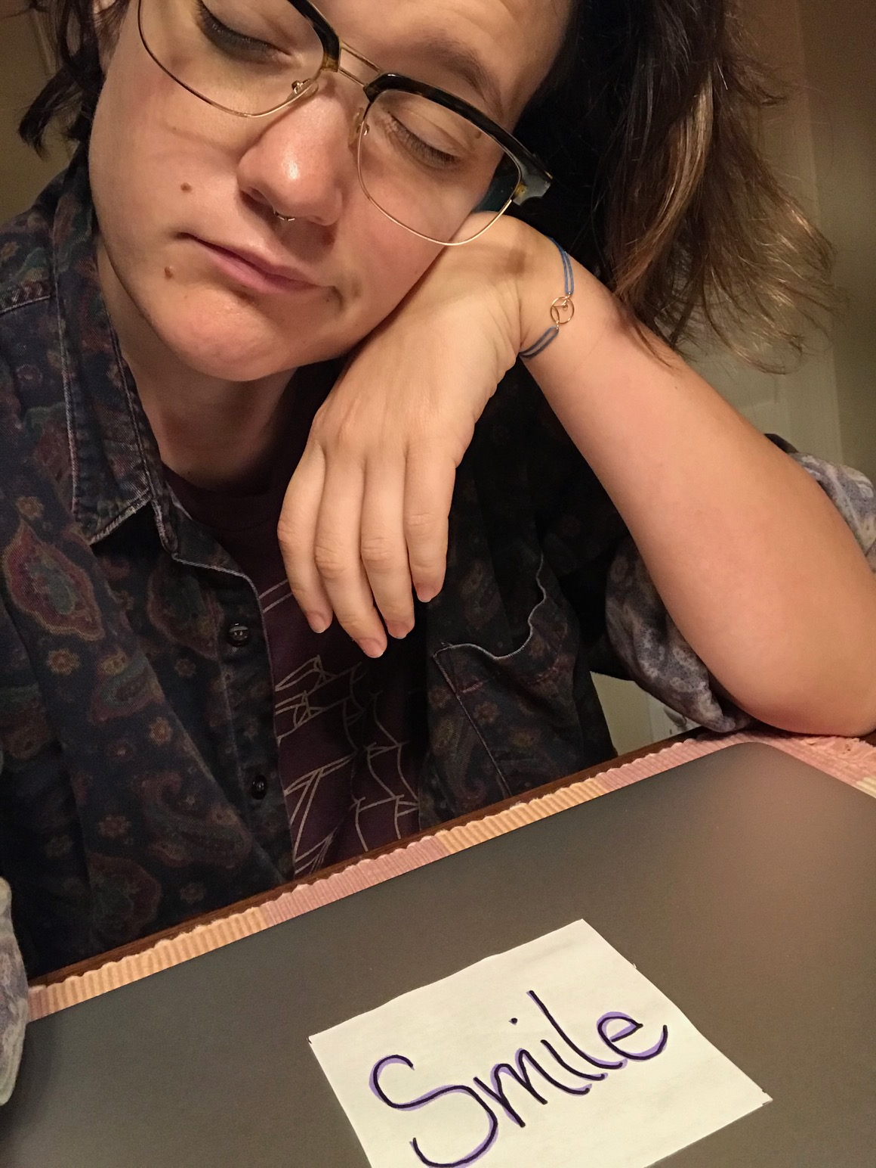
The Shifts in Education and Mental Health Impacts

Slide 5
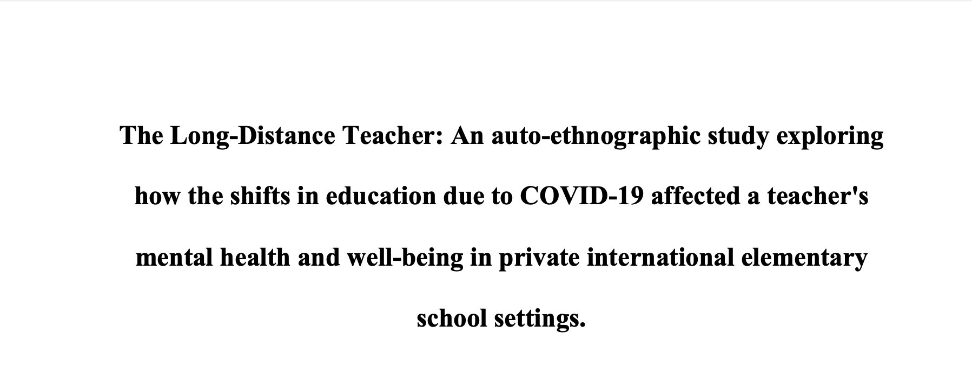
The Long-Distance Teacher

Slide 6
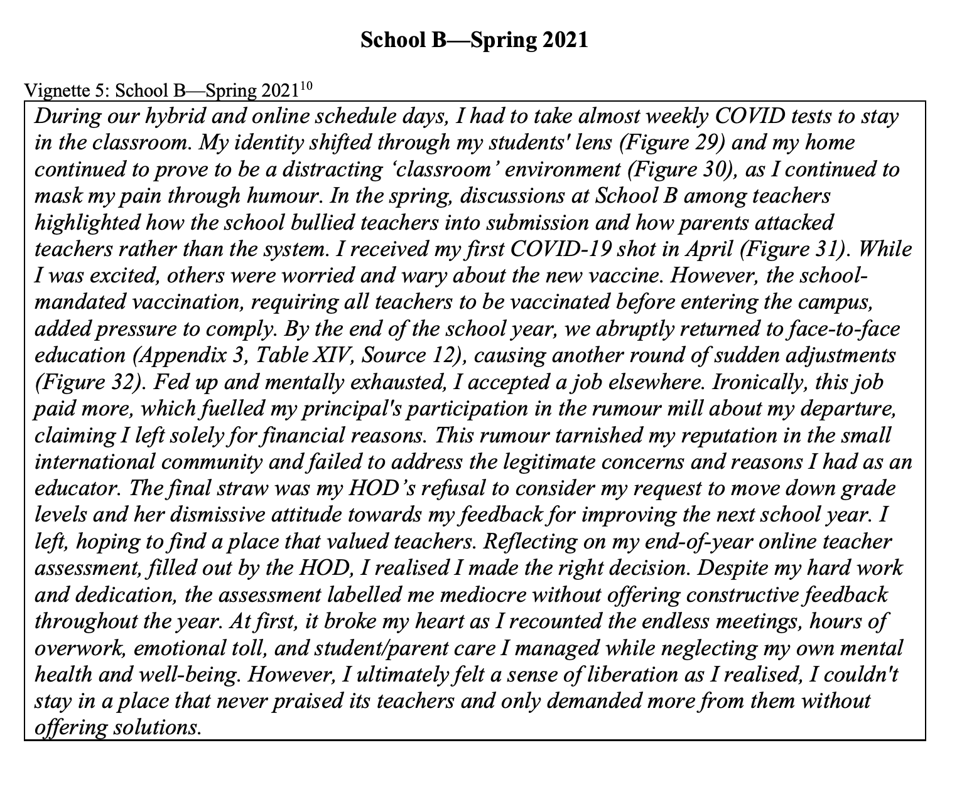
Vignettes

Slide 7
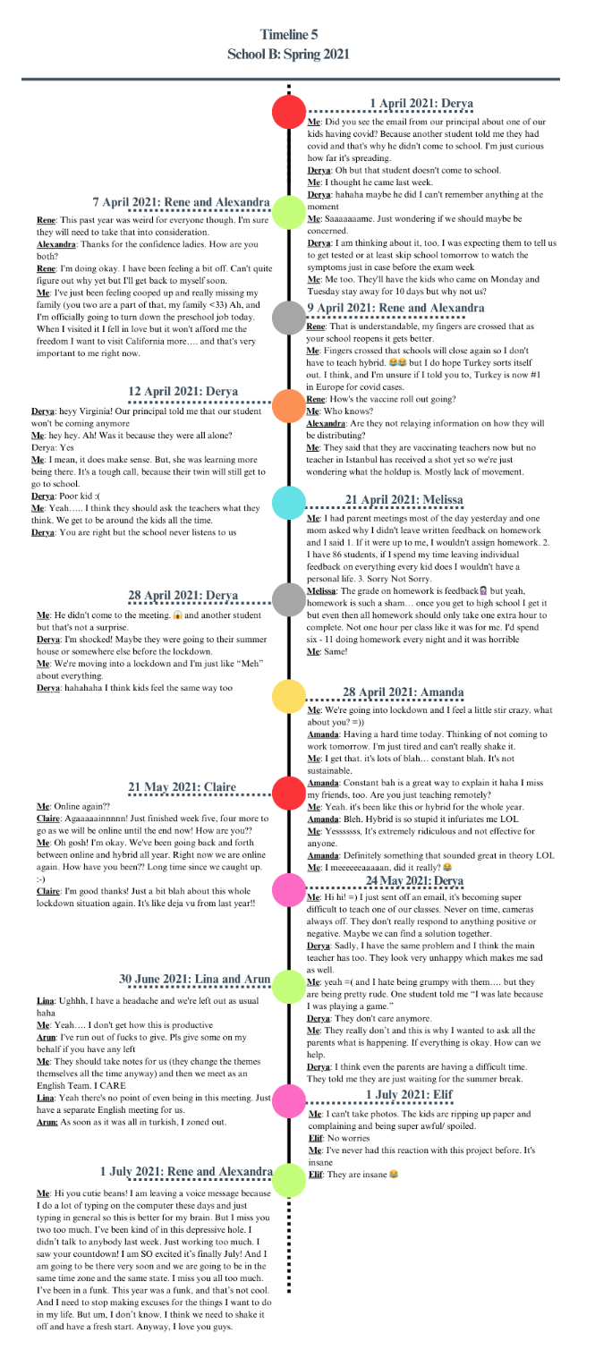
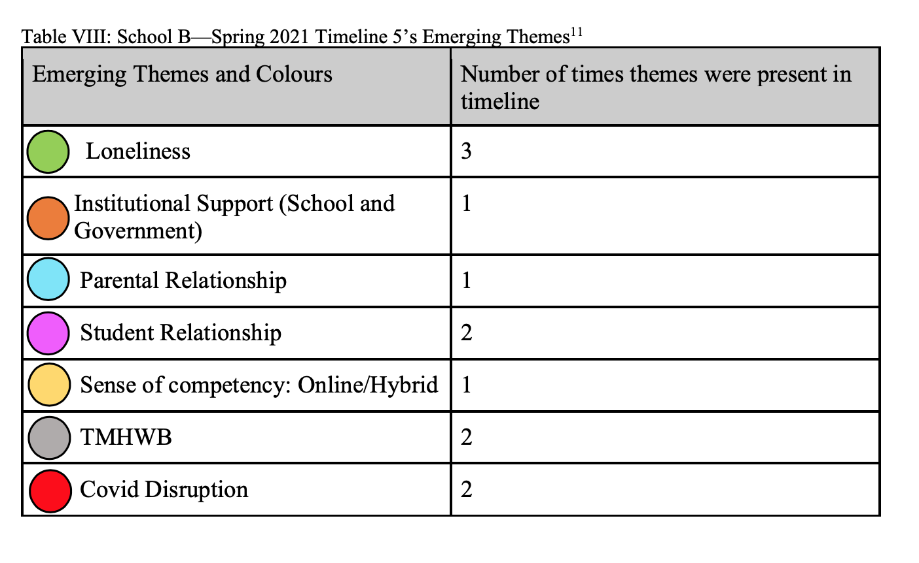
Timelines and Emerging Themes

Slide 8
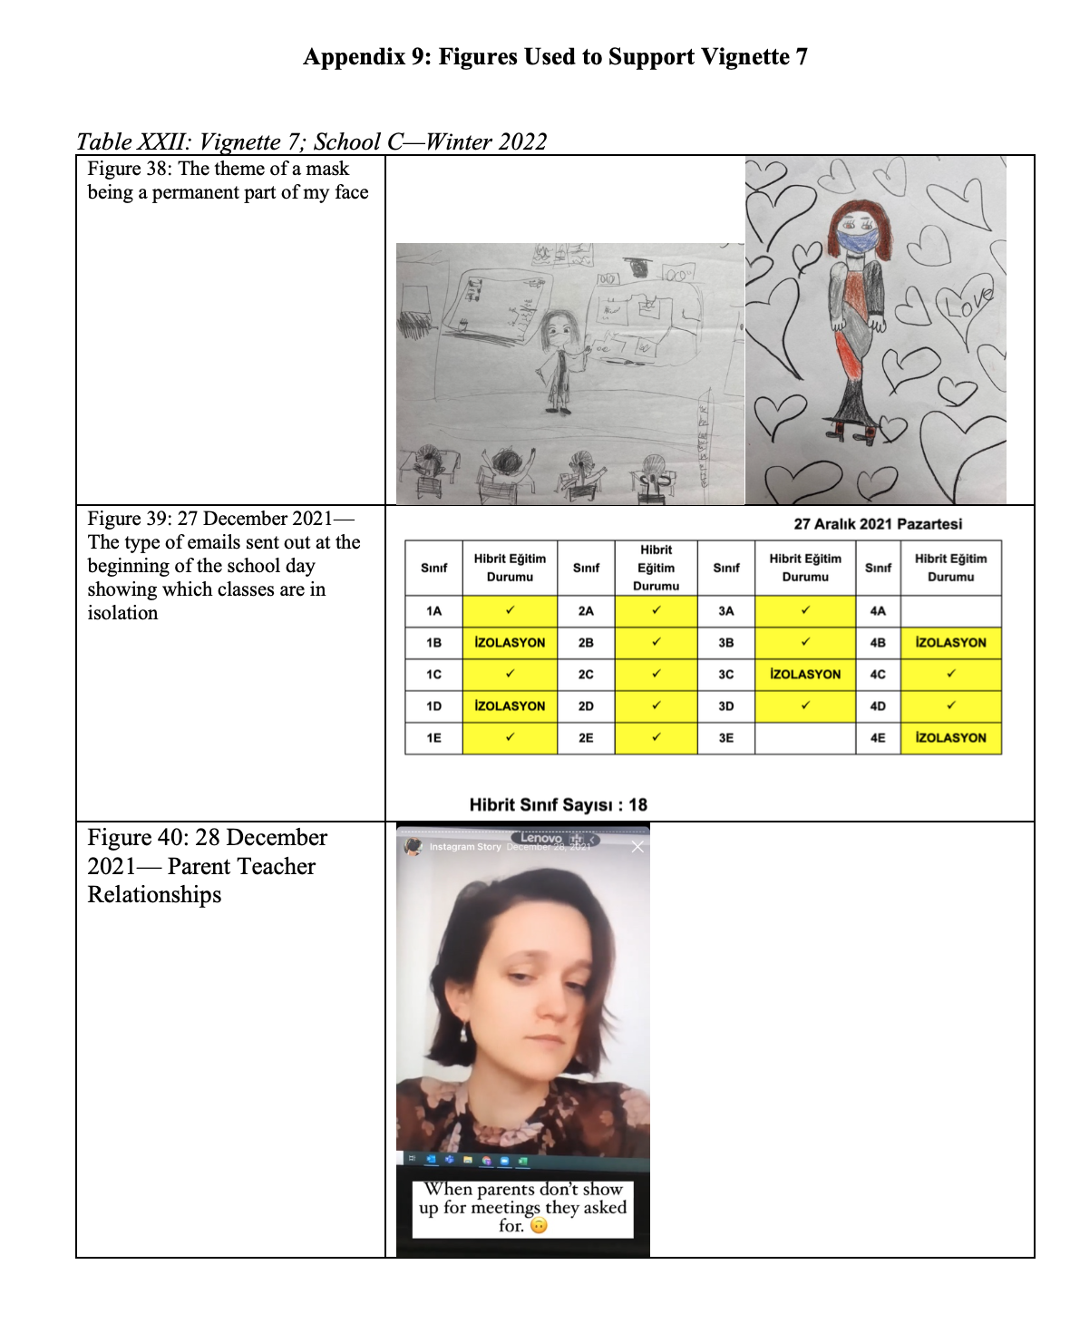
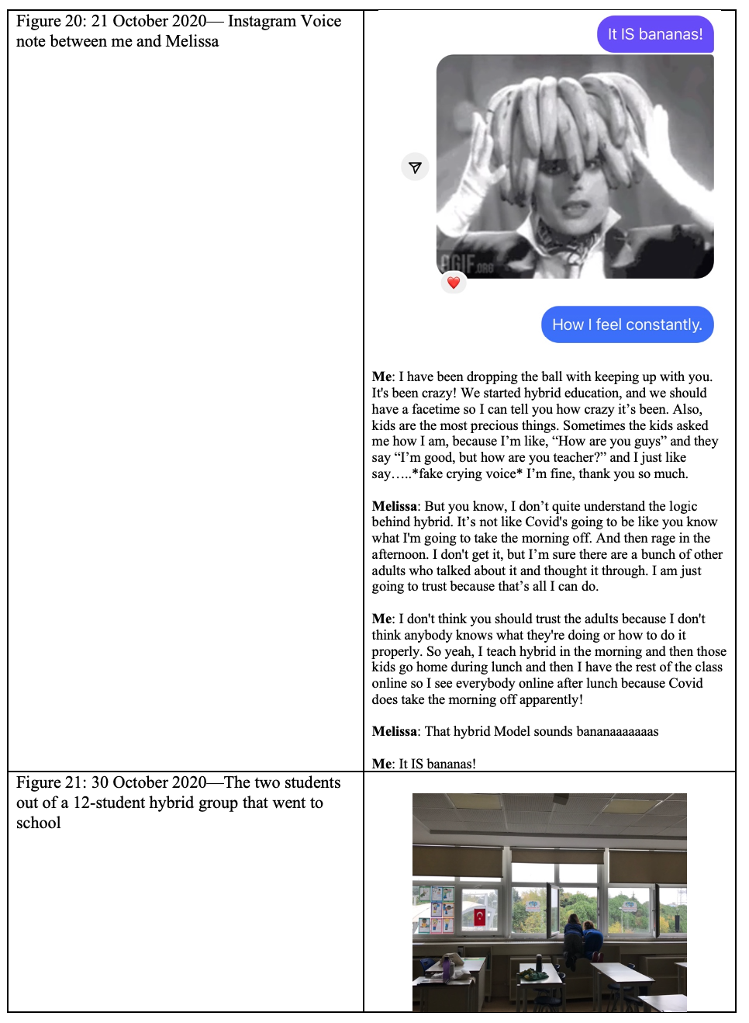
Appendix

Slide 9
Poll Time!
I want to teach abroad.
I have no interest in teaching abroad.
I am undecided.
I just want to survive.

Slide 10




Finding the “Right Fit” in Education
It’s not your job to fix a school while burning out.

Slide 11

Passion and Mental Health and Well-being Advocacy
Letting go of your ego and revisiting your “why”

Slide 12
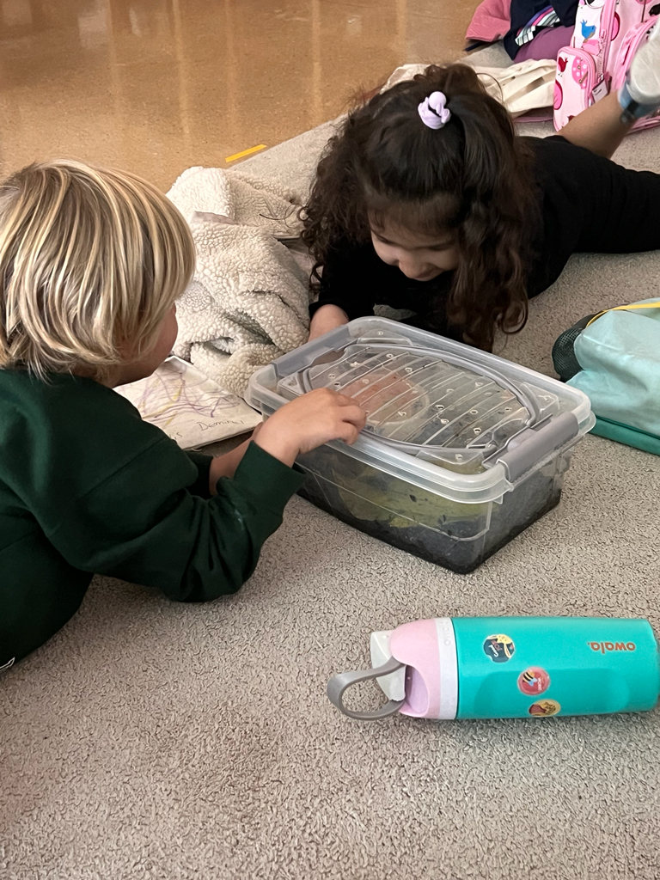
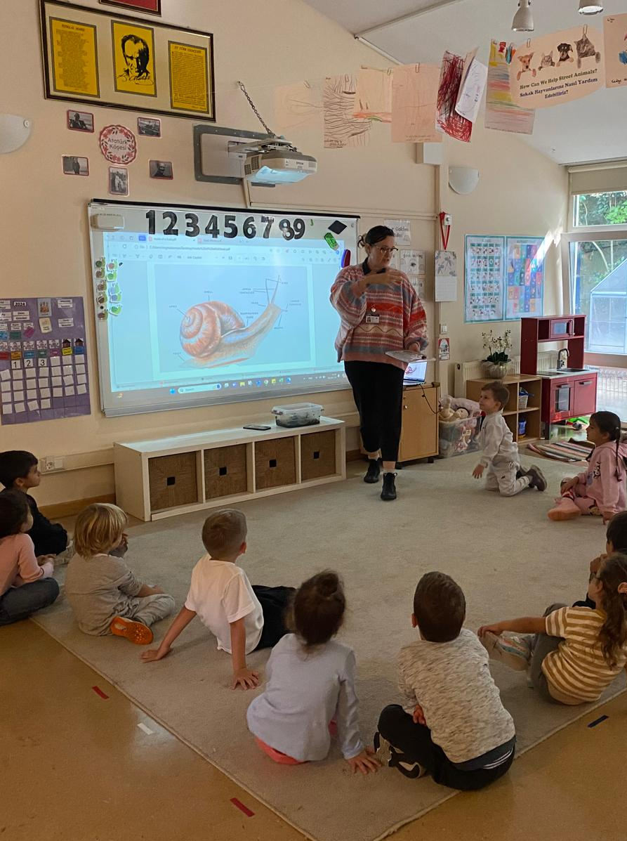
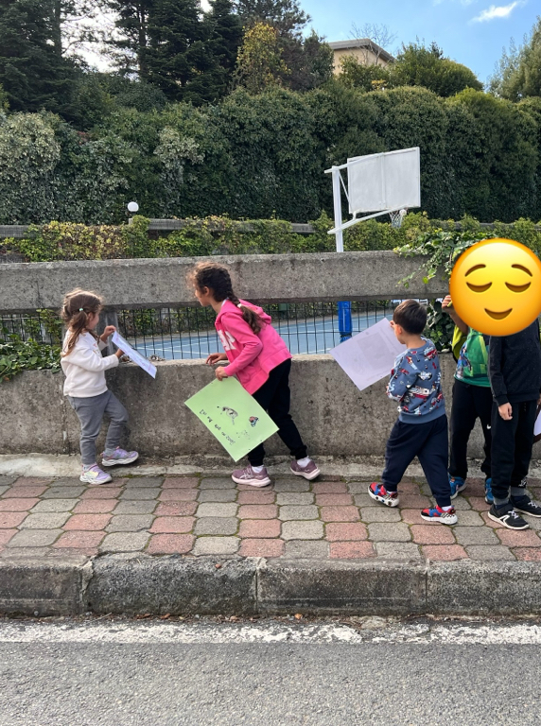
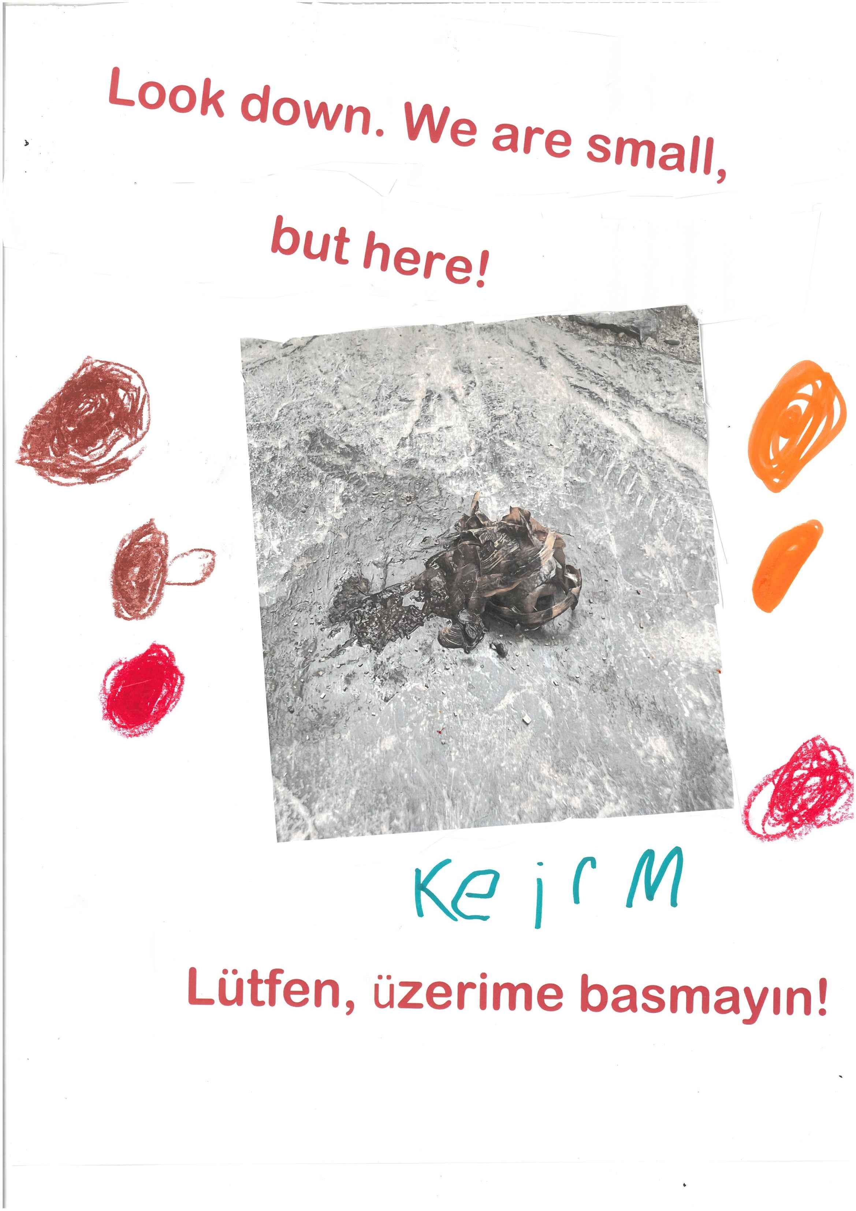
Engagement from the Heart

Slide 13
When Hope’s Not Enough
Read contracts thoroughly and know your commitments.
Build trust with colleagues.
Pursue professional growth through research and training.
Reflect on your teaching goals and values.
Advocate for mental health and social justice.
Use your voice to drive meaningful change.

Slide 14
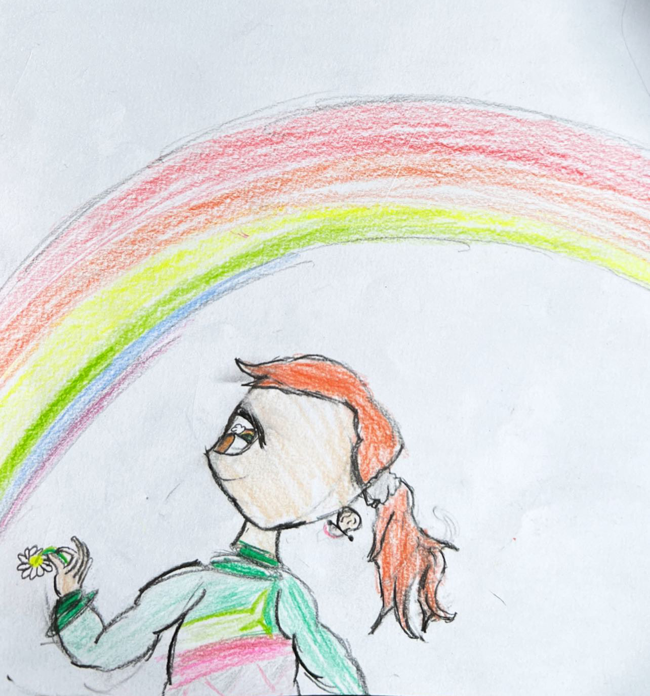
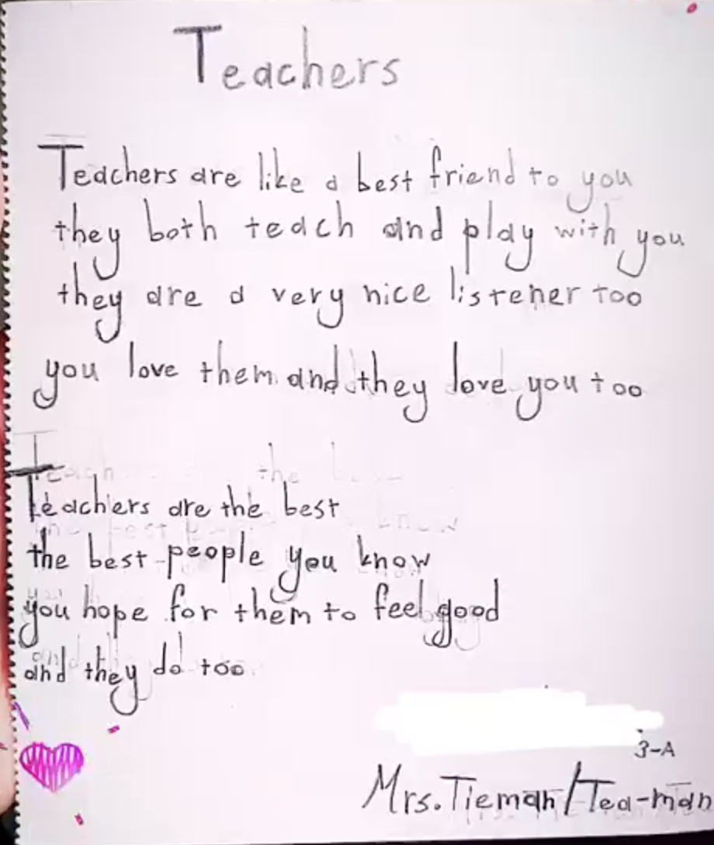
And When That’s Not Enough

Slide 15
Q&A / Questions for Reflection
1. How can you safeguard your mental health in your teaching journey?
2. What does engagement from the heart look like in your practice?
3. How do you plan to build your community as an educator?
4. What steps can you take to align your teaching with your values?

