Slide 1
The Translation of Cognitive Science to the Classroom
Reflections on the EEF Cognitive Science in the Classroom Review
Dr Tom Perry (@TWPerry1) Assistant Professor, Education Studies, University of Warwick
CTE Research in Action Conference 2021 10.12.2021

Slide 2
Overview
Introduction to the EEF Cog Sci Review
Basic and Applied Science Evidence
Translation to the Classroom
Principles and Strategies
Notes:
Translation of Cognitive Science to the Classroom
The (limited but helpful) role of research

Slide 3
Introduction to the EEF Cog Sci Review

Slide 4





EEF Cognitive Science in the Classroom Review
Dr Tom Perry
Prof. Deborah Youdell
Prof. Kimron Shapiro
Dr Rosanna Lea
Dr Clara Jørgensen
Niall Gamble
Christina Pomareda
Prof. Philippa Cordingley
Paul Crisp
Julia Harrington
Dr Amy Fancourt
Notes:
Note that we are from the Cog Sci review team.
Expertise in…
Cognitive neuroscience
Cognitive psychology
Education policy and practice
Review methodology

Slide 5
We want to know whether cognitive science techniques work in real classrooms, across the curriculum and for different pupil groups.

Slide 6
Focus Areas
1 | Spaced Learning
2 | Interleaving
3 | Retrieval Practice
4 | Managing Cognitive Load
5 | Working with Schemas
6 | Cognitive Theory of Multimedia Learning
7 | Embodied Learning and Physical Approaches
8 | Mixed Strategy Programmes
For each:
Systematic Evidence Review (of classroom trials)
Evidence-informed discussion and questions (Including practice review)
8 Areas 14 Strategies
Notes:
Spaced practice – distributing learning and retrieval opportunities over a longer period of time rather than concentrating them in ‘massed’ practice.
Interleaving - switching between different types of problem or different ideas within the same lesson or study session.
Retrieval Practice – using a variety of strategies to recall information from memory, for example flash cards, practice tests/quizzing or mind-mapping.
Dual Coding/multimedia learning - using both verbal (i.e. words) and non-verbal information (i.e. pictures) to teach concepts. This is sometimes referred to as cognitive theory of multimedia learning (CTML) or multi-media learning.
Strategies to manage cognitive load – focusing students on key information without overloading them e.g. breaking down or ‘chunking’ subject content; using worked examples, exemplars or ‘scaffolds’; ensuring important information stands out and is conveniently placed; reducing unnecessary information (extraneous load); and using models, analogies or mnemonics.
Spacing within/across
Worked examples/Scaffolding
Concept mapping
Visual aids/Diagrams

Slide 7

Headlines from the EEF Review
Cognitive science matters, basic science offers promise
The applied evidence is a) limited and b) more complex, less positive
It raises constructive questions about:
Gaps
Translation and implementation
Notes:
Dress - Bradley Busch
Cognitive science principles of learning can have a significant impact on rates of learning in the classroom. There is value in teachers having some working knowledge of cognitive science principles.
They should also be made aware of the serious gaps and limitations in the applied evidence base, the uncertainties about the applicability of specific principles across subjects and age ranges, and the challenges of implementation in practice.
There are large disconnects between the evidence-base for basic cognitive science and applied cognitive science. Applied cognitive science is far more limited and provides a less positive, and more complex picture, than the basic science.
The applied literature has many gaps relating to subject areas and age groups.
Applied research surfaces many theoretical and practical problems not encountered in controlled lab or pseudo-lab conditions.
The evidence base is largely working at the level of principles, rather than tests of specific classroom strategies. Principles do not determine strategies and do not determine specific approaches to implementation.
Principles tended to be clustered and interact in complex ways.
There are important connections across the cognitive science areas and strategies.
We also found that the current evidence base on cognitive science applied to the classroom is largely focused on how individual learners process and remember information. Social, emotional and physical aspects to cognition and learning receive less attention in the applied evidence we reviewed. Our survey of teachers, review of the underpinning science, and the applied evidence in areas such as embodied learning however suggest that social, emotional and physical aspects to cognition are equally important considerations for research and practice.
Concluding statement
Based on the findings of this systematic review of the evidence, we are convinced that basic cognitive science and applied cognitive science have the potential to offer, respectively, significant insights into learning and pedagogic practice.
We are also convinced, however, that the rapid popularisation of cognitive science inspired practice has led to the premature recommendation and even mandating of education practice underpinned by particular elements of cognitive science.
Of particular concern is the application of findings from particular subjects, age ranges and contexts to other – often quite dissimilar – areas. Moreover, given the weaknesses in the applied evidence base, cognitive science in the classroom is at present largely underpinned by evidence from controlled (e.g., laboratory) settings in conditions not typical of everyday classroom practice and with different populations such as university students. We suggest that the education community should not change its practices substantially without further applied evidence and more thorough and rigorous investigation into how practice might best be adapted.
Finally, our findings indicate that substantial investment is needed by the education profession to understand and model how practice might be adapted without eclipsing understandings of important other factors that influence learning, and ensure that members of the profession are skilled to understand and respond practically to these complexities.

Slide 8
Basic and Applied Science

Slide 9


‘Basic’
Cognitive
Science
‘Applied’ Cognitive Science
Practice
Fundamental
Realistic
Notes:
Conceptions:
1. Pure truth - lost in translation/lethal mutation/implementation failure.
2. incomplete/abstract – reductive. Taking a part or principle out of a system and then putting it back in.
‘Basic’ cognitive science – seeks fundamental understanding of learning, memory and the brain. It typically uses experiments in controlled conditions to establish findings that are likely to have wide applicability.
‘Applied cognitive science’ – seeks to apply knowledge from basic cognitive science to solve practice problems. It typically uses realistic field experiments and trials to establish where, for whom and in what circumstances a strategy works.
Translation/interpreted
Not tested in realistic classroom conditions

Slide 10
How to make your research less realistic:
Do it in a single school
Don’t let teachers deliver it
Use booklets/computer programmes/scripts
Don’t let teachers or students interact
Supervise it - step in where needed
If teachers must deliver, make sure they are experts
Keep the research to 2 weeks or less. Ideally just a single session.
Don’t teach in the classroom – pull out small groups.
Clear comparisons only – don’t examine the grey areas:
Use distinct (black and white) conditions
Use single ability groups
Use entirely new content
Make and use your own test
Notes:
Ecological valid
Teacher proof
A few studies had teachers redirect students back to booklets
Another had all feedback from supervising researcher – another sent off the work for standardised feedback and marking
(If you think feedback and marking is important interacting factor… Something at the heart of teaching is building up an understanding of pupil learning).
Take off the stabilisers

Slide 11
Gaps
Strategy | Age | Subjects
Spacing across lessons | Good coverage | literacy, maths, science, PE, critical thinking
Spacing within lessons | 7 to 15 | science, geography, and history
Interleaving | KS2-3 | Vast majority maths | Vast majority maths
Retrieval | All, but more KS2-3 | Good coverage | Good coverage
Worked Examples | KS3-4 | Maths and science | Maths and science
Scaffolds/Guidance SBI | KS2-4 | Mostly maths, reading comp, or science | Mostly maths, reading comp, or science
Collaborative prob solving | KS2-4 | Most maths, science, ICT | Most maths, science, ICT
Concept/knowledge mapping and organisation | KS2-3 | Most organised text using concept map | Most organised text using concept map
Schema/concept comparison and conflict | KS3 | All maths and science | All maths and science
Visual representation | KS2-4 | two-thirds maths and science (some other) | 2/3 maths and science (some other)
Diagrams | KS3-4 | Most maths and science | Most maths and science
Spatial, visualisation and simulation approaches | EY-KS2 | spatial visualisation in maths | spatial visualisation in maths
Embodied learning | EY-KS3 | range of subject areas | range of subject areas
Mixed Strategy Programmes | KS3 | maths and science | maths and science
Notes:
Making research less realistic
Subjects/ages

Slide 12

Where are we now?
Cognitive science matters. We should know/find out about it.
The basic cognitive science does not (extensively) examine factors relating to:
Teachers and teaching
Pupil groups and age
Subjects and their content
The applied evidence is limited and so doesn’t help much with these

Slide 13
Translation of Cognitive Science in the Classroom

Slide 14
Translate
put into a different language/form; interpret
Implement
to start using a plan or system
Transplant
move or transfer to another place or situation
Integrate
to form, coordinate, or blend into a functioning or unified whole, unite.
Incorporate
take in or contain (something) as part of a whole; include
Embed
fix (an object) firmly and deeply in a surrounding mass
Notes:
Shape
Sculpt
Improve
Refine

Slide 15
Teachers
Retrieval works (i.e., strengthens memory)
Retrieval practice works
… in specific:
Subjects
Age ranges
… using specific T&L activities (e.g., quizzing)
… for specific learning objectives/types of content
… for specific conditions:
Teacher experiences and expertise
Pupil prior knowledge
Pupil motivation
For my Year 4 maths lesson on fractions on Tuesday morning, delivered to mixed ability class with me working with a target group.
A specific moment with a specific pupil on a specific question during retrieval practice.
The evidence says….
Researchers
How much to demand of research?
Notes:
The evidence says…
(It is very confusing to say ‘strong evidence’ one minute, then ‘weak evidence’ the next). Another way of looking at that…
Evidence - We are working with mostly level 1,2 – albeit with some info for 3-6 (but this is often apparent in a review, rather than within the focus of the study).
Interpretation – must go to 7.

Slide 16



Way of thinking about translating basic science #1

Slide 17


Way of thinking about translating basic science #2

Slide 18
Teachers, teaching | Pupil individual factors (potentially different for each student)
Extent of teacher professional development and learning for the cognitive science technique. Teacher general pedagogical and subject-specific knowledge and skills Level of teacher experience Teacher motivation/ enthusiasm for the cognitive science technique Extent to which technique replaces/improves teacher’s existing practice (Many of the pupil factors, left, also apply to teachers) | Prior level of knowledge, in general and for the topic being learnt (and extent to which the teacher takes this into account) Working memory capacity Nutrition/hydration Alertness/activity level Mood/emotional state General/learning-specific motivation Personality and temperament Special educational needs, difficulties, or disabilities Learning behaviours and strategies Age and maturity
Classroom/social environment | Activity, Topic and Subject
Relations in the classroom (teacher-pupil, pupil-pupil) Culture of participation Emotional environment Disruption / Noise / distraction Decoration / information Access to learning resources | Subject/curriculum area (e.g., general differences in the nature of subject content and pedagogy) Nature of specific learning content (e.g., complexity/element interactivity, novelty, connection with other learning) Nature of specific learning activity (e.g., student-led, length, structure, resources)
Teachers, teaching | Pupil individual factors (potentially different for each student)
Classroom/social environment | Activity, Topic and Subject (and stage within these)
Principles and practicalities a) matter and, b) interact

Slide 19
Cognitive Science-Informed Principles and Strategies

Slide 20
8 Review Areas
1
2
Spaced practice
Interleaving
Retrieval practice
Managing cognitive load
Working with schemas
Cognitive Theory of Multimedia Learning
Embodied learning and physical factors
Mixed strategy programmes
3
1. Practice
2. Cognitive Load
3. Generative learning
Notes:
Generative learning is a theory that involves the active integration of new ideas with the learner's existing schemata. The main idea of generative learning is that, in order to learn with understanding, a learner has to construct meaning actively (Osborne and Wittrock 1983, p. 493).

Slide 21
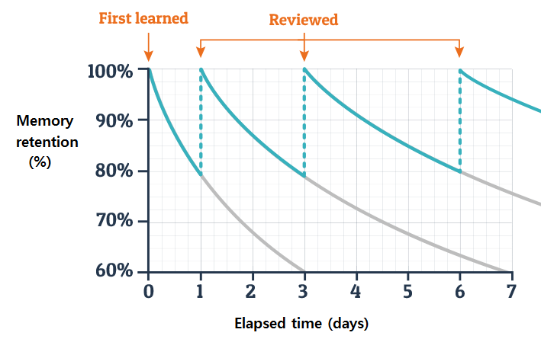
Principles of Practice
Interleave
to
Contrast
Retrieval
vs.
Restudy
Spaced Practice
Interleaving
Retrieval Practice
Desirable Difficulties
Notes:
Spacing across days/lessons
Separating or distributing learning over more than one lesson, usually across multiple days and weeks
Small positive effect compared with massed practice in maths and science.
Spacing within lessons
Spacing learning within a single lesson period, usually separated by short intervals where students complete an unrelated task.
Some promise, but insufficient evidence
Potential, but practical timetabling and planning questions.
Interleaving
Switching between tasks or topics requiring different, but usually related, knowledge and skills. Like spacing, interleaving can take place within or across lessons.
An effective approach for upper primary and lower secondary mathematics (moderate to large effects).
Value-added over spacing?
Value across other subjects and applications?
Retrieval Practice
Any activity that requires students to recall information from memory rather, than representing or restudying the information.
Moderate effect of retrieval practice compared to restudy, high variability (low).
Against any condition (not just restudy), more secure.
Issues with ecological validity
Does it work for more complex/subtle content?

Slide 22
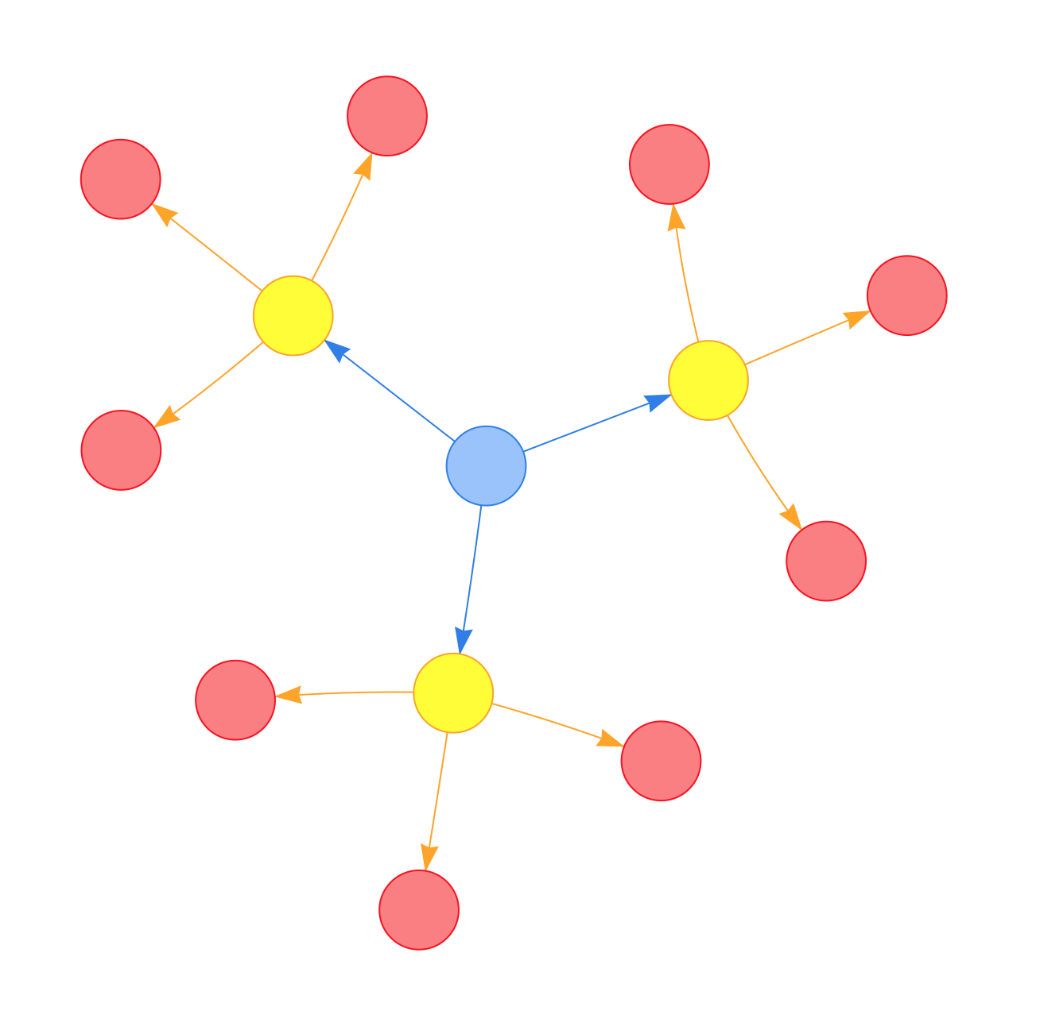
Integrating Practice into your Teaching
Selecting the content
Foundational/threshold
Variation (with/across)
Difficulty (new, complex, abstract). Higher order?
Formative assessment/Feedback
Motivation/enjoyment/anxiety
Type of activity
Planning (long/mid/short-term)
Workload/classroom management
etc. etc.

Slide 23
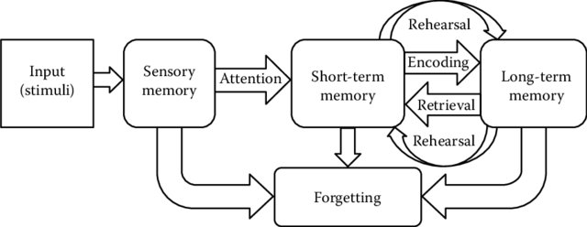

Cognitive Load – Central Problem
Long Term
Memory
∞
Working
Memory
3-5 Chunks
Source: Amin and Malik (2014, p.221) based on Atkinson and Shiffrin (1968).
Notes:
Spacing across days/lessons
Separating or distributing learning over more than one lesson, usually across multiple days and weeks
Small positive effect compared with massed practice in maths and science.
Spacing within lessons
Spacing learning within a single lesson period, usually separated by short intervals where students complete an unrelated task.
Some promise, but insufficient evidence
Potential, but practical timetabling and planning questions.
Interleaving
Switching between tasks or topics requiring different, but usually related, knowledge and skills. Like spacing, interleaving can take place within or across lessons.
An effective approach for upper primary and lower secondary mathematics (moderate to large effects).
Value-added over spacing?
Value across other subjects and applications?
Retrieval Practice
Any activity that requires students to recall information from memory rather, than representing or restudying the information.
Moderate effect of retrieval practice compared to restudy, high variability (low).
Against any condition (not just restudy), more secure.
Issues with ecological validity
Does it work for more complex/subtle content?

Slide 24
Principles/Practice of Cognitive Load
Prior learning and pre-learning
Simplify
Chunk (67295673 vs. 12345678 vs. 1966-1066)
Worked examples and Scaffolds
Expert reversal
My turn, our turn, your turn
Correct to incorrect worked examples
Lower to higher order: know, categorise, compare, apply, deconstruct, transform/synthesise
Split attention (avoid by keeping information together)
Remove ‘extraneous’ load (redundancy, ‘seductive’ details)
Group work - Focus
Notes:
Worked Examples
Providing students with step-by-step, or part-by-part demonstration of a task that makes clear the required product (i.e., answers or output) and the process of completing the task.
small to moderate positive effect for secondary age students in maths and science, compared to conventional problem-solving techniques (moderate)
Neutral/negative results more likely for incorrect/incomplete examples
Scaffolds, Guidance, and Schema-Based Instruction
Scaffolding is a general teaching strategy and concept, where educators providing learners with guidance or other forms of support, such as prompts, cues, instructions, information organisation, or reference materials. We focus specifically on scaffolding strategies designed to optimise cognitive load.
well-targeted scaffolds, guidance or schema-based supports effective to support students to solve problems or learn from complex tasks in KS2-4 (age 8-16) in a range of subjects (moderate)
Collaborative Problem Solving
Problem solving activities in which learners work together to complete a problem or complex task. Collaborative problem solving is a general teaching strategy and concept. Here we focus on a sub-set of this, specifically designed to optimise cognitive load.
Supportive in theory, but complex (practically and in terms of the evidence) (very low confidence)

Slide 25
Again, think about how you can integrate Cognitive Load Principles with your Practice
e.g….
Selecting the content
Foundational/threshold
Variation (with/across)
Difficulty (new, complex, abstract). Higher order?
Formative assessment/Feedback
Motivation/enjoyment/anxiety
Type of activity
Planning (long/mid/short-term)
Workload/classroom management
etc. etc.

Slide 26
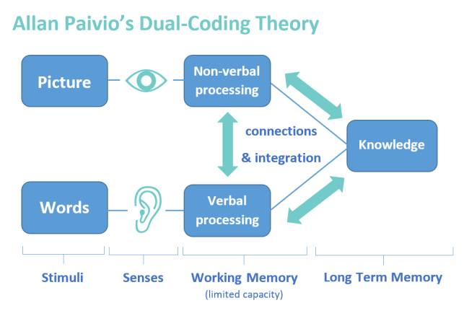
Principles/Practice of Dual Coding
https://sciencetltoolkit.wordpress.com/2019/03/11/20-ideas-strategies-for-student-led-dual-coding/

Slide 27
Sometimes helpful, sometimes harmful:
Visual representation and illustration
Learners being presented with, or creating, an additional image, picture or icon that symbolises, illustrates or represents aspects of the content being learnt.
Diagrams
Learners being presented with or creating an image that represents and/or organises learning content or process information schematically.
Spatial, Visualisation, and Simulation Approaches
Supporting children to imagine content or representations of it, often in order to simulate, manipulate or organise concepts and schema across time and/or space.
Notes:
Visual representation and illustration
Learners being presented with, or creating, an additional image, picture or icon that symbolises, illustrates or represents aspects of the content being learnt.
Visual aids are helpful during learning but frequently have no effect, and can sometimes be harmful (low)
Diagrams
Learners being presented with or creating an image that represents and/or organises learning content or process information schematically.
As above, plus diagrams tend to be helpful for older children to support learning of more complex content in maths and science (low)
Spatial, Visualisation, and Simulation Approaches
Supporting children to imagine content or representations of it, often in order to simulate, manipulate or organise concepts and schema across time and/or space.
Some promise but insufficient evidence (potentially useful in primary maths) (very low)

Slide 28
Dual Coding and Using Visuals/ Diagrams
Informative, illustrative, decorative
Older/Younger (+Prior Knowledge)
Subject and Content
Length of presentation
Spoken vs. written verbal (former better)
Expert reversal
Reverse expert reversal? Novice reversal?
Abstract/concrete
Relevant vs. tenuous
Essential vs. supplementary info
Student vs. teacher generated content
Learner control in a multimedia environment
Transfer and retention
Use of signals/cues/arrows or not
Animation versus static (and length)
Anthropomorphic (despite cog load)
Notes:
Visual representation and illustration
Learners being presented with, or creating, an additional image, picture or icon that symbolises, illustrates or represents aspects of the content being learnt.
Visual aids are helpful during learning but frequently have no effect, and can sometimes be harmful (low)
Diagrams
Learners being presented with or creating an image that represents and/or organises learning content or process information schematically.
As above, plus diagrams tend to be helpful for older children to support learning of more complex content in maths and science (low)
Spatial, Visualisation, and Simulation Approaches
Supporting children to imagine content or representations of it, often in order to simulate, manipulate or organise concepts and schema across time and/or space.
Some promise but insufficient evidence (potentially useful in primary maths) (very low)
(General point in this area) Decorative versus Informational

Slide 29
Embodied Learning
Embodied learning and physical approaches
Enacting or representing concepts through movement or the body, including learning or enhancing learning through the use of the body’s sensory and/or motor capabilities.
Evidence was mostly primary and quite limited but suggests promise for:
Gesture
Tracing with finger
Physical activity (e.g., enacting words)
Play (playground physics)
But caution!
Variation in this group
14 studies - breakdown

Slide 30
Principles/Practice of Working with Schemas (aka Generative Learning)
Generative learning:
E.g., Select, Organise, Integrate (with other ideas/existing knowledge), Summarise, Explain, Elaborate, Imagine, Adapt
Concept mapping and knowledge organsation
Can be effective, but student-generated approaches risk excessive cognitive load or inefficiency (low)
Concept comparison and cognitive conflict
Limited evidence – but promise in maths (comparison) and science (conflict)
Notes:
Concept/Knowledge Mapping and Organisation
Learners creating, being provided with, or engaging, with a schematic or organised overview of concepts, knowledge or information in a learning topic (e.g., the water cycle) or object (an encyclopaedia entry about the water cycle).
Can be effective, but student-generated approaches risk excessive cognitive load or inefficiency (low)
Schema or concept comparison and cognitive conflict
Teaching and learning activities in which leaners compare two or more contrasting or conflicting concepts or examples, with a view to discriminating between these or adopting a given conception.
Limited evidence – but promise in maths (comparison) and science (conflict) (very low confidence)

Slide 31
One final time… Think about how to integrate with your Practice:
Selecting the content
Foundational/threshold
Variation (with/across)
Difficulty (new, complex, abstract). Higher order?
Formative assessment/Feedback
Motivation/enjoyment/anxiety
Type of activity
Planning (long/mid/short-term)
Workload/classroom management
etc. etc.

Slide 32

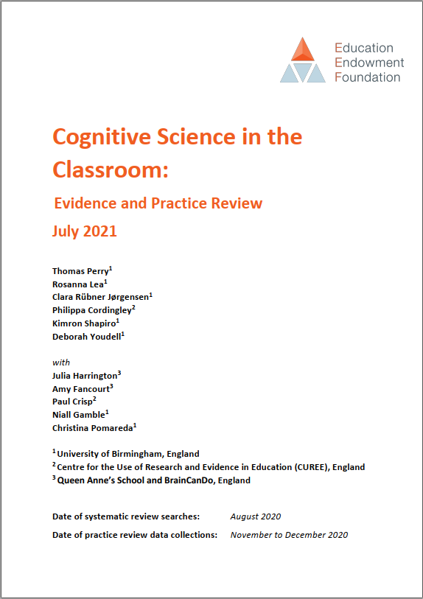
Find out more about the review (July 2021)
More info: https://eef.li/DoncCq
Download here: https://eef.li/cog-sci
Preview talk: https://tinyurl.com/4bxu8tw5
Summary Twitter thread: https://twitter.com/DrRoseLea/status/1415933389027385344
Get in touch
tom.perry@warwick.ac.uk @TWPerry1
Notes:
You can find out more about the review here…
One thing to note is that the review is an evidence review, not a guidance report.
So we have not produced a report which recommends teachers to X, Y or Z – we did a systematic review of the evidence, including a practice review.
The EEF summary then summarises the larger 300-page document into a 40-50 page document.
So this opens up a question about what this means and implications – our focus today.

