Slide 1
The importance of teacher engagement with research
Cat Scutt
Director of Education and Research
Chartered College of Teaching

Slide 2

Let’s start with a quiz!

Slide 3
Some of us are left-brained and some of us are right-brained
True or False?
Notes:
Your turn – neuromyths or neurotruths?

Slide 4
Some of us are left-brained and some of us are right-brained
True or False?
Notes:
Your turn – neuromyths or neurotruths?

Slide 5
Is self-quizzing on a chapter you have read more effective, less effective, or about as effective as re-reading the chapter?
A) More effective
B) Less effective
C) About as effective
Notes:
EG… easy, relevant stuff
Commit to others
Motivation
Fun? Reward?

Slide 6
Is self-quizzing on a chapter you have read more effective, less effective, or about as effective as re-reading the chapter?
A) More effective
B) Less effective
C) About as effective
Only 31% of respondents got this right!
Notes:
EG… easy, relevant stuff
Commit to others
Motivation
Fun? Reward?

Slide 7
Is reading something and highlighting sentences and vocabulary words in reading materials and re-reading them later more effective, less effective, or about as effective as reading something then writing everything one knows about the topic on a blank sheet of paper?
A) More effective
B) Less effective
C) About as effective
Notes:
EG… easy, relevant stuff
Commit to others
Motivation
Fun? Reward?

Slide 8
Is reading something and highlighting sentences and vocabulary words in reading materials and re-reading them later more effective, less effective, or about as effective as reading something then writing everything one knows about the topic on a blank sheet of paper?
A) More effective
B) Less effective
C) About as effective
Notes:
EG… easy, relevant stuff
Commit to others
Motivation
Fun? Reward?

Slide 9
Teenagers have different body clocks to adults
True or False?
Notes:
Your turn – neuromyths or neurotruths?

Slide 10
Teenagers have different body clocks to adults
True or False?
Notes:
Your turn – neuromyths or neurotruths?

Slide 11
Is “interleaving” problem types with each other (e.g., students solve a division problem, then a multiplication problem, etc) more effective, less effective, or about as effective as giving them “blocked” practice (e.g., students solve a bunch of division problems, then a bunch of multiplication problems)?
A) More effective
B) Less effective
C) About as effective
Notes:
EG… easy, relevant stuff
Commit to others
Motivation
Fun? Reward?

Slide 12
Is “interleaving” problem types with each other (e.g., students solve a division problem, then a multiplication problem, etc) more effective, less effective, or about as effective as giving them “blocked” practice (e.g., students solve a bunch of division problems, then a bunch of multiplication problems)?
A) More effective
B) Less effective
C) About as effective
Only 20% of respondents got this right!
Notes:
EG… easy, relevant stuff
Commit to others
Motivation
Fun? Reward?

Slide 13
Some reflections
Does belief in ‘neuromyths’ affect teaching?
What pupils believe about how they learn matters too!
Engaging with evidence can help us to refine (and understand) our practice
… but it doesn’t tell us everything

Slide 14
“There is a large body of research on how important teachers are to the academic outcomes of their pupils… [They] are the most important factor within schools that policy makers can directly affect to improve student achievement”
(Sutton Trust, 2011)

Slide 15
“The effects of high-quality teaching are especially large for pupils from disadvantaged backgrounds, who gain an extra year’s worth of learning under very effective teachers compared to poorly performing teachers”
(Sutton Trust, 2011)

Slide 16
What’s your response to this (imaginary) newspaper headline? What would you want to know?
Research shows starting a class by building a paper aeroplane is beneficial
Notes:
And time and money!

Slide 17
What measures were used? What does it ‘benefit’?
What was the methodology? Is it a one-off study, or has it been replicated?
Who was the research done with?
What does this look like in practice? What were the ‘active ingredients’?
How effective was it compared to the time taken?
Notes:
And time and money!

Slide 18
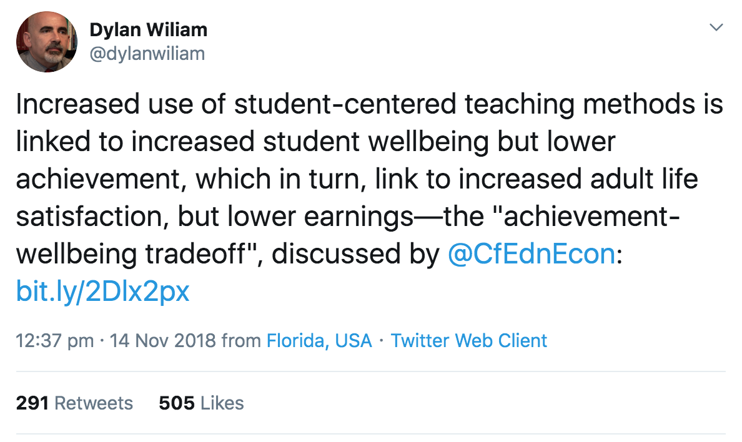

Slide 19
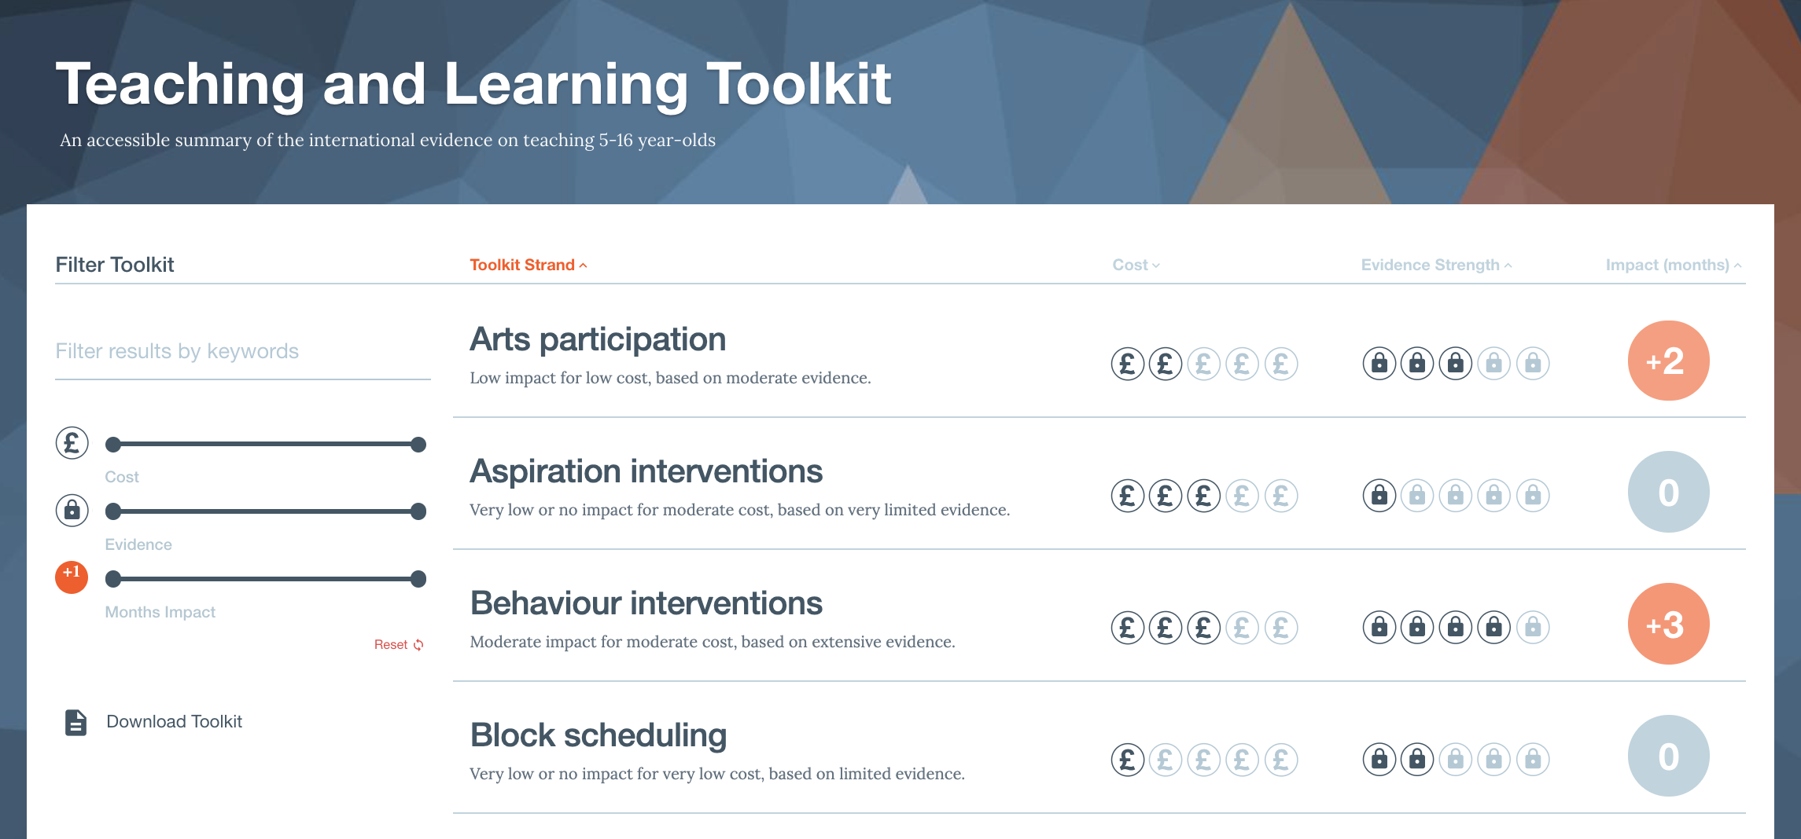
Understanding ‘effectiveness’ and ‘impact’
Notes:
And time and money!

Slide 20
What measures were used? What does it ‘benefit’?
What was the methodology? Is it a one-off study, or has it been replicated?
Who was the research done with?
What does this look like in practice? What were the ‘active ingredients’?
How effective was it compared to the time taken?
Notes:
And time and money!

Slide 21
Notes:
And time and money!

Slide 22
A hierarchy of evidence
Notes:
And time and money!

Slide 23
A hierarchy of evidence
EEF, 2017 (on Twitter)
Notes:
And time and money!

Slide 24
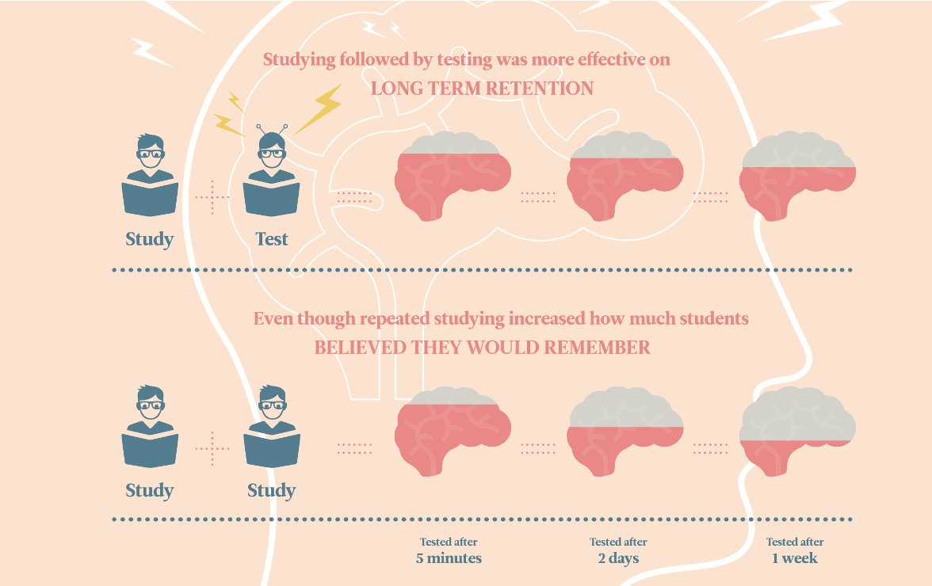
Can we trust self-report?
Impact, 2017, based on Roediger and Karpicke
Notes:
And time and money!

Slide 25

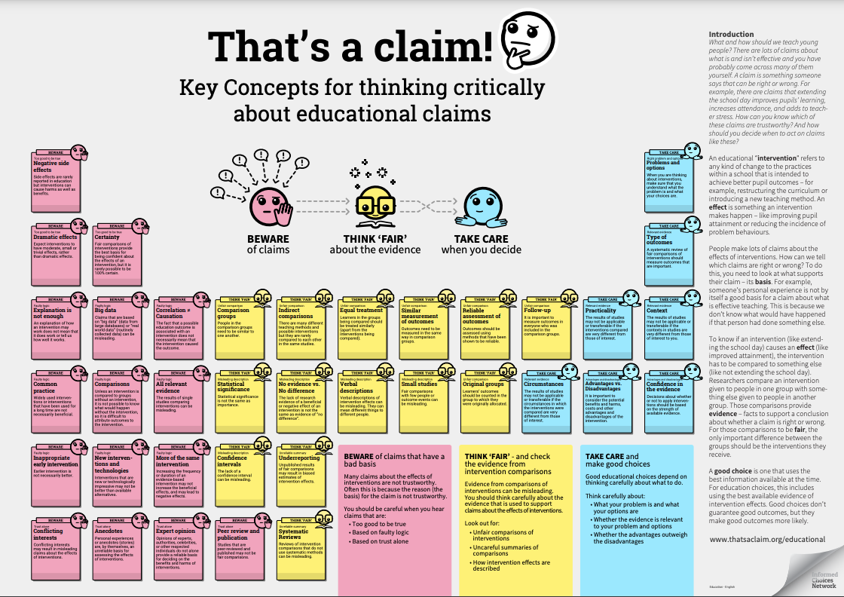
Judging the robustness of research
Notes:
And time and money!

Slide 26
And a few more things to think about…
Where was it published?
Is it a peer-reviewed source?
Who funded the work?
Who carried it out?
Notes:
And time and money!

Slide 27
What measures were used? What does it ‘benefit’?
What was the methodology? Is it a one-off study, or has it been replicated?
Who was the research done with?
What does this look like in practice? What were the ‘active ingredients’?
How effective was it compared to the time taken?
Notes:
And time and money!

Slide 28
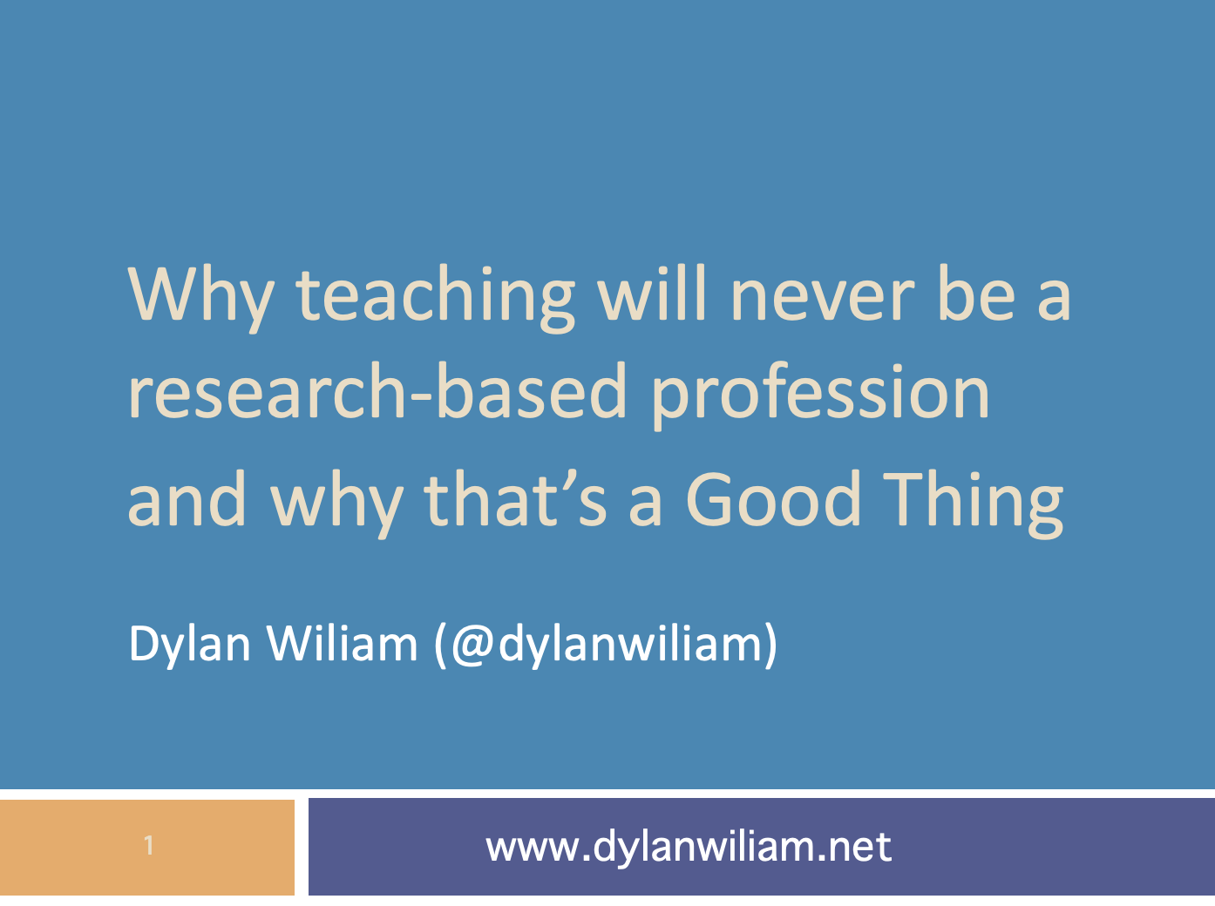
Context matters
Notes:
And time and money!

Slide 29
Notes:
And time and money!

Slide 30
What measures were used? What does it ‘benefit’?
What was the methodology? Is it a one-off study, or has it been replicated?
Who was the research done with?
What does this look like in practice? What were the ‘active ingredients’?
How effective was it compared to the time taken?
Notes:
And time and money!

Slide 31
The Bananarama Effect - Steve Higgins
“It ain’t what you do,
it’s the way that you do it,
That’s what gets results.”
Notes:
And time and money!

Slide 32
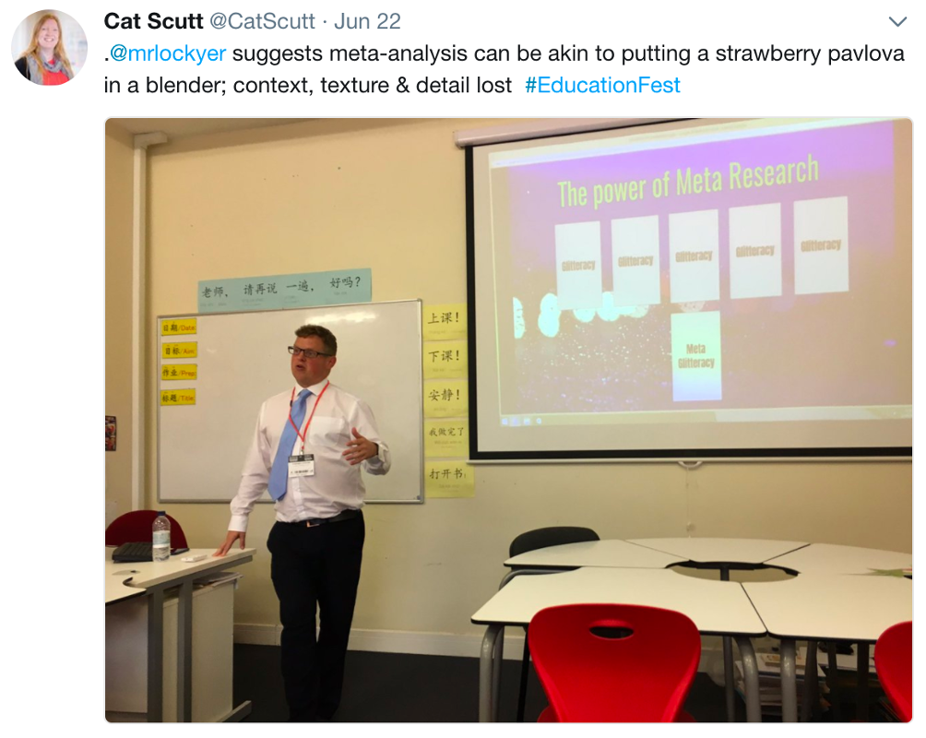
Eton Mess - Stephen Lockyer
Notes:
And time and money!

Slide 33

LETHAL MUTATION…

Slide 34
What measures were used? What does it ‘benefit’?
What was the methodology? Is it a one-off study, or has it been replicated?
Who was the research done with?
What does this look like in practice? What were the ‘active ingredients’?
How effective was it compared to the time taken?
Notes:
And time and money!

Slide 35
Effectiveness and Efficiency
Notes:
And time and money!

Slide 36
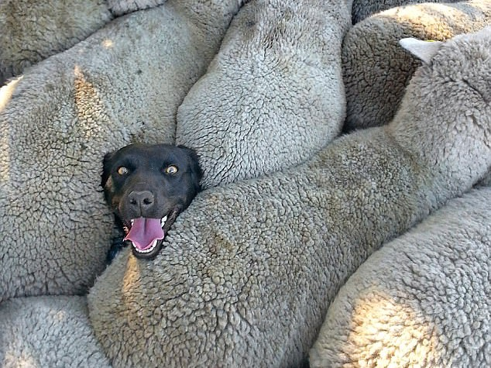
Notes:
BUT there are some things we know are important.
What influences teacher job satisfaction, retention and development?

Slide 37
On the flip side…
No evidence that starting a class by building a paper aeroplane helps learning
Notes:
And time and money!

Slide 38
Has no research been done, so we don’t know?
Has research been done and is inconclusive?
Has research been done and found it doesn’t make any difference?
Has research been done and found it negatively affects learning?
Why did anyone think it WOULD work?
Notes:
And time and money!

Slide 39
You can find research to back up any opinion
Strongly Disagree
Disagree
Neutral
Agree
Strongly Agree

Slide 40

Recognising Biases
Confirmation bias
Publication bias
Notes:
And time and money!

Slide 41
Where are we at with evidence-informed teaching?

Slide 42
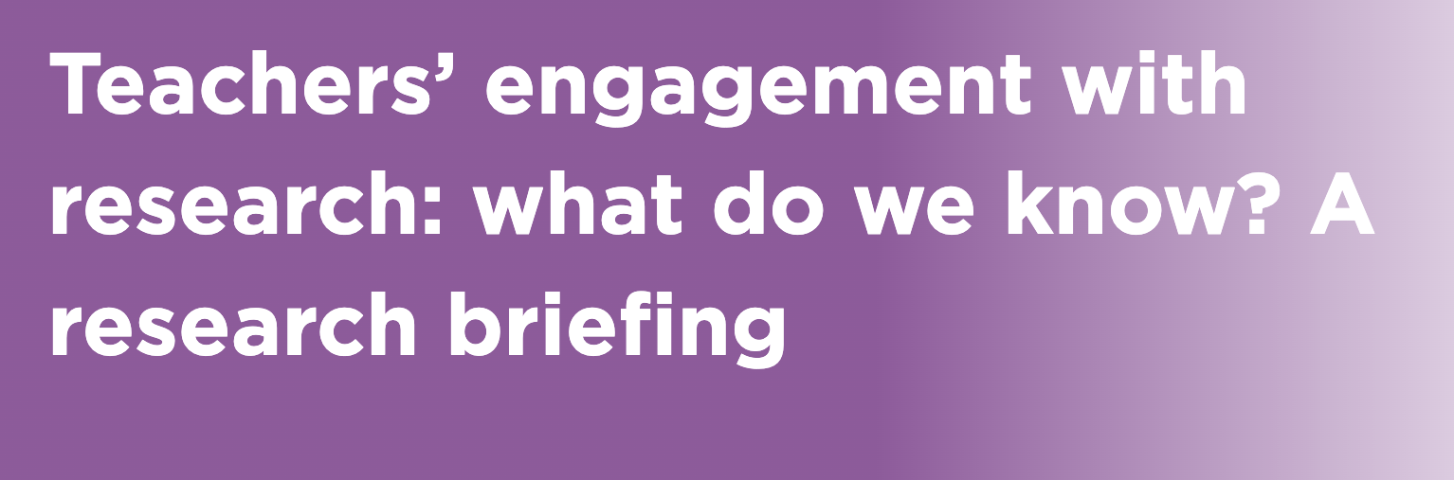
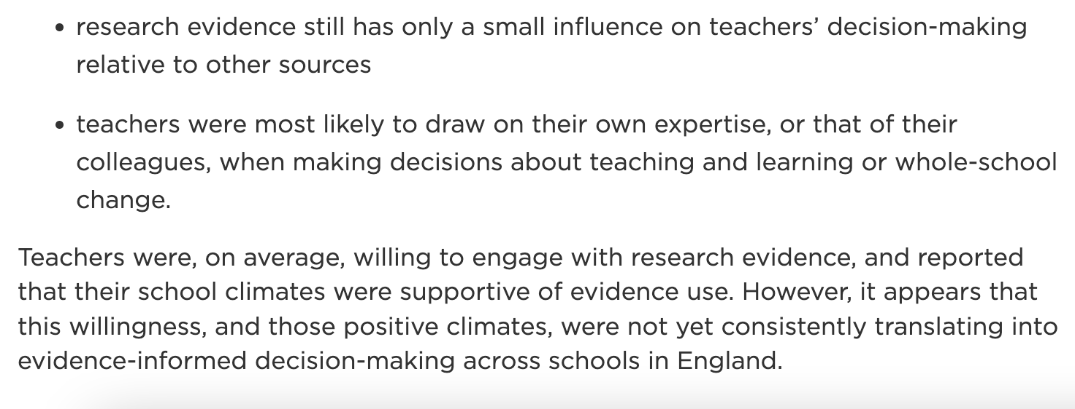
NFER, 2017

Slide 43
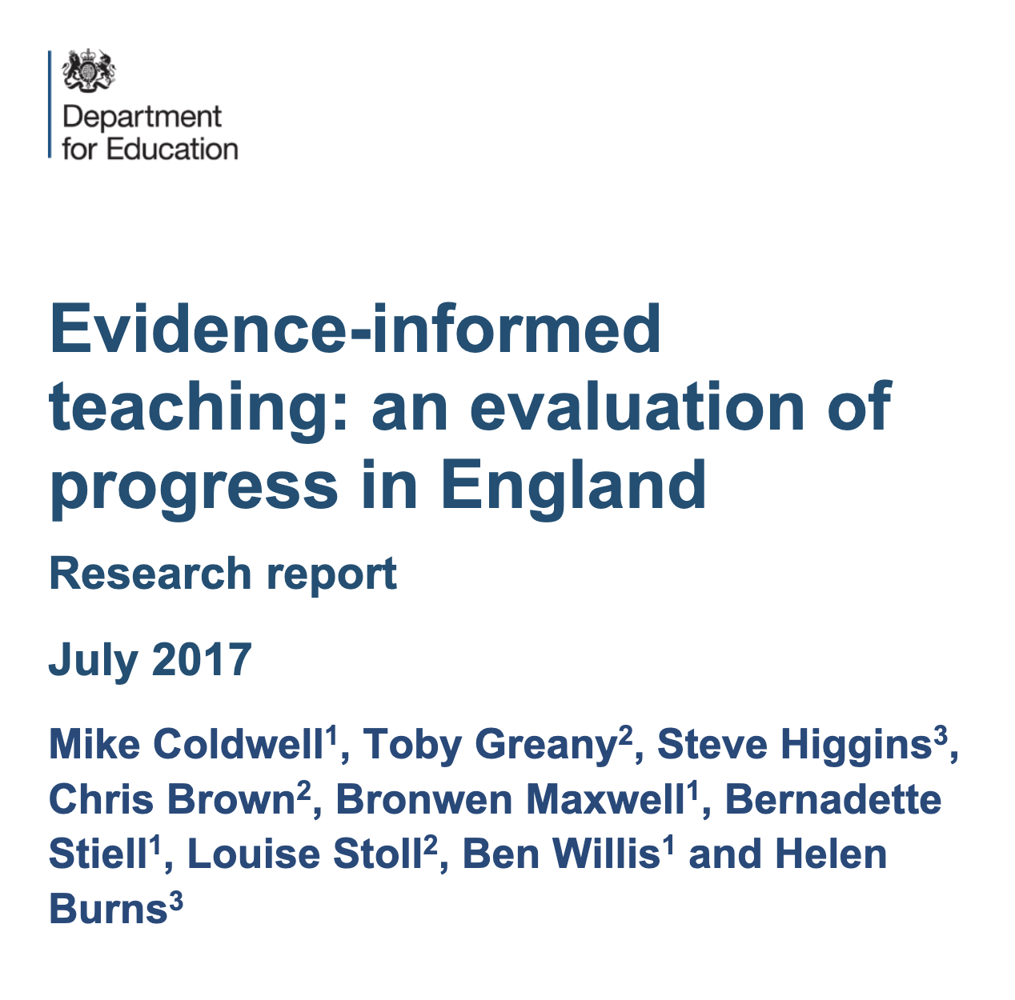

Slide 44
Evidence-informed professional learning
Support and promotion of evidence-engagement
Evidence-informed school leadership

Slide 45
Wider
education
system
Evidence-informed professional learning
Support and promotion of evidence-engagement
Evidence-informed school leadership

Slide 46
Top down vs bottom up

Slide 47

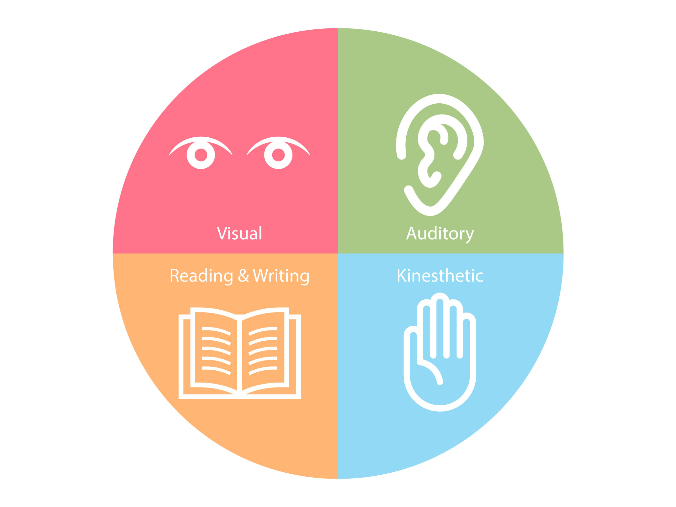
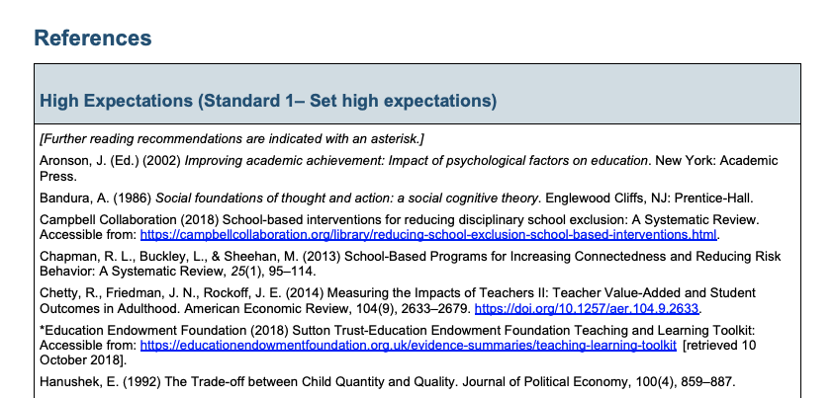

Slide 48
LETHAL MUTATION…

Slide 49
Notes:
And time and money!

Slide 50
The Chartered College of teaching
Your Professional Body
We celebrate, support and connect teachers to provide world-class education benefiting pupils and society.
Together we will raise the status of the teaching profession.

Slide 51
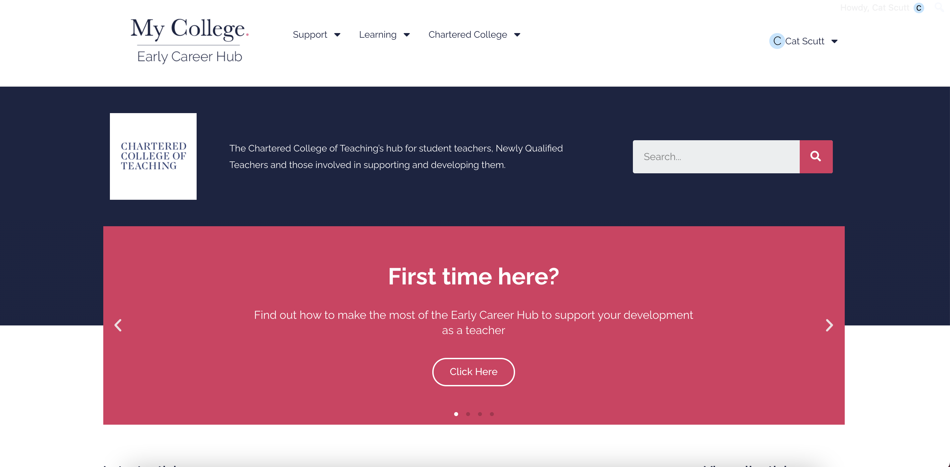
the early career hub
Notes:
And time and money!

Slide 52

the early career framework handbook
Notes:
And time and money!

Slide 53
the early career FESTIVAL
Notes:
And time and money!

Slide 54

Notes:
CCT is here to help! Journals… including edtech issue

Slide 55
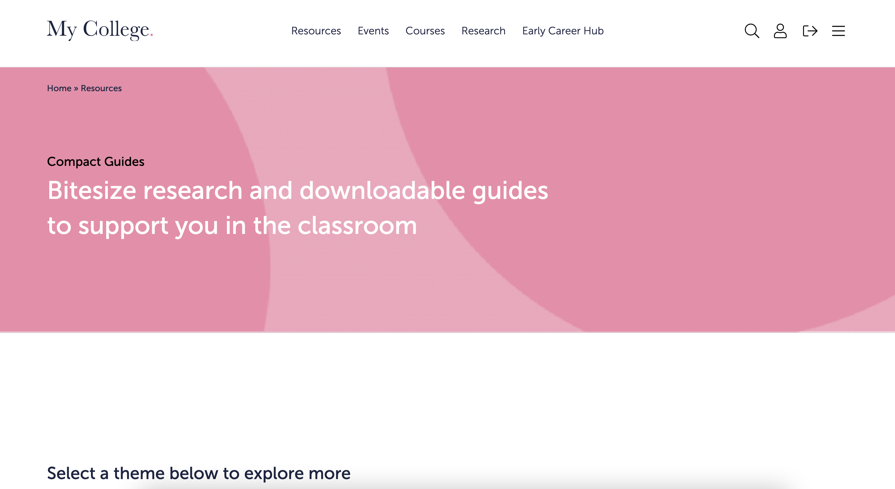
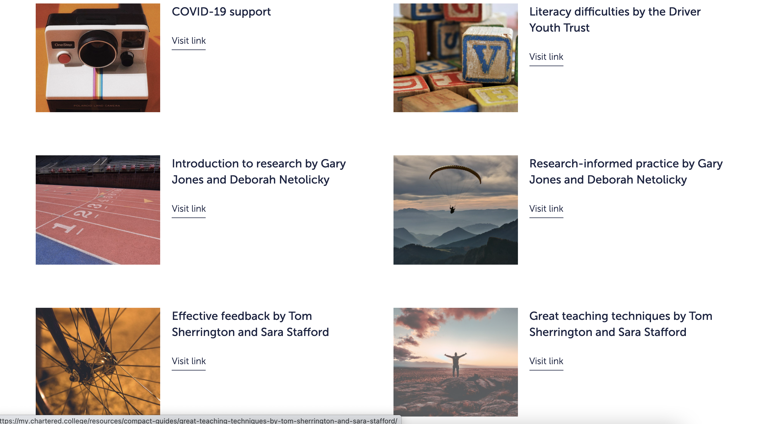
Notes:
And time and money!

Slide 56

Our Accreditation Programmes

