Slide 1
An effective mentor is invaluable to increasing teacher retention…and you must know this already!
Key finding in a research report by the UK Office of Manpower Economics (OME)
"Teachers would be willing to trade-off higher pay/rewards to work in supportive environments" (2021)

Slide 2

If you could describe your mentor in three words, what would they be?
What more specifically, did your mentor do to help you complete a challenging year of teacher training?

Slide 3
Feed Your Passion Sita Manghnani

Slide 4
Head of Dance at Alderbrook School
Senior Professional Mentor for Trainee Teachers and Early Career Teachers
Early Career Programme Facilitator for the Tudor Grange Development Trust
Master of Arts in Education researched about Continuing Professional Development for teachers aspiring to leadership roles
National Professional Qualification in Leading Teacher Development.

Slide 5

This session aims to…
Provide insight into the role of the Senior Professional Mentor.
Give you practical steps to gain experience should you wish to progress your career in a school.

Slide 6
What is a senior professional mentor…in a school setting?
The person with overall designated responsibility for trainee teachers. Often, this person is also responsible for Early Career Teachers too.
Monitors the training process in different subjects within the school.
Moderates the assessment outcomes for all trainee teachers.
Quality assures the mentor support.
Provides effective teaching experiences for trainees and ECTs, supports them so that they have a positive impact on pupil progress and learning from the outset.
Identifies and addresses the needs of trainees to support them in readiness for becoming ECTs.
Builds trust amongst the community of practice and is someone whom trainees and ECTs can rely upon.

Slide 7
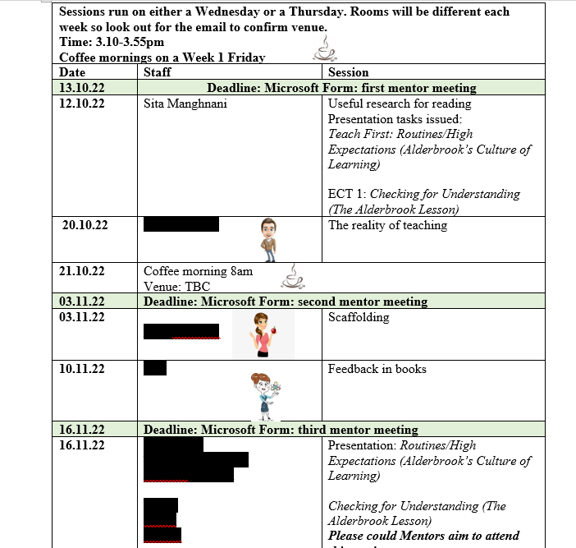
The role includes leading mentors as well as trainees and ECTs.
Sessions align to ECF and Teaching Standards.
Really important to look after the mentors and ECTs and provide as many opportunities to build a community of support.
Find an expert to deliver professional development sessions.

Slide 8
In ALL aspects of my profession as a middle leader, a teacher and as a leader of Early Career Teachers and trainee teachers, I aim to model:
Devotion and dedication. Reflection and Resilience
Get education and experience in the bag!

Slide 9
My journey to becoming a senior professional mentor
Practiced mentoring as a subject mentor.
I interviewed for the role of senior professional mentor…I didn’t get it. I reflected on the feedback.
I needed to educate myself and gain more experience.
Completed a Masters of Arts in Education and ensured my research would address professional development.
Dedicated every night to studying. The COVID memory.
Fed my passion about professional development.
Shadowed my assistant head (the senior professional mentor at the time) and he mentored me.
Notes:
I practiced mentoring as a subject mentor to a number of trainees – perhaps at this point I did not have the role of senior professional mentor on my radar
I interviewed for the role of senior professional mentor…I didn’t get it. My feedback “did you even bother to prepare for the interview?” Instead of deterring me, I became more driven and motivated...I suddenly had a fire in my belly.
I reflected thought about what I needed to do to be prepared.
I needed to educate myself and gain more experience
I applied to do my Masters and ensured my research would address professional development
It was a two year part time course and I dedicated every night to studying. The COVID memory.
I made sure my research fed my passion about professional development and without intention, the work resulted in me seriously mentoring and coaching and developing a professional development model which could be used to progress a teacher to middle leadership as well as be transferrable to anyone in a community of practice wanting to progress
Whilst mentoring and coaching a teacher to middle leadership, I shadowed my assistant head (the senior professional mentor at the time) and he mentored me. I would carry out small parts of the role such as, organising and delivering teacher development sessions. I did this for a year, and suddenly the job came up…

Slide 10
Steps to progress your career in a school
Practice the skill area you wish to develop
Reflect on your work and identify what else you need to practice – try journalling or logging your reflections because they come in handy for preparing for interviews
Read around the area of interest and find out if there are any further qualifications or courses you can undertake to increase your knowledge
Shadow and observe the experts, actively seek those experts out and ask to help
Ask the expert to informally mentor/coach you...these are the types of people who eventually become your advocate
Stay motivated, dedicated and be driven by your passion...

Slide 11
My interview feedback was “You knew your stuff and your passion shone through”

Slide 12
What I love about my role…
Seeing people transform and increase in confidence
Reminded everyday how important it is to be kind and supportive
Discussing teaching makes me love teaching
Knowing that I am perhaps someone who is making a little bit of a positive difference to those teachers who sometimes think about leaving the profession!
Hearing about the successes of teachers who I have worked with…cheerleader for life!
I love that I found a role which gives to me a similar feeling of passion and excitement that I had when I first began dancing…I never knew I could feel this way about anything else.

