Slide 1
Final reflections
What have been the highlights of your PGCE year?
What are you most proud of achieving?
What is the most useful piece of advice you’ve been given during your PGCE?

Slide 2

In case of OFSTED/really bad day/etc…
What advice would you give yourself?
Write it down and email to yourself, so that it is handy when you need it.

Slide 3
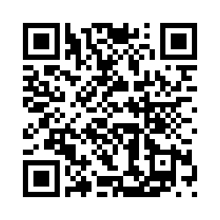
PGCE Course Feedback Survey
Please use the QR code to complete the end of year PGCE survey.
It should take no more than 10 minutes to complete
Thank you

Slide 4

Using your viva as your starting point, take some time to reflect on today’s workshops and complete your CEDP.
Submit your CEDP to Tabula by 12:00pm on 4th July 2023. The link can be found on the conference CEDP webpage.

