Slide 1
Primary/Early Years Mentor Development
Spring 2021-22
Notes:
Julie – paste link to mentor toolkit into chat box: https://warwick.ac.uk/fac/soc/cte/pintra/mentorresources/support/primary

Slide 2
Session Aims:
To introduce/further develop understanding of the instructional coaching model and how this applies to trainees at the ‘developing’ stage of their PGCE
To introduce mentors to the Core Content Framework and the relevant Warwick documentation that will support mentors to develop an instructional coaching relationship with their trainee(s)
To provide an opportunity for Q&A and support
Notes:
Julie

Slide 3
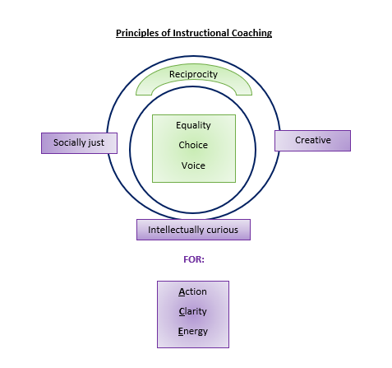
CTE Principles of good coaching/mentoring
Notes:
Julie - Jim Knight made reference to these. Here you can see how the principles work within the WTV to develop and strengthen the mentor and trainee relationship.
Equality-Collaboration
Choice-Ownership over approaches
Voice-Comfortable to express thoughts and feelings
Reflection-Planned and purposeful opportunities to reflect
Dialogue- Share discussions
Praxis-Productive and meaningful
Reciprocity-Shared power-authentic relationship
Ultimately we achieve Action, Clarity and Energy ( Enthusiasm, shared understanding and passion)

Slide 4

Instructional Coaching Model

Slide 5
Traditional Hierarchical Mentor/Mentee Relationship | Instructional Coaching Relationship
Compliance-orientated | Commitment to the trainee’s personal and professional development
The mentor dictates what the student needs for their development | The trainee’s views about their own developmental needs are encouraged and acknowledged
One-size fits all | Training is personalised for the individual
Directive feedback | Professional dialogue
Mentor does most of the thinking | Trainee is allowed the autonomy to do most of the thinking
Judgemental – ‘gatekeepers of the profession’ | Non-judgemental – trainees encouraged to try things out in a safe environment – mistakes seen as a part of the learning process
Trainee has a lower status to the mentor | Mentor/trainee relationship – more reciprocal
Why an instructional coaching model?
Reflect: For those of you who have already welcomed trainees to school, how have you attempted to establish a positive mentor-mentee relationship?
Notes:
Tracey - Based on MT visits and trainee feedback – still a number of mentors who are more aligned with the left hand side of the table. How as MTs can we help to make a shift more towards the second column?
Play the Jim Knight video here? It will explain the shift between the Directive, Facilitative and Dialogical and why instructional coaching is favoured. Further points he makes will be covered later in the presentation.

Slide 6

Warwick Teacher Values
The Warwick Teacher values comprise 3 core values and 5 subsidiary values and will underpin all aspects of our PGCE Primary, Early Years and Secondary programmes.
Notes:
Julie

Slide 7
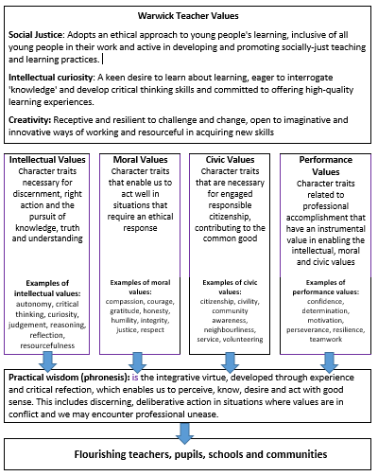
Warwick Teacher Values
Framework
The Framework will feature in the Training Plan and will enable trainees to regularly reflect on both the Warwick Teacher Values and personal values in guided reflection sessions at university and as part of the weekly trainee-mentor meeting. To ensure consistency of understanding, a glossary of the values is provided in the training plan.
Notes:
Julie

Slide 8

Phronesis
“Good sense” or professional/practical wisdom
Phronesis is the virtue that Aristotle called practical wisdom – this is the moral will to do the ‘right thing’ and the moral skill to figure out what the ‘right thing’ is
Practical Wisdom is the integrative virtue, developed through experience and critical reflection, which enables us to perceive, know, desire and act with “good sense”. This includes discerning, deliberative action in situations where virtues collide.
Notes:
Benefit for trainees – to give them wisdom to know how to respond to situations that arise in their classrooms and their day to day work.
Julie

Slide 9
My mentor made all the difference – she made my training experience work well for me as an individual and knew what I needed to help me be the best teacher I could be. | My mentor encouraged me by helping me to identify the positives first and built on my strengths to help me gain confidence. | My mentor was a brilliant role model – he embodied such positive values both in and out of the classroom, he helped me to realise the kind of teacher I wanted to be. | My mentor really encouraged me to try new things and be creative in my approach. They even said they learned some things from me!
My mentor was fantastic at picking me up after a bad lesson and helped me to accept that failing is a part of learning. They made me believe I could actually be a good teacher! | My mentor developed my practice by coaching me and challenging me to come up with the answers myself. | My mentor spent time with me thinking about the best way to respond to some really challenging situations that teachers face in school, particularly with parents. This really helped me to feel prepared to be in charge of my own class. | My mentor was a source of brilliant, practical advice whenever I needed it, but always allowed me the autonomy to develop my own teacher identity.
Trainees’ views on the value of an ethical coaching approach
Notes:
Julie

Slide 10
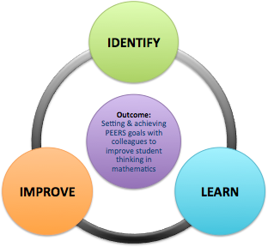
Instructional Coaching Model
How will you go about establishing the current reality?
Analyse current reality
Set goals
Identify and explain teaching strategies
Provide support until goals are met
Analyse new reality
How will you help the trainee establish the NEW reality?
What type of strategies can
you utilise to support
trainees to set targets?
The
Impact
Cycle
In what ways can you
provide support
until goals are met?
How will you ensure the trainee
understands how to achieve the goal and have ownership?
Jim Knight (2018)
Notes:
Tracey - How will you go about establishing the current reality for trainees? – Measureable evidence – eg – amount of time taken up with teacher talk/number of times lesson interrupted by behaviours
What type of strategies can you utilise to support trainees to set targets – show PEERS strategy
How will you ensure the trainee understands how to achieve the goal and have ownership over the goal– IC – checklists.
Provide support until goals are met – mentor modelling/view another teacher/lesson study type approach
Measurable evidence – what does it look like now
Kate/Julie

Slide 11

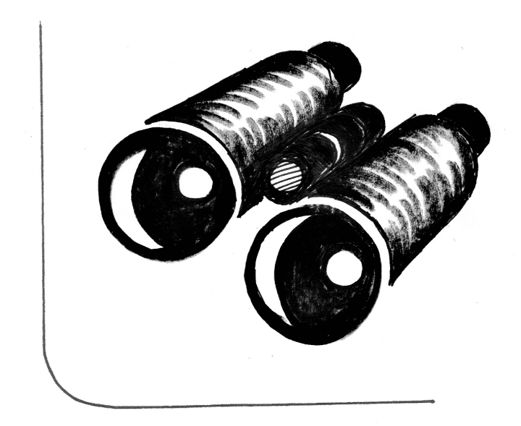


Reality
There is a need to gain an understanding of a shared clear picture of reality in the trainee’s classroom. This identifies the top priority for change and a clear picture for growth.
You offer an additional and valuable set of eyes on what is happening in an trainee’s classroom. Observing what learners are doing in the trainee’s classroom is invaluable feedback about a trainee’s current and new reality – clear data can be very useful here.
Eyes
Ask
The What and How questions V the Why questions
And What Else? The best follow up question!
Often the first response that comes to mind isn't the only answer or even the best answer.
Authentic listening builds trust and allows you to understand the trainee’s perspectives on the impact they are having and how they are developing. Listen for clarity. Learn rather than judge. Try not to listen with your own answer in mind.
Listen
Notes:
Tracey -Key coaching skills that underpin the instructional coaching model. Tracey

Slide 12
‘Developing’ Stage:
Trainees have had a placement (SD full term, shorter for Core) however for some trainees this will have been disrupted due to Covid/illness
Trainees will need sufficient time to adapt to a new school, different ways of working, schemes of work and new age phases – need time at start of placement for observing, orientation and will still require significant support with planning at this early stage of the placement.
May still be a need for mentoring approaches - providing clear direction for trainees e.g. sharing suggestions and advice or explaining a strategy to help develop a trainee’s practice.
However, to help shift from mentoring to coaching, the use of coaching questions can help increase ownership and commitment to follow-through even at this early stage.
E.g. “How will that look for you?” could help the trainee adapt what you have shared and begin to make it their own.
Precision-seeking (tactics) questions like “what will be your first small steps?”, “how will you do that?”, “when will you take each of those steps?” and “who else needs to be involved?”, help to facilitate good intentions, build autonomy and increase the likelihood of action.
Notes:
Tracey - Remembering what Jim Knight had said that there is a place for each of the models- Facilitative, Directive and Dialogical- we need to be mindful that some trainees may more “ direction” initially or more “guidance” than others.

Slide 13
Live Coaching
Guided Observations
- ‘Live coaching’ is where a mentor or class teacher in the role of ‘coach’, works alongside a less experienced teacher while they are delivering a lesson.
- The coach provides the teacher with live feedback about their teaching so that the feedback is immediate and acted upon rather than being given after the lesson when it is essentially too late.
- Guided observations are where the mentor observes an expert colleague with the trainee. This is particularly useful if the trainee is trying to develop a particular aspect of their practice (as part of the ELF process) and the mentor can support the trainee in knowing what to look for and unpicking the strategies the colleague is using in their classroom
Notes:
Tracey- There are observation proformas for the trainee to use but they can just make their own notes – better to have a focus when observing others.

Slide 14
Guided and Supporting Planning
At the start of this placement, trainees are expected to use the Warwick individual learning plan to support them in developing their understanding of the planning process
Year group colleagues need to support and model the planning process for the trainee and provide relevant resources/schemes that may help them.
Trainees must be involved in weekly PPA with year group colleagues and should not be used for cover.
Notes:
Tracey – might be worth suggesting that if PPA falls on a uni day that alternative plans need to be put in place so trainees can still learn from expert colleagues

Slide 15
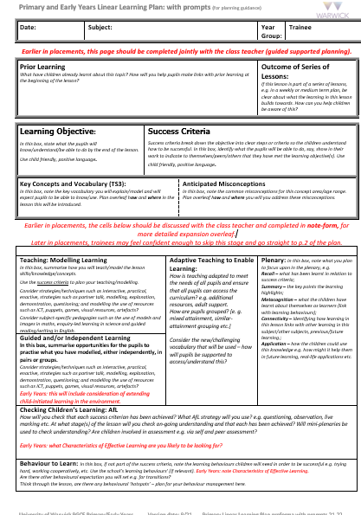
Individual Learning Plan Proforma - Primary
Stage 1
There are 2 versions of the plan – one with prompts and one blank
The first page of the plan is space for the trainee to write notes about the lesson you are going to teach.
It is fine for trainees to work from existing resources, previous plans, schemes of work etc. as a starting point but they will need to personalise it for their class
Please ensure trainees are supported in identifying the learning objective/intention and success criteria for the lesson so they are clear about the learning.
Notes:
Tracey

Slide 16
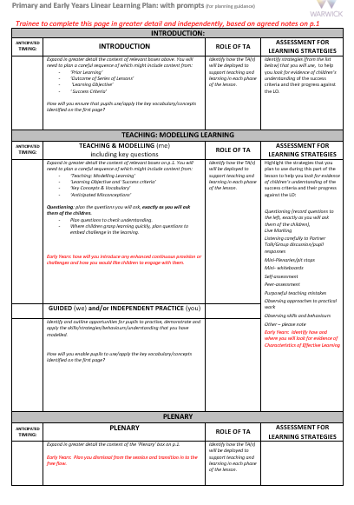
Stage 2
Stage 2 is for the trainee to turn their notes into a lesson plan
They will need to consider:
How they will introduce the lesson and build on prior learning
What they will need to demonstrate and model and which resources they will use to prepare children for their independent learning
What the children are going to do independently or in guided groups to show what they have learnt
What they will include in your plenary to end the lesson effectively
How they will use any additional adults
How they will assess during the lesson to monitor whether children have understood the concepts you have taught
Trainees have been asked to share plans in advance with their class teacher so they can have feedback and make any amendments before they deliver the lesson
Notes:
Tracey

Slide 17
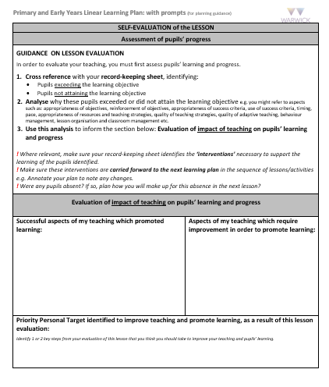
Stage 3
After each lesson trainees must reflect and evaluate their teaching to demonstrate their ability to analyse lessons and draw conclusions about their impact
They are also asked to identify a potential target which can feed into your weekly discussion
Early Years trainees should use this plan for their KS1 placement but would be advised to use the Early Years learning opportunities plan/weekly continuous provision plan available in Essential Documents on the partners’ intranet to help them to plan for their learning environment– they will have support with planning as part of their EY input
Notes:
Tracey

Slide 18
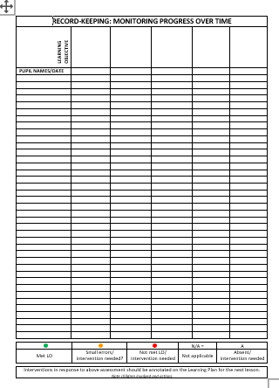
Record Keeping Sheet
Trainees should continue using this sheet to record children’s progress
This proforma will enable them to consider the progress of the children and encourage them to plan interventions that will address individual needs
Notes:
Tracey

Slide 19
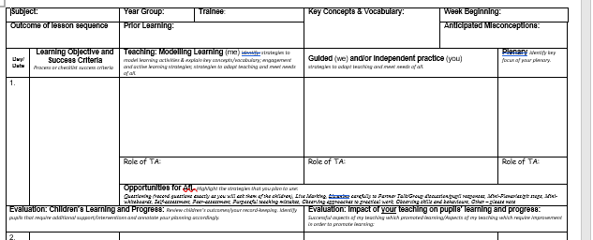
Weekly Planning Proforma
If the trainee’s planning is consistently having a positive impact on pupil learning, the mentor and moderation tutor can decide to move the trainee onto weekly planning.
Trainees can use school proformas at this stage, however, please ensure the proforma has similar information to the Warwick version.
Notes:
Tracey

Slide 20
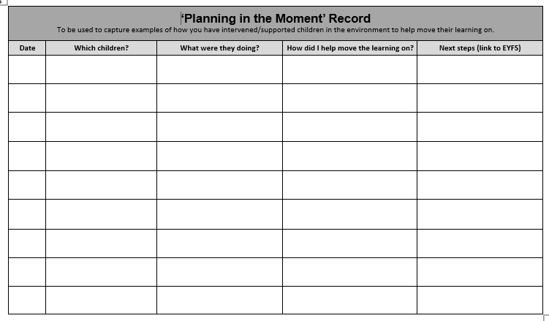
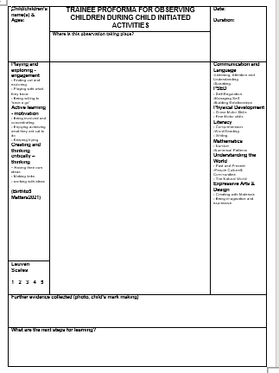
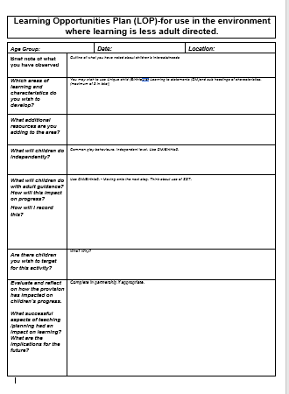
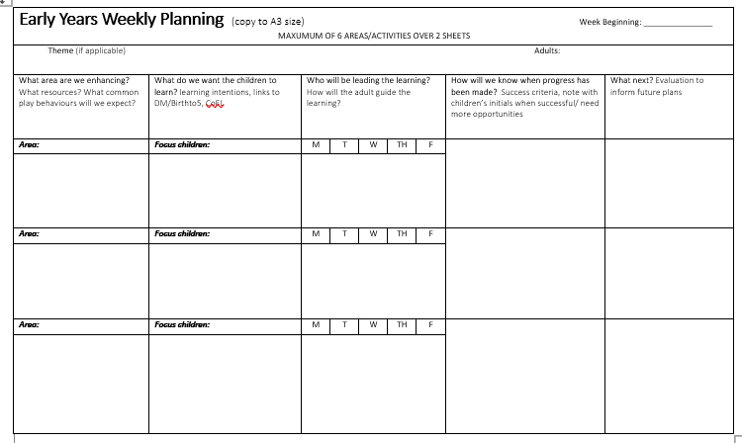
Early Years
Trainees based in EY will have a different set of plans to use to support trainees to respond ‘in the moment’ and plan for their learning environment, their additional adults and their continuous provision. Trainees should use the LOP (Learning Opportunities Plan) as their main planning form but there are additional proformas on the intranet which can also be used where appropriate. Some trainees based in KS1 and SEND settings may also be adopting a continuous provision approach in their settings and would benefit from using these proformas rather than the standard primary ones.
Notes:
EY Core will be in KS1 – Y1 trainees may need these proformas if they are working with continuous provision

Slide 21
Expectations of Professional Mentor
Agree a time for a weekly meeting and a weekly lesson observation (ideally timetabled in advance) with the trainee during placements to review training and discuss trainee development
Mentor to facilitate a trainee’s reflective practice through the use of professional dialogue and coaching approaches to unpick trainee’s development during that week and the placement as a whole – not tell you all the answers!
Support the trainee to identify their own targets, the actions/strategies they could try to meet those targets and review progress on a weekly basis
Mentor to regularly and collaboratively review progress using the Collaborative Review Document and Core Content Framework to ensure trainees are making progress and receiving their minimum training entitlement
Write a brief profile at each assessment point to summarise trainee progress including comments that feed into their reference
Signpost the trainee to colleagues with a particular expertise, subject specialists etc. to enable them to observe and learn from good practice and expert colleagues across the school
Raise any concerns with the trainee and moderation tutor if there are any concerns about professionalism or progress as early as possible
Notes:
Julie – emphasise difference in roles between CT and mentor

Slide 22
Expectations of Class Teacher
Day to day support
Critical friend – ongoing informal feedback
Live coaching and team teaching
Support for planning and assessment – check trainee plans before they deliver lessons
Modelling good practice
CTs can undertake some aspects of mentor role if needed e.g. observations – mentor to train and support as required
CT and mentor may be the same person – good to have another key person in school for the trainee to go to if needed

Slide 23
Expectations of Trainees on Placement
Keep files and training plan up to date and available for the mentor and university staff to view at all times
Communicate and engage with mentors on a weekly basis through a timetabled meeting – come prepared, identify a focus – ask mentor to timetable observations
Ensure that the key discussion points from the professional discussions with mentor during your weekly meetings are recorded in their training plan – share with mentor
Share Sharepoint file with new mentor to collaboratively review progress
With guidance as necessary, identify targets/actions with mentor following lesson observations and in weekly meetings and record in training plan – trainees should use these targets to help drive their development
Constructively raise with mentor & MT if they have any concerns or questions re: placement or feel they are not receiving the minimum expectations e.g. PPA with colleagues; not having weekly meetings/observations or time to review progress
Notes:
Julie

Slide 24
Expectations of University Moderation Tutor
Provide a link between school and university
Be your first point of call with any placement-related issues
Lead 4 visits with the mentor and trainee in school through the year – this term ‘visits’ before half term will be online due to ongoing Covid issues but may return to face to face if it is safe to do so later in the term
Moderate mentor judgements and placement provision
Regularly review the trainee’s teaching file, the training plan, the collaborative review document and your professional development file (refer back to intro to course notes for more detail on these)
Support the development and review of any intervention plans considered necessary for the trainee
Notes:
Julie

Slide 25
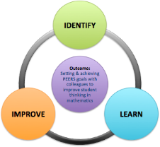
The Warwick Toolkit
To support the implementation of the Instructional coaching model
The coaching contract
ITT Core Content Framework document
Mentor’s Guide to the ITT Core Content Framework
Placement Reference Guides
The initial meeting/subsequent meetings guidance documents
The Collaborative Review Document (trainee will have an online copy of this shortly)
The Weekly Instructional Coaching Notes (ICON)
Experiential Learning Form (ELF)
Analyse current reality
Set goals
Identify and explain teaching strategies
Provide support until goals are met
Analyse new reality
Notes:
Julie introduce - The Warwick Toolkit will contain………….Introduce each document in turn briefly explaining its importance and relevance to effectively supporting the trainee.

Slide 26
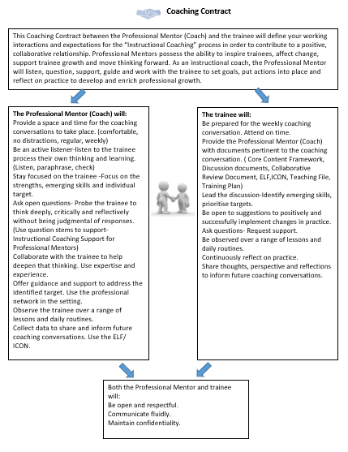
Coaching Contract
Share and discuss the coaching contract early in the placement - this can help establish clear expectations for both mentor and trainee and will help to promote a positive and professional relationship.
Notes:
Tracey

Slide 27
Core Content Framework
Notes:
Julie

Slide 28

What is the Core Content Framework?
…part of a training and development system in which:
ITT CCF and ECF establish a minimum entitlement to a structured package of support for future teachers;
Mentoring/support from expert colleagues is a key element of this entitlement;
QTS will continue to be awarded at the end of ITT against the Teachers’ Standards.
Please download and familiarise yourself with this document
https://assets.publishing.service.gov.uk/government/uploads/system/uploads/attachment_data/file/919166/ITT_core_content_framework_.pdf
Notes:
Julie

Slide 29
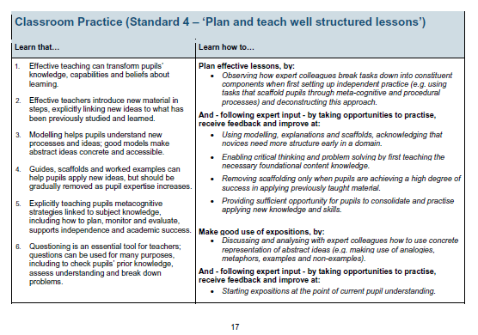
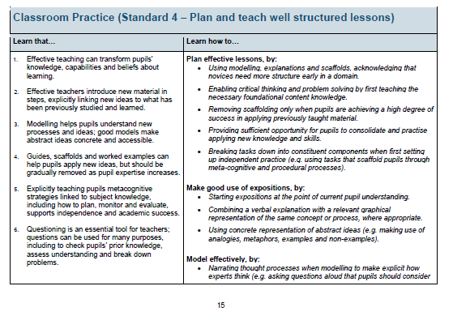
Early Career Framework
Core Content Framework
Notes:
Julie

Slide 30
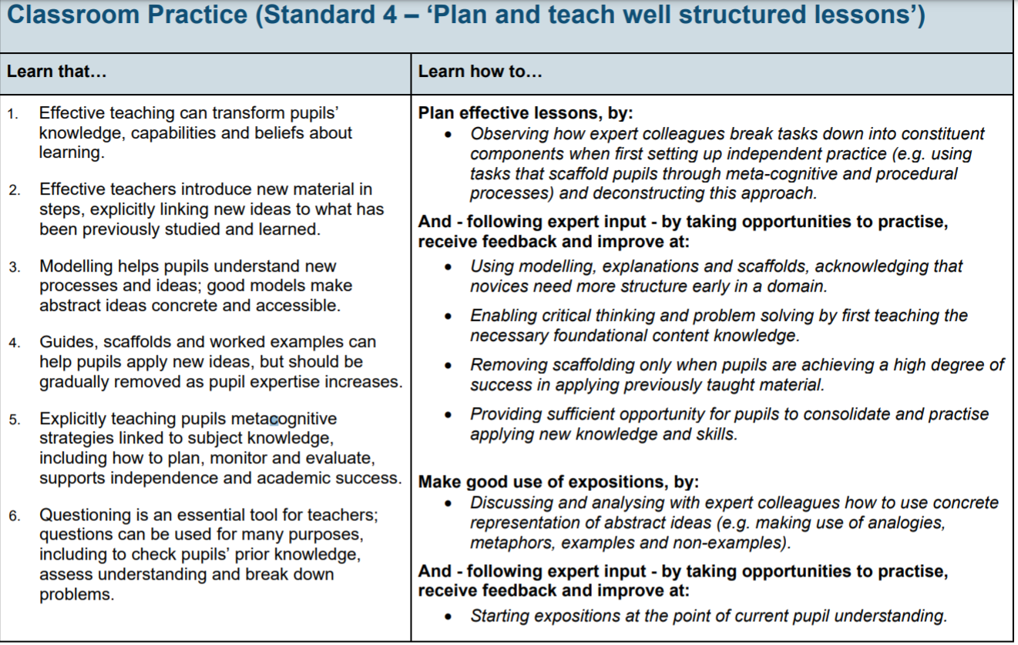
Notes:
Julie

Slide 31
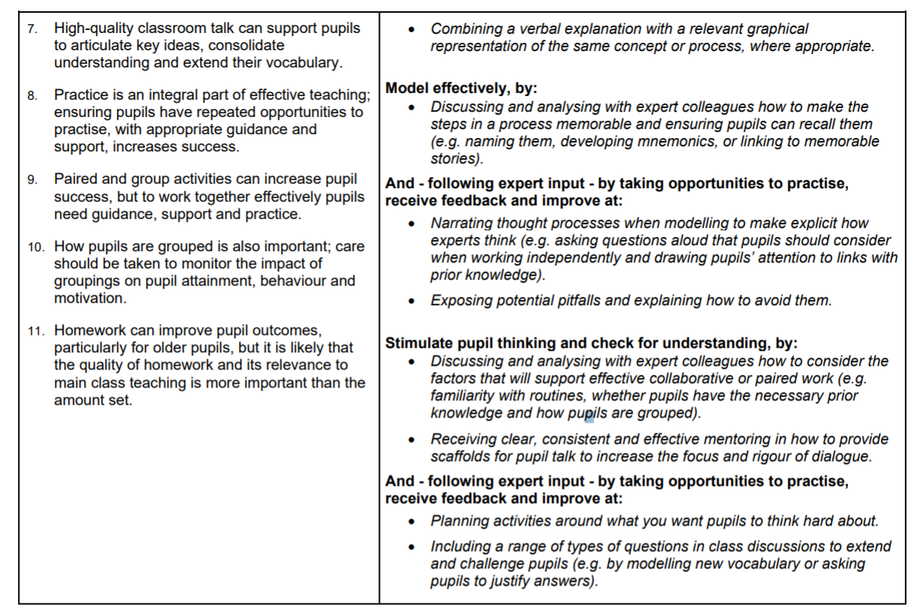

Notes:
Julie

Slide 32
Warwick documentation and practices that support the facilitation of the coaching model

Slide 33

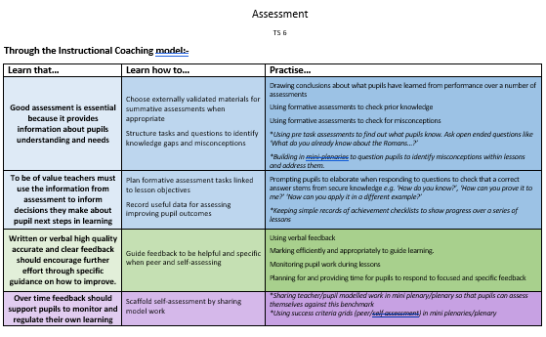
Mentor’s Guide to the ITT Core Content Framework
Additional support document for mentors in navigating the Core Content Framework and providing practical strategies and advice for each of the 5 core areas.
Should be used to feed into trainee targets and discussion points in weekly meetings
Notes:
Tracey

Slide 34

Placement Reference Guides
Programme-specific information can be found in the placement guides.
Core have placement guides for serial days and per placement and SD have a placement reference guide for the year but additional information will be shared with mentors where appropriate
Notes:
Tracey

Slide 35
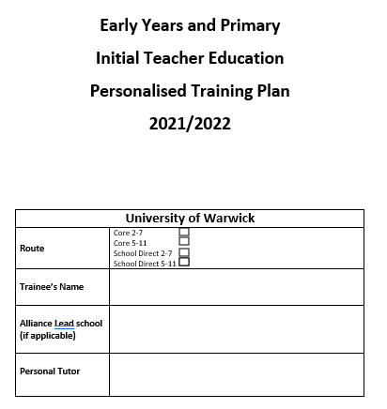

PGCE Personalised Training Plan
Trainees are responsible for their own training plan – should be kept in their Professional Development File
Mentors and trainees meet weekly to discuss trainee’s progress – trainee records notes in the weekly log – this should be separated from lesson observation feedback
Trainee should be prepared for the meeting and have identified an aspect of their progress they wish to discuss in detail
Mentors to check accuracy of the weekly mentor meeting log and monitor progress of targets
Notes:
Tracey

Slide 36

Initial Longer-Term Targets
Trainees have been asked to identify targets from their Autumn term placement and the CRD that they wish to address this term.
School Professional Mentor signs off targets on placement as the trainee meets these.
Notes:
Tracey

Slide 37
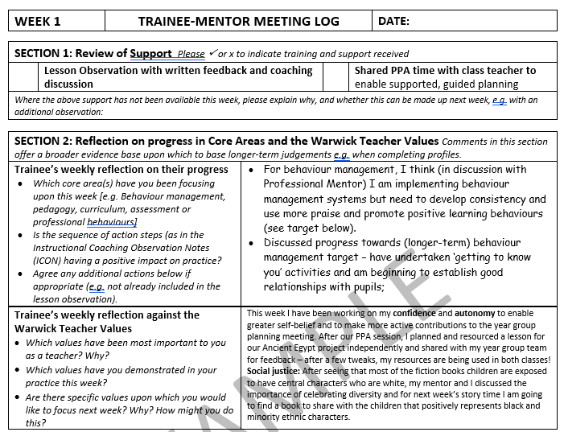
Section 2:
- Reflection on progress in relation to Core Content Framework expectations to support professional development
- Reflection on Warwick Teacher Values/
personal values to promote reflection on character and personal development
Notes:
Tracey

Slide 38
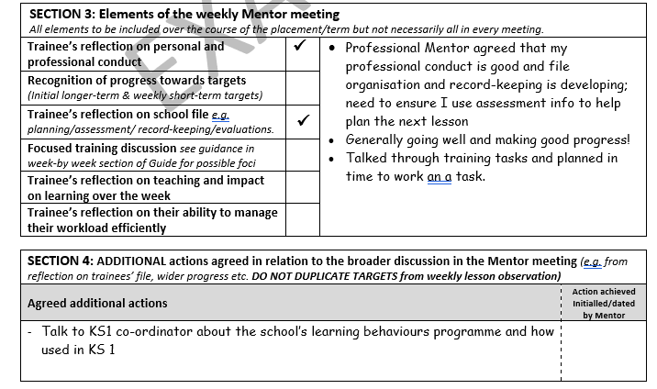
Section 3: Additional areas to discuss informed by trainee’s progress that week
Section 4: Targets (these should be different from the lesson observation targets that relate to the broader discussion about the trainee’s ongoing progress
Notes:
Tracey

Slide 39
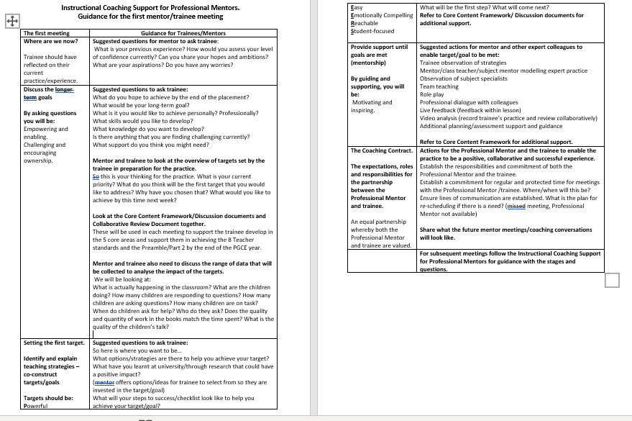
Coaching guidance for mentors for the initial meeting with trainee
This guidance provides a suggested structure for early meetings with your trainee to gather information about your trainee and enable you to be able to most effectively meet their needs
Notes:
Tracey

Slide 40
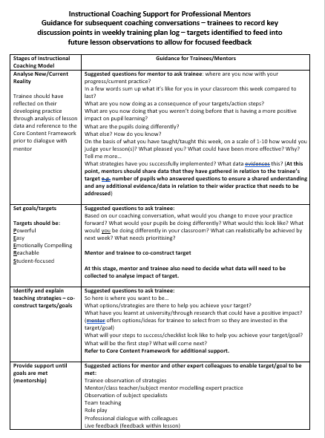
This guidance is for subsequent meetings – trainees have been encourage to be proactive and ensure they have prepared for the mentor-trainee meeting, identifying an area of focus for which they want some support/feedback. This focus should be informed by the week by week guide in the placement booklets, feedback the trainee has received during the week and any gaps on the CRD
Notes:
Tracey

Slide 41
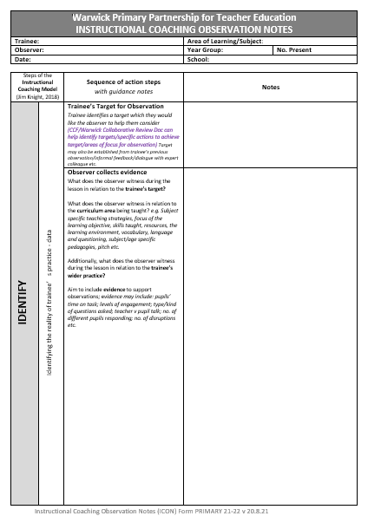
Lesson Observation Form 1 – Instructional Coaching Observation Notes Form (ICON)
PAGE 1:
Trainee’s target for observation – trainees should identify what they want specific feedback on (this should be informed by CCF, CRD, previous lesson feedback, mentor-trainee dialogue, training plan notes)
Evidence collected by observer: this includes data to demonstrate your impact in relation to your identified target e.g. time on task, number of children participating, time of teacher v pupil talk; subject specific feedback and any other key points that the observer wants to share
This form will be used for the majority of lesson observations
Notes:
Julie

Slide 42
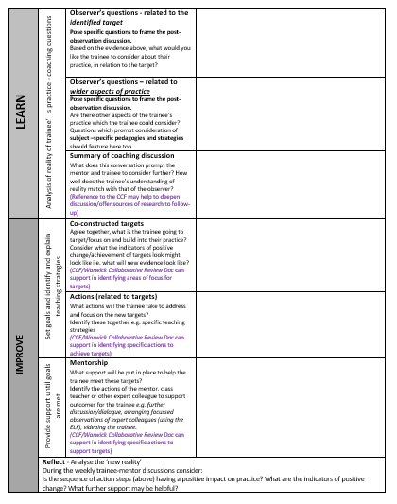
Page 2
Observer’s key questions/prompts related to the specific target that will feed into the post-lesson dialogue
Observer’s questions related to wider aspects of practice
Summary of coaching discussion (to be completed after the mentor-trainee dialogue to summarise key points to take away -CCF can support with this)
Co-constructed targets – based on the feedback and progress against the chosen focus, agree together a target that the trainee will work on the following week (see PEERS goals)
Specific actions – What actions will the trainee need to take to be successful with your target? Break the target down into achievable steps
Mentorship – What support will the trainee need to enable you to be successful with your target? Observation of a colleague who demonstrates good practice in this area (use the ELF to support with this); colleague to model strategies with the trainee’s class; discussion with an expert colleague; research/reading related to identified next steps
Reflect – trainees are asked to consider before your next meeting with their mentor, what impact they have seen in their classroom after putting these new strategies in place? What’s gone well? What has been challenging? What would they like to do next to further your progress?
Notes:
Julie

Slide 43
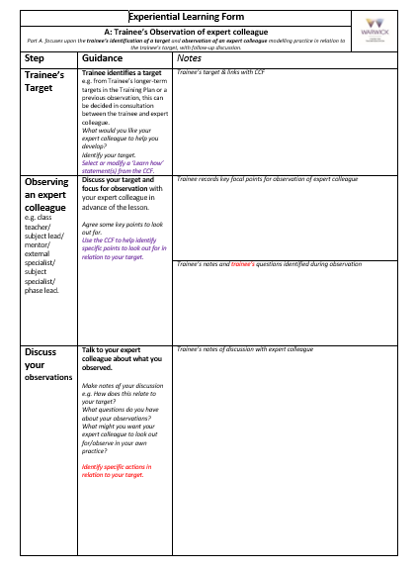
Lesson Observation Form 2 – Experiential Learning Form (ELF)
Trainee’s target for observation – what do trainees want specific feedback on? (this should be informed by CCF, CRD, previous lesson feedback, mentor-trainee dialogue, training plan notes)
Observation of expert colleague – trainees should discuss their target/focus with the relevant colleague before the lesson and observe them modelling this in their practice to help develop the trainee’s understanding – the trainee should make notes on the form – what were they hoping to gain from the observation? What did they learn?
Discuss your observations – After the lesson, trainees should discuss their observations with an expert colleague after the lesson. Draw out some key learning points. How is the trainee going to try to apply what they have learnt to their own practice? What specifically want the observer to look for when they observe you teaching this particular strategy?
Page 1
To be used when trainees would benefit from additional support from expert colleagues on a particular area of their practice.
Notes:
Julie

Slide 44
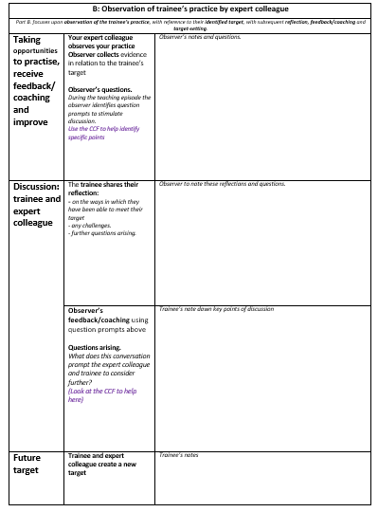
Page 2
Taking opportunities to practise, receive feedback/coaching and improve – observer makes notes in relation to the focus and jots down evidence to show impact on pupil learning
Discussion: trainee and expert colleague:
Trainee reflections: Trainee to share their reflections on how successfully they have addressed the focus
Observer reflections: Observer records their feedback
Future target: based on the feedback and progress against the chosen focus, trainee and mentor should agree together a target that the trainee will work on the following week (see PEERS goals)
Notes:
Julie

Slide 45
PEERS Goals/Targets
Powerful: makes a big difference in children’s lives
Easy: simple, clear and easy to understand
Emotionally Compelling: Matters a lots to the teacher
Reachable: Identifies a measureable outcome and strategy
Student-focused: Addresses a student achievement, behaviour or attitude outcome.
Notes:
Julie

Slide 46
Collaborative Review document (CRD)
Online Excel document – trainee and mentor has access to a SharePoint folder and will share access rights
Notes:
DR

Slide 47
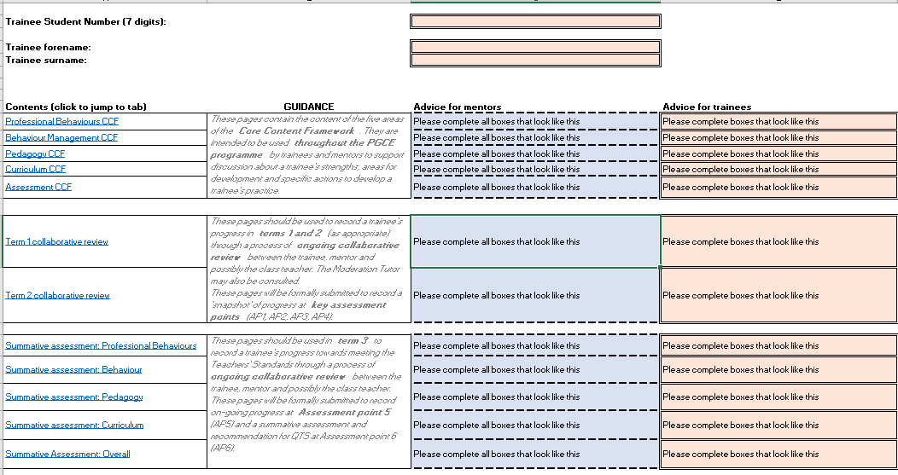
Introduction
Notes:
DR

Slide 48
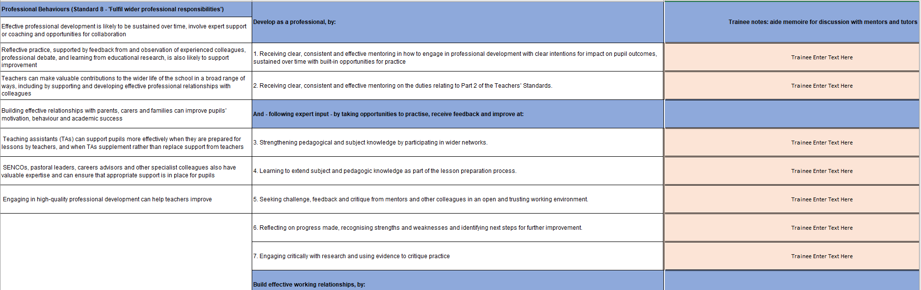
Core Content Framework (CCF) sections
Learn that statements
Learn how statements
Trainee notes/aide memoire for discussion
Notes:
DR

Slide 49
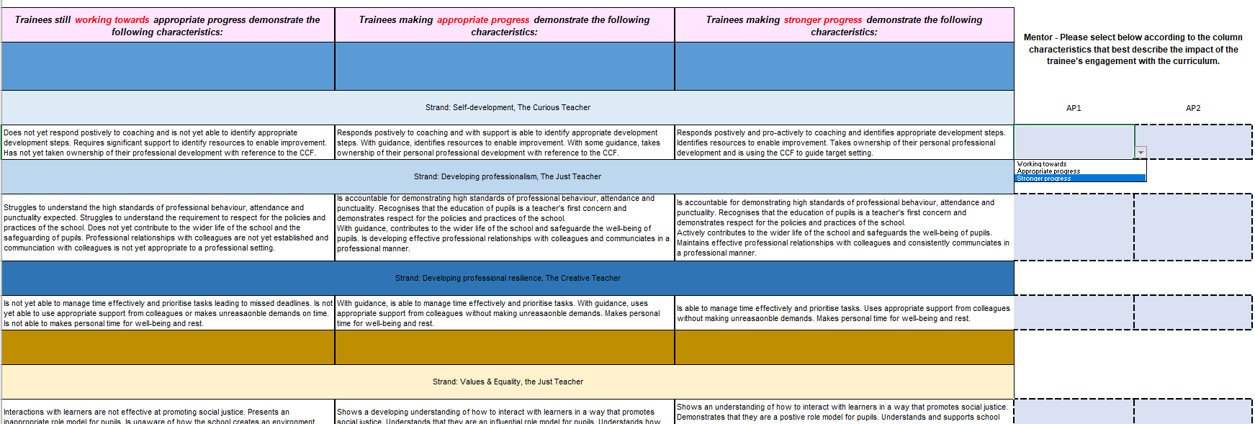

Terms 1 & 2 expectations for Progress on placement
Notes:
DR

Slide 50
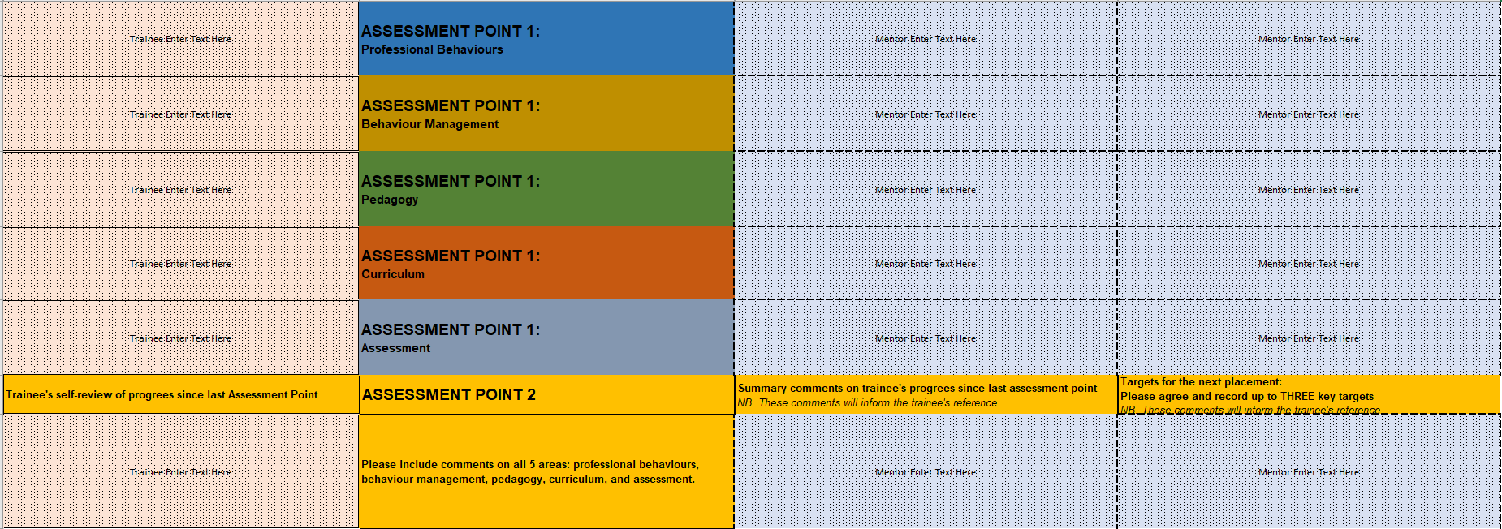
Terms 1 & 2 expectations for Progress on placement
Notes:
DR

Slide 51
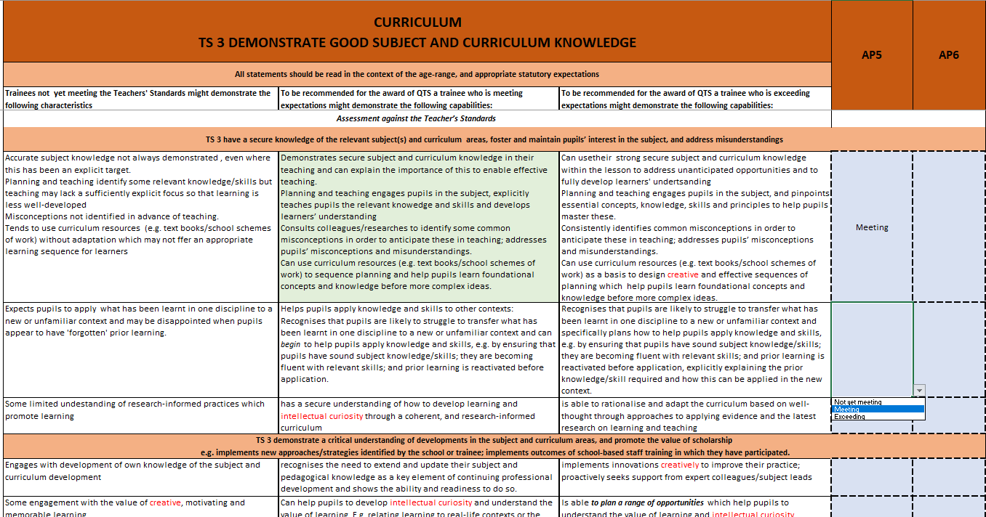
Summative Assessment against the Teachers’ Standards – at the end of the course
Notes:
DR

Slide 52
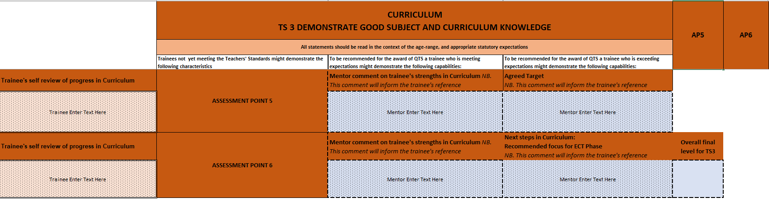
Summative Assessment against the Teachers’ Standards – at the end of the course
Notes:
DR

Slide 53
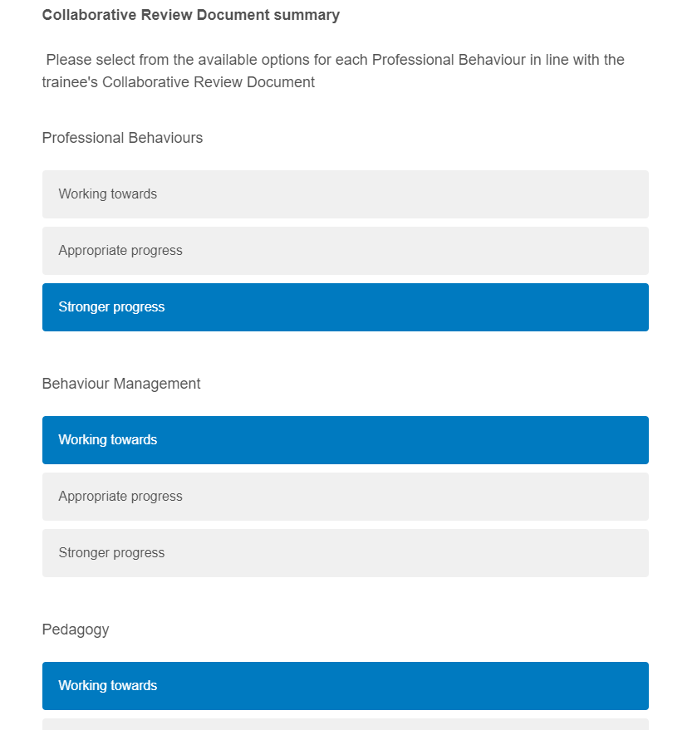
Qualtrics: Half-termly progress
Sign off form for data integrity
Webform
Trainee details +
Summary of attainment
Attendance
Against 5 areas of the CCF
Notes:
DR

Slide 54
You might find it helpful to watch CRD guidance video: https://echo360.org.uk/media/303f63eb-34a9-45f8-acde-7ed72a4befdc/public
Collaboratively review trainee’s progress using the CRD and use the CCF statements to guide training provision in school and to inform targets and dialogue during weekly meetings
At each assessment point, mentor and trainee will together review progress against the 5 core areas of the CCF and write comments to summarise progress at this point. These comments will be used for the trainees’ references.
Additional support will be implemented for those trainees struggling to meet the minimum expectations.
Notes:
https://echo360.org.uk/media/303f63eb-34a9-45f8-acde-7ed72a4befdc/public

Slide 55
Progress on Placement – doesn’t look like this
Trainee progress
Start Term 1 Term 2 Term 3
Notes:
Julie

Slide 56
More likely to be…
Trainee progress
Notes:
Julie

Slide 57
Teaching Expectations
Outlined in placement guides
30% approximately by Assessment Point 1
50%-60% by Assessment Point 2
50%-60% by Assessment Point 3
60%-70% by Assessment Point 4
70% by Assessment Point 5
80% by Assessment Point 6
Profiles will be completed on the Collaborative Review Document ready for submission at each assessment point and the grades verified on a very brief Qualtrics form. This replaces the WADs and the old profile forms.
Notes:
Julie

Slide 58
Whilst not timetabled to teach, trainees might:
Observe learning and teaching – class teacher and other expert colleagues
Meet with expert colleagues to learn from their area of expertise; discuss lessons they have observed; receive feedback
Have their weekly mentor-trainee meeting (although this may need to take place after school or at lunchtime depending on mentor’s responsibilities)
Support the class teacher – before, after and during the school day
Develop relationships with the children by working with groups/individuals
Review and monitor progress and prepare for mentor-trainee meetings, including updating training plan and collaborative review document
Time for planning, preparation and assessment
Complete university tasks/conduct research for assignments e.g. documenting children’s dialogue for Spring term ‘talk’ assignment
Notes:
Julie

Slide 59
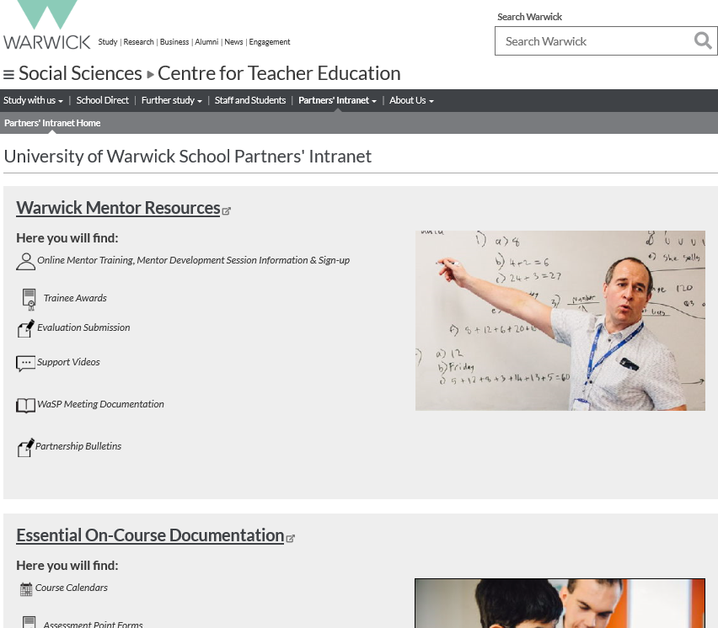
Where to find documentation and training materials…
Partners’ Intranet:
https://warwick.ac.uk/fac/soc/cte/pintra/home/
Password: partnercte
Notes:
Julie

Slide 60

What are your next steps to develop your mentoring practice?
Opportunity for Q&A
Notes:
What questions/thoughts do you have?
What are your next steps? – your reflections are key….

