Slide 1
Assessment, Progress and Expectations on the PGCE Primary Core and SD courses
Introduction to the Collaborative Review Document
Deborah Roberts, Julie Taylor, Des Hewitt
Notes:
All

Slide 2
Why do we have this document?
Core Content Framework (2020)
Minimum curricular entitlement
‘A partnership’s ITE curriculum sets out the aims of a teacher-training programme. It also sets out the structure within which those aims should be implemented, including the knowledge, skills and behaviours to be gained at each stage. It enables the evaluation of trainees’ knowledge and skills against those expectations.’
OFSTED Handbook for Inspection of ITT (2020)
Movement away from assessing the Teacher Standards throughout the PGCE year
‘The teachers’ standards provide an end-point assessment for qualified teacher status (QTS) in primary and secondary phases delivered by ITE partnerships. They are not a curriculum. ‘
OFSTED (2020: p.9)
The Curriculum Review Document (CRD) replaces the Warwick Assessment Descriptors (WADs) for all Primary, Early Years and Secondary trainees starting in September 2021
Notes:
DH

Slide 3
Some principles of assessment
Improvement: improve not prove
Trainee Agency: Student-led instructional coaching approach – students an active part of the process
Supportive: identify students not on track to achieve the TS by the end of programme to enable intervention and support (need sufficient information to inform this)
Dialogic: an entitlement to dialogue with expert colleagues /entitlement to expert mentoring and observation of expert colleagues
Clarity: shared expectation of expected progress
Statutory expectations: CCF and OFSTED requirements and advice
Notes:
DH

Slide 4
Structure of the Collaborative Review document (CRD)
Notes:
DR

Slide 5
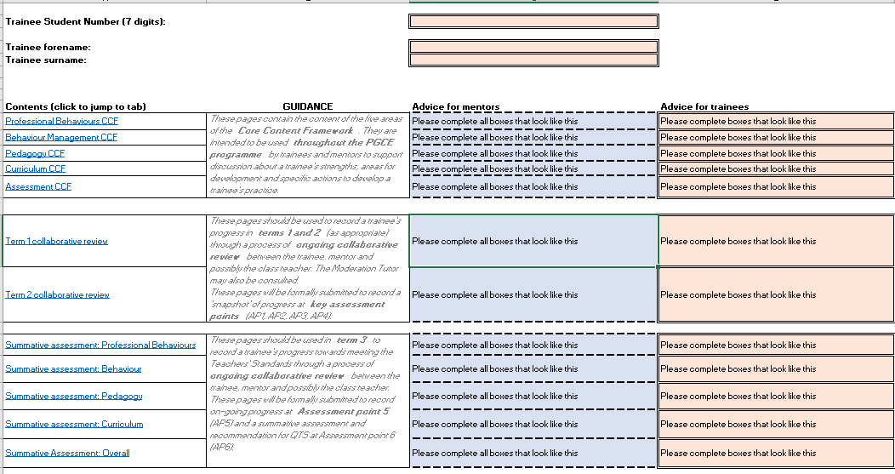
Introduction
Notes:
DR

Slide 6
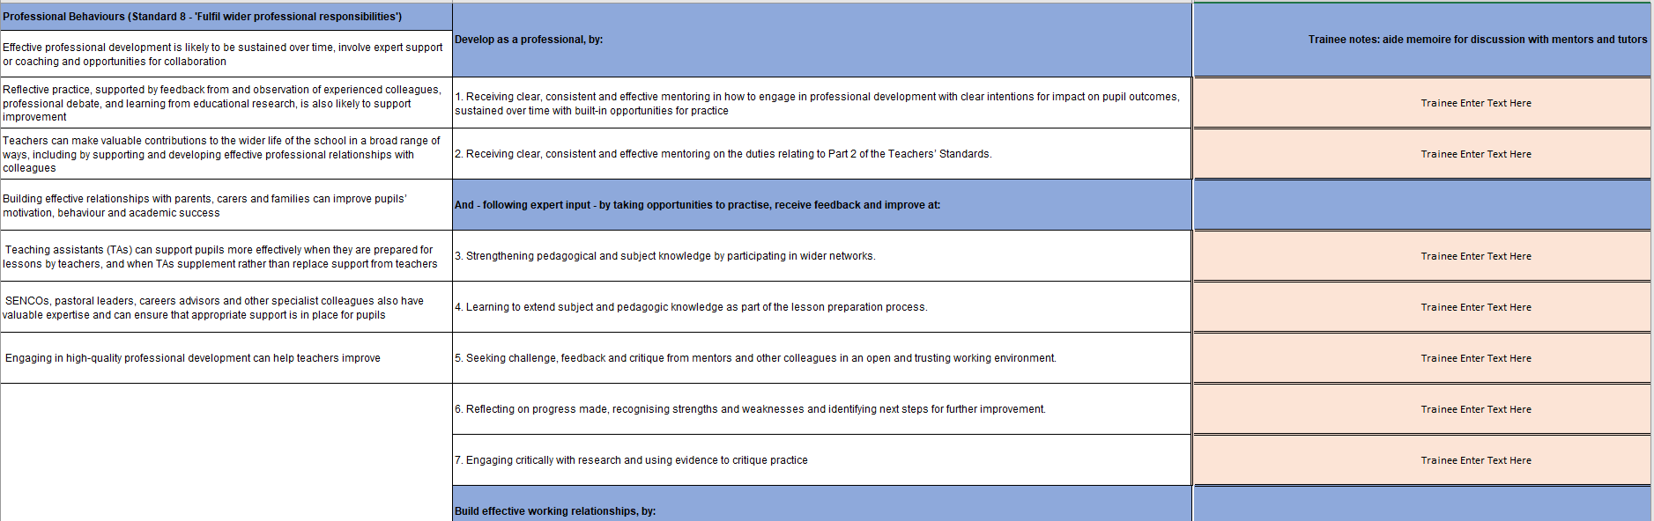
Core Content Framework (CCF) sections
Trainee notes/aide memoire for discussion
Learn that statements
Learn how statements
Notes:
DR

Slide 7
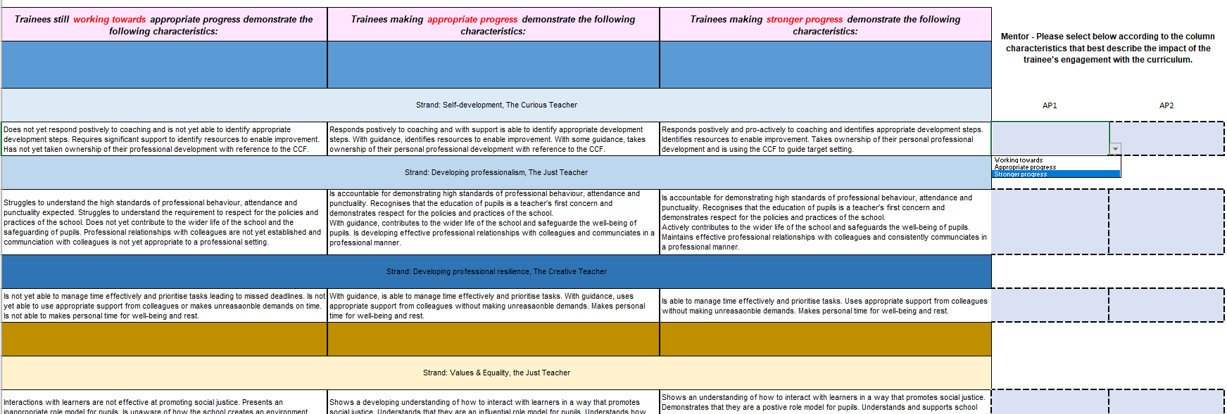

Terms 1 & 2 expectations for Progress on placement
Notes:
DR

Slide 8
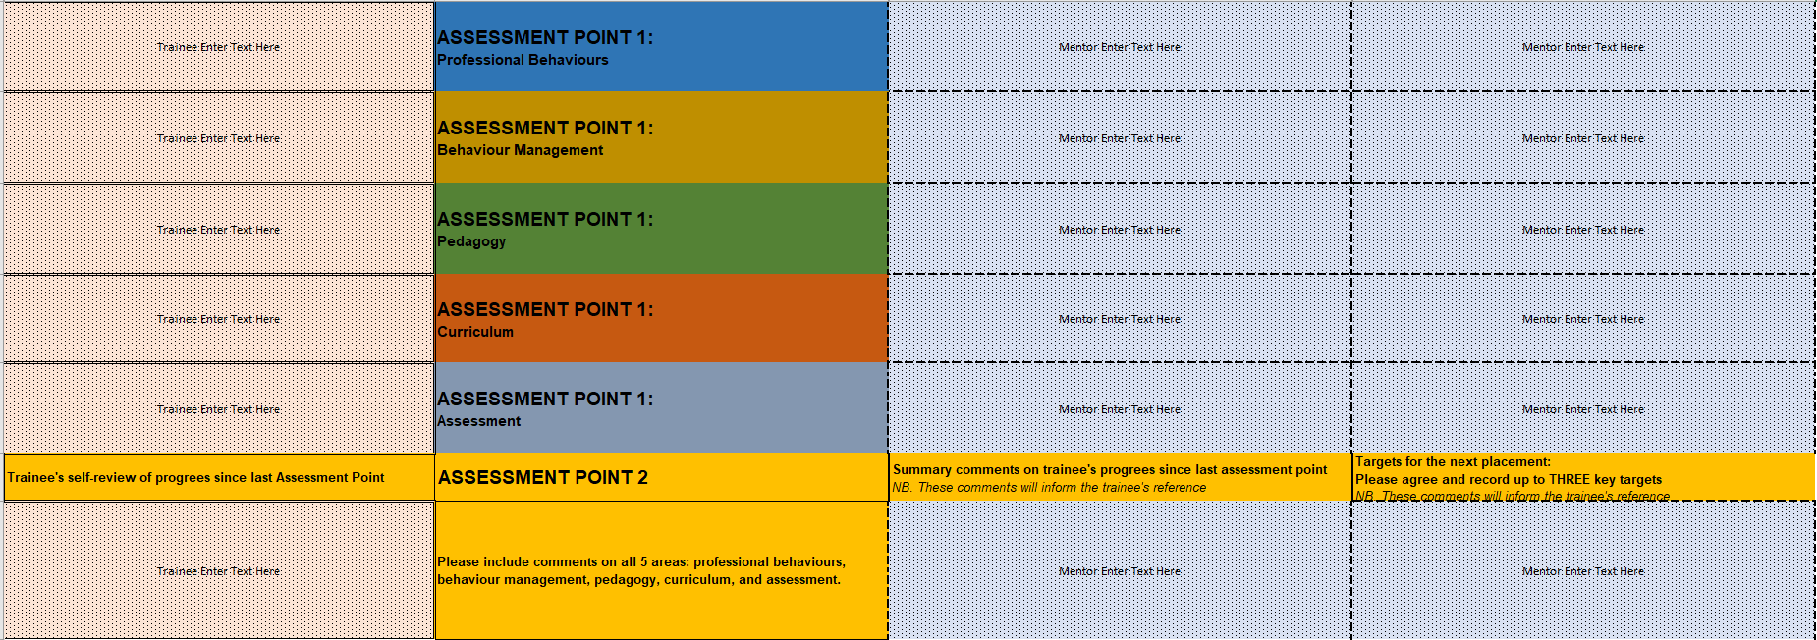
Terms 1 & 2 expectations for Progress on placement
Notes:
DR

Slide 9
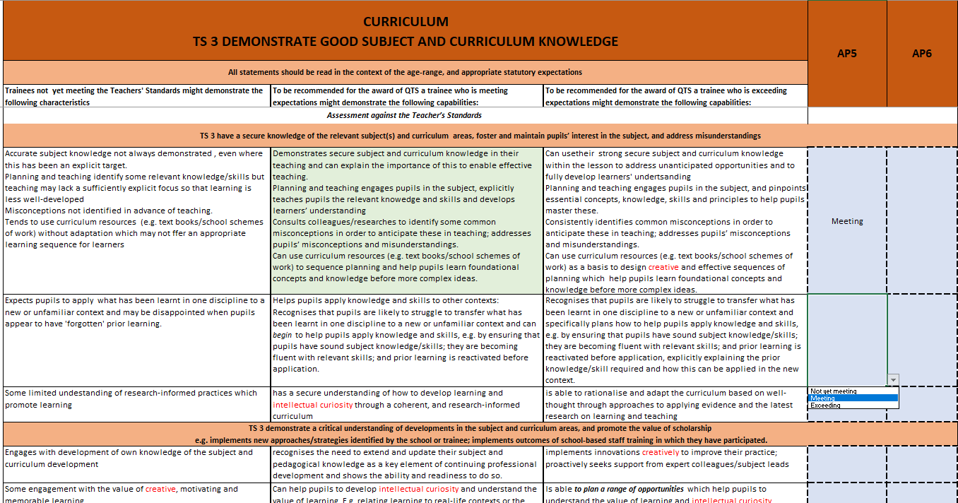
Summative Assessment against the Teachers’ Standards – at the end of the course
Notes:
DR

Slide 10
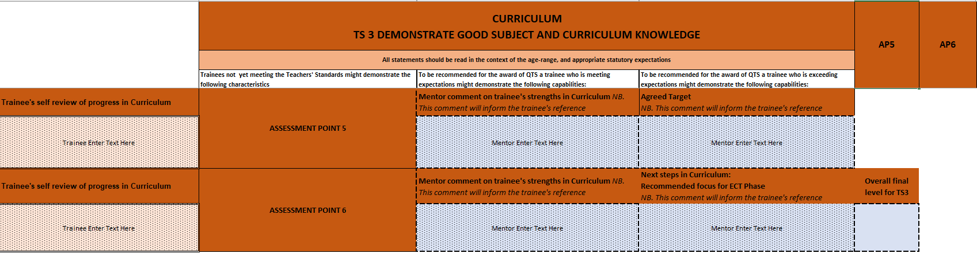
Summative Assessment against the Teachers’ Standards – at the end of the course
Notes:
DR

Slide 11
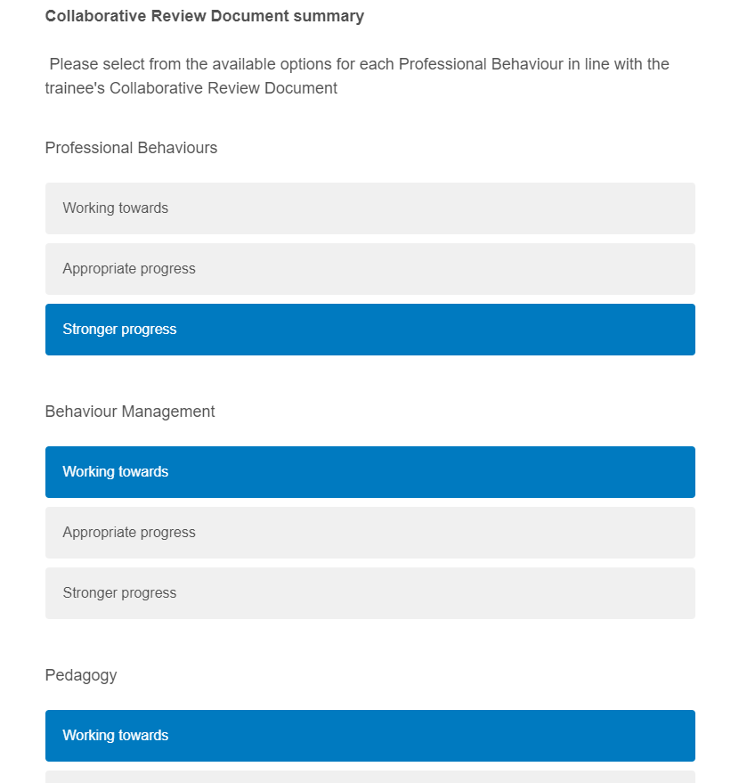
Qualtrics: Half-termly progress
Sign off form for data integrity
Webform
Trainee details +
Summary of attainment
Against 5 areas of the CCF
Notes:
DR

Slide 12
How does this document support you?
Trainee Perspective:
Ensures trainees receive their minimum training entitlement as outlined in the Core Content Framework and provides consistency in expectations between schools
Provides a regular opportunity to review progress and will help trainees to understand areas of strength and areas for development
Promotes regular professional dialogue with an expert colleague
Will inform targets, next steps and focus for observations and feedback
Trainee voice is key – collaborative not ‘done to’
Mentor Perspective:
Will help to familiarise mentors with the minimum training expectations for trainee teachers as outlined in the Core Content Framework
Mentors will be able to see their trainee’s progress throughout the year in one online document
Profile data is incorporated into the CRD and is an opportunity for both mentors and trainees to have their say– no separate lengthy profile
Aligns with the coaching model – promotes a reciprocal working relationship
Useful reference point when considering trainee targets and next steps and can help the expert colleague in identifying what support needs to be put in place to help the trainee to be successful.
Clear progression from CCF > Teacher Standards – ensuring trainees are well equipped for their ECT year
Notes:
JT

Slide 13
Next steps
Notes:
JT

Slide 14
Trainees will be allocated a SharePoint folder
They will need to share access permission with their mentor and moderation tutor
Mentors and trainees to spend time familiarising themselves with the document and to begin review progress regularly (may choose to focus on a particular area of the CCF in weekly meeting, according to the needs of the trainee)
Mentors and trainees to meet to discuss progress leading up to the deadline for the relevant assessment point– trainee and mentor to add comments and agree ‘assessment of progress’
The trainee will add a comment about their progress at the assessment points
Once agreed collaboratively, mentor to complete Qualtrics form (online link) to verify progress ‘assessment judgments’ to ensure data security.
Data will be automatically captured from all CRDs after the deadline and reviewed by university tutors at half termly review meetings. Additional support and additional intervention will be planned where necessary.
Comments will inform trainees’ references.

