Slide 1
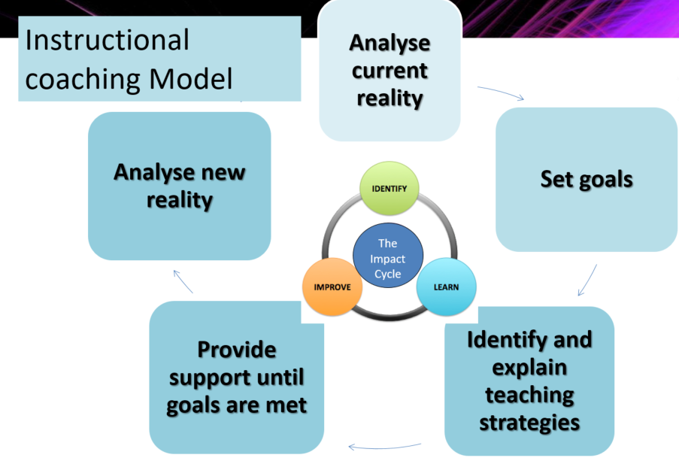
Instructional Coaching
Keeping it R.E.A.L

Slide 2

Reality
Current reality
New reality
There is a need to gain an understanding of a shared clear picture of reality. This identifies the top priority for change and a clear picture for growth.

Slide 3
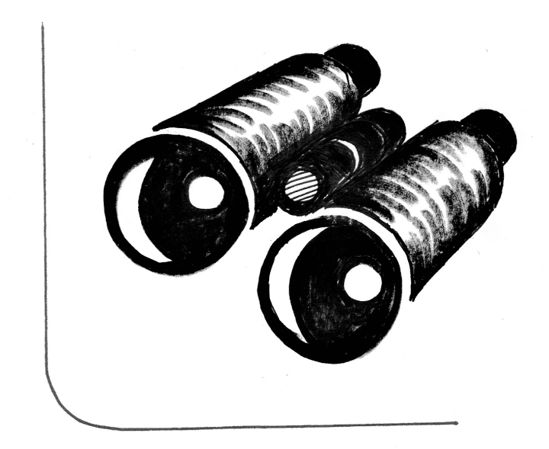
Eyes
You offer an additional and valuable set of eyes on what is happening in a trainee’s classroom.
Observing what learners are doing in the trainee classroom provides valuable feedback about a trainee’s current and new reality
Feedback should be about what is going on in a trainee’s classroom, not what you think should be going on in a trainee’s classroom…

Slide 4

Ask
Asking powerful questions rather than giving advice
Questions hold the power to
Cause us to think
Create answers we believe in
Motivate us to act on our beliefs

Slide 5

Listen
Authentic listening builds trust and allows you to understand how a trainee views what impact they are having and how they are developing
Listening for clarity not a response
Keeping ourselves out of the answer
Learning rather than judging
Hobson and Malderez (2013) http://shura.shu.ac.uk/7224/1/Hobson_and_Malderez

