Slide 1


Recruitment and retention
Georgina Newton
Principal Teaching Fellow, University of Warwick
Notes:
Good morning, thank you for that introduction yes, I have the privilege of sharing with you some findings from my work in teacher education and from my recent masters level study into why teachers quit and what we can do to keep them.
I will be covering
- what recent studies tell us about teacher retention
- who the teachers are who are at most risk of leaving in the next 2 years
Some actions which could be taken to address retention issues
Fortunately over the last 4 months I have had the opportunity to share these findings with a number of audiences, through the Research associations and also in Parliament, at the APPG for the teaching profession, at Teach Meets and in my work as a teacher educator in the Warwick and Schools Partnership.
You will notice that I affiliate strongly with the teaching profession. I was a secondary teacher for 21 years and had a very enjoyable and productive 8 years as governor and then chair of governors in a junior school. I don’t present these thoughts to you as a list of jobs for you to do, but rather considerations for us all within the teaching profession to be aware of and to work on.
So, why should we address issues to do with retention?

Slide 2









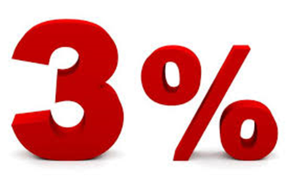

PPI
Notes:
Recap and any questions

Slide 3
Why address retention issues?
Between 2011 and 2014 the number of teachers leaving the profession increased by 11%, and the proportion of those who chose to leave the profession ahead of retirement increased from 64% to 75%
NAO November 2016
Notes:
Addressing teacher retention issues is important – if retention were better the need for recruitment would not be so extreme each year.
The DfE is concerned with attracting new entrants into the profession, and whilst there is much debate on the way in which the Teacher Supply Number is reached, usually the sector comes close to recruiting the number of teachers into one of the (alleged) 27 training routes. Though it has fallen short in real terms for the last 4 years (mainly in some hard to recruit secondary subjects).
However, with the reduction in primary bursary, we are likely to see challenges in primary recruitment also.
We know that pressures this year are seeing this year’s applicants fall behind those of previous years and those required to fill all the vacancies this year. In particular there is a noted drop in the number of 22 year olds applying for courses, which may be a result of
the tuition fee bill faced by those who already have a hefty amount of student debt
More lucrative options outside of teaching (though with our exit from the EU on the horizon this may be stalled in the near future)
Fewer young people wanting to enter teaching because they aren’t attracted to it….
There is an inherent risk to running a system which has disillusionment, poor morale, pay stagnation and heavy workload as some of its main frustrations – children see their teachers under strain every day and, either tacitly or explicity decide that the teaching profession is not for them….
And in some areas these challenges are worse than others.

Slide 4
Why address retention issues?
54% of leaders in schools with large proportions of disadvantaged pupils said attracting and keeping good teachers was a major problem compared with 33% of leaders in other schools.
NAO November 2016
Notes:
It’s helpful to look at the most recent figures from the school workforce census –

Slide 5
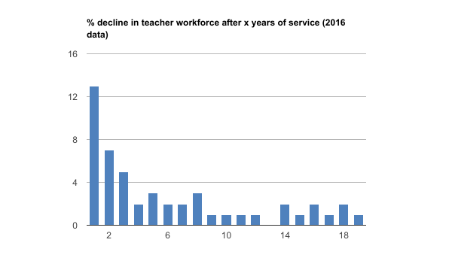
What actions can be taken to address retention issues?
Notes:
showing a 13% dropout rate for NQTs and almost 40% dropout rate in years 1-5 being reported by some.
Compare with France and Germany where this figure is only 5%
- Room for further study
So let’s take a look at what has been learnt from recent studies – in this I am going to refer to my recent research of over 230 teachers, these results coming from the 70 primary colleagues who responded to my survey and interviews

Slide 6
What recent studies tell us about teacher retention
Overall around 50% of teachers intend to remain, 25% have already left and 25% intend to leave in the next two years
In primary 20% intend to quit in the next two years. The vast majority of these are women
Notes:
More about these individuals – firstly, how long have they been in teaching?

Slide 7
Notes:
What age groups do they fit into?

Slide 8
Notes:
… Why do they want to leave?
What will be the top 3 reasons?

Slide 9
Notes:
And what could be done to keep you?

Slide 10
Notes:
You can see there are many responses here- to break them down a bit here are the most important ones

Slide 11
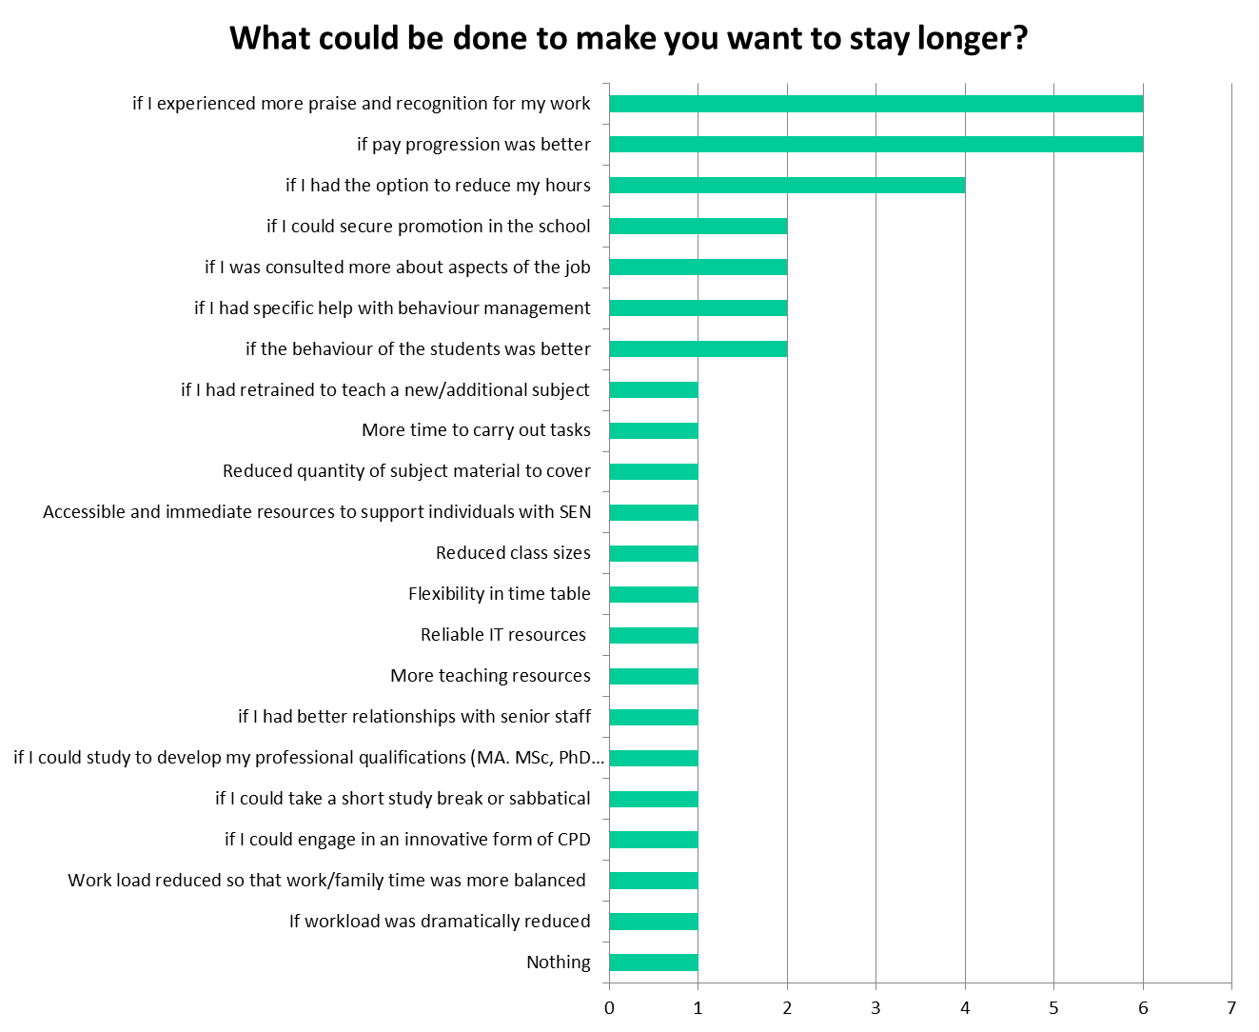
Notes:
In common with all teachers across primary and secondary, praise and recognition was the most sought-after factor
Increasingly, pay is becoming an important issue (particularly feeding into shortages in London and the South East)
Flexible working is a common theme, as are pupil behaviour and teacher consultation or sense of agency.
And as a whole those things they would like to see changed are here:

Slide 12
Better work/life balance
Flexibility in timetable
Better resources
Reduced quantity of subject material to cover
Reduced class sizes
more opportunities for (pay) progression
If workload was dramatically reduced
Nothing
if I could study to develop my professional qualifications (MA. MSc, PhD etc)
Accessible and immediate resources to support individuals with SEN
reduced hours
more praise and recognition
if I could take a short study break or sabbatical
if I had better relationships with senior staff
if I had retrained to teach a new/additional subject
better behaviour
if I could engage in an innovative form of CPD
More time to carry out tasks
more agency
Notes:
And if these actions were taken, how much longer do teachers think they would stay?

Slide 13
29 % would stay 1 or 2 more years
71 % would stay 5 years or more lower staff turnover = better pupil outcomes higher teacher effectiveness after 5 to 8 years of service
Notes:
29 % would stay 1 or 2 more years
71 % would stay 5 years or more
This in turn would impact upon school effectiveness as studies have highlighted both:
The relationship between staff turnover and lower pupil performance
The effectiveness of teachers is maximised after 5 to 8 years in the profession
Of course, the other side of the coin is the recruitement and retention of quality NQTs so let me talk you through a scenario

Slide 14



Recruiting quality teachers
HOW?
Notes:
Picture the scene: West Ham needs a new striker (hard to imagine, I know…) because they want to do better than their 11th place performance last season
So that’s OK, they have an academy scheme and young players are being trained there all the time
-so they go to the academy and watch some players and choose one or maybe even two
-(maybe they give him a trial on the training ground with the full team)
Is this the striker they need to secure the position they want to be in at the end of the season?
What might he need?
When will he be at his most effective?
Might need to do trials in a variety of situations
Might be great at set pieces but need lots of game-play practice
Might need a phased introduction
Psychological or medical support (always on hand)
And there are a few other ways you could recruit quality into your squad as well.
I’m sure you have tried most of these, but it’s worth having another look at how to recruit returners to the profession

Slide 15
Consider returners to teaching
  31% of entrants to teaching are returning after a gap in service (53% are NQTs and 15% are from other sectors e.g. working abroad)
  84% of those who have left teaching say they felt positive or very positive about their careers on entry
Notes:
Returners to teaching can be a very valuable asset –
31% of entrants to schools are returners, often returning after a career break.
The DfE website on returning to teaching has case studies of how returning to teaching has been very successful for the schools and the individuals (DfE pilot) and this pilot is continuing in the NW and SE of England this year so there will soon be further findings and expansion of this initiative.
Schools encouraged (financially) to recruit a returner
Schools encouraged (even more, financially) to recruit that returner to a part time post
Returners require support and guidance to help them to settle – why not invest in them as if they were an NQT, considering their training needs, outside commitments, areas of capacity and aspirations?
Here we can learn a little about what Male calls “pedagogical leadership”

Slide 16
Understand the needs of the individual
  An understanding of pedagogical leadership is concerned with the links between desired educational outcomes and the set of social realities that surround the educational setting (Male, 2015)
  This method of leadership recognises that career decisions can’t be separated from the personal biography of the individual and links “core identity with positive professional identity” (Lindquist and Nordanger, 2015, Day 2011)
Notes:
Pedagogical leadership
This method of leadership recognises that career decisions can’t be separated from the personal biography of the individual and links “core identity with positive professional identity”
Understands the context of the team members, their background, aspirations and limitations. Leads according to this understanding

Slide 17
PPI

Slide 18
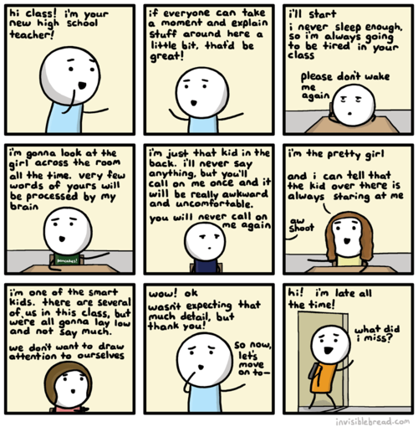
You
Home
Family
Relationships
Experience
Personality
Health and well-being
Hopes, dreams, successes, failures

Slide 19

Your school
Department context
Relationship with closer team
Relationship with wider team
School performance and Ofsted rating
Intake
Other local factors e.g. Queen’s visit, fire, mergers, local/pupil issues
Change of curriculum affecting your subject/your students

Slide 20

Educational policy
Budget changes/implementation of national funding formula
Union action
National policy changes
  Your subject becomes a core subject
  Your subject stops being a core subject
  Your subject is dropped from the curriculum
Change of Government/Secretary of State

Slide 21




Slide 22
PPI

Slide 23
PPI

Slide 24
PPI

Slide 25
PPI

Slide 26
PPI

Slide 27
PPI

Slide 28
Insure your PPI
Know yourself and recognise when under pressure
Identify source of pressure
Consider ways of reducing the pressure
Ask for help if you need it
Respect your work/life balance and that of others
Don’t let the little things get to you
“Good enough is good enough!” (Dr. Alison Morgan, 2016)

Slide 29
Teacher years | 1-3 | 4-8 | 9-15 | 15-22 | 23-30+
 | Developing a sense of efficacy | Identity and efficacy in the classroom | The crossroads… | Sustained commitment | Sustaining motivation
 | 85% very committed 15% teaching “grows on you” (Menzies, 2015) Making mistakes… Reflecting… Developing resources… “teaching will shape you” (Clandinin, 2015) | Highly effective ☺ Good PPI ☺ Additional responsibility leads to greater sense of effectiveness Workload immense – learning to deal with it “being good at it” causes commitment (Menzies, 2015) | Work/life tensions The most common phase at which teachers quit (12 years) If they continue, it’s with increased commitment, responsibility and impact on others | Challenging work/life balance See teacher171 blog for help! | Additional leadership responsibilities (85%) Another initiative! 31+ Ability to cope Looking to retire (Day & Gu, 2014)
Notes:
Recognise the seasons
Menzies identifies “practitioners, rationalists, idealists and moderates” – people flex between different types – see Why Teach? For more information
Resilient Teachers, Resilient Schools, Day and Gu 2014

Slide 30
PPI
Notes:
Key messages for school leaders out of all of this are:
Responsive schools are redeploying some staff - recycle

Slide 31

Notes:
Consider recycling

Slide 32

  A full time teacher who is wanting to
  quit (a recent study showed that half of those facing quitting in the next 2 years are women, aged 30-39) into a part time teacher
Notes:
Full timer who needs work/life balance flexibilities due to increased caring responsibilities
Consider recycling
A full time teacher who is wanting to quit (a recent study showed that half of those facing quitting in the next 2 years are women, aged 30-39) into a part time teacher
The same study found that the factor those who wanted to quit wanted to change (apart from workload and disillusionment, was flexible working)
And 87% of these also said that, if this was available they could envisage staying in teaching for a further 2 years or more. 33% said over 7 years!
Or
Tired teachers,

Slide 33

  “tired teachers”
Notes:
Tired teachers, identified by Laura McInerny (Schools Week in 2016)
having held a number of consecutive temporary contracts
maybe mid 40s/early 50s and therefore relatively expensive to employ
not invested in by any of the schools
little access to CPD given by schools
maybe a range of specialisms gained over the years
never quite able to gain that permanent job offer
highly committed to the profession
range of experiences to bring to your school
Consider also retraining to retain… try to find the unrealised potential

Slide 34
Consider retraining to retain
  What % of teachers said they had been trained for a new role they had been asked to undertake in school?
Notes:
What % of teachers said they had been trained for a new role they had been asked to undertake in school?

Slide 35

  said they had been trained for a new role they had been asked to undertake in school
Notes:
What % of teachers said they had been trained for a new role they had been asked to undertake in school?
And, returning to what the majority of survey respondents said they would most like in their school lives – praise and recognition

Slide 36

Consider rewarding the teachers you want to retain

Slide 37
  teachers said that the thing that would most encourage them to stay is receiving praise and recognition
  Authentic, genuine recognition (not necessarily pay or chocolate!)
Notes:
As we saw earlier, teachers who had quit and those who were considering it in the next two years said that the thing that would most encourage them to stay is receiving praise and recognition
Authentic, genuine recognition (not necessarily pay or chocolate!)

Slide 38
NQT and Beyond – Top 10 Tips from an RQT
Learn to say NO – prioritise your own workload
Work-life balance is important (Have Saturday or Sunday off, 9pm cut off)
Re-use resources - this is not cheating!
Don't be afraid to ask for help (you have a mentor for a reason)
Eat well and get enough sleep – visit the staff room
Make use of professional development time (10% - Visit departments/observe)
Follow the 30 minute rule when planning
‘Routine Routine Routine’ – Ofsted preparation
Always have PLAN B – mistakes/misconceptions can always be rectified
Challenge yourself – have a long term plan (Pastoral,HOD,SEN)

Slide 39
Caspersen , J. and Raaen, F. 2013 Novice Teachers and how they cope
Teachers and Teaching pp189-212
Day C. and Gu, Q. 2007 Teachers’ Professional Learning and Development
Oxford review of Education Vol 33, No 4, pp 423-443
Lindqvist, P. and Nordänger, U, 2015 Already elsewhere –
A study of (skilled) teachers’ choice to leave teaching.
Teaching and Teacher Education pp 88-97
Male, T. and Palaiologou, I. 2013 Pedagogical Leadership in the 21st Century
Educational Management Administration and Leadership
Vol 43, Issue 2, pp. 214 - 231
Notes:
Any questions?

Slide 40
PPI
Notes:
Recap and any questions

