Slide 1
MA Professional Education
Jan – May Year 1 FRM (Foundation Research Methods )@ 30 credits – online introduction to research methods. Assignment: Practice Research Proposal with reflection
June Year 1 – Aug Year 2 Dissertation @ 60 credits - Independent Study with tutorial support and Saturday sessions

Slide 2
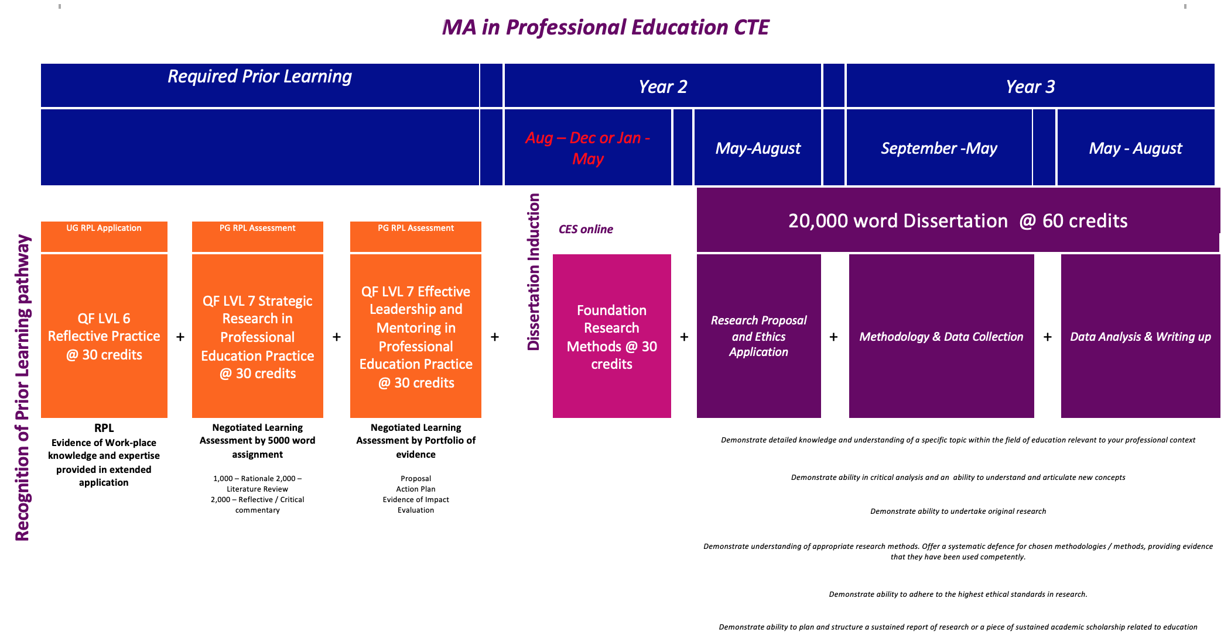
Future Plans

Slide 3
Teaching is not difficult. As long as you have a supportive leaders who ensure consistent behavior and learning expectations are met, its easy to master.
It takes its toll when you realise that most decisions made in education are made by people who only superficially know what it going on. The longer I teach the less I’m sure that any one really knows or believes in what they are doing.
I love the actual teaching part but hate all the rest. Its best to just close the classroom door and leave the politics on the outside
Don’t smile before Christmas!
The bottom line is that children and young people need their teachers to know them and communicate that they like being with them. Everything else grows from that.
You can’t be a perfectionist as a teacher and survive long term. Resilient teachers know that it is OK to just be OK most of the time.
Sometimes I have to implement change that I’m not sure I fundamentally agree with.
To survive long term as a teacher it helps to have a healthy skepticism about new initiatives
I love that teaching is different everyday, you never know what you are going to expect. If you reach the point where you are no longer excited by that then it is time to go.
My guilty secret is that I love planning. My files are always exemplary. My favourite time of year is in September just before the students return when I’m ready and good to go
Its surprising how much teaching forms you as a person. I quit teaching 5 years ago but I still get accused of putting on my ’teacher face’.

Slide 4
I went into teaching because I loved my subject, and then I spent years teaching in a school where my subject and my expertise were not valued. Now I teach in a school where I get to teach students who want learn what I have to teach them and my subject is valued by senior teachers. I am much happier.
I am so fortunate to have found work in a great school when I qualified. I have been here a long time and I love being Head of Department. It is difficult to imagine working anywhere else, particularly as I’ve been here so long and to be honest, the children here are so lovely, – I’m not sure I would survive anywhere else!
I just couldn’t do it anymore. I had no work / life balance. Financially it is difficult but, to be honest, I can’t imagine going back to teaching, which makes me sad because I did so love it at the start.
My school is part of a huge trust and I’ve been asked to be a lead teacher in my subject across our group of schools. I was really chuffed but I’m also very unsure. I have to oversee planning of a new knowledge-based curriculum for the subject across the schools and I feel uncertain about the what knowledge looks like in my subject and uncomfortable with imposing my ideas on colleagues in other contexts that I don’t know so well.
We’ve spent a long time setting up the department, writing units of work and organizing resources for each year group, so that we can reuse these each year and not have to re-invent the wheel all the time. Next year the school will have all years for the first time and then I think we’ll be able to relax a bit.
At the moment, although I’m exhausted a lot of the time, I plan to stay in this school for a couple more years at least as there are still things to implement here.
The school I teach in is really challenging and is in a constant state of change. For quite a long while I loved it, there was a real sense of staff pulling together to try to turn the school round. But then the management changed and the initiatives we’d worked hard to put in place were rejected and it was really demoralizing. Lots of colleagues left. I’m almost at retirement age. I’m just biding my time now.

Slide 5
I have found that teaching continually challenges who you are at a fundamental level, you have to be willing to engage in constant self-reflection and growth in order to stay effective as a teacher. Its easy to think its all about the students but its actually far more about you at the end of the day.

Slide 6
Becoming ‘Masterly’

Slide 7
Choose the three most masterly statements from those provided.
Choose the three least masterly statements from those provided.

Slide 9
What is the role of research in becoming masterly?
What is the role of MA study in developing masterly practice and research in schools?

Slide 10
The Guild System:
Apprentice - attached’ to a ‘master’, in one place, often for several years (study, training)
Journeyman – given ‘letters’ by your master that enable you to travel and practice under tuition of Masters with different guilds in different places. (research, reflection, new perspectives, adaptability and critique)
Master – by approval of your peers, a financial donation to a Guild and the production of a ‘masterpiece’. (study, long term commitment, assessment and recognition)

Slide 11
Study
Verb: devote time and attention to gaining knowledge of (an academic subject), especially by means of books.
Critique
NOUN
a detailed analysis and assessment of something, especially a literary, philosophical, or political theory.
Research
NOUN
the systematic investigation into and study of materials and sources in order to establish facts and reach new conclusions.
VERB
investigate systematically.
Reflection
Synonyms: consideration, thought, contemplation, deliberation, musing
Antonym: impulse
Perspective
Noun: a particular attitude towards or way of regarding something; a point of view.
Academic
Synonyms: theoretical, abstract, hypothetical, speculative, abstract
Antonym: practical

Slide 12
Grade | Comprehension | Analysis | Critique | Presentation
A*/A (Mark of 80 or above = A*; 70 -79 = A) | A wide range of relevant sources, which are well understood, are skilfully and concisely deployed to support arguments. Demonstrates a highly developed understanding of relevant concepts, theories and/or research methodologies. | Recognises the demands of the question providing a well-focused, relevant answer. Sets sources and viewpoints in a wide context and makes a comprehensive assessment of issues involved. High levels of ability to analyse, identify relevant issues, synthesise and apply knowledge and concepts. Relevant theories/theoretical models are applied to deepen understanding of the links between theory and practice. | Skilful evaluation which synthesises both the literature and personal perspectives in response to the question. Demonstrates a balanced critical understanding of the issues. Displays critical awareness of methodological and theoretical considerations. Some originality of thought and creativity. | Material is very well-organised and the structure complements the content. A high level of written communication with very few errors of spelling, grammar and syntax. Points are comprehensively and appropriately substantiated. Mastery of referencing conventions.
E (Mark below 40) | Few relevant sources used. Serious gaps and/or errors in knowledge and understanding. | The question may have been ignored or badly misunderstood, and there is much irrelevance. Superficial treatment of the topic much of which is descriptive. Lacks appropriate critical or theoretical framework. | The commentary may not be seen as sensible in relation to the question. | Unstructured presentation, lacking coherence. Expression of ideas is poor and may also be impaired by frequent errors of spelling, grammar and/or syntax. Much of the writing is unsubstantiated. The recommended referencing system has not been mastered.

Slide 13
Donald Schon
The Reflective Practitioner
Educating the Reflective Practitioner
Land, Meyer and Flanagan
(2016) Threshold Concepts in Practice
Schulman (2005) Signature Pedagogies in the Professions
Biesta (2014) The Beuatiful Risk of Education
Etienne Wenger
(1998) Communities of Practice: Learning, Meaning & Identity

Slide 14
MA research impacts:
You personally
Your community
Your profession

Slide 15
(MA) research is more likely to change you and your perspective than it is to change the context around you
He lay down behind the blade of grass
To enlarge the sky.
Bureau – cited by Bachelard Poetics of Space

Slide 16
The Impact of a School-based Mindfulness Programme on KS2 Pupil Wellbeing
A critical evaluation of the ways in which the recent GCSE and A Level reforms in England are impacting on the role and identity of middle leaders.
A study in resilience and access to education for looked after children.
What strategies are effective in promoting mathematical reasoning skills for EAL pupils?
An investigation into whether “most able” GCSE students feel pressure and stress by the expectation of their high target grades in Geography.
An investigation into whether involvement in a Forest School intervention impacts upon resilience in primary school aged children who are entitled to the Pupil Premium Grant.

Slide 17
Doing a Masters doesn’t make you a Master

