Slide 1
Secondary Mentoring Matters.
Examining the current provision and next steps for mentoring in the Warwick Partnership.
Notes:
I would like to talk to you where I am at in serving you as mentors and then ask where you are at and feedback on what is working, what needs refining and what needs doing next.
2 dilemmas I have been grappling with this year. – ensure all mentors are informed of the structural process of the Warwick Programme and their role in that.
How to ensure that the role of the mentor in ITT is really understood.
I am undertaking an MA in coaching and mentoring with that as my focus and have learned a great deal about adult learning theory and how it aligns with ITT.

Slide 2
The current landscape
Key role of the mentor
Carter Review – 2015
National Mentoring standards:
    Personal qualities – establish trusting relationships
    Teaching – to meet the needs of all pupils
    Professionalism – to understand the roles and responsibilities as a teacher
    Self-development – CPD

Slide 3
Learning Outcomes
Notes:
The Carter review led the way in stressing the need for a relentless focus o pupil outcomes. At the same time however recognising that ITT is initial/ first stage….

Slide 4


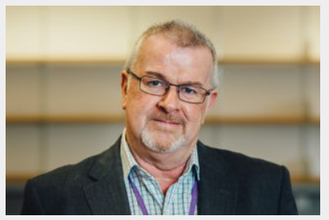


Face to face placement briefings
Online podcasts
Compliance
Learning Outcomes
PSS team
Partner’s intranet

Slide 5




Communication
Compliance
Learning Outcomes
Teaching Fellow
Moderation tutor

Slide 6
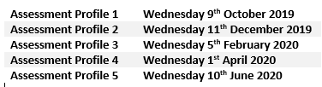
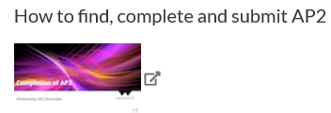

98%
Not Met and Met
Communication
Compliance
Assessments
Learning Outcomes

Slide 7
Communication
Compliance
Assessments
Learning Outcomes

Slide 8

Next Steps
Communication
Compliance
Assessments
Learning Outcomes
E-Learning

Slide 9
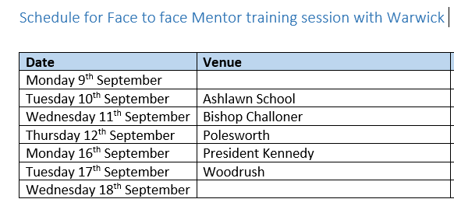
Next Steps
The standard
Professional development:
Should have a focus on improving and evaluating pupil outcomes.
Should be underpinned by robust evidence and expertise.
Should include collaboration and expert challenge.
programmes should be sustained over time.
And all this is underpinned by, and requires that:
must be prioritised by school leadership.
Communication
Compliance
Assessments
Learning Outcomes
E-Learning
Mentoring/
Instructional coaching model
Notes:
Example: When a trainee has more than one mentor we need to ensure parity roles – an example – a trainee in their first placement had personal issues and was mothered and allowed to step out of lessons and use the dept office as a personal space. At the second placement, when the same thing happened the expectations were the same and the mentor rightly showed empathy with the expectation that the trainee would fulfill their professional duties. At this point the trainee fell apart and had to take time out for well-being issues.

Slide 10
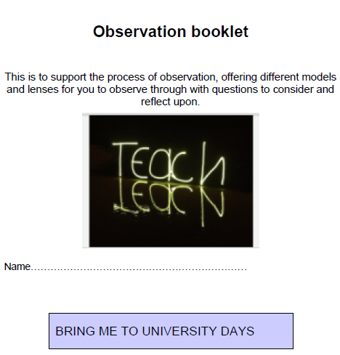

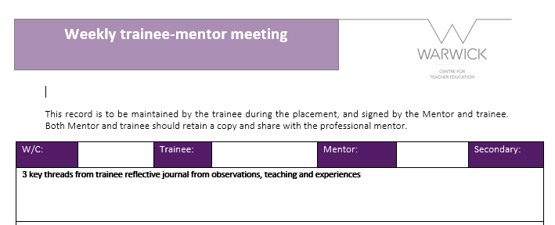
Next Steps
Moderation visit
Communication
Compliance
Assessments
Learning Outcomes
Reflective
Practitioners
E-Learning
Mentoring/
Instructional coaching model

Slide 11

