Slide 1
Primary Update
Distinctiveness in Initial Teacher Education
Professor Des Hewitt
“Every teacher needs to improve, not because they are not good enough, but because they can be even better.”
Dylan Wiliam

Slide 2
Overview
Looking back: 2017-18
Looking forward:
  What makes Warwick distinctive?
  Being distinctive in education: who and how?
  Barriers and opportunities
  What does distinctive look like?

Slide 3





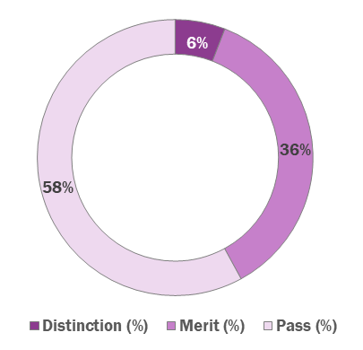

2017/18 data review
95%
95%
of our trainees were awarded a final teaching grade of
Outstanding
or
Good
retention of trainees across all phases¹
95%
86%
of our trainees found employment in teaching²…
of our trainees rated their overall provision Outstanding or Good
…of which
Over
72%
600
Masters outcomes
are in local³ schools
schools providing placements
to over
200
trainees…
…that’s over
2000
placements!
1 exc. trainees on temporary withdrawal or currently at Chair’s Action
2 of those who responded that they wished to pursue a career in teaching
3 local defined as CV, B and LE postcodes

Slide 4
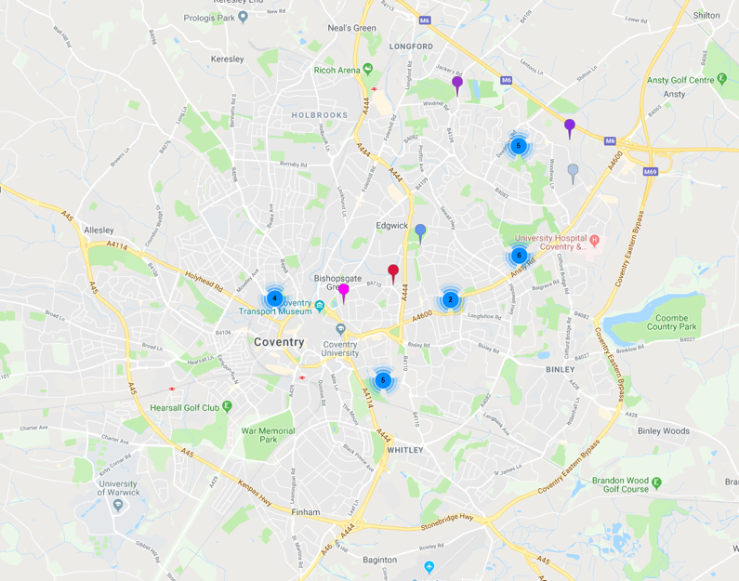
Coventry employment
28
trainees employed within Coventry in 17/18 alone!

Slide 5
Primary Partnership 18-19
Increased emphasis on professionalism – use of ethical dilemmas to support trainees to develop skills to respond to these at key points during the year (further developments in 19-20)
Launch of new specialisms – PE and Creative Arts – both well received
Consistently positive feedback from students re: mentoring and link tutoring (data from Sam?) A number of returning students have been expertly supported by university staff, moderation tutors and alliance leads to enable them to successfully complete the programme and gain their QTS
Increased focus on managing workload – student/mentor participation in focus groups as part of Deborah’s research will inform future changes to the programme
Initial work undertaken on Early Career Framework to begin preparation for official launch in 20/21 – mentor development sessions focused on good mentoring skills relevant for both ITE students and NQTs
Staff research on character and social justice beginning to inform programme content – both are key aspects of new Ofsted framework

Slide 6
Primary Partnership 19-20
Changes to programme – increased emphasis on wider curriculum and planning sequences of learning
Further developments to be made to programmes to develop character and phronesis (professional wisdom) to encourage critical reflection and giving trainees the autonomy and skills needed to make their own informed professional judgements
A number of SD alliances expanded to include primary provision plus new alliances joining the partnership
Greater emphasis on cross-phase working to ensure greater parity between primary and secondary provision – revisions to paperwork; procedures etc.
Significant changes to mentoring (linked to preparation for ECF) placement briefing to move online in mentor portal and mentor development to be led geographically – primary/secondary/core and SD based on instructional coaching model and driven by ITT mentoring standards) all to attend to encourage good practice across the partnership
Partnership visits to collaboratively work with SD alliances re: Warwick KPIs and to provide support as needed, particularly for new partners

Slide 7
Course changes 2020-21
Same module and credit structure
  Professional Studies
  Subject Studies
  Professional Practice
Early Years 2-7 age phase
Primary 5-11 age phase
No specialism but focus on SEND/ inclusion for all students

Slide 8
MA Professional Education
32 submissions for dissertation.
range of dissertation themes ranging across student and teacher well-being, academisation, building pupil self-efficacy through engagement in sport, Oracy, GCSE reform, supporting students with English as a second language to name just a few of them.
this year’s cohort are completing their research training in preparation for beginning their dissertations in the Autumn.

Slide 9
Being distinctive in Teacher Education

Slide 10
University
School
Mentor
Student
Child
Course content
Experiences
Values
Expectations
How are we distinctive?

Slide 11
Barriers and opportunities
Govt. requirements: NC and OFSTED inspection framework
Capacity for change: management and staff
Student / Applicant expectations
School expectations as partners and employers
University requirements

Slide 12
What does distinctive look like?
Uni
Learning experiences
Assessment strategies
School
Placements
Partnership activities
Beyond
International opportunities
A lifelong Warwick education

Slide 14
Framework of core ITT content (DfE 2016), currently under review
TS1
Most able / SEND: expectations know and support all learners
TS3
Draw upon scholarship
TS5
Mental health & well-being; working memory; over learning; language & communication; emotional development – significant emphasise on SEND / barriers to learning
TS4
Empirical research qualitative and quantitative methods
Research informed practice; and other relevant aspects of research, know where to find evidence supported resources, benefits or otherwise of different kinds of research
Gain an appropriate understanding of curriculum design and development

Slide 15
TS6
Standardized tests
The requirements for continuous assessment, national expectations, mapping will be required
Adolescent as well as child development
TS7
Behaviour for learning, not just behaviour management, variety of contexts: this does not reflect the behavour paper
Part 2
Evidencing part 2 of the standards, including the meeting of legal obligations, safeguarding issues, responding to ethical issues

Slide 16
University of Warwick distinctiveness: education strategy
Excellence
Disciplinary excellence
Inter-disciplinarity
Internationalization
Undergraduate (student) research

Slide 17
Radical thinking
Existing
Teacher Standards
Pre-amble
TS1,2,3,4,5,6,7 and 8
Part 2
Potentially
Additional Warwick Standards
Part 3 (some possibilities)
Creativity
Leadership
International
Digital literacy
Evidence of impact on social mobility

Slide 18


Warwick Teacher Characteristics
Centre for
Teacher Education
Social justice, creativity, inclusion and the international dimension

Slide 19

Rationale
In the last three years we have been challenged to articulate and evidence the distinctiveness of Warwick trainee teachers.
Whilst we are incredibly proud of the achievements of trainee teachers, and our partner school, we felt that we should challenge the current status quo to go beyond compliance with national and local statute to fully embrace the values and practices which we characterize the Warwick Teacher.
We aspire to excellence in our provision. Compliance in national and local statute are essential, but this can also be achieved with a clear commitment to knowing who we are, what we value and how we work.
We want to go beyond compliance.

Slide 20
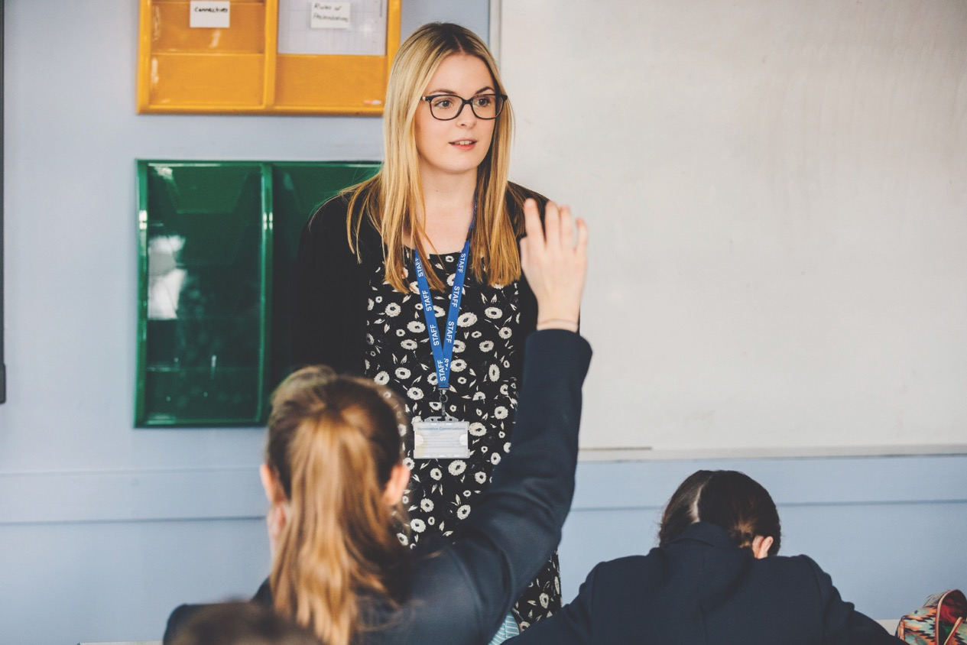
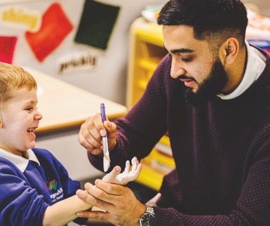
What is distinctive about a Warwick teacher?
Social justice
Changing children’s lives
Inspiring others
Creativity
Experience fulfilment
Fun and creativity
Inclusion
Make a difference to all children of different abilities and backgrounds
The international dimension
Working in a diverse and rich community
Opportunity to travel

Slide 21
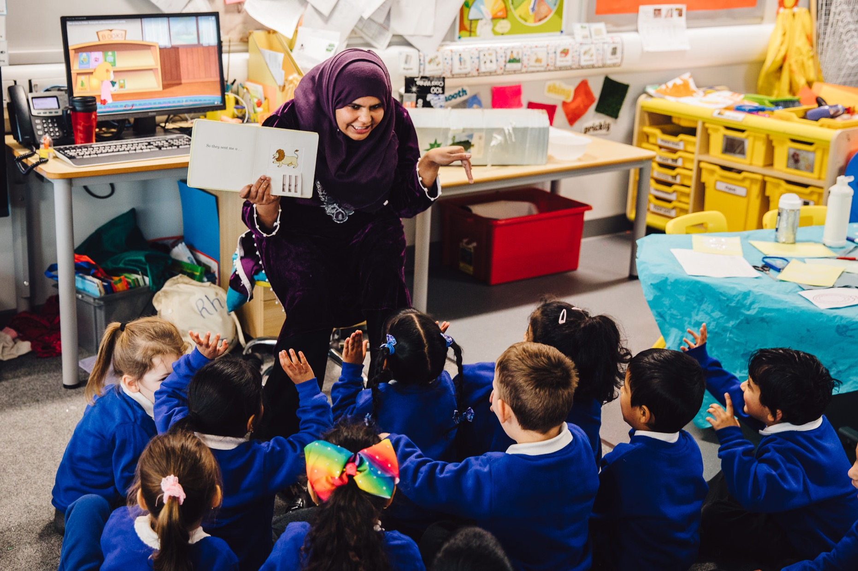
How do we develop the Warwick Teacher?

Slide 22
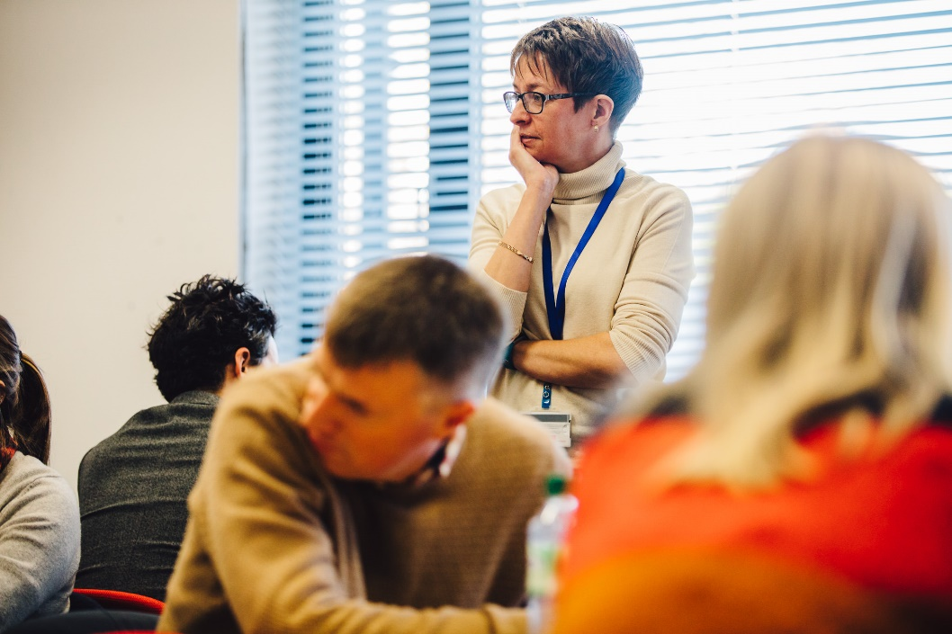
Embedding the Warwick Teacher Characteristics
PGCE Curriculum
Course and module aims and Los
Taught Programme
Assignments
Placement assessment criteria
Warwick Assessment Descriptors (Part 3: Warwick Teacher Characteristics
Partnership
Placement expectations and documentation
Mentor training and coaching development
Research and scholarship
Staff and School Research Groups

Slide 23
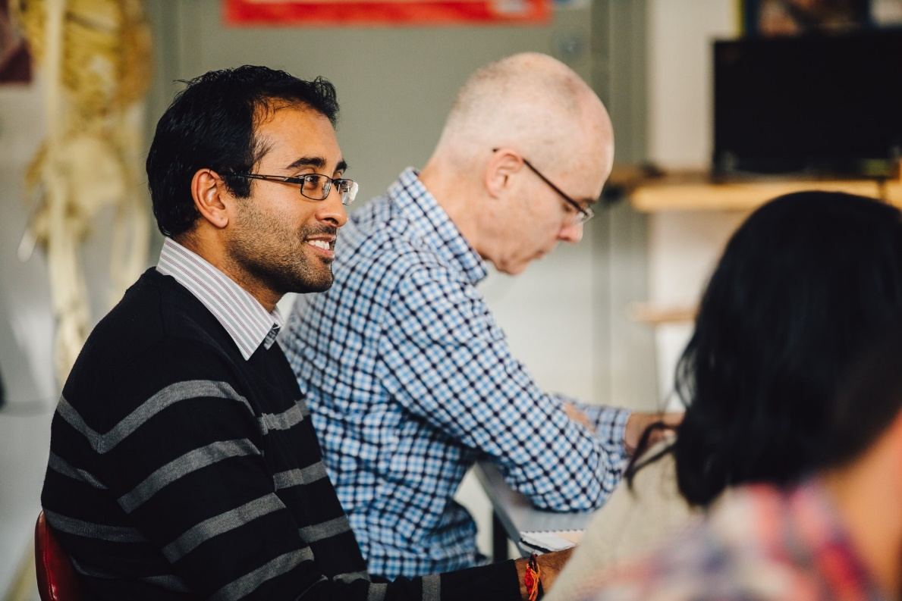
Impact
Trainees and staff will focus on the embedding of the Warwick Teacher Characteristics in all elements of the Warwick Teacher Education curriculum in University and school: including curriculum design, teaching and assessment of student outcomes.
They will also form an important starting point for staff and student scholarship, School Research networks and course evaluation.

Slide 24
Discussion
How can we all be supported and energized through being distinctive?
How could we be more distinctive?
How can we attract the best possible students by being distinctive?
Any further thoughts to…
D.m.hewitt@warwick.ac.uk

