Slide 1


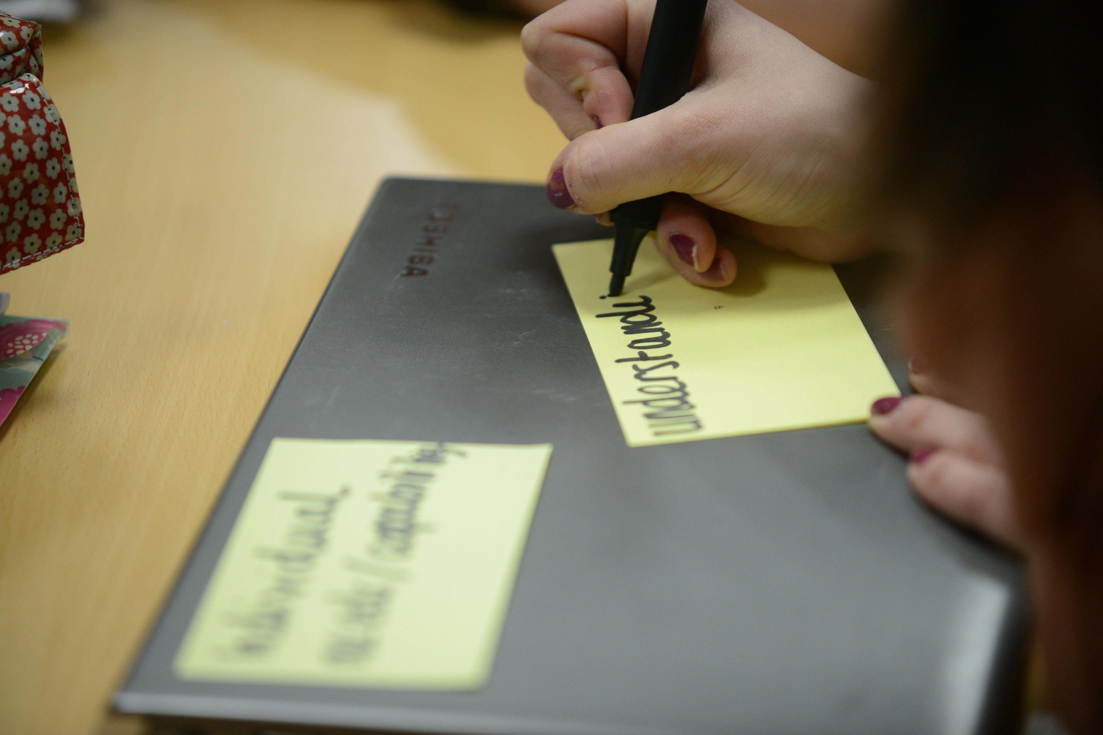
How Research Schools can support teachers and their career development
Mo Cusworth-Yafai

Slide 2
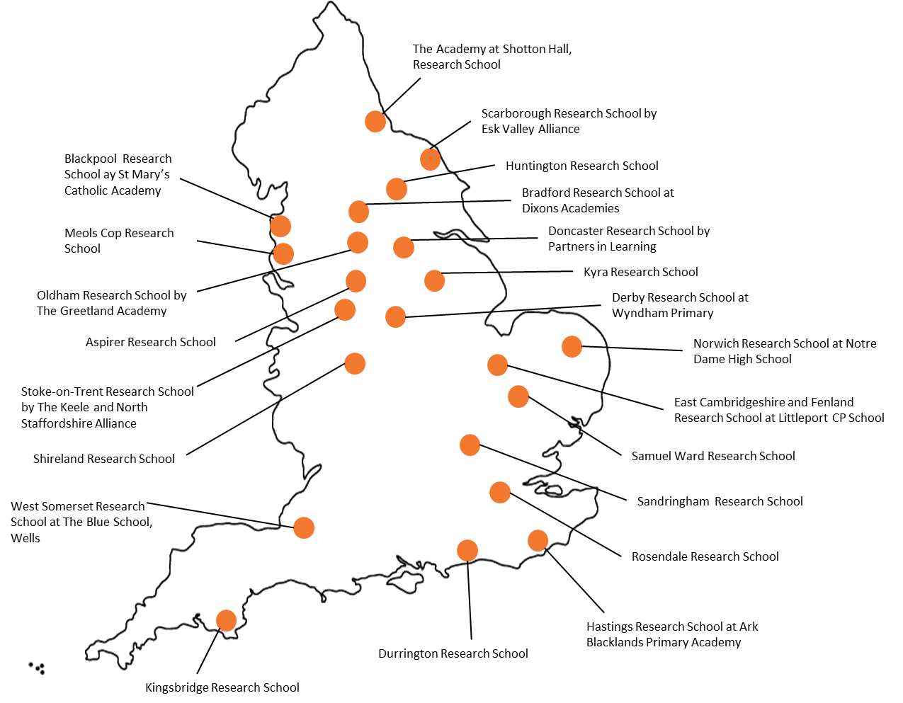
Research Schools Network
The Research Schools Network is a partnership between the EEF and the Department for Education.
There are 22 (soon to be 32) Research Schools which provide school-led support for the use of evidence to improve teaching practice.

Slide 3
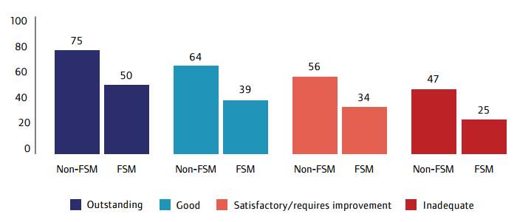
Tackling the attainment gap: the EEF approach
The attainment gap: it exists in ALL types of school
% FSM-eligible pupils attaining 5 GCSEs (A*-C) incl English and Maths
by school’s overall effectiveness judgement, according to Ofsted
25% gap
25%
22%
22%
Source: Unseen children: access and achievement 20 years on (Ofsted, 2013)

Slide 4
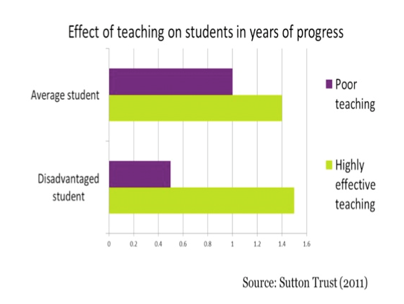
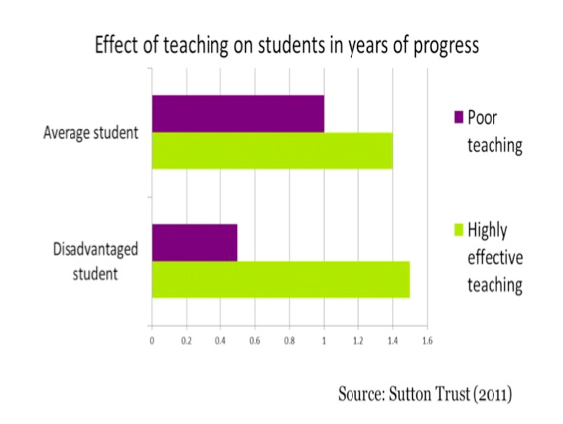
What’s the answer?
Notes:
Used this in session one – come back to it as the intended outcome of improved CPD

Slide 5
The Big Question?
When was the last time you learnt something about teaching & learning which inspired you to change what you do in the classroom…
and, having made that change, your students’ outcomes improved?
Notes:
Used this in session one – come back to it as the intended outcome of improved CPD

Slide 6
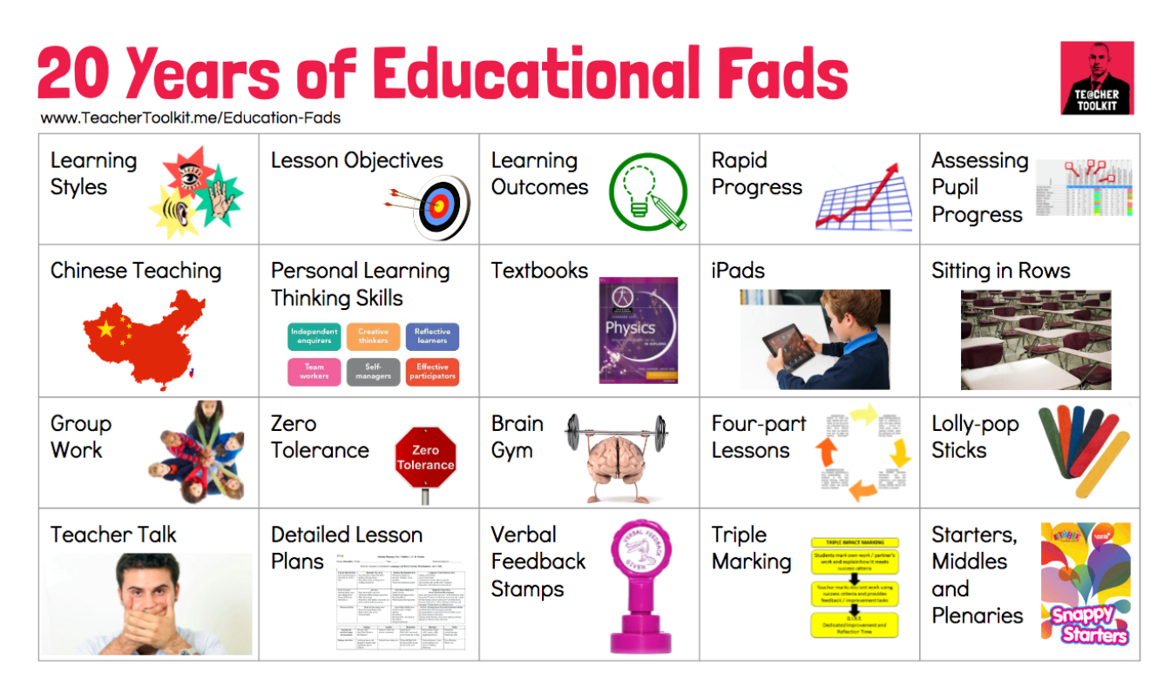

Is it on this list?
Practice constantly changes…
Notes:
The pedagogy of teaching constantly evolves as we research into how people learn. What was ‘normal practice’ 10, 20 years ago may well have been overtaken by other practice as we learn more about what works. Research Schools will support teachers in developing their practice to reflect latest thinking, latest research outcomes.
Quick task- In pairs brainstorm on ‘initiatives’ you have seen come and go over your teaching career……
GIVE POST ITS AND ADD TO FLIPCHART
E.g. AVK activities / Learning styles
Brain gym
Big Writing / VCOP
APP
‘Rapid progress’ in 20 mins?!
Mastery
Pink / Green pens for marking
Triple Impact marking
But rather than purely be a vehicle for academic research, Research Schools are based within schools, and will reflect bullet points above. No-one has time to do this all themselves, but everyone needs to know if what they are doing is making a difference.

Slide 7


Notes:
Techers as magpies; shiny jewel collectors! Are we thinking about the evidence?
Everything works somewhere, nothing works everywhere.
We need to stop doing so many good things.

Slide 8
The CPD Standards
“Trainees should be introduced to the most relevant and recent research, propositions and theories relevant to good classroom practice”
Section 4, A Framework of core content for ITT
“Professional development should be underpinned by robust evidence and expertise” and that in best practice school leaders “draw on expert input to ensure that activities are clear about how and why practices work in different contexts”
Part 2, Standard for teachers’ professional development
Notes:
Your experience to date is based on relevant and recent research and you have been fortunate enough to be training with a university known for engaging in and with research.
As a professional this doesn’t stop when qualified, and since July 2016 this has been explicit through the publication of cpd standards (2nd click)
You should expect that your school will support you, membership of professional bodies will support (Eg ATM) and of course being alumni of Warwick. But what else do we know about how people interact with research (next slide) Obviously there has ben some research undertaken into this!

Slide 9
Evidence
Professional Expertise
Evidence- informed Practice
Context
Notes:
Evidence isn’t a new silver bullet, this will fix everything solution for all problems.
It is another tool to supplement and support the expertise of teachers and leaders, and a great deal of professional expertise if needed to get it right.

Slide 10


Why use research?
Best bets for improving outcomes for pupils
Effective use of time and resources
Teaching seen as more professionalised
Increased teacher autonomy
Notes:
Effective use of time and resources: evidence helps to identify things which are unlikely to work. Using evidence to identify the best (and worst) bets allows you to do less and do it well.

Slide 11
What do we mean by the term ‘robust evidence’?
Where do we look for evidence?
Notes:
Research sch remit is about supporting schools to make better use of the evidence, but what do we mean by ‘evidence’?

Slide 12
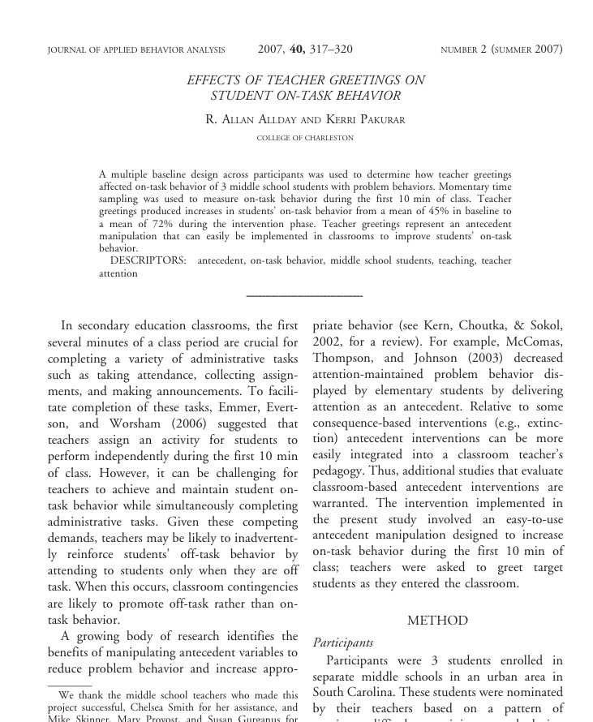
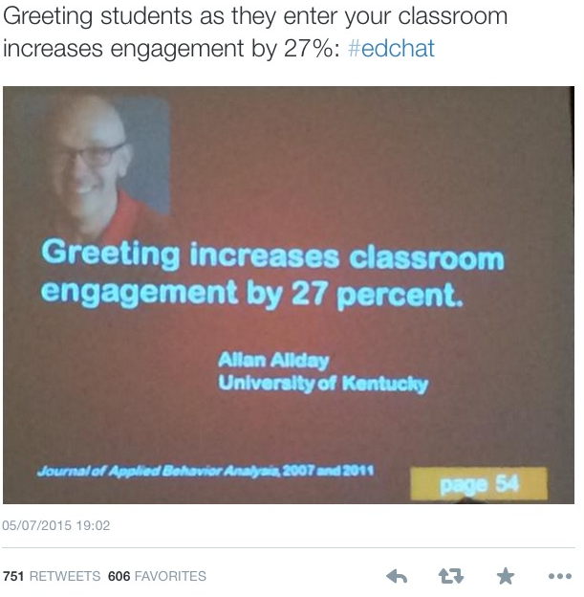
Notes:
751 retweets!
3 middle school students 10mins of class time

Slide 13
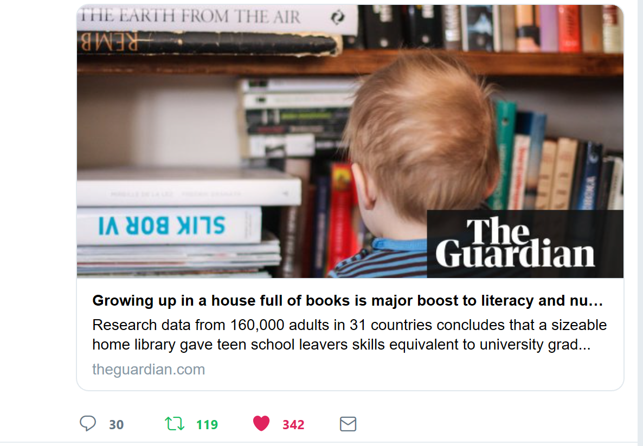
Notes:
Link to full article https://www.sciencedirect.com/science/article/pii/S0049089X18300607#fig2

Slide 14







Lots of people and organisations are interested in helping promote evidence informed practice:
Notes:
There are lots of organisations that have taken up the charge to help teachers to use evidence informed practice over the last few years….all will have slightly different approaches and agendas, but broadly want to help people use evidence. We are going to take one example - the EEF and look a bit more closely at their approach

Slide 15
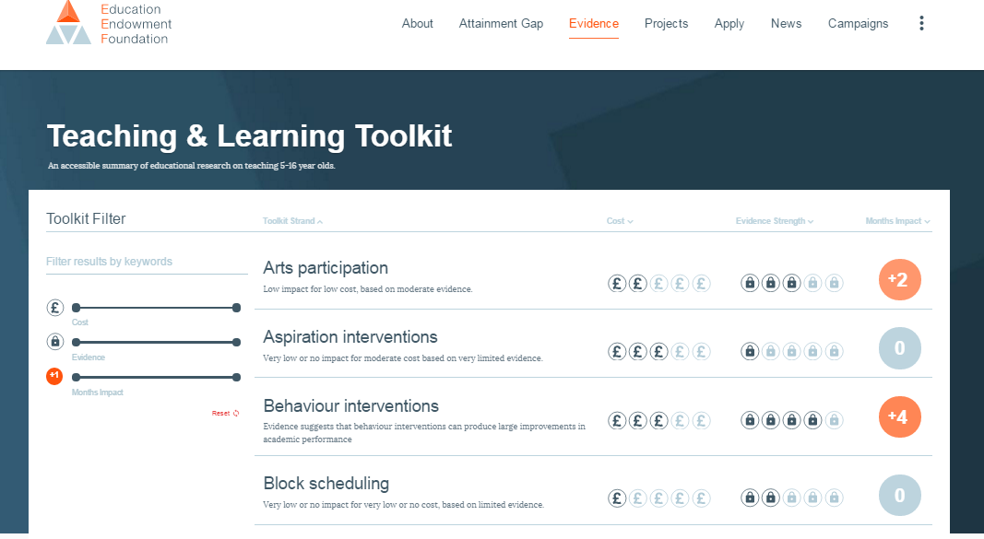
Using the Toolkit
(or any other source of evidence)
Understand your CONTEXT:
- What are our priorities for better learning?
- Where should we focus our efforts?
- What change do we want to make?
Seek independent, high-quality INFORMATION:
- Who tells us what to do?
- Where do get our ideas from?
- Who do we trust?
Promote professional CONVERSATIONS:
- How will it work in practice?
- Can we deliver this in our setting?
- Should we stop doing that?

Slide 16
Support teachers to use high-quality evidence and data

Slide 17
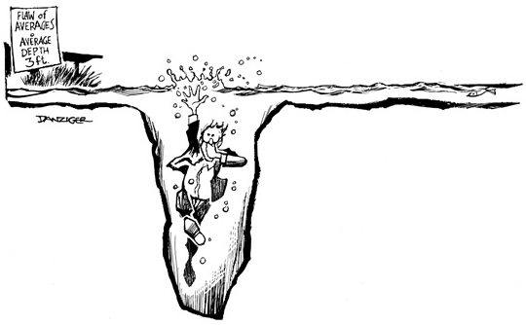
Support teachers to use high-quality evidence and data
Credit: Jeff Danziger
BEWARE!
The Flaw of Averages…
a statistician drowns while crossing a river that is 3 feet deep, on average.

Slide 18
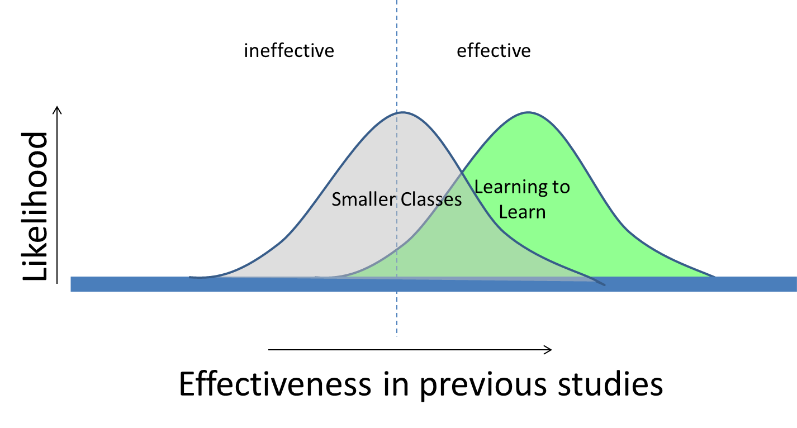
Support teachers to use high-quality evidence and data
Toolkit caveat: it reports averages. It doesn’t offer guarantees!

Slide 19
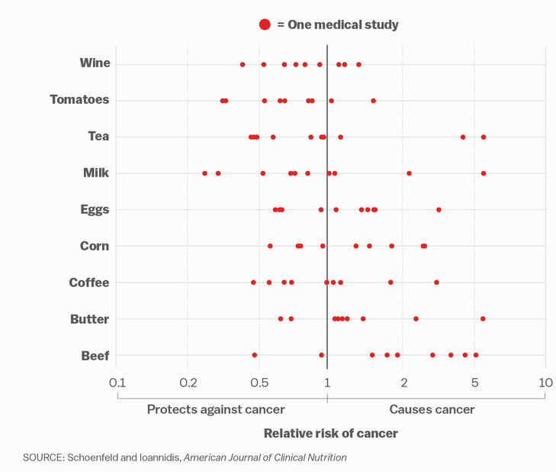
Why aggregate results?
Notes:
Meta-analyses and literature reviews aggregate the results of numerous studies in the same area (looking at the impact of the same behaviour or practice on the same outcome). No research carried out in the real world is perfect: they all have biases and use samples of individuals, so they will all give slightly different results. By looking at the outcomes of numerous studies, which have all been selected because they were carried out to a high enough standard, we can get a better overall picture of what is likely to be effective, or not.

Slide 20
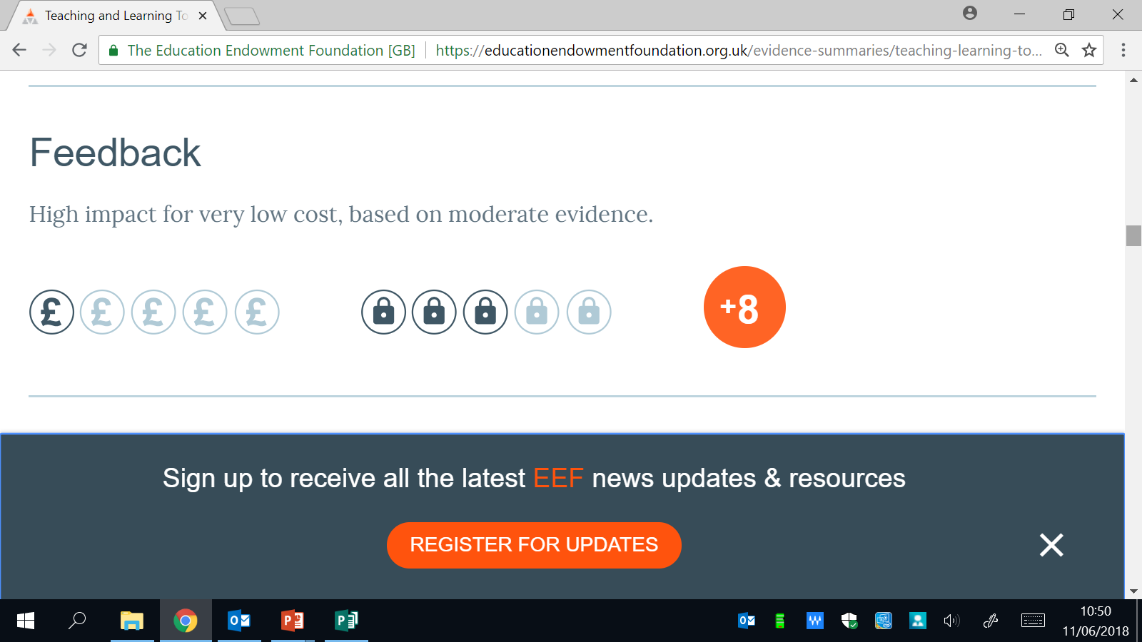
The EEF Teaching & learning Toolkit
Teaching strand
How effective is it?
What are the costs?
How secure is the evidence?
Notes:
Exemplify the toolkit layout by discussing the key elements; strand, costs, security and progress/gain.
Just explain the four key elements of the toolkit not the feedback strand!

Slide 21



Communication
Newsletter
Social media
Blogs
Conferences
Research Schools work with the other schools in their network to support them to make better use of evidence to inform their teaching and learning.
Training
Workshop programmes for leaders and teachers
Innovation
Support with developing innovations and evaluation models
Applications for research innovation grants
Invitations to participate in new and developing evaluations
Notes:
Communication – Regular communication and advice on new and existing evidence
Training – Deliver CPD on how to improve classroom practice based on the best available evidence.
Innovation - Support schools to develop and evaluate innovative ways of improving teaching and learning

Slide 22
Getting involved
Uptake of research is based on trust and personality as much as practical usefulness:
Research use is a social process
Schools listen to other schools
Teachers listen to other teachers
Research needs practical application: dialogue, coaching and training - is key to producing substantive changes in teachers’ practice
Notes:
The pedagogy of teaching constantly evolves as we research into how people learn. What was ‘normal practice’ 10, 20 years ago may well have been overtaken by other practice as we learn more about what works. Research Schools will support teachers in developing their practice to reflect latest thinking, latest research outcomes.
But rather than purely be a vehicle for academic research, Research Schools are based within schools, and will reflect bullet points above. No-one has time to do this all themselves, but everyone needs to know if what they are doing is making a difference.

Slide 23

Effective CPD – what does the evidence say?
“at least 2 terms – more usually a year (or longer).”
“… a “rhythm” of follow-up, consolidation and support activities.”
“relevance of the content to its participants - their day-to-day experiences with, and aspirations for, their pupils.”
(Developing Great Teaching, TDT, 2015)

Slide 24



Slide 25
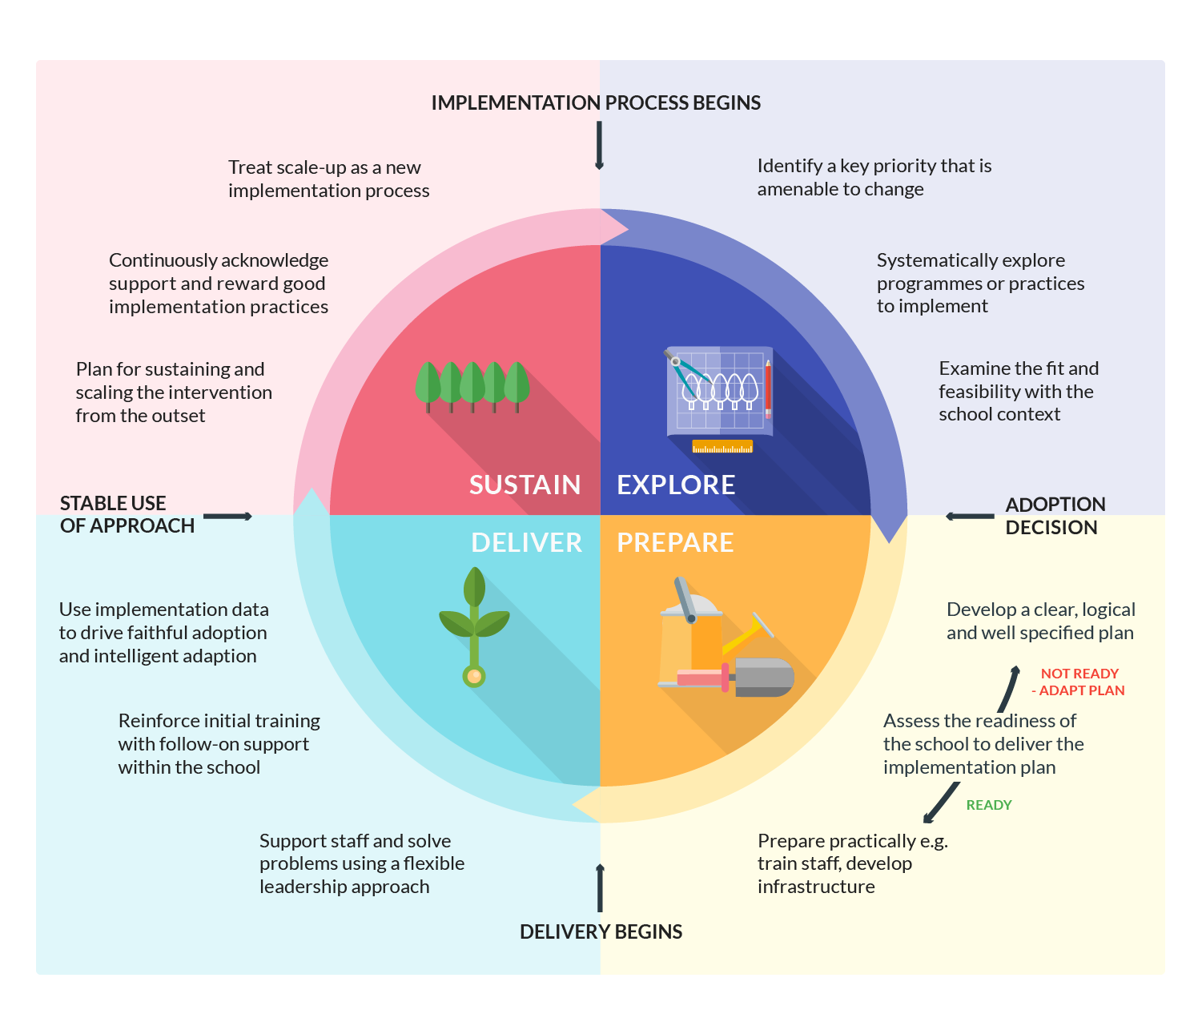
Notes:
Recap the implementation cycle, which is a useful model and guide to use – foundation stage

Slide 26
Consider your own practice..
How do you know if you are making a difference?
How do you effectively evaluate the impact of your approaches?
Notes:
Take 2 mins – answer the first Q
Turn to the person next to you – discuss
Then show the next Q. In pairs discuss initial responses

Slide 27
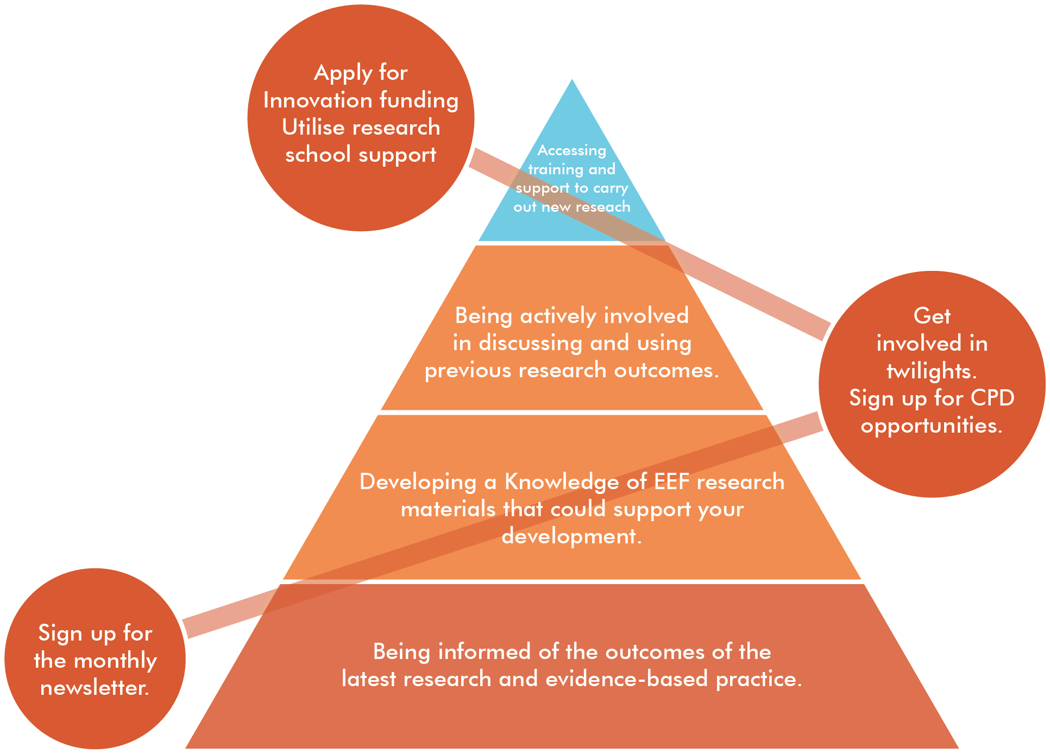
How can we support you?
Notes:
Doesn’t have to be all consuming. Teachers are in different stages of development, and have different capacities. Show model
Use an involvement with Research School to support you in this.

Slide 28
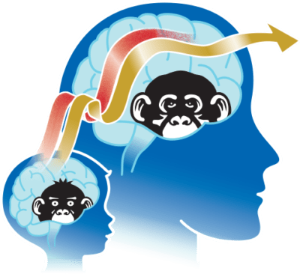
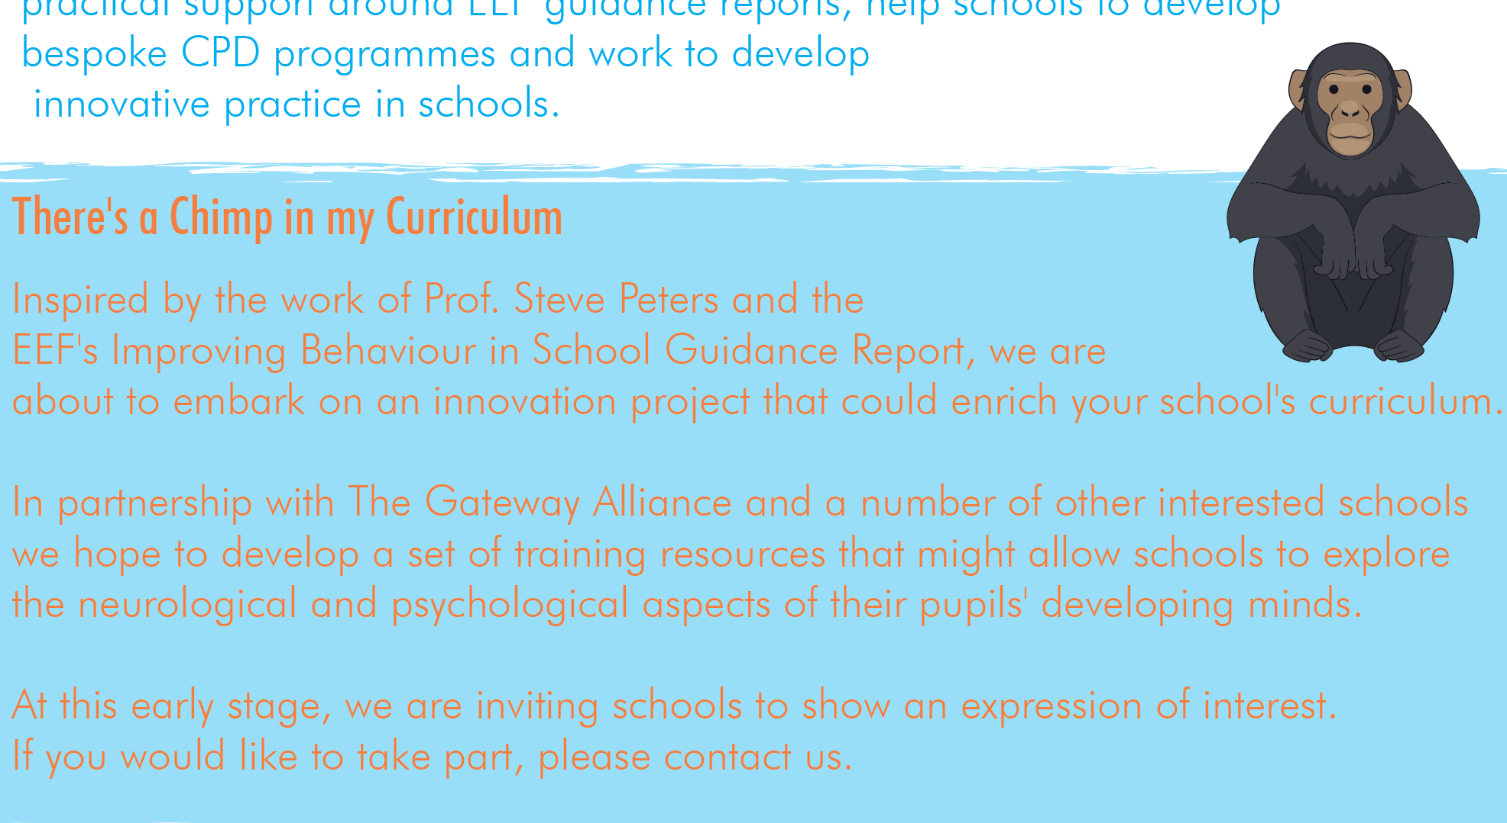

Slide 29

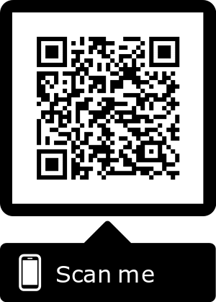

Contact details
mohamed.yafai@collegiateacademy.org.uk
@ShirelandRSch
Newsletter Sign-Up

