Slide 1



Mentor
Training
2022 - 2023
Kate Hamer

Slide 2

Aim
To understand the role of the Mentor in the Trainee ITT curriculum.
Session summary
The role of the Professional Practice Units
The role of the documentation to support the placement
The role of the mentor in Instructional Coaching
The coaching contract

Slide 3

Core Content Framework
curriculum

Slide 4



How we go about this at Warwick
Core Content Framework
curriculum
Notes:
Mentors – peers – tutors – INTEGRATED CURRICULUM

Slide 5

How we go about this at Warwick
Notes:
Mentors – peers – tutors – INTEGRATED CURRICULUM

Slide 6
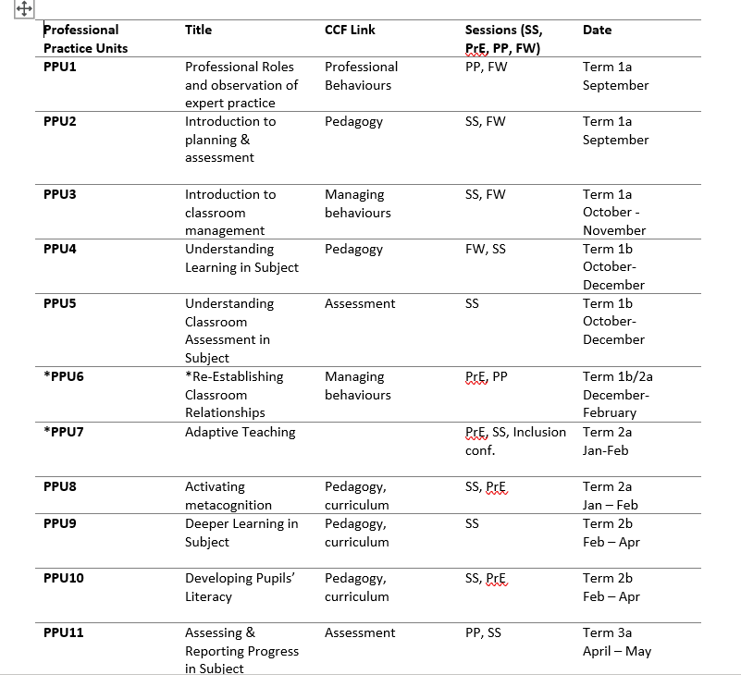


Slide 7



Notes:
Activity of the trainee

Slide 8
Notes:
Activity of the trainee

Slide 9
Professional Practice Units

Slide 10
Unit content
Introduction and curriculum links
Key learning
Trainee activities
Activity Outputs
Optional Synoptic writing task

Slide 11
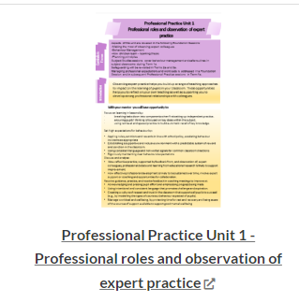

Slide 12

Activity Outputs:
The beginnings of a plan to share with your mentor
Ideas on how to organise people, the space, the equipment and time, before, during and after lessons.
Ideas of rules and routines to establish the environment you want for learning
A set of notes on what needs to be included in a planning template.
Notes on how to increase the time pupils spend on task in lessons to share with your mentor
Understanding of the 4 domains of learning and the importance of the Affective domain to set up the conditions for learning.

Slide 13
Trainee Outputs
A SWOT analysis
A set of long-term targets for the first term
An outline plan of a coaching contract
A plan/spreadsheet to track completion of PPU activities
A shared ‘Sharepoint Folder’
A 5-step plan for the feedback book

Slide 14

6 synoptic writing tasks
11 Units to choose from and only 6 to do – 2 are compulsory!

Slide 15
Compulsory

Slide 16

The documentation to support the placement

Slide 17





Supporting Documentation
Professional practice units
Observation feedback book
Collaborative review document (CRD)
Mentor’s guide to
Instructional
coaching notes form
Weekly Instructional
coaching notes form
Subject plans

Slide 18

The mentor in Instructional Coaching framework
https://samsims.education/2019/02/19/247/

Slide 19


Instructional Coaching Model
Analyse New / Current Reality
Set targets
Identify and explain teaching strategies – co-construct targets/goals
Provide support until targets are met (mentorship)

Slide 20




Slide 22

The coaching
contract

Slide 23
Aim
To understand the role of the Mentor in the Trainee ITT curriculum.
Session summary
The role of the Professional Practice Units
The role of the documentation to support the placement
The role of the mentor in Instructional Coaching
The coaching contract

Slide 24



Slide 25
Additional resources for you to consider

Slide 26
CTE Principles of Assessment
Improvement: improve not prove
Trainee Agency: Student-led instructional coaching approach – students an active part of the process
Supportive: identify students not on track to achieve the TS by the end of programme to enable intervention and support (need sufficient information to inform this)
Dialogic: an entitlement to dialogue with expert colleagues /entitlement to expert mentoring and observation of expert colleagues
Clarity: shared expectation of expected progress AND of important principles e.g. WTV, expectations of support.
Purposeful - streamlined to ensure that assessment contributes to progress with a minimum of workload

Slide 27
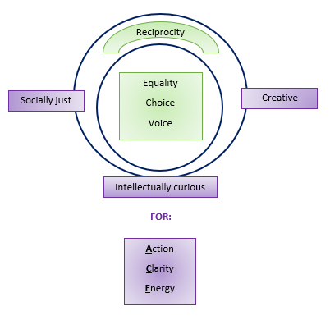
CTE Principles
CTE Principles of assessment
CTE Principles of coaching
Improvement: improve not prove
Trainee Agency: Student-led instructional coaching approach – students an active part of the process
Supportive: identify students not on track to achieve the TS by the end of programme to enable intervention and support (need sufficient information to inform this)
Dialogic: an entitlement to dialogue with expert colleagues /entitlement to expert mentoring and observation of expert colleagues
Clarity: shared expectation of expected progress AND of important principles e.g. WTV, expectations of support.
Purposeful - streamlined to ensure that assessment contributes to progress with a minimum of workload

Slide 28
Knight, 2018
Instructional Coaching principles
Equality | Choice | Voice |  | Dialogue | Reflection |  | Praxis | Reciprocity
Social Justice |  |  | Intellectual Curiosity |  |  | Creativity
Warwick Teacher values

Slide 29

Instructional coaching principles
.
.

Slide 30
Instructional coaching principles
Equality: I don’t believe any person or group is more valuable than any other, and I recognise the honour and dignity of every individual
Choice: I communicate in a way that acknowledges the professional discretion of others by positioning them as decision makers
Voice: I want to hear what others have to say, and I communicate that clearly
Dialogue: I believe conversations should consist of a back-and-forth exchange, with all parties hearing and responding to one another’s opinions.
Reflection: I engage in conversations that look back, look at, and look ahead.
Praxis: This can be defined as ‘any experience that combines reflection, learning and action’.
Reciprocity: I enter each conversation open and expecting to learn

Slide 31
Instructional Coaching Questions
On a scale of 1-10, with 1 being the worst lesson you've taught and 10 being the best, how would you rate that lesson?
2
What pleased you about the lesson?
3
What would have to change to move the lesson closer to a 10?
4
What would your students be doing differently if your class was a 10?
5
Tell me more about what that would look like?
6
How could we measure that change? ( what stats might we collect here?)
7
Do you want that to be your target?
8
If you could hit your target, would it really matter to you?
9
What teaching strategy can you use to hit your target?
10
What are your next steps?
Notes:
20 min Task: Think about a lesson that you have recently taught / observed. Thinking about our current knowledge about effective mentoring - Mentor should ask Trainee these questions and listen actively to responses. Learn by doing!

Slide 32
TO LISTEN AND QUESTION EFFECTIVELY, I NEED TO:
Make sure my conversation partner does most of the talking.
Pause and affirm before I start talking.
Don’t interrupt (except when it is very helpful).
Ask one question at a time.
Ask for clarification when I’m not certain what is being said.
Ask, “And what else?”
Assume people are doing their best.
Avoid leading questions.
Avoid giving advice disguised as a question.

Slide 33
Language Matters
What is said?
“Talk to me about…”
“I’m going to push you on… think about how that links to the theory we have been learning about linked to…?”
“Is there anything else that you wanted to…?”
“I just want to follow up and clarify…”
“How do you think that links to our standards…?”
“Tell me more about that section of the session…”
“I know that you have been working on…”
“Tell me how you assessed that?”
“Was there anything else that you were assessing today?”
“Name some things that you did that contributed to student learning…”
What is done and what is the tone and body language?
Clarifying and simultaneous note taking for shared understanding
Take example from lesson and pose question from that
Return to facts (number of pupils responding, for example) and ask for other possibilities – to capture other things that mentee might be thinking
Specific positive reinforcement comments
Mentor echoed what was said and captured (ICON form)
Silence
Balance of talk – equal
Encouraging experimentation of innovation.
https://players.brightcove.net/268012963001/rJenILPQx_default/index.html?videoId=5533115800001
Notes:
Task: Watch 6 min vid and 10 min discussion - what did you notice? How did the Mentor use effective coaching skills? https://players.brightcove.net/268012963001/rJenILPQx_default/index.html?videoId=5533115800001

Slide 34
Coaching skills the most effective mentors embody
Adapted from CUREE National Framework for Mentoring and Coaching and informed by research with trainees and evaluation data)
CUREE is an internationally acknowledged centre of expertise in school and college improvement and evidence-informed leadership and practice in education

Slide 35

Which coaching skills do the most effective mentors embody?
Relate sensitively to their trainee(s) and build trust and confidence (e.g. coaching contract, investing time to build relationships and familiarise with new school)
Respect the trainee as an individual and personalises the training experience for the individual
Keep up to date with training, familiar with documents and processes
Model expert practice and good character
Facilitate access to research to support the development of pedagogic practice (e.g. CCF, build on university taught professional practice programme, school CPD)
Work in collaboration with trainee – aspire towards a reciprocal relationship
Observe, analyse and reflect on the practice of the trainee
Notes:
4 mins

Slide 36
Provide support and guidance that enables professional learning – mentorship e.g. signposts to relevant expert colleagues
Facilitate the trainee’s growing independence – empower the trainee to have autonomy for their own learning and development
Listen actively – accommodating and valuing silence and thinking time; concentrating on what’s being said, using affirming body language, reiterating ideas to reinforce, value and develop thinking, trying not to listen with an answer in mind
Use open questions to: raise awareness, explore beliefs, encourage professional learners to identify their own targets, understand their impact and develop ways forward
(Adapted from CUREE National Framework for Mentoring and Coaching and informed by research with trainees and evaluation data)
Notes:
4 mins

