Slide 1
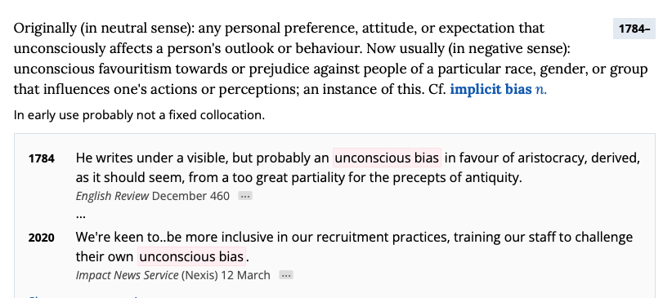
What is ‘unconscious bias’?
The Oxford English Dictionary states:
Notes:
https://www.oed.com/dictionary/unconscious-bias_n?tab=meaning_and_use#1306765720
Display as text

Slide 2
Unconscious Bias
We are all inherently biased and that fact that biases can be unconscious means that we are unaware of them.
These biases develop throughout our lives and can be influenced by friends, family, cultural background, personal experiences and the media.
We categorise people based on certain characteristics, such as age, gender, skin colour and disability. If unchecked, this can lead to stereotyping, prejudice and discrimination.
Discrimination against anyone with one or more protected characteristics is prohibited under the Equality Act (2010).
Notes:
https://www.legislation.gov.uk/ukpga/2010/15/part/2/chapter/1

Slide 3
Understanding Unconscious Bias: Types of Bias
Affinity Bias: we favour someone who is similar to us.
Conformity Bias: we make decisions based on the views of others.
Confirmation Bias: we look for evidence to confirm our bias and ignore evidence that disproves our bias.
Attribution Bias: we attribute the successes of certain people to luck rather than talent or ability, whereas we attribute our own successes to our own talents and skills.
Notes:
Affinity bias:
We favour someone who is similar to us
Conformity bias – we make decisions based on the views of others
Confirmation bias
We look for evidence to confirm our bias and ignore evidence that disproves our bias
Attribution Bias
We attribute successes of certain people to luck rather than talent or ability, whereas we attribute our own successes to our own talents and skills

Slide 4
Further Reading
Milner, R. (2007). ‘Race, Culture, and Researcher Positionality: Working Through Dangers Seen, Unseen and Unforeseen’. Educational Researcher, 36: 7, pp. 388-40
Newcastle University, Leeds Beckett University and National Education Union (2022). Anti-Racism Framework for Initial Teacher Education. https://www.ucet.ac.uk/downloads/14636-Anti-Racism-ITET-framework.pdf [Accessed 15th March, 2024].
RAISE (2024) Student Belonging and Good Practice Guide. https://www.raise-network.com/_files/ugd/12e0cd_539f72c96f54437882abc7401fcd6794.pdf [Accessed 15th March, 2024].
Santoro, N. and Allard, A. (2005) ‘(Re)Examining identities: Working with diversity in the pre-service teaching experience’. Teaching and Teacher Education, 21 (7), pp. 863-873.

