Slide 1
Assessment of Trainee Progress:
How to Complete Assessment Profiles for Primary/Early Years Warwick PGCE trainees

Slide 2
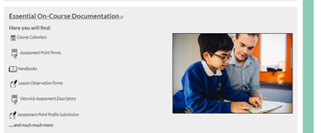
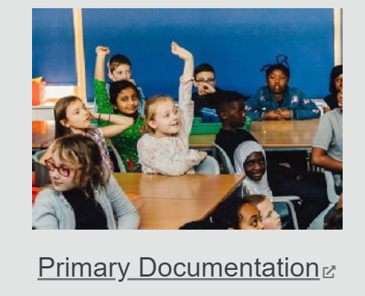
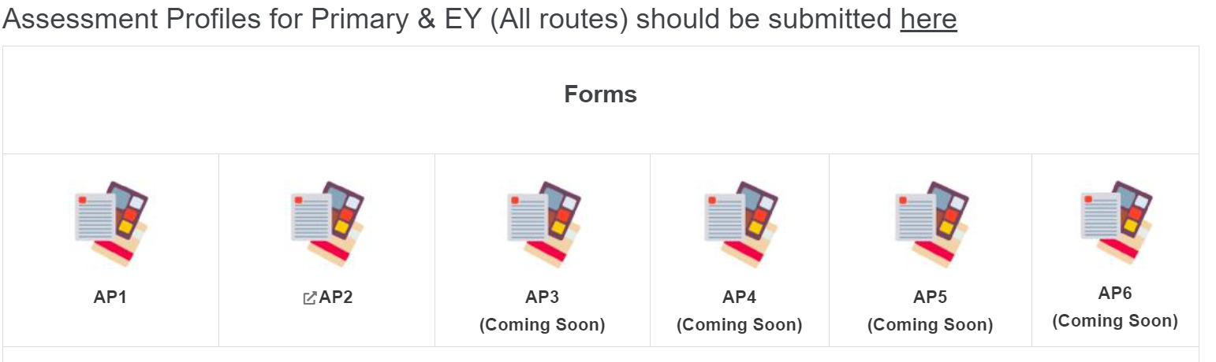
Partners’ Intranet
Partners’ Intranet – access to all mentor resources and documentation https://warwick.ac.uk/fac/soc/cte/students-partners/pintra/
Password: partnercte
Profiles can be found in Essential On-Course documentation page > Primary Documentation
Scroll down to the Assessment Profile section and download the relevant form

Slide 3
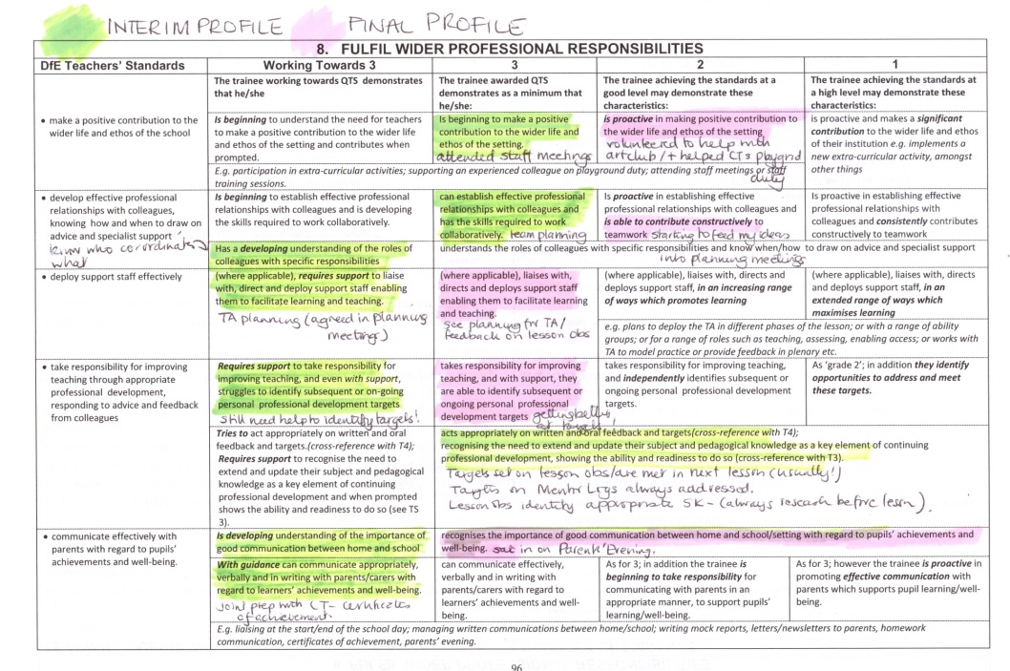
Warwick Assessment Descriptors (WADs)
Trainees should assess their own progress using the WADs.
Mentors must use the WADs to inform their judgements when completing the assessment profiles
Can be found in the relevant placement guides, trainee’s training plan and available on the Essential Documentation page.

Slide 4
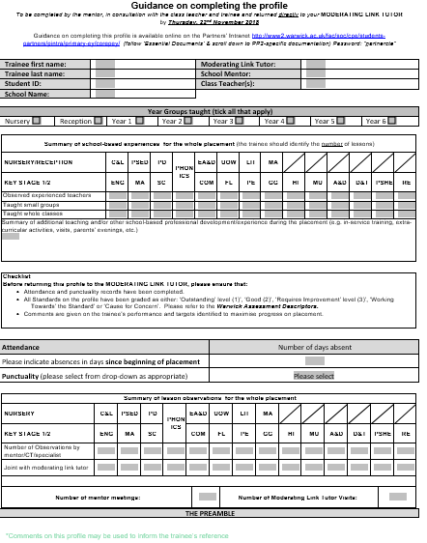
Assessment Profiles
Mentors to take responsibility for completing the assessment profiles:
AP1, AP3 and AP5: Completed part way though - formative – targets which trainee can work on in 2nd half of placement
AP2, AP4 and AP6: summative - at the end of the placement.
Both profiles require mentors to make judgements against the Teachers’ Standards.
This should be a collaborative process mentor/teacher/trainee

Slide 5
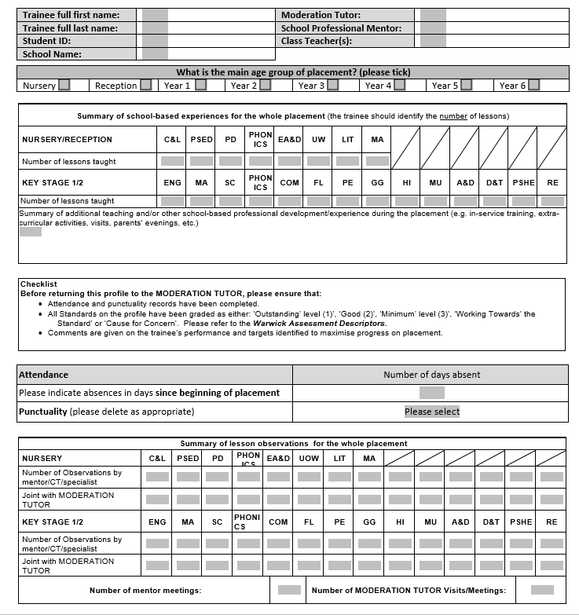
Assessment Profile - Front Page
Trainee/school information
Year group trainee is based in
How many lessons/sessions the trainee has taught in each subject area on this placement
Attendance/punctuality
How many formal observations the trainee has had by the mentor/class teacher/moderation tutor

Slide 6
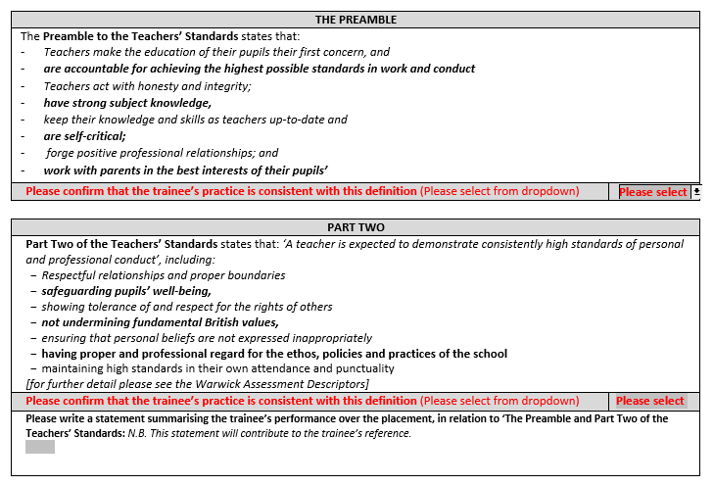
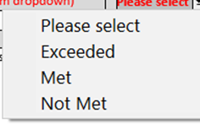
Professionalism
Mentors are asked to grade the Preamble and Part 2: exceeding, met or not met.
Summary comment – trainee’s performance in relation to the Preamble and Part 2 – this forms part of the trainee’s reference.
Please note that to achieve Met – the Preamble requires trainees to ‘be accountable for achieving the highest possible standards in work and conduct’ and Part 2 requires trainees to ‘demonstrate consistently high standards of personal and professional conduct’.
Exceeded should only be awarded for trainees who go over and above the expectations.

Slide 7
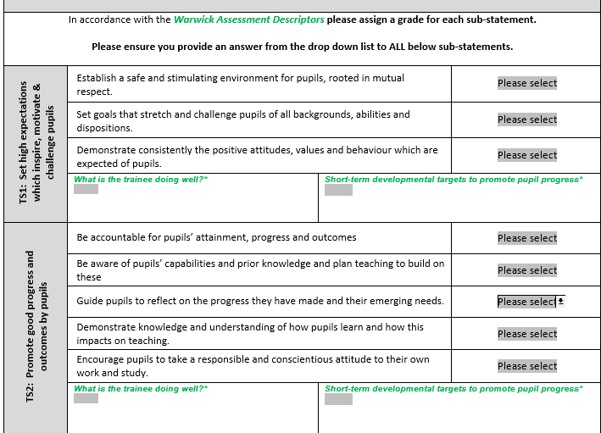
AP1, AP3, AP5 – Formative Profiles
AP1, AP3 and AP5 require:
Grades for each sub-standard
A summary of what the trainee is doing well in relation to each of the Teachers’ Standards
At least one short-term development target for each of the Teachers’ Standards

Slide 8
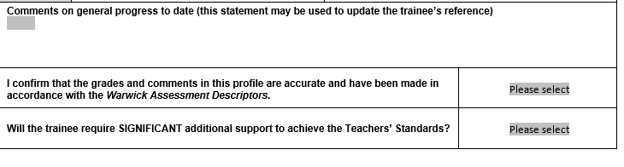
AP1, AP3 and AP5: Summary Page
To complete these profiles, mentors are asked to:
Write a general progress comment, used to inform the trainee‘s reference
Confirm the WADs have been used to inform grades to ensure accuracy and consistency across the partnership
Select whether a trainee will need significant support to successfully meet the Teachers’ Standards (more information later and in the relevant placement guides/handbooks)

Slide 9
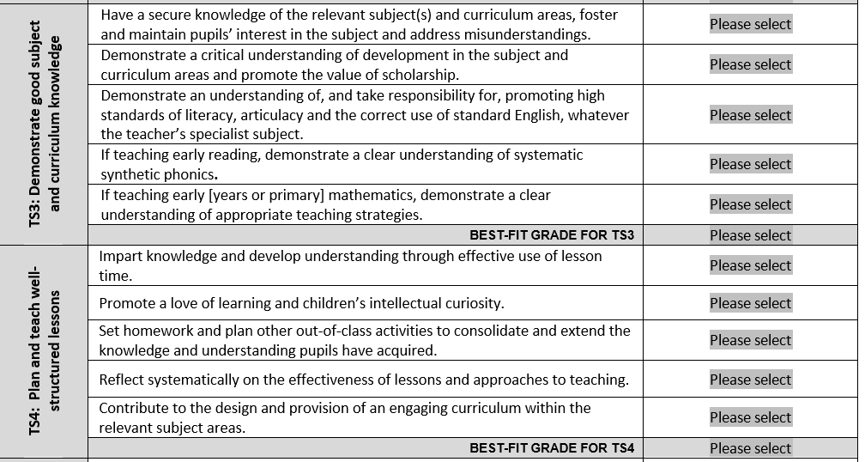
AP2, AP4, AP6 – Summative Profiles
AP2, AP4 and AP6 require:
Grades for each sub-standard
Best fit grade for each standard (please round down if there is an even split of grades)

Slide 10
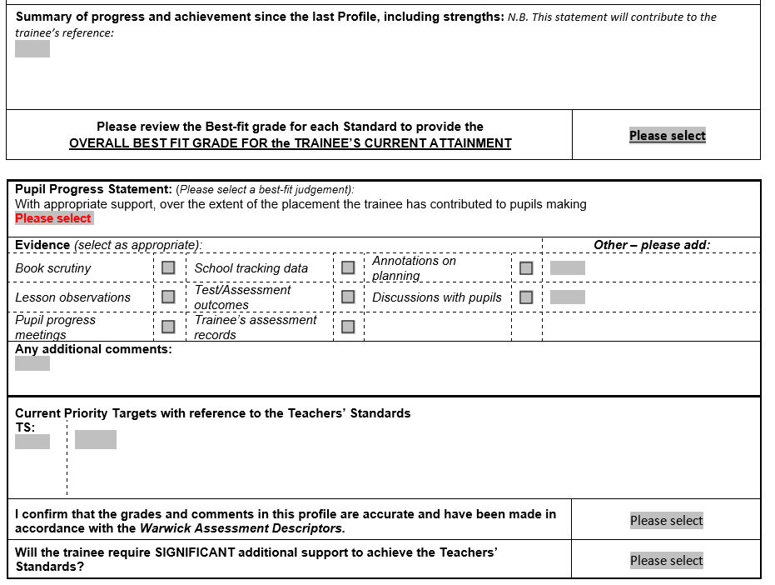
AP2, AP4 and AP6: Summary Page
To complete these profiles, mentors are asked to:
- Write a general progress comment, summarising progress since the last profile - used to inform the trainee‘s reference
- Identify the overall best fit grade (please round down)
- Select a best-fit judgement that best summarises the trainee’s impact on pupil progress and select the evidence this grade was based on
- Based on the evidence in the profile, select up to 3 priority targets for the trainee to work on during their next placement
As with AP1, AP3 and AP5:
- Confirm the WADs have been used to inform grades to ensure accuracy and consistency across the partnership
- Select whether a trainee will need significant support to successfully meet the Teachers’ Standards (more information later and in the relevant placement guides/handbooks)

Slide 11
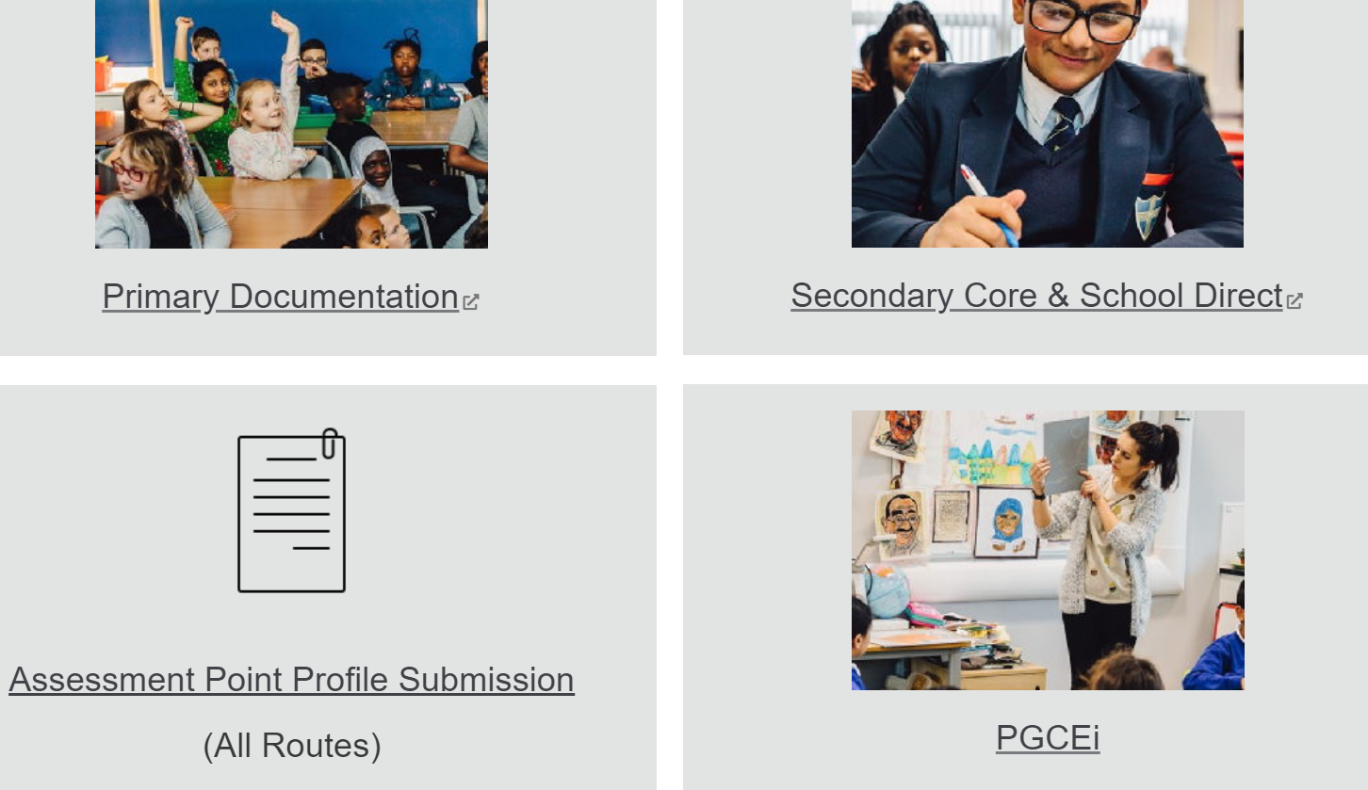
Submitting Profiles
Profiles should not be sent via email (as the macros are often blocked by Firewalls) so please upload online.
The upload page can be found in 2 ways on the Partners’ Intranet:
On the primary documentation page just above where the form was downloaded.
Or from the main Essential Documents menu page (to save you having to scroll through the Primary documents to find it)
Moderation tutors will advise and send reminders

Slide 12
Progress on Placement – doesn’t look like this
High level (1)
Good level (2)
Min level (3)
Not achieving Standards
(WT)
Start Term 1 Term 2 Term 3
Please see the expectations in the relevant handbooks/placement guides for further course specific information

Slide 13

More likely to look like this!
High level
Good level
Min level
Not achieving Standards

Slide 14
Procedures for Weak Trainees
In the event of concerns about a weak trainee, please contact your Moderation Tutor (and Alliance lead - SD only) as soon as possible - who will be able to support you.
Please be honest on the profiles if you have any concerns, particularly regarding professionalism and indicate on the profile if you believe a trainee needs significant support to make required progress.
Where a profile does indicate significant support is needed, this will result in an intervention plan being implemented with explicit and short-term personalised targets designed to support struggling trainees to make progress.
Intervention plans are created by mentors with support from moderation tutors and are reviewed weekly.
If progress continues to be a concern, further action may be needed, please see relevant pages of handbooks/placement guides.

