Slide 1

Character Education – What is it and can it really be taught?
“The aim of our studies is not just to know what virtue is, but to become good.”
Aristotle
“Good character is more to be praised than outstanding talent. Most talents are to some extent a gift. Good character, by contrast, is not given to us. We have to build it piece by piece by thought, choice, courage and determination.”
John Luther
Julie Taylor – University of Warwick
June 2017

Slide 2
My interest in character education…
Masters from September – not yet an expert!
How to deliver effective character education programmes in schools and the impact this can have
How character education relates to ITE – what are the positive personal strengths of effective practitioners & how to develop character in trainee teachers?
WCS/PSHE lead - How we can make character education an integral part of our PGCE programme

Slide 3

Session Outline:
What is character education?
Key principles for character education
Which virtues constitute good character?
Can you really teach character? Case studies of good practice
Why is character education important?
Where to go for further information

Slide 4
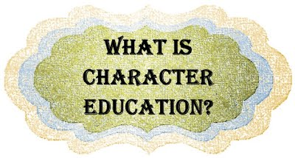
Character is a set of personal traits or dispositions that produce specific moral emotions, inform motivation and guide conduct.
Character education includes all explicit and implicit educational activities that help young people develop positive personal strengths called virtues.

Slide 5
Character education is about helping students grasp what is ethically important in situations and how to act for the right reasons.
The ultimate aim of character education is the development of good sense, or practical wisdom; the capacity to choose intelligently between alternatives.
This capacity involves knowing how to choose the right course of action in difficult situations and it arises gradually out of the experience of making choices and the growth of ethical insight.

Slide 6

The character of children cannot simply be put on hold at school until they reach the age where they have become wise enough to decide for themselves.
To consider…
Some form of character education will inevitably be taking place in school but is the character education strategy in your school intentional, planned, organised and reflective, or is it assumed, unconscious and reactive?

Slide 7

Educational Excellence Everywhere…
(p.88) 6.1. The best possible education for adult life in 21st century Britain is one that equips children and young people with the knowledge, skills, values, character traits and experiences that will help them to navigate a rapidly changing world with confidence.
Building character and resilience in every child (p.94)
6.33. A 21st century education should prepare children for adult life by instilling the character traits and fundamental British values that will help them succeed: being resilient and knowing how to persevere, how to bounce back if faced with failure, and how to collaborate with others at work and in their private lives.
DfE, 2016

Slide 8

Time to reflect…
Have a quick read through the key principles for character education
Discuss as a table to what degree character is currently taught in your school
Consider what might be the challenges around the implementation of a character education programme

Slide 9
KEY PRINCIPLES FOR CHARACTER EDUCATION
Character is educable and its progress can be assessed holistically
Character is important: it contributes to human and societal flourishing
Good education is good character education
Character is largely caught through role-modelling and emotional contagion: school culture and ethos are therefore central
A school culture that enables students to satisfy their needs for positive relationships, competence, and self-determination facilitates the acquisition of good character.
Notes:
Don’t need to show these slides unless there are any questions – skip through them

Slide 10
Character should also be taught: direct teaching of character provides the rationale, language and tools to use in developing character elsewhere in and out of school
Character should be developed in partnership with parents, employers and other community organisations
Character education is about fairness and each child has a right to character development
Positive character development empowers students and is liberating
Good character demonstrates a readiness to learn from others
Good character promotes democratic citizenship and autonomous decision-making

Slide 11
Which virtues constitute good character?
On your tables, discuss and record which virtues you believe need to be developed to effectively prepare children for adult life in the 21st century?
Justify your ideas
Are any of these virtues more important than others? Why? Why not?
Notes:
Post-its or flipchart paper/pens to record ideas

Slide 12
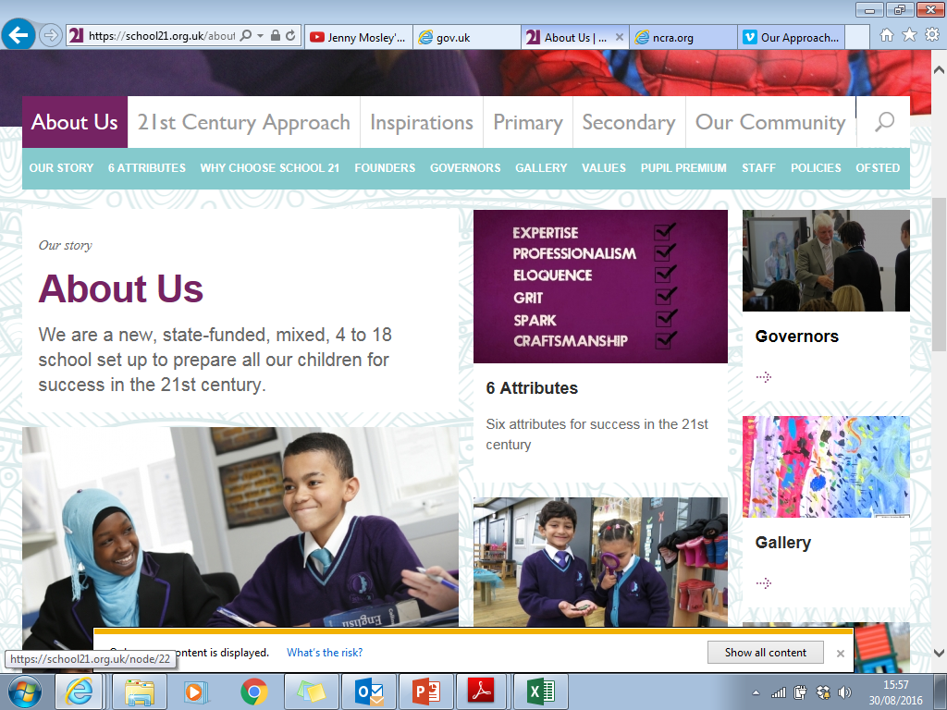
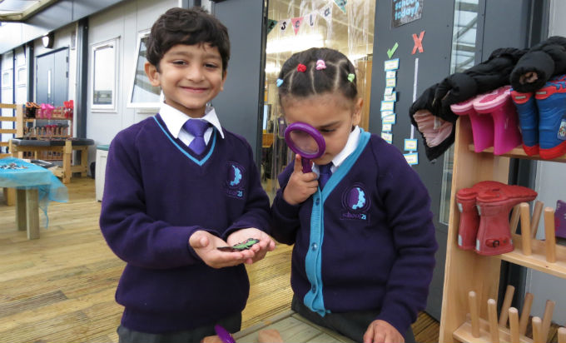
School 21
Before we share, let’s have a look at this video clip of the attributes this school has identified.
How do these compare to the virtues on your group’s list?
school 21 - 6 attributes

Slide 13
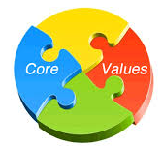
Discuss as a group….
How can we ensure a school’s values become an embedded part of the ethos?
The research evidence is clear: schools that are values-driven have high expectations and demonstrate academic, professional and social success.
Students and teachers need to learn not only the names and meanings of character virtues, but display and refer to them in the school’s thinking, attitudes and actions.
Character virtues should be reinforced everywhere: on the playing fields, in classrooms, corridors, interactions between teachers and students, in assemblies, posters, SLT messages and communications, staff training, and in relations with parents.
Notes:
Discussion question –what

Slide 14
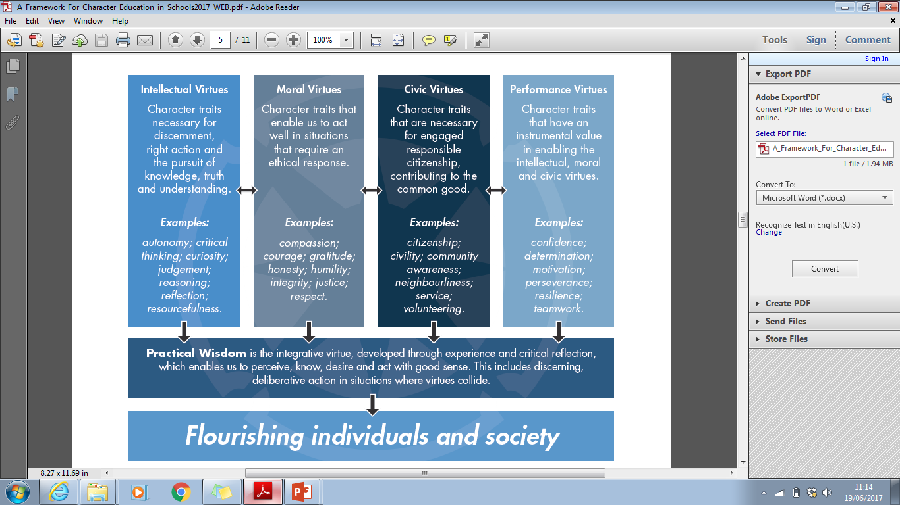
The building blocks of character
Notes:
Although virtues can be divided up into different categories, they form a coherent, mutually supportive whole in a well-rounded life, and character education is all about their integration, guided by the overarching intellectual virtue of practical wisdom or ‘good sense’.
VIRTUE DEFINITIONS
Courage
Acting with bravery in fearful situations
Justice
Acting with fairness towards others by honouring rights and responsibilities
Honesty
Being truthful and sincere
Compassion
Exhibiting care and concern for others
Gratitude
Feeling and expressing thanks for benefits
Humility
Estimating oneself within reasonable limits
Integrity
The quality of having strong moral principles
Respect
Due regard for someone’s feelings and rights

Slide 15
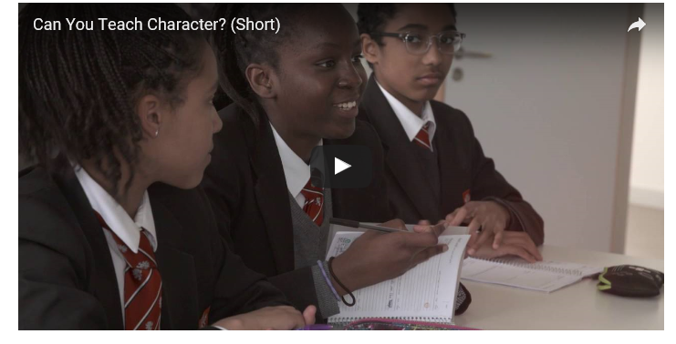
Can you really teach character?
University of Birmingham School – how they embed Character Education into their day to day school life through their character virtues

Slide 16
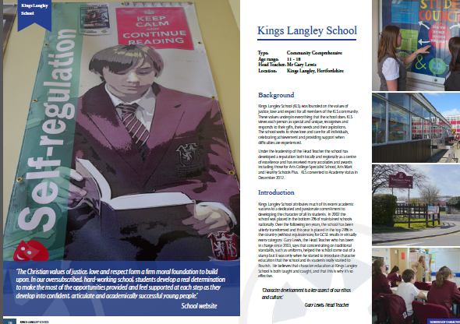

Case studies of good practice
Have a look at the case study of a school that has character education at the heart of their ethos.
How do they embed character education in their day to day practice?
What has been the impact on the school community?
Are there any common features between the practice of these schools of character?

Slide 17
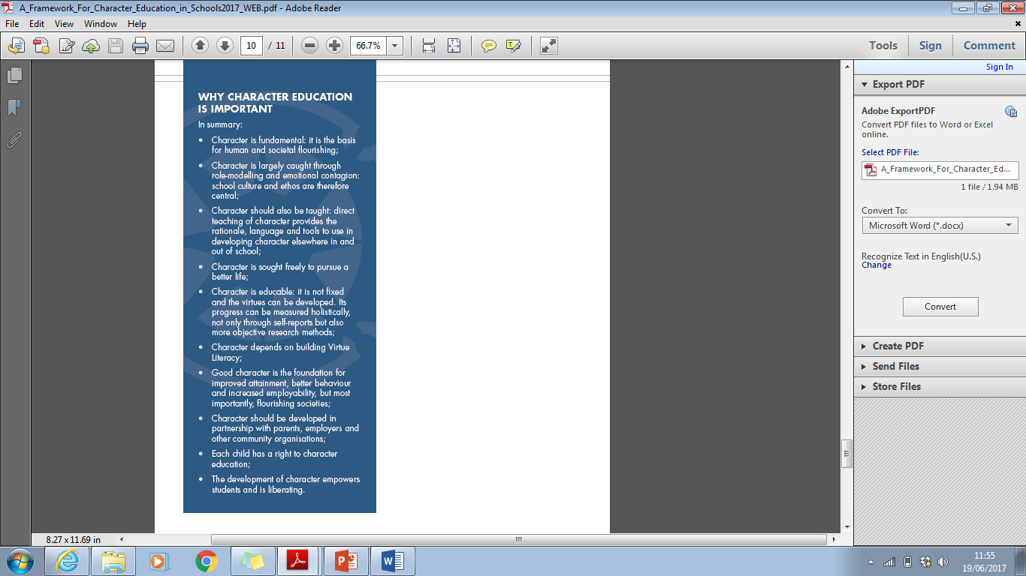

Why character education is important…

Slide 18
Final thought…
“The function of education is to teach one to think intensively and to think critically. Intelligence plus character - that is the goal of true education.”
Martin Luther King

Slide 19
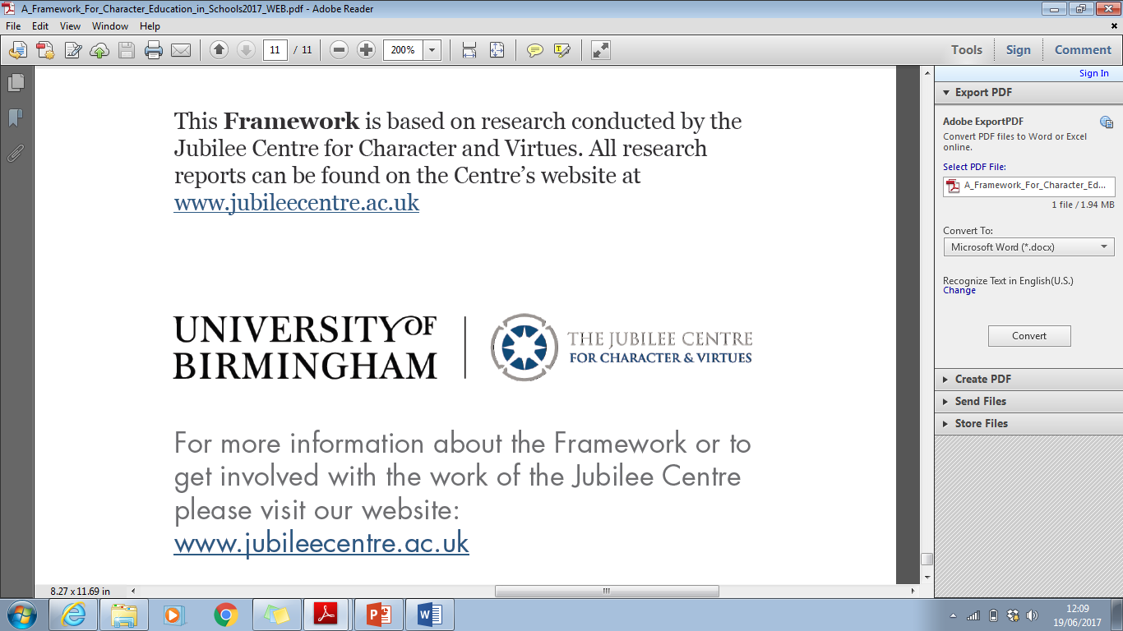
Resources and further information
Character Education section of website: Resources/Online learning/Publications
http://www.jubileecentre.ac.uk/
Association for Character Education (ACE)
Annual conference on 14th July
My email address:
Julie Taylor Primary Teaching Fellow
J-A.Taylor@warwick.ac.uk

