Slide 1


Supporting NQTs
Rewarding
Challenging
Teaching
Christian Education with Care

Slide 2

Christian Education with Care

Slide 3
Role of Professional Mentor
Build a Philosophy of Collaboration
Link with ITT (School/Provider/Alliance)
Select, Train & Support SMs
Audit of ITT provision (KPI)
Professional Training and Induction of NQTs
Assessment of NQTs
Intervention and Support
Christian Education with Care

Slide 4
Key Principles of Successful Professional Mentoring
Partnership
Preparation
Personalisation
Pupil Progress
Protection
Christian Education with Care

Slide 5
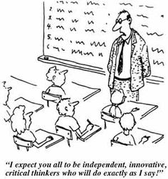

Partnership
Christian Education with Care

Slide 6

Preparation
What are the key elements of training a PM could provide as part of the training year?
Christian Education with Care

Slide 7
Preparation: Assessment of Teaching Standards
Name | Subject | Yr | SM | Autumn |  |  |  | Spring |  |  | Summer
 |  |  |  | Mt | Obs | P Tk | AP1 | Mt | Obs | AP2 | Mt | Obs | AP3
Standard 1: Set high expectations which inspire, motivate & challenge pupils
Establish a safe and stimulating environment for pupils, rooted in mutual respect. | Comments/Evidence: Emily creates a safe and secure learning environment for her students, providing learning challenges and activities that stretch and challenge them. She creates a purposeful atmosphere in her classroom where she models mutual respect and positive behaviours.
Set goals that stretch and challenge pupils of all backgrounds, abilities and dispositions.
Demonstrate consistently the positive attitudes, values and behaviour which are expected of pupils.
Christian Education with Care

Slide 8
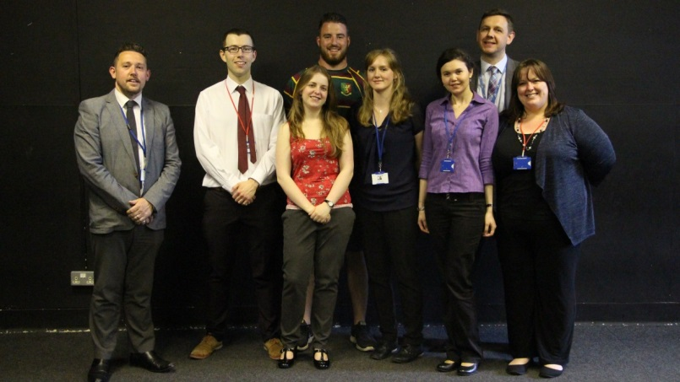
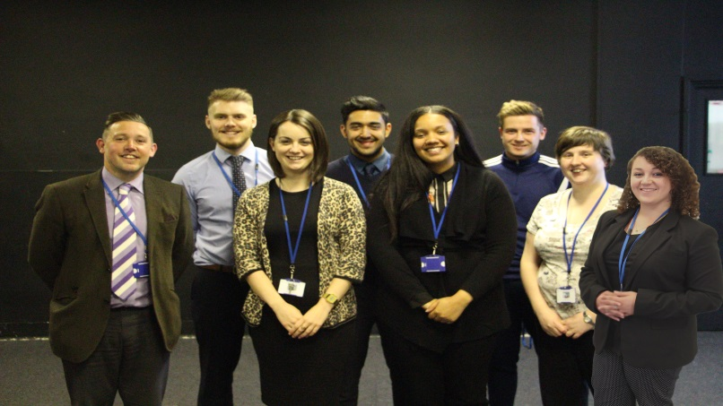
Personalisation
Christian Education with Care

Slide 9

Pupil Progress
Christian Education with Care

Slide 10
Protection
Case study:
You have recruited a seemingly able and very personable NQT in History at your school starting in September. Unfortunately, the school were unable to fill a vacancy for a Head of Department in that subject for September. Without consulting you, the NQT has been approached by the Deputy Head in your school to take on the duties of Head of Department, without extra time or remuneration. The NQT has come to see you as they are concerned about this request and the impact it could have on their training year.
In your role as PM, how would you respond to this situation?
Christian Education with Care

Slide 11
Primary case study
Observations have indicated that your NQT can teach one-off lessons that meet school expectations. However, pupil progress meetings suggest that the pupils are not making the expected progress by the end of their first term.
What strategies might you use to develop their expertise in this year group which is new to them?

Slide 12

From a trainee’s perspective…
Subject mentor essentials
Honesty, support and encouragement in lesson observations and meetings
Does the boring stuff (paperwork, liaison and extra curricular)
Daily access for advice and mentoring
A positive working relationship based on trust and respect
Professional mentor essentials
Caters in school training with what is happening at universities (keeps it relevant)
Provides time with other trainees to share ideas and discuss worries
Again, does all the boring stuff (paperwork, liaison and extra curricular)
Provides another layer of support and trusted guidance
Christian Education with Care

Slide 13
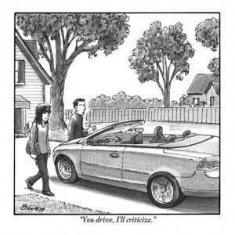
Key Principles of Successful Professional Mentoring
Partnership
Preparation
Personalisation
Pupil Progress
Protection
Christian Education with Care

Slide 14
Question Time
Please feel free to ask any questions you may have in relation to the role of Professional Mentor in supporting NQTs.
Christian Education with Care

Slide 15
Contact Details:
Matthew Connor-Hemming
Deputy Headteacher
Blue Coat School, Coventry
connor-hemmingm@bluecoatschool.com
024 7622 3542
Christian Education with Care

