Slide 1
Warwick Journal of Education – Transforming Teaching
Dr. John Thornby
University of Warwick, Centre for Professional Education

Slide 2
Overview
Context and Rationale
Journal Aims
Meet the WJETT Editorial Team
Journal Info
Meet the contributors to Volume 1
How to Get Involved and Future Opportunities
Q&A

Slide 3
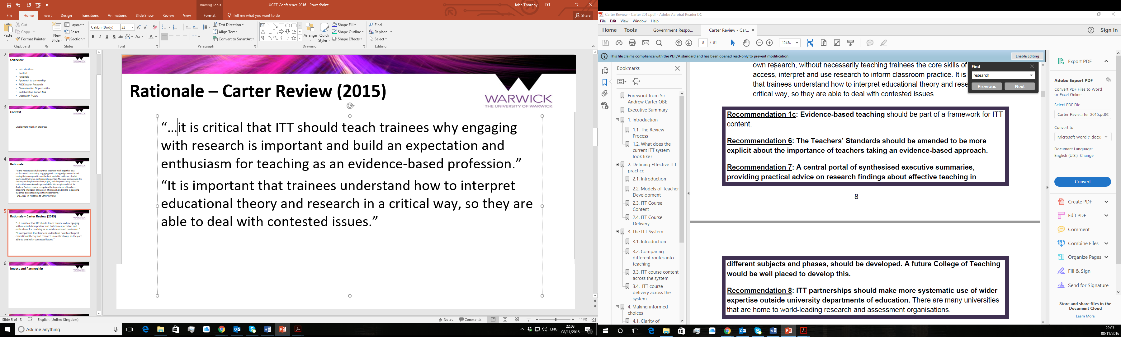
Context – Carter Review
“…it is critical that ITT should teach trainees why engaging with research is important and build an expectation and enthusiasm for teaching as an evidence-based profession
It is important that trainees understand how to interpret educational theory and research in a critical way, so they are able to deal with contested issues.” – Carter Review (Carter, 2015)

Slide 4
Context – Response to Carter Review
“In the most successful countries teachers work together as a professional community, engaging with cutting-edge research and basing their own practice on the best available evidence of what works and their own professional expertise. They are accountable for the impact they have on their pupils, and they constantly strive to better their own knowledge and skills. We are pleased that Sir Andrew Carter’s review recognises the importance of teachers becoming intelligent consumers of research and skilled in applying evidence-based teaching in their classrooms.”
– Government response to Carter review of ITT (DfE, 2015)

Slide 5
Rationale – Supporting Teachers’ Standards
“High-quality professional development requires workplaces to be steeped in rigorous scholarship. Professional development should be underpinned by robust evidence and expertise… should include collaboration and expert challenge.”
– Standard for teachers’ professional development (DfE, 2016)
“Trainees should be introduced to the most relevant and recent research, propositions and theories relevant to good classroom practice… encouraged to view these with a critical eye, questioning outcomes, conclusions and limitations.
…demonstrate an understanding of the basics of empirical research methods, both quantitative and qualitative, and understand the benefits and limitations of different types of research.
…are fully conversant with… bias, reliability and validity”
– A Framework for Core Content for ITT (DfE, 2016)

Slide 6
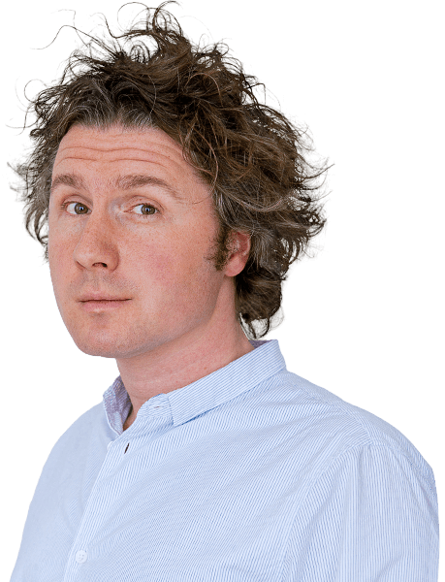
By collecting better evidence about what works best, and establishing a culture where this evidence is used as a matter of routine, we can improve outcomes for children, and increase professional independence.
– Dr. Ben Goldacre
Teaching
IMPACT
Outcomes
Building Evidence into Education, Bad Science, (Goldacre, 2013)

Slide 7


Slide 8
Journal Aims
WJETT aims to bridge the gap between academic researchers and practitioners
Platform to share (best) practice
Deliver innovative and creative pedagogy
Intellectual discourse
Aimed at all education phases (Early Years through to Higher Education)
Range of contexts, i.e. not just schools!

Slide 9
Journal Goals – Partnership
Journal
Schools
PGCE / MA Students
Partners
Academics
Pupils
Attracted internal funding from Institute of Advanced Teaching and Learning to launch a journal
Partners can contribute innovative practice, practitioner research and whole school initiatives
Student involvement
Use partnership to encourage the community of practice we want to see

Slide 10

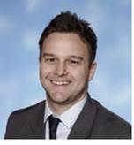
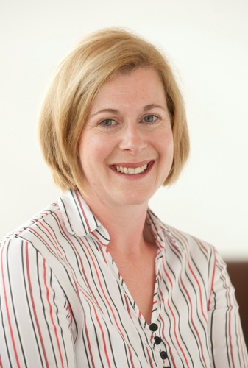

The Editorial Board
John Thornby
Editor-in-Chief
Chris Heal
Editor
Deb Outhwaite
Editor
Ralph Tabberer
Associate Editor (International)

Slide 11

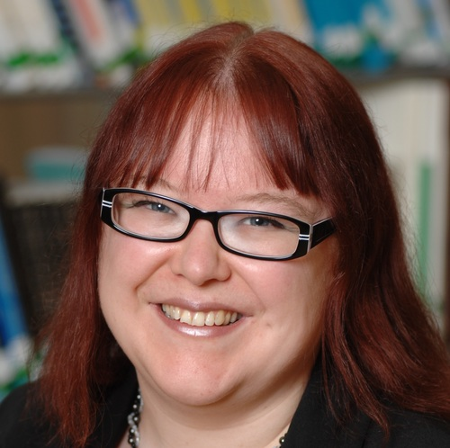
Acknowledgements
Institute for Advanced Teaching and Learning
Yvonne Budden
Head of Scholarly Communications,
University of Warwick Library

Slide 12

Journal Info
WJETT currently publishes annually (plus special issues)
Will review next year to examine feasibility of publishing 6-monthly
Free of charge, Open Access
Articles and literature reviews are all peer-reviewed (double blind)
Reviewers: usually one practitioner and one academic
Predominantly an online journal (URL & contact info on final slide)
Hard copy inaugural issue to mark the launch
A copy will be posted to each partner school in the next few weeks

Slide 13
Focus and Intended Audience
Aimed at the practitioner / school leadership
Each piece, we hope, has a take-home message for the reader
Focus is on transforming / developing education
Classroom strategies / new approaches or pedagogy
School improvement
Practitioner research

Slide 14
Over to the contributors…

Slide 15
Opportunities to Get Involved
WJETT is recruiting!
Looking for: Editors, Reviewers and Authors
In particular, seeking representation from other phases / contexts (especially Primary, Early Years, FE)
No experience necessary, we will provide guidance and hand-holding for those new to this kind of work
Competition: Design a logo!

Slide 16
Q & A
Dr. John Thornby john.thornby@warwick.ac.uk
Dr. Deborah Outhwaite d.outhwaite@warwick.ac.uk
WJETT wjett@warwick.ac.uk
http://journals.warwick.ac.uk/index.php/wjett/

