Slide 1

‘Time to TaLK’
Finham Park School

Slide 2
“Always make new mistakes.”
—Esther Dyson
Today’s Outcomes
To know our TaLk structure
To understand our principle of research for all teaching colleagues
To reflect on research in your own schools

Slide 3

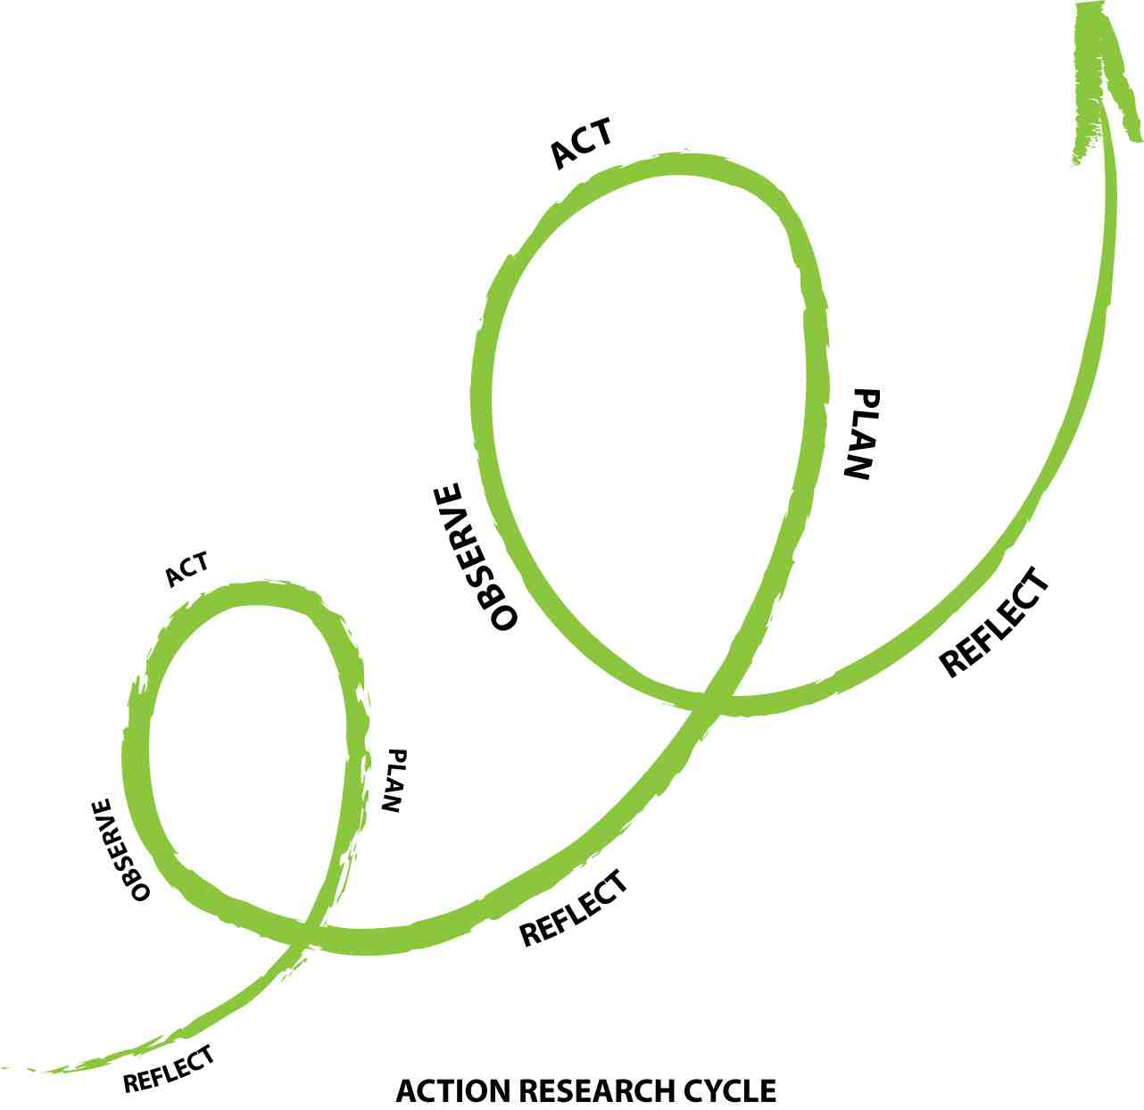

Slide 4

Don’t good teachers always. . .
. . . reflect on their work?
. . . raise questions every day about their practice?
. . . learn from their teaching?
YES! This is informal “teacher research”
We know this is happening ….. but we need to show impact

Slide 5
What do Teacher Researchers Do?
Develop questions based on their own curiosity about their students' learning and their teaching
Investigate their questions with their students systematically documenting what happens
Collect and analyse data from their classes including their own observations and reflections
Examine their assumptions and beliefs
Articulate their theories
Discuss their research with their colleagues for support as "critical friends" to validate their findings and interpretations of their data
Present findings to others
Talk to their students
Give presentations (talk to teacher in room next door, go to conferences)
Participate in teacher research web sites, online forums, and e-mail communications
Write about their research (school-wide publication, national)

Slide 6
TaLK
2015/16
FROG
High Challenge Classrooms
SEN
KS5
Closing gaps
AfL
Numeracy
Literacy

Slide 7
Teaching and Learning Communities
(TaLk)
2016/17
English
Maths
Science
IT &
Business
MFL
Humanities & Social Sciences
Art &
Technology
PE & Creative Arts

Slide 8
FACILITATOR
⬇
CO-FACILITATOR
⬇
FACULTY GROUP
LT LINK
Organisation of our research groups

Slide 9
TaLK Blogs / T and L Frog Page / Spotlights / Performance Management documentation / Lesson Sample
Department Meeting
What areas does the faculty need to work on.
Allocate staff to groups
Meeting 1
Question setting and research methods
Meeting 2
Reviewing and Analysing Progress
Department Meeting
Share ideas, approaches being used with department
“Time to TaLK”
Meeting 3
Reviewing and Analysing Progress
Department Meeting(s)
Present work from TaLK group
Meeting 4
Evaluating Work and Feedback
Summary of sub groups –Share work at WAGOLL Wednesday(s) Autumn Term
Meeting 5
Evaluating Work and Feedback

Slide 10
2016-2017 priorities…
ASSESSMENT FOR LEARNING including marking for literacy
HIGH CHALLENGE CLASSROOMS
ENGAGING BOYS AND IMPROVING THEIR PROGRESS
Linked to our School Development Plan
and included on appraisal for all staff

Slide 11
A “signature pedagogy” for teacher learning
Every TaLk workshop follows the same structure and sequence of activities:
Activity 1: Introduction (5 minutes)
Activity 2: Starter activity (5 minutes)
Activity 3: Feedback (15 minutes)
Activity 4: New learning about one of 3 priority areas (15 minutes)
Activity 5: Personal action planning (10 minutes)
Activity 6: Review of learning (5 minutes)

Slide 12

Every TaLk group needs direction
The job of the TaLk facilitator(s):
To ensure that all necessary resources are available at meetings
To ensure that the agenda is followed
To maintain a collegial and supportive environment
But most important of all:
It is not to be the “expert.”

Slide 13

Making a commitment
Action planning:
Forces teachers to make their ideas concrete and creates a record
Makes the teachers accountable for doing what they promised
A good action plan:
Does not try to change everything at once
Spells out specific changes in teaching practice and the impact they will have
Relates to the 3 key priorities
Is achievable within a reasonable period of time
Identifies something that the teacher will no longer do or will do less of

Slide 14

Peer observation
Run to the agenda of the observed, not the observer:
Observed teacher specifies focus of observation:
E.g., teacher wants to increase wait time.
Observed teacher specifies what counts as evidence:
Provides observer with a stopwatch to log wait times.
Observed teacher owns any notes made during the observation.

