Slide 1

PGCE Primary and Early Years
New Mentor Training
Kate Glavina & Sally Hewitt
‘My mentor was an inspiring role model to look up to…’
‘Thank you to my mentor for a really supportive attitude.’
‘Even though my mentor was busy, she always found time for my weekly meetings.’
‘My mentor put me at ease right from the beginning.’

Slide 2


Welcome to today’s session
We aim to:
Introduce you to the Partnership
Overview of the mentor role
Familiarise you with key documents

Slide 3
The Warwick Partnership
School Mentors
1ST - PUPILS
2ND TRAINEES
Class teachers
Link Tutors
Uni tutors
Notes:
Warwick is an ‘Outstanding’ provider
You are excellent trainees

Slide 4
Ofsted – key strengths
The partnership’s strong emphasis on the impact of teaching on pupils’ progress and learning. Trainees are acutely aware of their accountability for pupils’ achievement and progress over time.
The impressive range of specifically detailed partnership documentation, which provides a meticulous focus on the teachers’ standards. This shared and well-understood information enables the partnership to track accurately the progress of individual trainees, evaluate the quality of their work and provide detailed steps for continued development.

Slide 5
Exceptionally high expectations of trainees, which drive ambitious levels of challenge supported by expertly crafted training.
The partnership has a clear and ambitious vision for sustained excellence and is clearly focused on further improving high-quality provision and outcomes for trainees and pupils in schools.
The partnership’s strong drive to sustain and further develop the highest quality provision possible. All improvements are informed by a systematic and scrupulous analysis of internal and externally validated information.

Slide 6
What do you think the role of the mentor is?

Slide 7
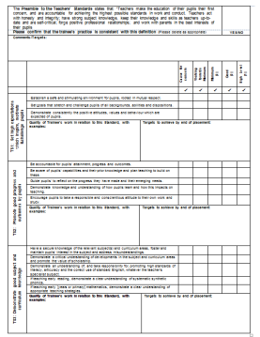
Link Tutor role...
Mentor
Link Tutor
Providing challenging developmental targets
Moderation of the judgements
LT will submit the Profile to SPO

Slide 8
Roles: the school Mentor
Manages training in school
Monitors the trainee’s individual targets during weekly meetings
Maintains direct contact with Link Tutor and raises any concerns with them during placement as soon as necessary
Is responsible for final assessment of the trainee’s progress (NB: role and context! They are not qualified yet…don’t judge them as you would your colleagues)
Checks the trainee’s planning and assessment file
Arranges weekly observation (as a minimum) with written feedback. This may include observation by the class teacher or subject co-ordinators.
Arrange observation of teaching of phonics (all placements)

Slide 9
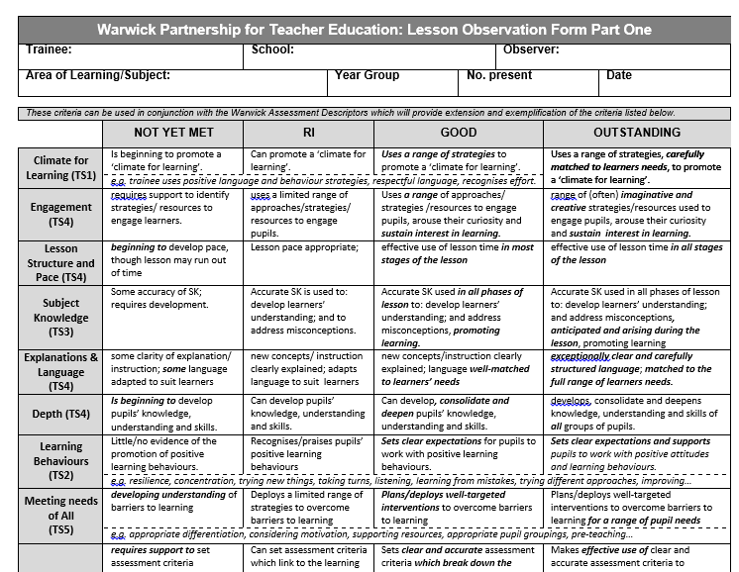

Slide 10
A key emphasis in our mentor and Link Tutoring:
Please ensure that trainees reference any points of discussion at Mentor Meetings against the Teachers’ Standards.
Please ensure that when you feedback to trainees after a lesson, you refer to the Teachers’ Standards orally as well as in writing e.g. Let’s think about TS4: Planning well structured lessons...what did you think about the length of time children were kept on the carpet before moving to the independent task?
Notes:
A recent ‘mock inspection’ highlighted that in sessions observed by the inspector, Teachers’ Standards were not being referred to routinely either in oral feedback or in terms of targets on forms. Standards referenced on paperwork is an important evidence trail for the trainee, but the emphasis on oral reference to the Standards ensures that trainees are ‘immersed’ in their expectations, aiding self-evaluation and accurate self-assessment.

Slide 11
Lesson Feedback …
works best when:
Trainees are actively involved in the discussion;
  ‘share’ feedback rather than ‘give’ feedback
Trainees are able to identify ‘what went well’ BEFORE listing ‘what went wrong’!;
  Need to assess whether they know what worked
Trainees are encouraged to focus on pupil progress and outcomes;
  Could bring outcomes as evidence;
Refer back to personal targets from previous lessons to identify progress;
  Recognise the assessment cycle for their own practice

Slide 12

Notes:
Reminder – trainee responsibility BUT mentors to see and sign weekly especially re targets each week.
Trainees have their own copy and are responsible for keeping it up to date and in placement file and transfer it between placements

Slide 13
Training Plan
Aims of the training plan:
To support trainees’ self-management of their professional development over the PGCE/EYITT programme, including target-setting and review of progress against these targets.
To facilitate mentor engagement with a trainee’s development over the whole PGCE/EYITT programme, including target-setting and review of progress against these targets.
It is the trainee’s responsibility to keep their Training Plan up to date; at your weekly meeting please initial it to confirm targets have been met/addressed.

Slide 14
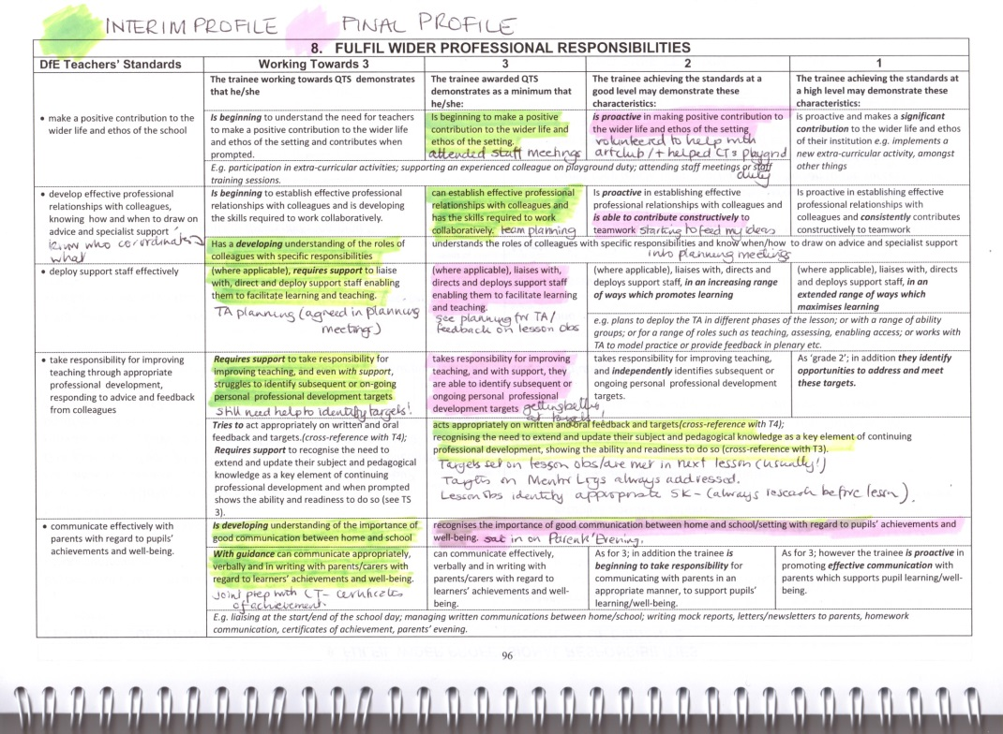
The WADs are the trainees’ ‘Steps to Success’
Notes:
Essential Tools – of your Mentor/CT isn’t using give them a copy of the Lad to support your lesson obs; share WADs in a Mentor meeting
However – even more important that YOU use them!
Use to self-assess, identify gaps and next steps.

Slide 15
Processes for ‘challenging short- and longer-term developmental targets’
through Mentoring that:
- is provided by experienced and expert mentors;
- responds to trainees’ specific training needs.
So you need to know that:
- our trainees arrive on placement with individualised
targets that are shaped by outcomes of their SK audits and
progress on previous placement.
- these targets will be the focus of Mentor meetings and will
change and evolve as the placement unfolds.

Slide 16
Interim and final Profiles
Interim - Completed part way though and offers a formative opportunity to assessement
Final Profile – Completed at the end of the placement.
Both profiles require mentors to make judgements against the Teachers’ Standards.

Slide 17
Progression in Placements
Early in the course/PP1 Observation, discussion, micro-teaching
Autumn/PP2 Teach core subjects/EY curriculum; 55-60% of TT
Spring/PP3 - Teach core and foundation/KS1; 65-70% of TT
Summer/PP4 - Teach core and foundation subjects/EY curriculum; 75-80% of TT

Slide 18
Progress on Placement – doesn’t look like this
High level (1)
Good level (2)
Min level (3)
Not achieving Standards
(WT)

Slide 19
Peaks and Troughs – not necessarily ‘over-grading’
High level
Good level
Min level
Not achieving Standards

Slide 20
Mentor Role
Manages training in school
Consider implications of trainee’s ISP where appropriate.
Monitors the trainee’s individual targets during weekly meetings (recorded in Training Plan)
Maintains direct contact with Link Tutor and raises any concerns with them during placement as soon as necessary
Is responsible for final assessment of the trainee’s progress (NB: role and context! They are not qualified yet…don’t judge them as you would your colleagues)
Checks the trainee’s planning and assessment file
Arranges weekly observation (as a minimum) with written feedback. This may include observation by the class teacher or subject co-ordinators.
Arrange observation of teaching of phonics (all placements)

Slide 21
The Mentor will also:
Organise observations throughout the school to meet trainee’s needs/targets (recorded
Liaise with class teacher and file feedback from other staff in school, as evidence of performance
Use Warwick Assessment Descriptors formatively throughout placement to promote trainee’s progress
Conduct a joint observation/feedback with the Link Tutor
If necessary, be prepared to mediate between trainee and class teacher

Slide 22
Procedures for Weak Trainees
In the event of concerns about a weak trainee, please contact your Link Tutor - as soon as possible - who will be prompt to support you.
An action plan can be implemented to support trainees who are struggling to make progress.

Slide 23
National Priority areas for ITE
Phonics and early reading
Early (ie primary) mathematics
Behaviour Management (including all types of bullying)
EAL and SEND
PE
Additional Inspection themes:
-RE & SMSC – including Prevent and British values and being familiar with how these are delivered in school
Notes:
These are areas of the curriculum and of pedagogy that trainees are expected to discuss, observe, teach, see school policy for etc

Slide 24
The trainees’ perspective
My mentor made all the difference – she was JUST GREAT! | My mentor encouraged me by always identifying the positives first. | Thank you for being there when I really struggled. | My mentor really encouraged me to try new things and be creative in my approach.
My mentor was fantastic at picking me up after a bad lesson. | My mentor developed my practice by being challenging and believing in me. | My mentor believed in me, even when I didn’t believe in myself. | My mentor was a source of brilliant, practical advice.
Notes:
Warwick is an ‘Outstanding’ provider
You are excellent trainees

Slide 25
Trainees emphasised the importance, to them, of the following:
Having regular meetings
Time for incidental chats
The value of your encouragement and positivity, especially when they are feeling ‘low’ or have had a weak lesson
The importance of providing accurate, supportive feedback with ‘next steps’ so they can implement the changes to improve their practice
Help using the WADs to ensure that everyone is clear about their progress and what they have to do next

Slide 26
Coaching behaviours
Push:
Solving someone’s problem for them
Pull:
Helping someone to solve their own problem

Slide 27
Push
DIRECTIVE COACHING BEHAVIOURS
Instructing
  Giving advice
Offering guidance
    Giving feedback
Making suggestions
Summarising
Paraphrasing
Reflecting
Asking questions that raise awareness
Listening to understand
Pull
NON-DIRECTIVE COACHING BEHAVIOURS

Slide 28
Final thoughts…..
Relationships
Values
Growth

Slide 29
The Partners’ Intranet: Password: partnercpe
Lots of information is available on our Partners’ Intranet including podcasts of:
a mentor discussing their role
a mentor discussing how to receive and support a trainee on placement
how to conduct a mentor meeting
how to support a weak trainee
http://www2.warwick.ac.uk/fac/soc/cpe/pintra/ey_primary_mentor_portal/

