Slide 1


Proactive support for ITT Mentoring and Coaching
How you choose your mentors
Challenges to mentors
How you support your mentors
Aidan Jenkins Lead Practitioner for Initial teacher Training
Notes:
Short sharp

Slide 2

What words immediately come to mind when you think of a mentor?

Slide 3
Mentoring and Coaching words
correcting focussing guiding caring
leading listening advising enlightening
testing probing helping questioning
motivating challenging shaping supporting
teaching counselling criticising sharing
trusting demonstrating loving encouraging
training achieving explaining planning
facilitating comforting protecting problem-solving
exploring inspiring developing pushing
summarising suggesting paraphrasing reflecting
instructing reflecting giving advice giving feedback
re-framing modelling balancing redirecting ……..
Notes:
A lot here, but pick some emotional and deep. Show how diverse the role is no need to read all

Slide 4
advising
Leading
Criticising
Testing
Loving
Caring
Trusting
Facilitating
Challenging
Training
Reframing
Inspiring
Modelling
Problem solving
Correcting

Slide 5
Mentoring: Definitions
‘giving another person help and advice over a period of time and often also teaches them how to do their job or role’ (International Institute of Coaching)
‘concerned with “growing an individual”, both professionally and personally and is somewhat characterised by an ”expert-novice” relationship’ (Lord, Atkinson, Mitchell 2008 p.9)
‘ a development process, including elements of coaching, facilitating and counselling, aimed at sharing knowledge and encouraging individual development’ (Renshaw 2008, p.11)
Notes:
What are the key words. Link to coaching

Slide 6
Coaching: Definitions
‘an interactive results orientated enlightening process that brings about change’ (International Institute of Coaching)
‘typically conceived as [having] an emphasis on improvement of skills and performance’ (Simkin et al 2006, p.323
‘an enabling process aimed at enhancing learning and development with the intention of improving performance in a specific aspect of practice. It has a short term focus with an emphasis on immediate micro issues’ (Renshaw 2008 p.12)
Notes:
All about performance and change

Slide 7

Mentoring and coaching as connected and distinct processes
Notes:
So how do they link? How are they different?

Slide 8
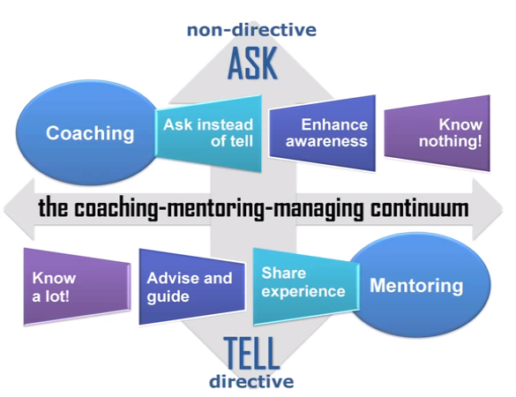
Notes:
A fluid movement along this line dependant on the trainee and the area for development

Slide 9
Directive
Mentor seen as having expertise in the area for discussion
Approach is instructional, similar to tutoring
Mentor seen as driving the required actions
Non-directive
Coach does not need to have expertise in the area for discussion
Approach is non-directive
Coachee takes responsibility for setting goals and deciding on actions

Slide 10
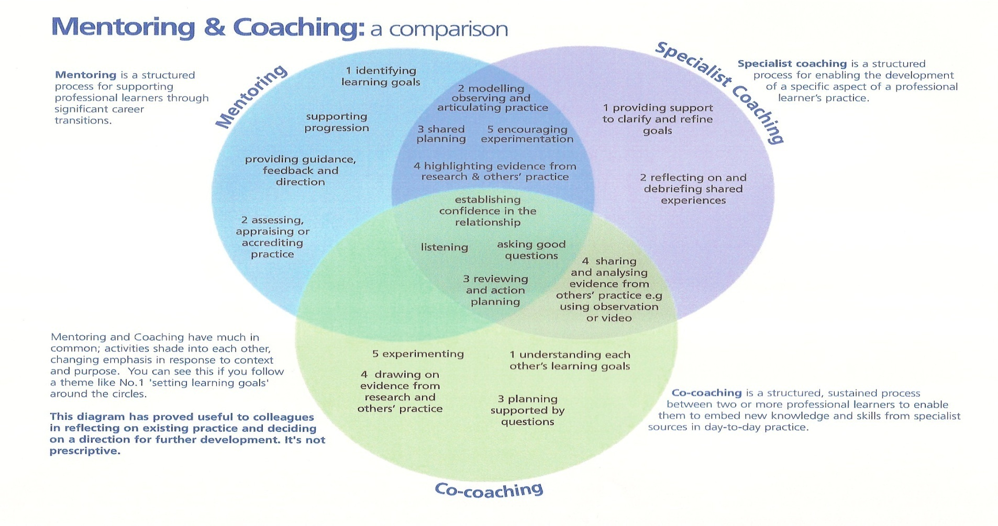
Notes:
Ideally in the middle. But ability to move between

Slide 11

Qualities of a great ITT mentor?
On the flip chart paper put down all the qualities your group can think of
Notes:
After 5 minutes put all the flip charts up around the room

Slide 12

Mentors
Focus on helping the learner to develop their abilities
Act as a knowledgeable friend
Listen and challenge assumptions
Question to encourage a wider view and range of learning and experimentation
Provide openings for change and autonomy
Let the learner own and direct the relationship
Help someone, having no hidden agenda, with their personal or, professional career development
Create a safe arena in which a trusting relationship can develop
Maximize the learner’s internal resources
Can learn to be more effective
http://www.resourcesystemsconsulting.com/mentoring/
Notes:
Add the theoretical qualities

Slide 13

Diamond Nine
A Diamond Nine Diagram helps to prioritise and categorise key factors. The most important factors are placed towards the top of the "diamond 9 ". The least important factors are placed towards the bottom. Factors of equal importance are placed in the same row.
Notes:
Choose your top 9

Slide 14
1
2
2
3
3
3
4
4
5
Notes:
Put diamond 9s around the room or leave on table and candidates walk around and look at others.

Slide 15
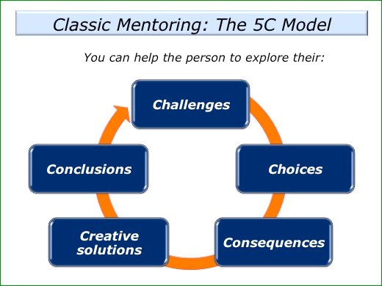

Slide 16

Challenges to mentors
Notes:
Think pair share. Time, confidence, ability, paperwork, relationship breakdown. Should you ever change a mentor?

Slide 17

How do you choose your mentors?
Notes:
TLR? Volunteers? Most keen? Don’t need to show this slide

Slide 18

How do you support your mentors?
Money
Time
Training
Joint observations
Swapping mentees
Recognition
Reflective logs
Access to training at Warwick
Common vision
Accountability
Notes:
Mentors are back bone of the training. Needs thought, planning and a vision. Don’t need to show this slide

Slide 19

Action planning
How will you:
Recognise key Qualities
Identify the right people
Overcome Challenges
Apply Best Practice

