Slide 1
Excellence in Education Conference
Warwick and Schools Partnership
WELCOME
Kate Ireland - Director of the Centre for Professional Education

Slide 2
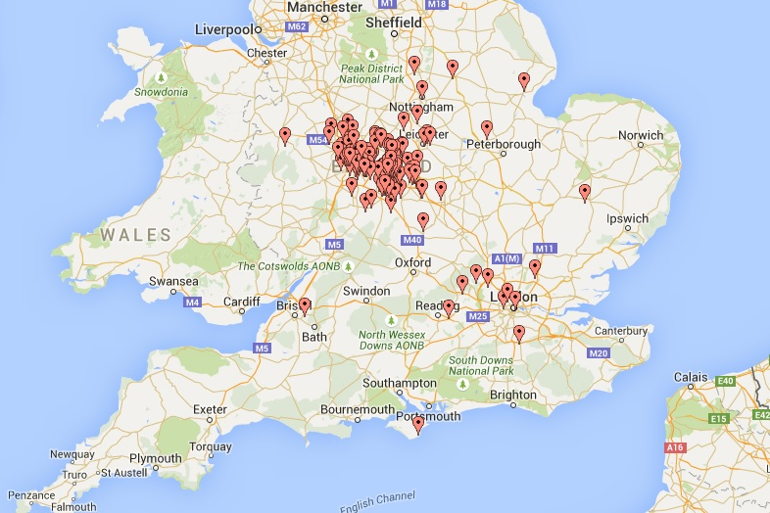


Partnership with Schools
Over
500
schools in the Warwick Partnership…
98%
employment,
with
…accommodating
around
2000
placements in 2016/17
70%
of these in
local schools

Slide 3







Key Data 2015-16
97%
94%
completion for
our 2015-16 cohort
“Outstanding” or Good” final grades 2015-16
of our trainees that rated their overall satisfaction "Outstanding" or "Good" in contrast to
for all Russell Group Universities (PTES, 2016)
PG element of their course…..
43% of our 2015/16 cohort achieved Distinction or Merit

Slide 4
Centre for Teacher Education (CTE)
Vision:
To be the first choice for teacher education. Strongly contributing to teacher supply, school improvement in our local & regional communities, with an outstanding national & international reputation for academic & professional excellence.
Mission:
To create expert teachers & innovation in teacher education which makes a lasting difference in children's & young people’s lives.
Distinctiveness of CTE
What makes the Warwick Partnership with Schools Distinctive?
Research-led
Well-being and resilience of teachers
Notes:
Changing identity of CPE: set up as a mainly teaching dept, but now greater pressure to ensure research underpinning and knowledge exchange

Slide 5
Professor Stuart Croft
University of Warwick
Vice-Chancellor and President

