Slide 1
Pupil Wellbeing
Nikki Sawyer
Warwickshire Specialist Teaching Service

Slide 2
Aims
• To consider the impact of pupil wellbeing
To recognise behaviour as an indicator of wellbeing
To provide an initial introduction to the theory behind functional behavioural analysis, through;
-Considering the reasons for (function of) challenging behaviour and;
-Considering the idea of behaviour as communication.

Slide 3
What is wellbeing?
noun.
The state of being comfortable, healthy, or happy
English | Oxford Dictionaries

Slide 4
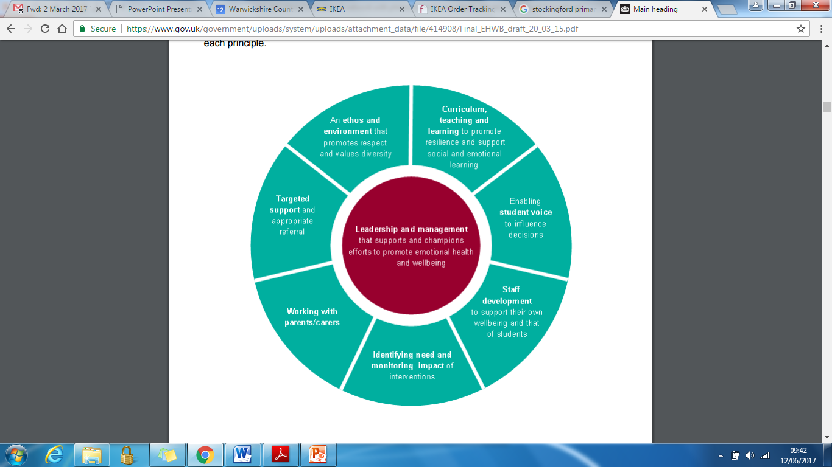
Eight principles to promoting a whole school and college approach to emotional health and wellbeing
Public Health England (2015)

Slide 5
This briefing provides a broad, succinct scope of the scientific evidence highlighting the link between health and wellbeing and educational attainment. It underlines the value for schools of promoting health and wellbeing as an integral part of a school effectiveness strategy, and highlights the important contribution of a whole-school approach

Slide 6
The link between pupil health and wellbeing and attainment
A briefing paper by Public Health England
Key points from the evidence:
Pupils with better health and wellbeing are likely to achieve better academically.
Effective social and emotional competencies are associated with greater health and wellbeing, and better achievement.

Slide 7
3.The culture, ethos and environment of a school influences the health and wellbeing of pupils and their readiness to learn.
4. A positive association exists between academic attainment and physical activity levels of pupils.

Slide 8
There are resources available to help school staff support good mental health and emotional wellbeing. The PSHE Association has produced guidance and lesson plans to support the delivery of effective teaching on mental health issues. In addition, MindEd, a free online training tool, provides information and advice for staff on children and young people’s mental health and can help to sign post staff to targeted resources when mental health problems have been identified.

Slide 9

Behaviour as Communication
Warwickshire Educational Psychology Service
Dr Dan Lake, Educational Psychologist

Slide 10

Behaviour / Belonging

Slide 11
Why do young people engage in behaviours of concern?
What are some of the possible causes?

Slide 12



Behaviour = Communication
=
=
=
I’m feeling silly / I’m feeling bored so I’m not listening to you!
I’m scared / I feel unsafe/ I need to escape
I’m annoyed / frustrated

Slide 13

Children are invariably trying to solve
problems rather than be one!
Their solutions to problems
are often misguided because
their concept of the problem
is faulty or because their
skills leave much to be desired.
Martin Herbert (1985) Caring for Your Children

Slide 14
How can we establish the purpose of the behaviour?

Slide 15
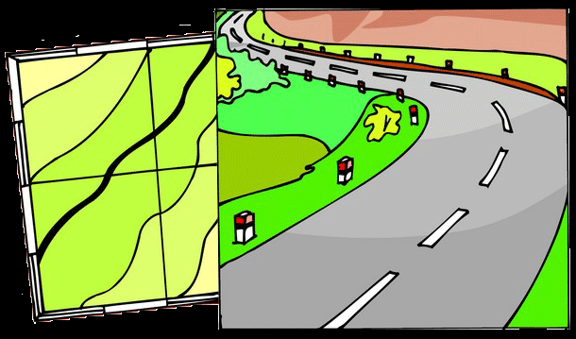
Functional Behaviour Analysis:
•Helps us to learn about people before we intervene to offer support
•Is carried out in collaboration with key people
•Leads to theories for challenging behaviour on which we can base our intervention
•Guides us towards an individually tailored plan

Slide 16
Functional analysis summarised:
1.Identify specific behaviours of concern
2.Consider triggers that may prompt the behaviour (antecedents)
3.Consider responses that may maintain the behaviour (consequences)
4.Consider the purpose of the behaviour, and what this may communicate
5.Adapt and intervene accordingly

Slide 17
The 4 main (internal) functions of behaviour
To gain social attention
Escape/ avoidance
To obtain something e.g.tangibles or activities
Sensory stimulation e.g. ASD

Slide 18
The importance of environmental (external) factors
What might be going on in a young person’s life that might be:
a)triggering
b)maintaining
c)exacerbating
…the behaviour of concern?

Slide 19
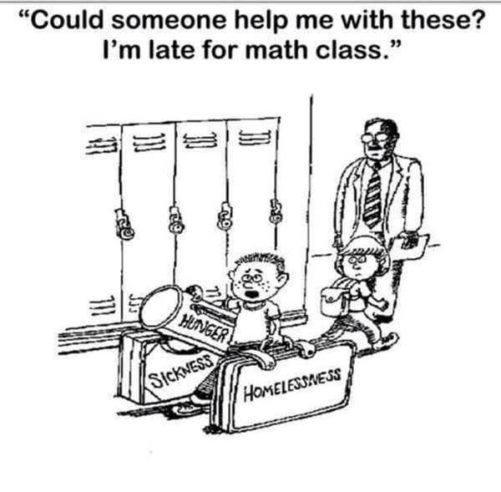
Environmental factors…

Slide 20

Environmental factors…

Slide 21
Identifying behaviours
of concern...

Slide 22
ABCC chart
Date & Time | Antecedent | Behaviour | Consequence | Communication

Slide 23
ABCC Charts
A - Antecedent (what happened before the incident) is key and may give you a fuller picture as to what the child is trying to communicate
B = Behaviour. Describe what the child is actually doing such as biting or throwing rather than phrases like ‘being aggressive’ or ‘disruptive’ (these are open to interpretation)
C = Consequence. What was the result for the child from their behaviour? e.g. did they have to leave, receive attention from others etc.
C = Communication, what you think the child is trying to say through their behaviour? What does the child get out of behaving in this way? What is the purpose?

Slide 24
We can also ask and answer questions….
Why does.….do…?

Slide 25
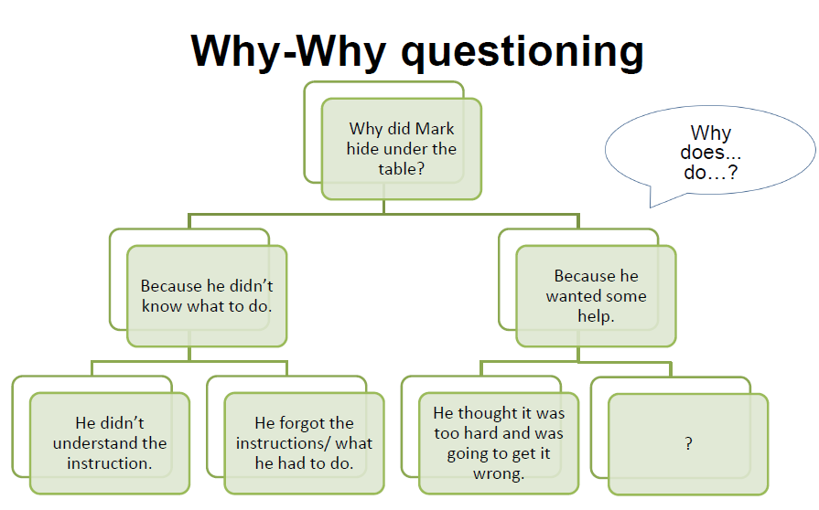
Language Memory Fear of failing/confidence

Slide 26
Why-Why questioning
We can use the Why-Why approach to consider many scenarios below and the possible reasons for behaviours:
–Why did Sally hit Peter?
–Why did Luca run out of the classroom?
–Why did Brandon not line up for lunch?

Slide 27
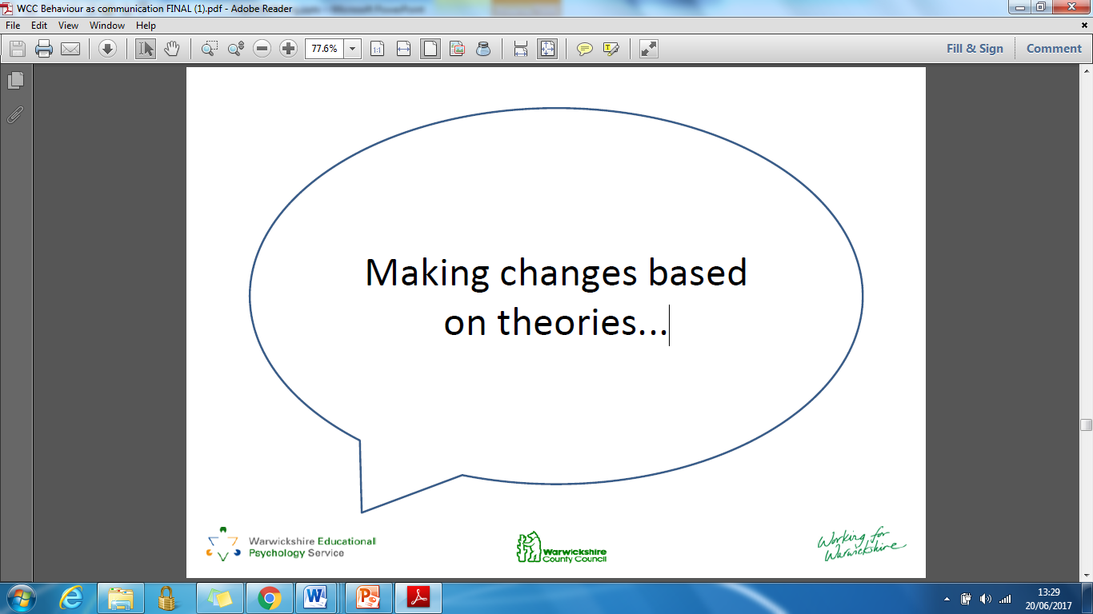

Slide 28
Purposes of behaviour:
Managing/altering behaviour is about recognising the possible purpose of the behaviour and supporting the child to have those needs met in an alternative, more appropriate manner.

Slide 29
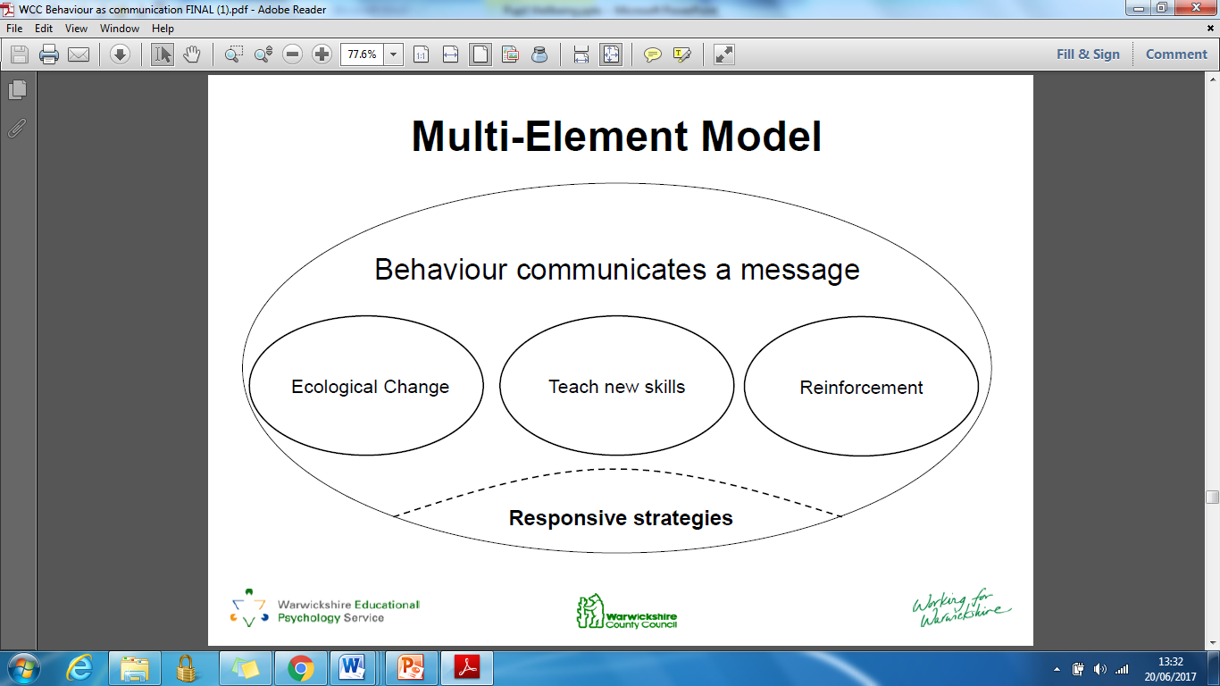

Slide 30
Teaching New Skills
There are two main types of replacement skills:
1.Teaching alternative skills
Direct replacement
2.Teaching coping skills
Increasing tolerance

Slide 31
Why is reinforcement important?
Behaviour is learned and maintained because of its consequences
Behaviour and consequences that have been ‘rewarded’ are more likely to be repeated

Slide 32
Functional analysis summarised:
1.Identify specific behaviours of concern
2.Consider triggers that may prompt the behaviour (antecedents)
3.Consider responses that may maintain the behaviour (consequences)
4.Consider the purpose of the behaviour, and what this may communicate
5.Adapt and intervene accordingly

Slide 33
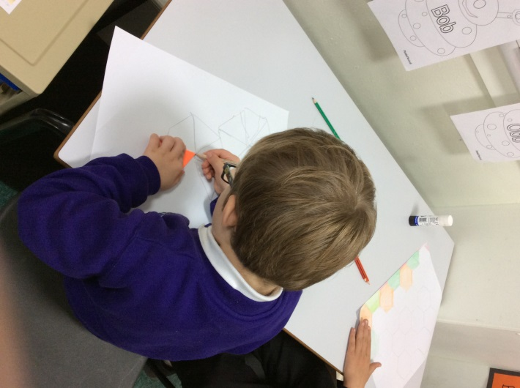
The Links

Slide 34
Where are they?
Bedworth: Wheelwright Lane Primary School
Nuneaton: Stockingford Primary School
(due to open fully September 2017)
Rugby: venue and start date tbc.

Slide 35
What are they?
A higher needs provision for primary age pupils
They offer a two term intervention, four days per week, aimed at those pupils who are struggling to manage their behaviour in school
Pupils remain registered at own school
Pupils may be at risk of exclusion and need support with their social and emotional well-being
It is considered that pupils will likely be re-integrated back into their own school
Pupils do not have an EHC Plan

Slide 36
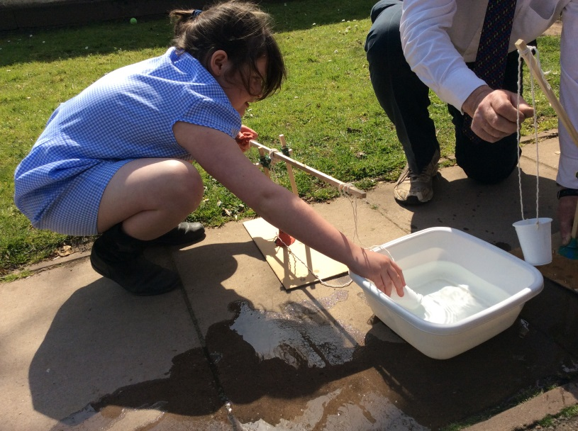
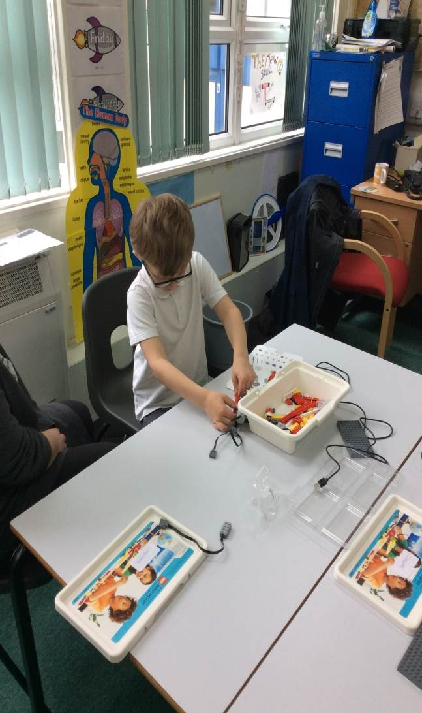
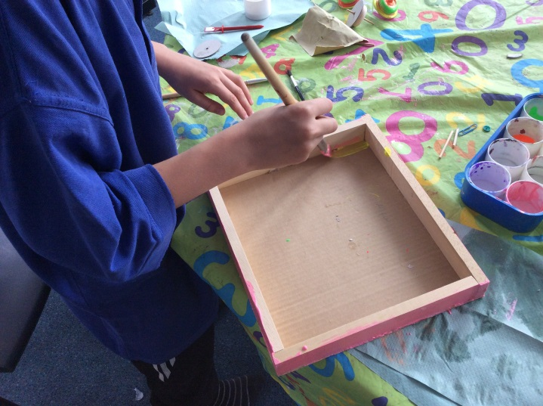
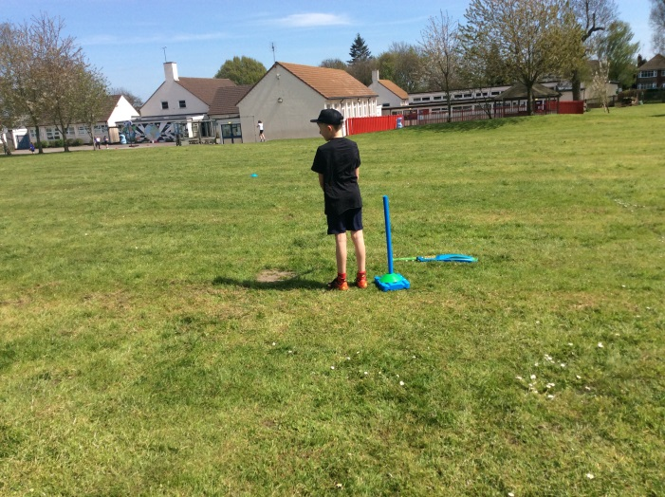
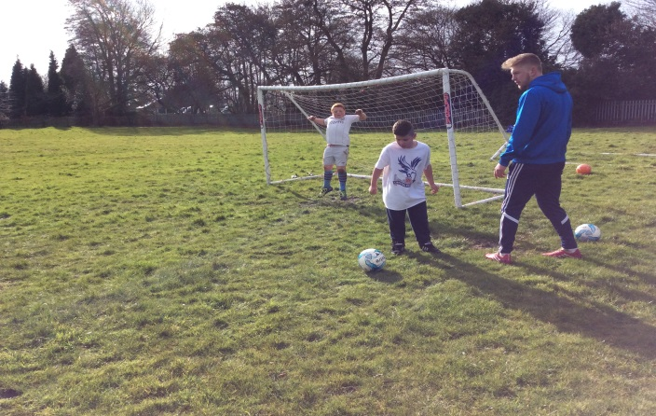

Slide 37
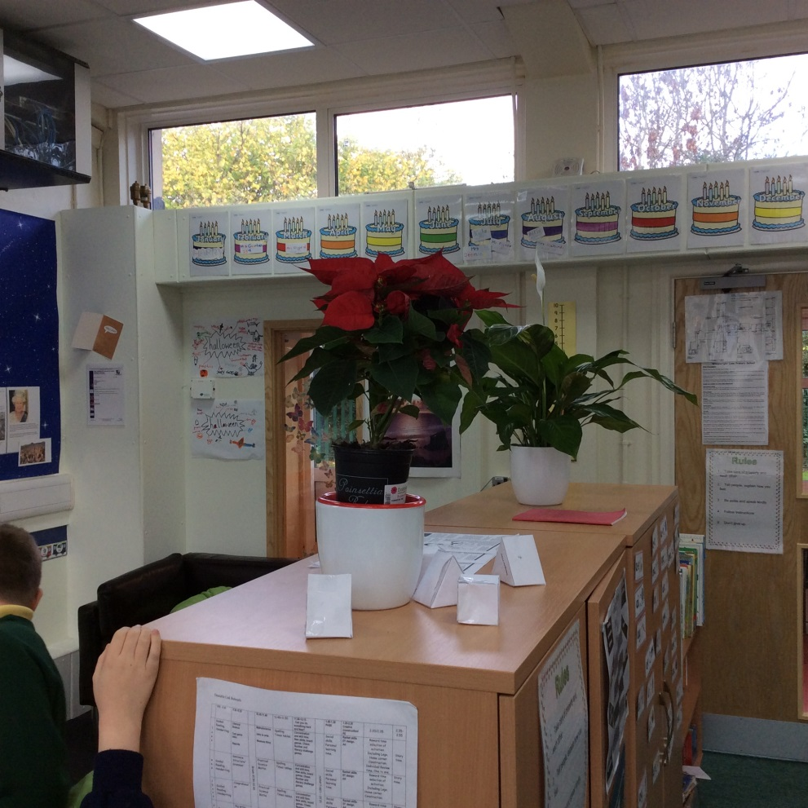
Core Skills in a Classroom environment
We aim to have the same expectations for work and behaviour.

Slide 38
How does a school apply?
Evidence of the following must be in place:
Multi agency involvement through EHSA, Priority Families or Children’s Social Care is in place
Home school and professionals involved in above plans and reviews support the placement
Reintegration into home school is probable.
Placement would be in the child’s best interest

Slide 39
How does a school apply?
Essential Evidence Included:
Positive Intervention Plans
Provision Map etc. (at least 2 terms)
At least 2 terms of Behaviour log (ABCC Charts)
Pastoral Support Plan (PSP)
Evidence of higher needs intervention
Boxall Profile
Evidence of working with parents

Slide 40
Who makes the decision?
A panel consisting of two senior leads for The Links; Educational Psychologist and two head teachers.

Slide 41
Where can I get more information?
Nikki Sawyer
nikkisawyer@warwickshire.gov.uk

Slide 42
Tips:
Know your children
Interventions such as ‘Time to Talk’
I.O.U: 5 minutes card
2 o’clock letter
Self referral to a learning mentor
2-6-2
www.minded.org.uk

