Slide 1
Reducing workload with digital technology
James Hannam
@iamjameshannam

Slide 2
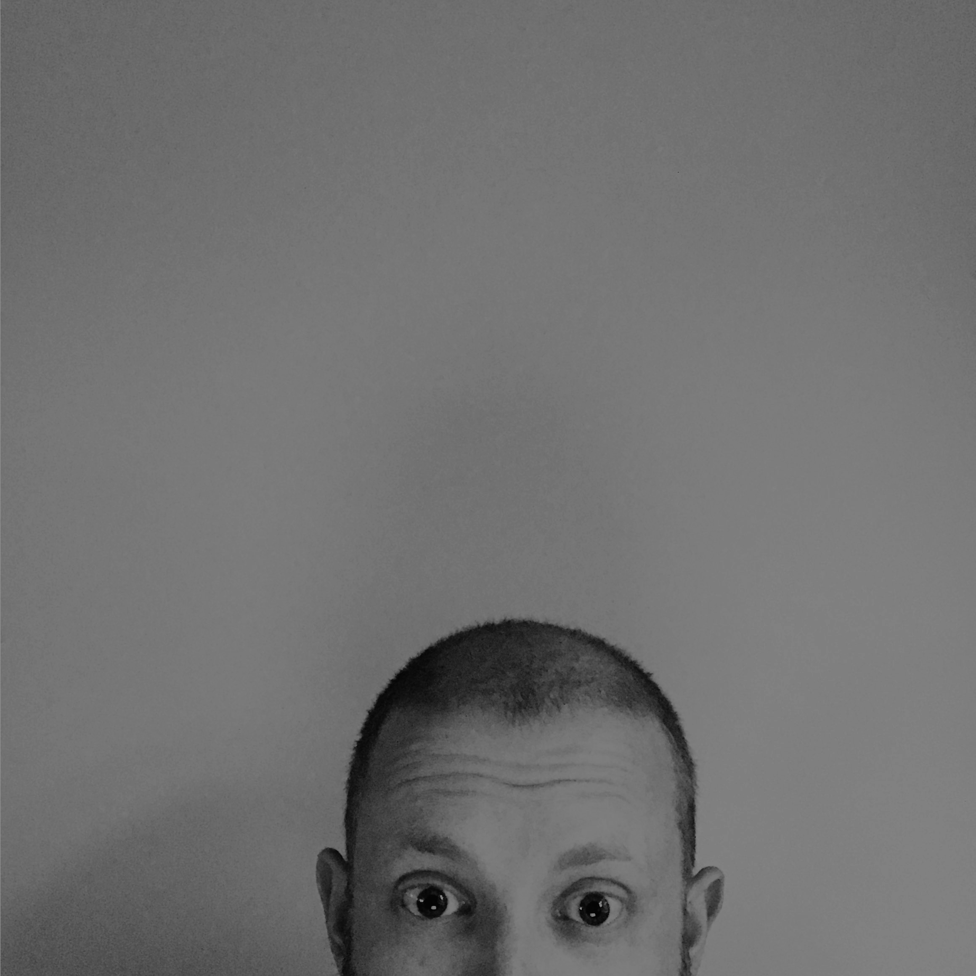
@iamjameshannam
Teacher. Consultant. Geek.
Notes:
I am james and this is what I do
Child story, everyone is a maker, teaching is making
...what I do now...current project MakerLabs

Slide 3

Notes:
MakerLabs

Slide 4
training / teaching
consultancy / advice
labs / camps
Notes:
Always boils down to...
Cost/Time secret sauce stuff
Focus on Workload
Invicta
Malton

Slide 5
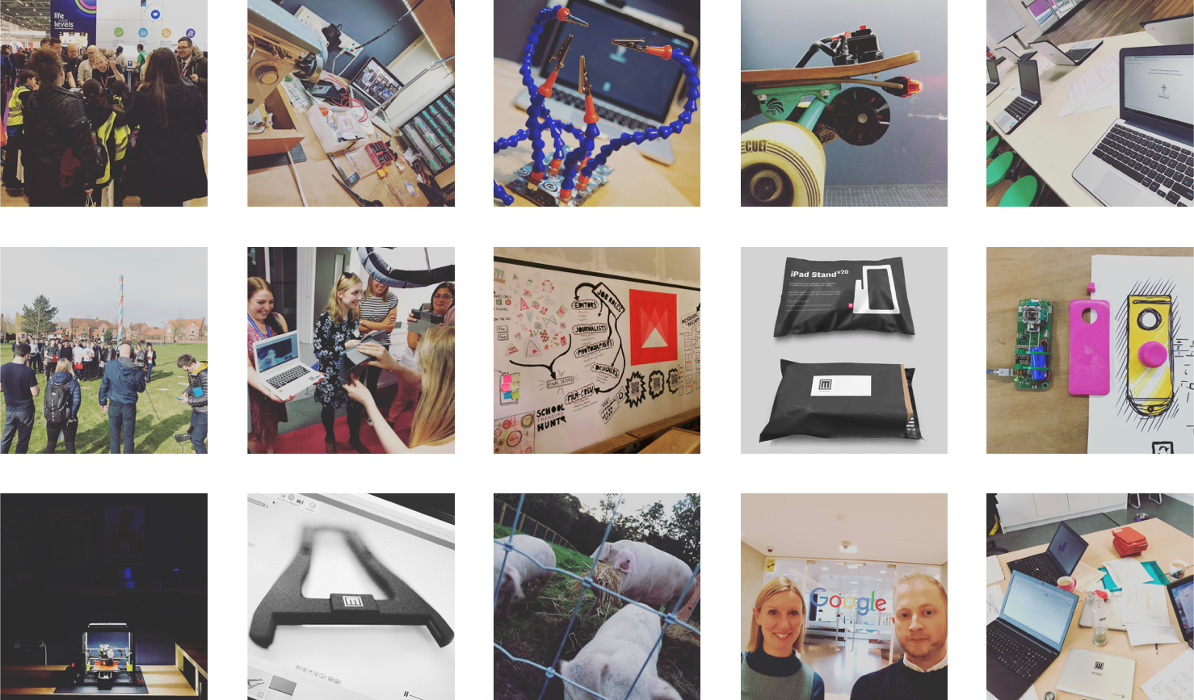
Notes:
These are the things I do.
I teach 14 yrs +
I make +34.5 years
I help schools make better use of their tech, and get back to creating teaching/learning experiences - fun

Slide 6
3 things
Notes:
Found 3 key problems across the UK

Slide 7
cost
time
workload
resources & things
to do, learn, apply
everything else
Notes:
Always boils down to...
Cost/Time secret sauce stuff
Focus on Workload
Invicta
Malton

Slide 8
workload 💪
Notes:
Quick wins with biggest impact in the shortest time

Slide 9
planning & sharing
assessment & feedback
automation
Notes:
Let’s have a look at these…
Different ways of doing it

