Slide 1

EXCELLENCE IN EDUCATION
Teacher Development, Recruitment and Retention - Learning from the Carter Review :
Developments in local and regional ITE/CPD
The role of Universities and multi-organisational collaboration in school improvement)
Prof Sam Twiselton Director of Sheffield Institute of Education Member of Advisory Panel for the Carter Review Member of the Advisory Panel for ITT Behaviour Report @samtwiselton s.twiselton@shu.ac.uk 22nd June 2017

Slide 2
My research in teacher development:
Involves membership of a critically reflective community of practice
Most likely in learning organisations that are conducive to this
Crisis and Regional Response
Not enough teachers coming in
Not enough teachers staying
Support and development unclear and not guaranteed
Carter Review
Not long enough
Not joined up to early career
Need to strengthen use of evidence and systematic enquiry

Slide 3
My research in teacher development:
Involves membership of a critically reflective community of practice
Most likely in learning organisations that are conducive to this
Crisis and Regional Response
Not enough teachers coming in
Not enough teachers staying
Support and development unclear and not guaranteed
Carter Review
Not long enough
Not joined up to early career
Need to strengthen use of evidence and systematic enquiry

Slide 4
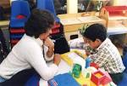
MY RESEARCH
Student teachers talking about their decisions in the classroom moment by moment – do any of the comments ring a bell?
I need him to keep busy
I want to get through this task
I want to feel in control
I don't want it to be too noisy
Martha
I want it to be finished by the end

Slide 5

Three types of teacher - or three points on a sliding scale:
Task Manager
Curriculum Deliverer
Concept/
skill Builder

Slide 6

TASK MANAGERS
I didn’t want them to start
being silly, that was really
the main thing I was
thinking about
My role was organisation -
make sure they went in
turns - went clockwise.
I wanted them to get the
sheet filled in
Really I was just concentrating
on getting it done.
Classrooms should look busy.
Classrooms should look orderly.
Children should complete their tasks. Teachers should be in control.

Slide 7

CURRICULUM DELIVERERS
To be honest I don’t know why - it was just what I was told to do – it’s what they always do
It was in the scheme…
that was what was next.
I have objectives to meet
My lesson plan focuses on this feature
I was mainly trying to get through the plan
Sajid
Learning is prescribed. Learning is dictated by someone else.
The curriculum is a goal in itself. Beyond this it is hard to give a reason why the learning is important.

Slide 8

CONCEPT/SKILL BUILDERS
I needed them to see which were the effective words
I wanted them to 'get' the text
I wanted them to see how it works so they could do it later
I was trying to get him to make the link
I knew they had to really get it - to understand .. before they could use it properly
I knew she would be able to use it in her writing
Lisa
Focused on the subject and why it matters. The concepts and skills are key.
Tasks only a vehicle for learning. The main goal lies beyond the lesson - transferable and transformative learning within and beyond subjects.

Slide 9



Tochon and Munby
Expert teachers - synchronic notion of teacher time
Novice teachers - diachronic time epistemology

Slide 10



Big Picture
Detail

Slide 11
A developmental 'continuum'
Task Manager
Near beginning of ITE
Informed by experience as pupil
Likely to revert
Curriculum Deliverer
Next Stage of Development
Can stick in this category
Prescribed curricula very dominant factor
Concept/skill builder
Towards the end of ITE
Need access to multiple contested perspectives
Need iterative experiences /dialogue
Task Manager
Curriculum Deliverer
Concept/skill Builder
A continuum or a cycle?
A vicious circle? A trap to try and avoid?
Something much more messy – but also all of the above
NOT JUST RELEVANT TO ITE OR JUST CONFINED TO SCHOOLS

Slide 12
THE IMPACT OF CONTEXT AND CULTURE
More likely to be/stay a Task Manager or Curriculum Deliverer if:
Very crowded and prescriptive curriculum - stops asking 'why'?
No built in developmental programme or time for reflection - no time for anaylsis and debate
More likely to become/remain a Concept/Skill Builder if:
Contexts conducive to articulation and professional engagement with subject
Able to compare/contrast/critique approaches

Slide 13

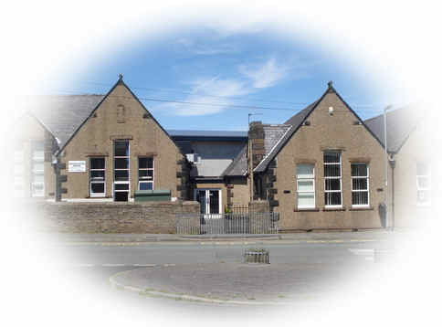
The best teacher development?
Research/co-enquiry
Bigger picture
Depth and breadth
Relevance
Immediacy
Distance/objectivity
Compare/contrast/contest
Pupil focus
Academic frameworks
Practitioner

Slide 14
My research in teacher development:
Involves membership of a critically reflective community of practice
Most likely in learning organisations that are conducive to this
Crisis and Regional Response
Not enough teachers coming in
Not enough teachers staying
Support and development unclear and not guaranteed
Carter Review
Not long enough
Not joined up to early career
Need to strengthen use of evidence and systematic enquiry

Slide 15

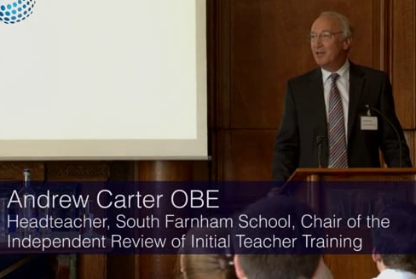

Slide 16



The Advisory Group
An advisory group was appointed, representing a diverse range of views, to support this work on the review. The members of the group:
Professor Samantha Twiselton (Sheffield Hallam University)
Dr Louise Walker (Manchester University)
Sir Dan Moynihan (Harris Federation)
Judith O’Kane OBE (Bright Futures Education Trust)
Daisy Christodoulou (ARK Schools)
'Sadly, this is nothing short of a scandalous selection of political appointments, the majority of whom have little if any, meaningful experience of ITT.'

Slide 17


Slide 18
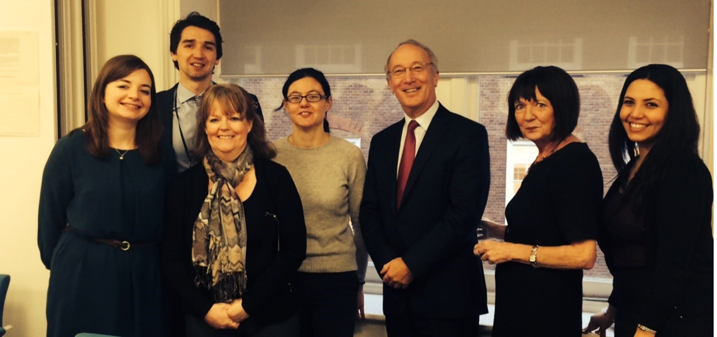
By the end of the Review:
Possible debates around whether ITT should be delivered by School-Centred Initial Teacher Training providers (SCITTs) or universities, School Direct or not, are not terribly helpful in this process. The truth is that partnership is the key. Sometimes universities will take the lead, sometimes and increasingly, it will be the schools that lead the way.
However, neither can do it alone and our review has made recommendations that emphasise the strength of working together within a system that is increasingly school led.
Foreword by Sir Andrew Carter OBE

Slide 19
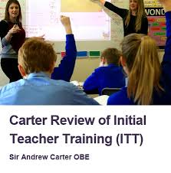
The scope of the review included all ITT routes (HEI, SCITT, School Direct as well as Teach First) and a range of subjects and phases.
A comprehensive assessment of the content of ITT provision in England
Which types of delivery arrangements are key to equipping student teachers with the required skills and knowledge to become outstanding teachers.
How close the system is to delivering high quality ITT across the board and recommend ways to address any identified weaknesses.

Slide 20
The Review Process
We gathered a wide range of evidence and views through a range of activities including:
A review of the existing evidence base including international evidence, Ofsted evidence and findings from the Newly Qualified Teacher (NQT) survey
A call for evidence that received 148 responses from a range of individuals and institutions, including universities, professional bodies, schools, teachers and trainees
11 themed roundtable discussions with sector experts
24 meetings and discussions with experts and stakeholders
31 visits to ITT providers and schools involved in ITT, involving meetings with trainers, mentors, head teachers as well as current and former trainees
A review of course materials from ~150 programmes.
A survey of trainee and applicant opinions about ITT course information

Slide 21
Key Findings: What does good course content look like?
The most effective ITT courses :
form the basis for on-going development
have a relentless and explicit focus on pupil focused mission
show why engaging with research is important and how to do this well
equip new teachers to use summative as well as formative assessment
include most common SEND issues and practical strategies for addressing these
Trainees should:
be taught child and adolescent development
be given practical advice on behaviour management
assess/address gaps and misconceptions in subject knowledge, and subject-specific pedagogy
have an on-going focus on professionalism and resilience
be given significant time and emphasis on planning

Slide 22
Key Findings: What does good ITT Delivery look like?
Across all routes, schools should play a leading role
High quality mentoring is critically important for ITT. Outstanding teachers and subject experts, who are also skilled in deconstructing their own practice
The most effective partnerships include a range of types of schools and expertise, ideally including Special Schools and Pupil Referral Units (PRUs) as well as a university
Clear benefits of experiencing school as early as possible in the
Built-in opportunities to observe outstanding teaching in a range of contexts
Beyond traditional placement models to carefully crafted and integrated school-based experiences
Systematic coming together in peer groups and subject communities
It is critical that progression between ITT and the NQT year is as seamless as possible

Slide 23

REFLECTIONS ON CARTER
The review found a lot of very good practice BUT:
An inconsistent picture as to what is included and how it is delivered
The best carefully craft and integrate types of knowledge and experiences HOW, WHO, WHERE, WHEN and HOW OFTEN as important (if not more) than WHAT
Some MATs and TSAs create a seamless join from ITE to NQT/RQT but this is variable regionally and nationally
The system is fractured nationally and regionally - coordination is lacking systemically
ITE IS NOT LONG ENOUGH AND NOT SUFFICIENTLY JOINED TO EARLY CAREER SUPPORT

Slide 25
My research in teacher development:
Involves membership of a critically reflective community of practice
Most likely in learning organisations that are conducive to this
Crisis and Regional Response
Not enough teachers coming in
Not enough teachers staying
Support and development unclear and not guaranteed
Carter Review
Not long enough
Not joined up to early career
Need to strengthen use of evidence and systematic enquiry

Slide 26




Slide 27
In South Yorkshire...
Attainment is too low and too variable.
Good practice in MATs and TSAs but too little regional strategic and collaborative work
School success is variable - Percentage of children in good/outstanding primary schools:
National average - 90%, Doncaster (77%), Sheffield (80%), Barnsley (86%), Rotherham (82%)
Percentage of children in good/outstanding secondary schools:
National average - 81% Doncaster (52%), Barnsley (66%), Sheffield (79%), Rotherham (91%)
Percentage of most deprived children who attend good or outstanding schools:
Nationally - 82%, in Doncaster (53%), Barnsley (59%) , Rotherham (65%) Sheffield (74%) .
There is a need for regional reform.

Slide 28
Teacher workforce in S Yorkshire
More affluent schools in Yorkshire and Humber have more stable workforce - most deprived have the opposite
There has been a significant year on year rise in the number of teachers:
leaving the profession for non retirement reasons
considering leaving the profession
reporting that they do not feel engaged

Slide 29



The time is right -
An appetite to collaborate
Systemic change for the young people of SCR communities depends on something more: a coherent, shared commitment to addressing weaknesses, building on strengths and mobilising knowledge and resource across the entire City Region.
A great teacher in every classroom.
System collaboration and clear/high
System collaboration and clear/high quality routes into teaching supports successful teacher training.
New partnerships and communications mechanisms are essential to ensure that excellent practice is shared across different institutions ...

Slide 30

OBJECTIVES
SHEFFIELD CITY REGION
To bring stakeholders together to collaborate more strategically to improve educational attainment
To agree an initial focus on the quality of the teaching workforce
To make a step change in the recruitment, retention and development of teachers in the SCR
To develop a model for ITE/NQT/RQT/RQT+1 development to attract, develop and retain excellent teachers in the region
EDUCATIONAL ATTAINMENT
QUALITY OF TEACHING
TEACHER RECRUITMENT, DEVELOPMENT RETENTION
PROPOSAL AGREED WITH SOS DFE

Slide 31
The Proposal: SCR stakeholders and ITE provider partnerships will:
Careful calculation and oversight of ability to meet local needs
a) work together to market and recruit to calculated ITE places needed for the region - a common charter
Pooling/maximising of collective expertise and contexts to create compelling regional ITE/Early Career 'offer'
b) develop a collective enhanced model for ITE tailored to regional need.
Addressing 'cold spots', ensuring variety of experience
c) give exposure to and engagement with the schools with the greatest needs.
d) develop a collaborative approach to early career (NQT/RQT/RQT+1) support and development pathways
Guaranteed support building on regional and personal needs

Slide 32
Further considerations:
Early career routes that allow teachers to work across the region in a range of ways (e.g. Fast Track to leadership, specialisation in e.g. SEND)
New attractive career paths for teachers who are experts in T&L to become teacher trainers and researchers whilst keeping up to date with reality of the current demands on teachers by retaining part of their week in teaching.
Collective ways of using teaching, schools, MATs, TSAs, ITE providers and universities as a vehicle to enhance social mobility for the region

Slide 33
PROGRESS TO DATE
There is an appetite to collaborate
3 year allocations key
Meeting recruitment DfE/NCTL priority
Top level principles quickly agreed - need to retain 'brands' but collaborate to enhance
Neutral governance vital
Some issues re 'cold spots'
Potential re pathways/ secondment /sabbatical opportunities
Potential to pilot CCT and CPD standard
Link to Northern Powerhouse
Logistic challenges
Link to Doncaster OA
SoS support - but purdah delay
University as 'convener ' recognised and valued
Meetings have been held with:
DfE and NCTL
DfE secondment to lead
Hallam SCITT
University of Sheffield
Doncaster SCITT
National MFL SCITT
Teach First
All lead partnership schools
Relevant MATs and TSAs
Head teacher groups
LAs
Learn Sheffield
Team Doncaster
Regional School Commissioner
CEO of the Chartered College of Teaching
Chair of Teaching School Council
Chair of DfE CPD Expert Panel
OFSTED

Slide 34
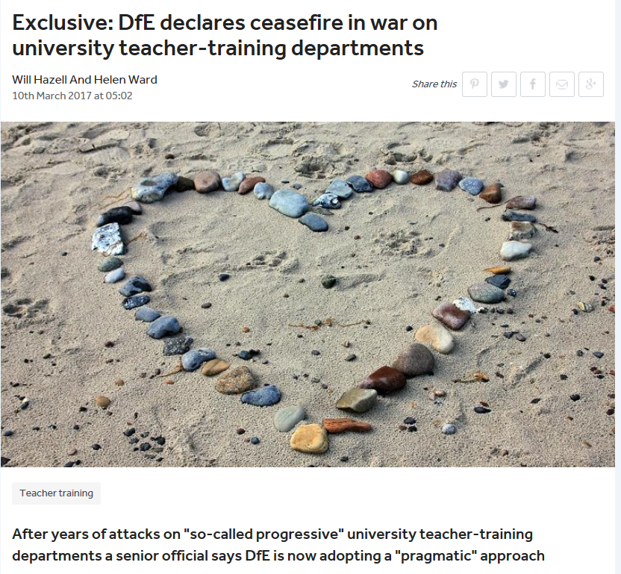
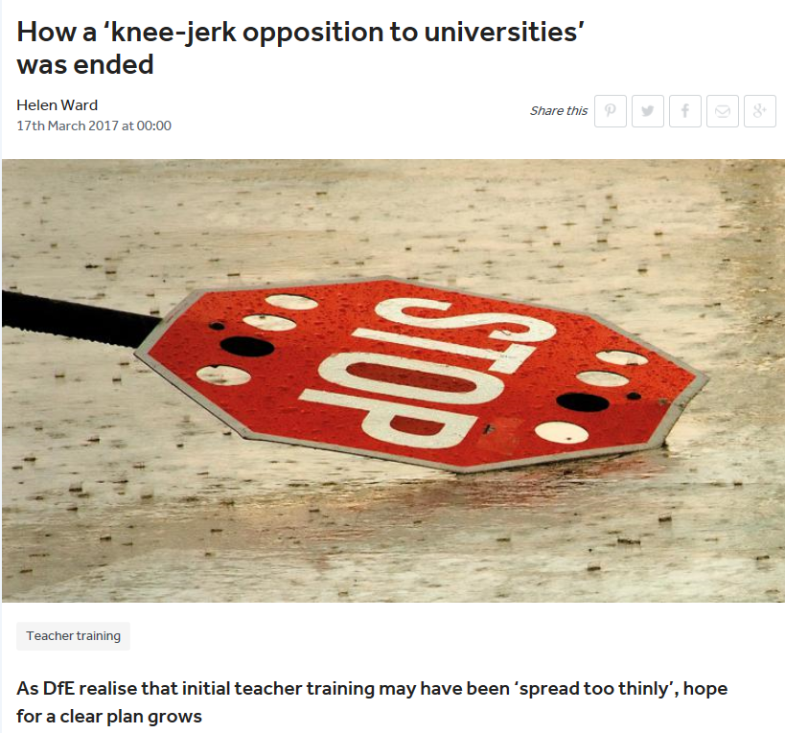

Slide 35

LEADERSHIP SUCCESSION joined up to creative use of workforce
PROFESSIONAL DEVELOPMENT joined up to Subject and Pedagogy
Collaboration/Coherence at Regional Level
RETENTION Ongoing CPD and recognition - pooling expertise in the region
RECRUITMENT - a regional ITE guarantee linked to early career development
Create new Middle Tier - Role of Partnerships, including HEI
FROM CHAOS TO COHESION

Slide 36



PRACTITIONER EXPERTISE
CONTEXTUAL UNDERSTANDING
BIGGER PICTURE
ACADEMIC FRAMEWORK
RESEARCH EVIDENCE CO-INQUIRY
COMPARE CONTRAST CRITIQUE
PUPIL KNOWLEDGE SCHOOL
IMMEDIACY/RELEVANCE APPLICATION LINK TO OUTCOMES

