Slide 1
Examining best practice
Mentoring as a broad concept is changing, and is increasingly being ‘associated with collaboration...working together and not just working with’ Lofthouse 2015

Slide 2
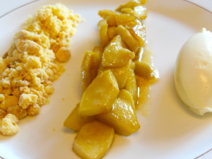
Find the connection

Slide 3
Stages of training matched to stages of learning Helps to explain the trainee’s actions and reactions
Survival
Consolidation
Renewal
Maturity
Awareness of these stages of development
means support is appropriate and
beneficial to the trainee
Notes:
Explain that this is a framework representing the development of BSTs.
During AP1 they are likely to be in the first two stages – many will display some aspects of each stage
Some will jump over the ‘survival’ stage quickly, others wont. However we must not give up on them – we must give them time to develop

Slide 4
Survival Stage…what does it look like?
Characteristics
Mentoring

Slide 5
Survival
Characteristics (of a trainee in this stage of development)
Coping – day by day
Self – completely self focused
Blame – the context, the children
Confusion – no clear rules and routines
Script – keeping to script – not aware of children’s lack of engagement
Doubts –
‘Can I get to the end of the week?’
‘Can I really do this day after day?’
Mentoring (skills and training used by the mentor)
Clear guidance
Specific suggestions
Sharing resources
Multiple options
‘Try this – if it doesn’t work, then try this
‘This is what I would use – you try it and then we’ll talk’

Slide 6
Where to start?
Rose Churchill

Slide 7
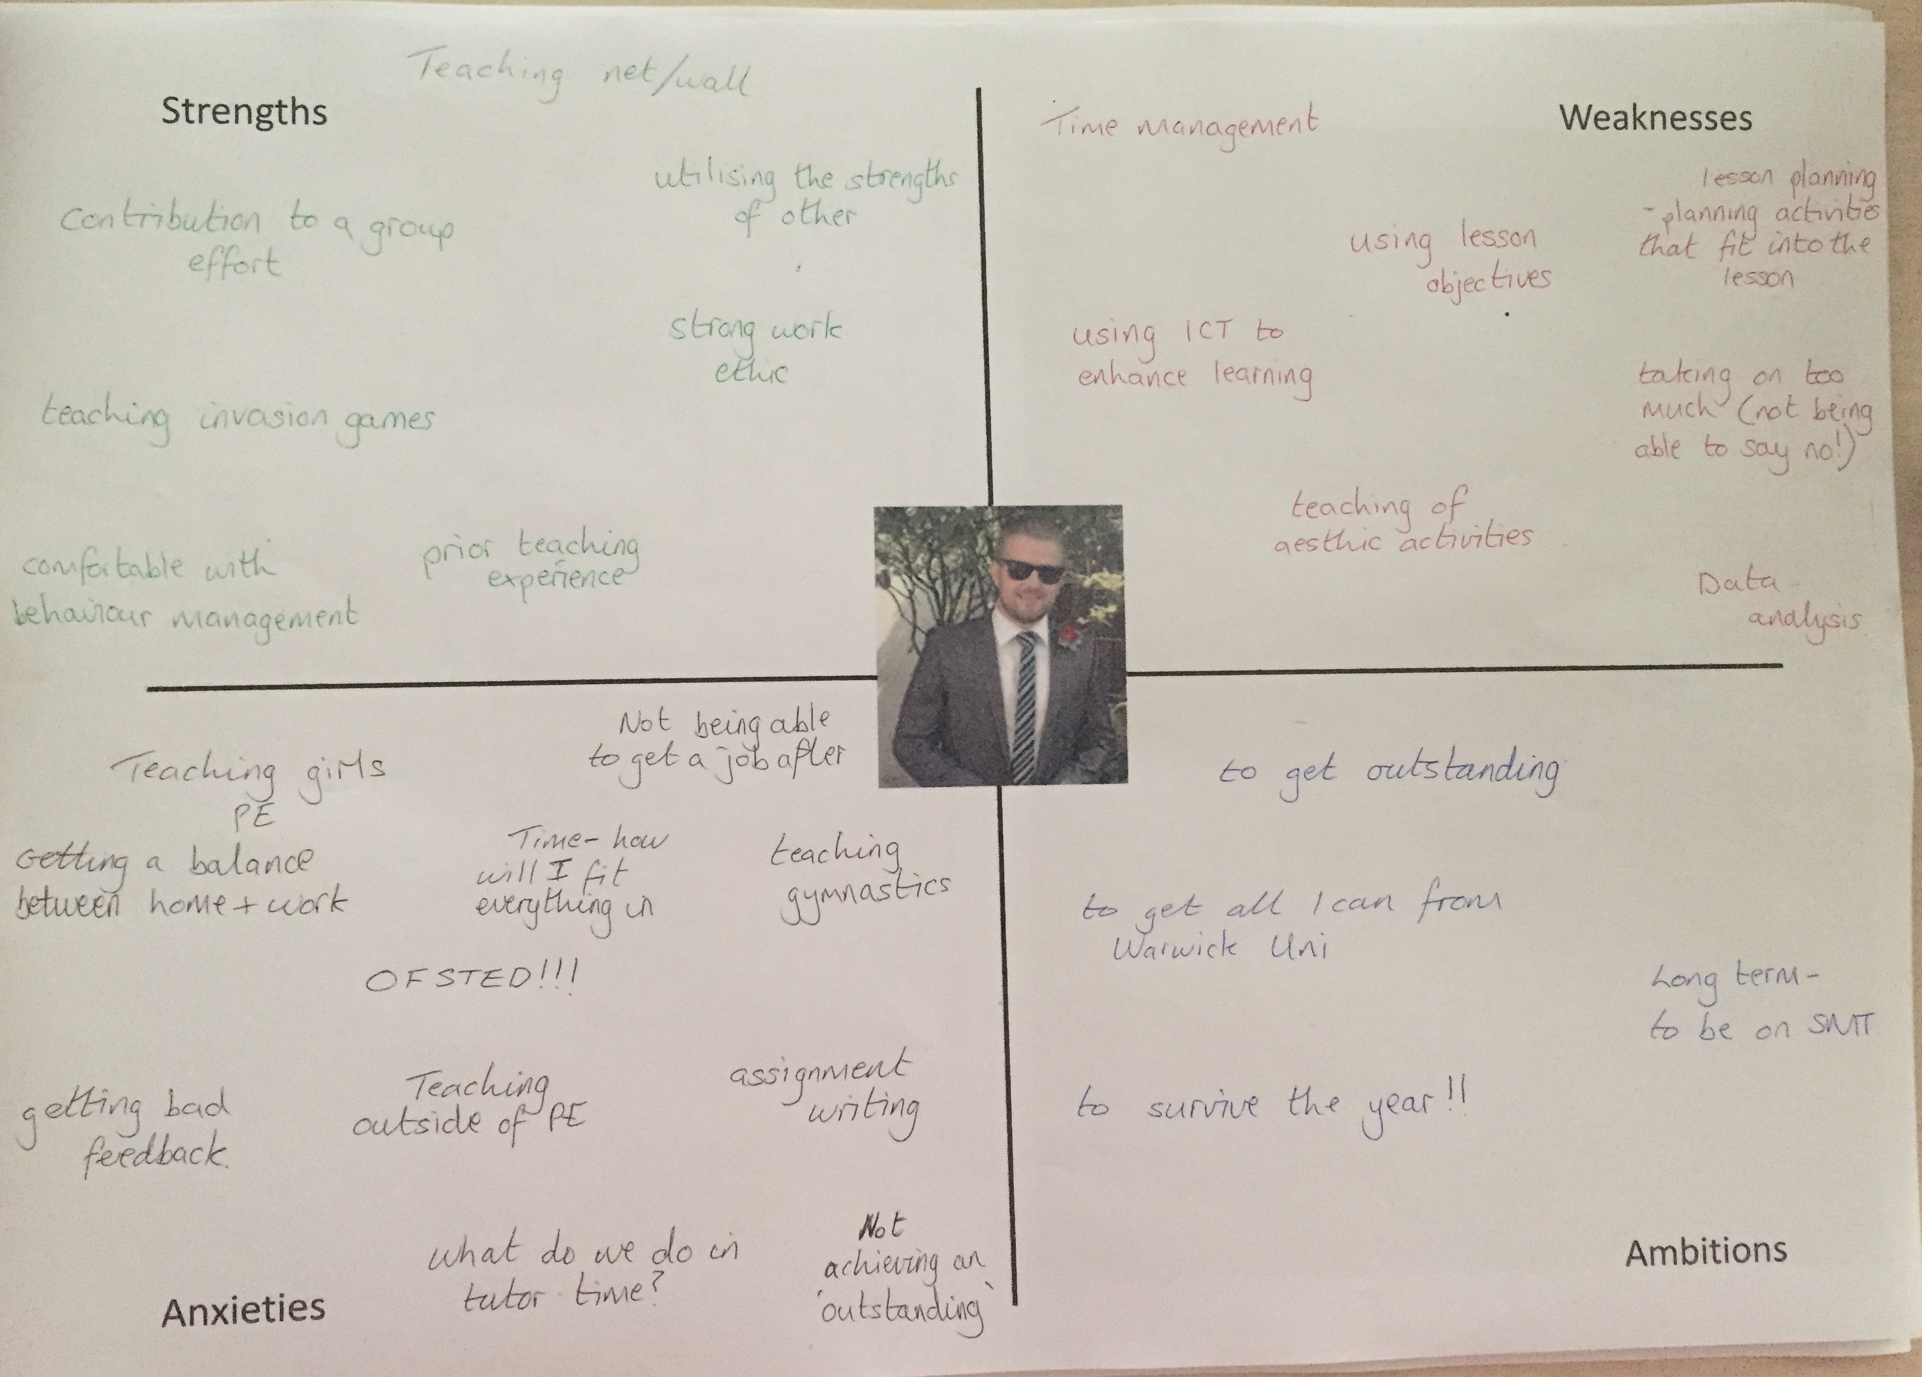
Joe’s self analysis

Slide 8
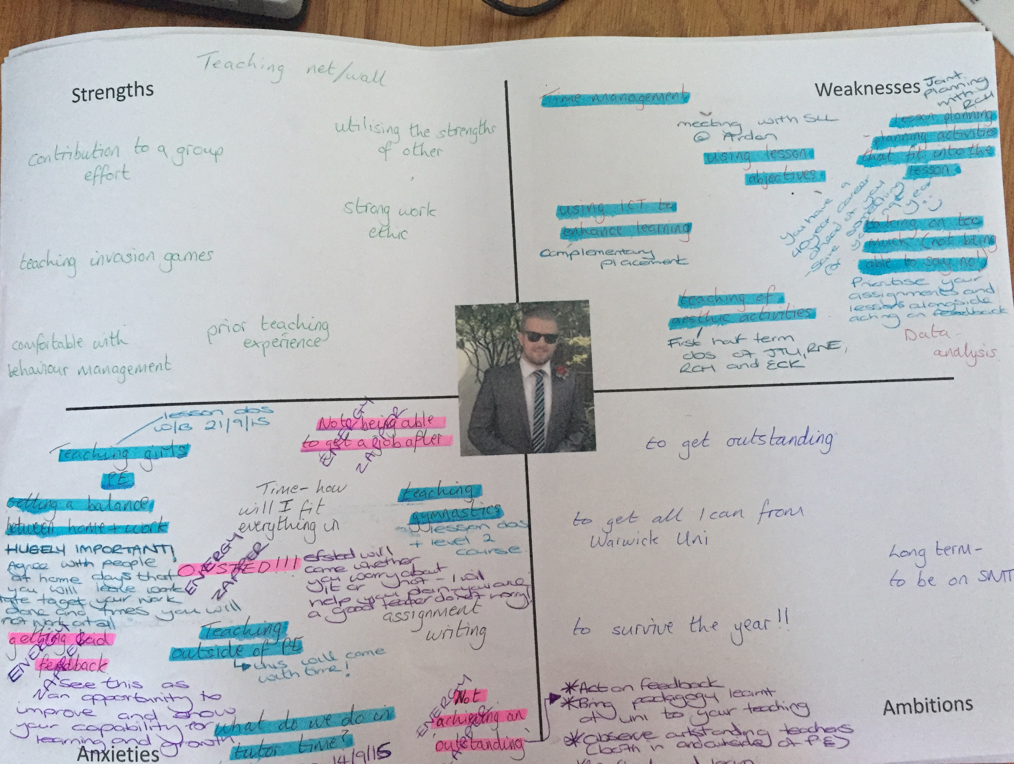
Rose’s response

Slide 9
Consolidation
Characteristics
Implementing rules and routines
Beginning to question –
‘Should I try it this way?’
Focusing on individuals and groups – but not yet managing all the children,
e.g. SEN, G&T, EAL, etc.
Mentoring
Encouraging the trainee to have a go – being there to support them
Joint exploration and teaching
Exchanging ideas and exploring resources
Encouraging them to talk to other trainees and colleagues
Reviewing documentation and children’s specific needs

Slide 10
It’s all in the detail
Polly Giddings
“owning the change” is the most important hallmark for the [train]ee (Garver, 2008)

Slide 11
Renewal
Characteristics
Routines now embedded – but sometimes boring!
Mastering a range of strategies
Self-critical - striving to improve
Self-motivated – offering suggestions – designing resources, organising after-school clubs,
Questioning –
‘Do you think I should….?’
‘I’m not sure that works for me’
Mentoring > coaching
Listening
Questioning
Allowing them to take chances, make mistakes and reflect on what might have worked
Letting them explore beyond the classroom and the school

Slide 12
The learning conversation
4 different case studies.
Lindsay James
Socrates was an exponent of deep questioning, and critical debate.
Applying this principle to coaching where the coach is truly curious and does not already know the answer has been shown to provide superlative results (Bell, 2013)

Slide 13

Ingredients of an Expert Mentor
Approachable
Adaptable
Compassionate / Personable
A ‘Guide’
Reflective
Courageous

Slide 14
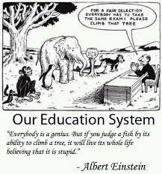
However…one size does not fit all!

Slide 15

Case Study A – The ‘Resistant’ One
Characteristics
Approach
Disengaged during feedback
Agrees with everything you say!
Aggressive questioning
Disinclined to make suggested changes to lesson plans
Encourage self reflection through questioning during feedback.
Give a clear set of targets that are measurable – this means that they have to follow through with actioning them – not just agreeing at the time.
Don’t be scared to have a courageous conversation with them about their attitude – never forget that you are the expert!
Set strict deadlines for suggested changes to be made.
Be a coach – often the resister will need to be ‘coached’ into a different way of thinking – be patient: they will have an opinion that they need to voice – listen to it, acknowledge it and guide them to alternative points of view.

Slide 16

Case Study B – The ‘Disorganised’ One
Characteristics
Approach
Start small – can you help them create a systematic approach towards their training year.
Don’t let them take on too much – ensure that they are on top of their workload before they take on additional tasks.
Put the emphasis on them to make notes during mentor meetings / feedback – this way they have no excuse for forgetting anything.
Give them an area to keep their belongings/paperwork in - it is their responsibility to keep this area tidy.
Set strict time boundaries – i.e. if they have a lesson after lunch, set an expectation of what time you want them to go to the classroom.
Flustered
Agrees to everything…good intentions
Often misses a deadline
Doesn’t make notes
Messy!
Always in a rush when there has been plenty of time.

Slide 17
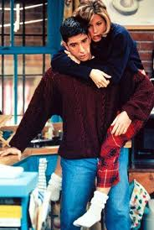
Case Study C – The ‘Needy’ One
Characteristics
Approach
Need for constant reassurance
‘flitting’ about
Emails out of work hours
Unable to find positives in their lessons
Asking for additional mentor meetings
Demonstrate that you are compassionate person and be willing to reassure them. They will need this when they are in their survival stage!
At the same time, they need boundaries…we are all busy – you need to ensure that you look after yourself as well as time. Have set time slots to see them in during school hours and limit the hours you are willing to communicate with them in the evening/weekend.
Have feedback rules – they have to come up with at least one ‘what went well’ and one ‘even better if’. Start small and build them up – they will soon be recognising their strengths and growing in confidence.

Slide 18

Case Study D – The ‘Laid Back’ One
Characteristics
Approach
Outwardly calm
Leaves tasks to the last minute
Slow to implement suggested changes
Can sometimes struggle with behaviour
Short regular check in’s to make sure that they are update with their tasks throughout the week.
‘Triangulate’ with them – ensure you are on top of all of their university tasks and deadlines and make they are building in time to complete them on top of their school commitments.
Short deadlines – if changes need to be made then make sure they have to send them back to you quickly i.e 24 hour turnaround
Make sure that they are aware of school expectations for behaviour. If the ‘laid back’ attitude creeps into the classroom then it can lead to lesson disruption. Support them to have structures in place.

Slide 19

Of course, you could end up with an amalgamation of them all…
And you might just need to mix up the layers of your cake!
Contact: stjamesl@caludoncastle.co.uk

Slide 20
A mediocre mentor gives feedback
A good mentor creates dialogue
A great mentor facilitates a learning conversation
S Walton, Head of Warwickshire School Improvement Services uses the term “coaching with edge” (Beere, 2013)
to describe a conversation containing critical challenge which promotes honest self-reflection

Slide 21
Maturity
Characteristics
Developing own beliefs, teaching style and strategies
Asking deeper questions –
‘How can I …….’
‘I’m not sure that’s the best
solution for….’
Exploring wider examples, opportunities, views, etc.
Rearranging the classroom
Coaching
Use of coaching conversations
‘What would you like to achieve
this week?’
‘What areas/targets would you
like to work on this week?’
‘Why do you think that worked?’

Slide 22
Encouraging experimentation
Like success, failure is many things to many people.
With Positive Mental Attitude, failure is a learning experience, a rung on the ladder, a plateau at which to get your thoughts in order and prepare to try again.’
W. Clement Stone.
Some models have moved beyond goal-setting and focus upon experiencing the
richness of learning that comes from experimenting, reflecting and analysing (Megginson, 2012)

Slide 23
Transformational learning
This is about becoming open to possibilities and perspectives
by critically reflecting on one’s experiences together
Kerry Mills
Successful coaching extracts the best out of individuals on both sides of the dialogue (Gallwey, 2009)
and therefore results in reciprocal benefit (Cohen, 2011).

Slide 24
How can we piece all this together?
How to map student progress using a working document to link targets throughout the year.
Sarah Pooley

Slide 25
Collaborating to develop
a mentoring culture
The Mentoring Manual
Kate And Abi
http://moodle.warwick.ac.uk/course/view.php?id=20414

Slide 26
Thankyou
Any questions: kate.hamer@warwick.ac.uk
Please complete the feedback form
for our ongoing development.

