Slide 1
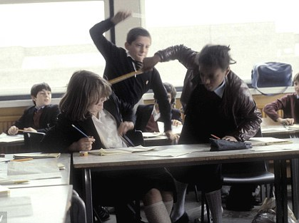
SURVIVING THE CHALLENGING CLASS
THRIVING IN
MATT STILES
Social, Emotional & Mental Health Specialist

Slide 2
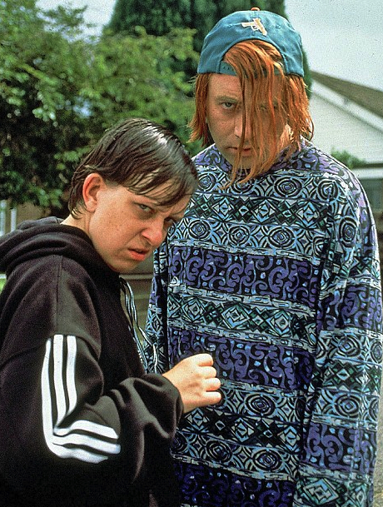
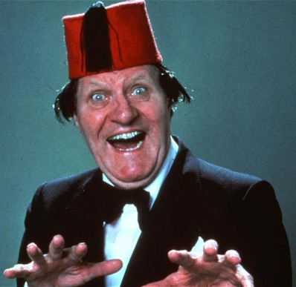
“Why should I?”
Know your students

Slide 3
Power Bases
Legitimate Power
Coercive Power
Reward Power
}
Position Powers
}
Referent Power
Expert Power
Personal Powers
French and Raven(1960)

Slide 4
Response Styles
Assertiveness
Assertive
Passive
Aggressive

Slide 5
Basic Assertion Tips
Use ‘I’ statements (not ‘You...’).
Say “I need you to…” rather than “I want you to…” to amplify your assertion.
Say ‘thanks’ rather than ‘please’.
Say which behaviours you want to see, then praise them when you see them.
Speak in a calm, clear voice.
Public praise & private sanctions. Deal with as much as possible as discretely as possible.
Criticise the behaviour, not the person.

Slide 6

Positive relationships
Managing
Behaviour
Relationships
‘The only thing that works for me is to form a relationship with the students.’
– Member of staff (Grace Academy Solihull)

Slide 7

The ‘Relationship Bank’

Slide 8
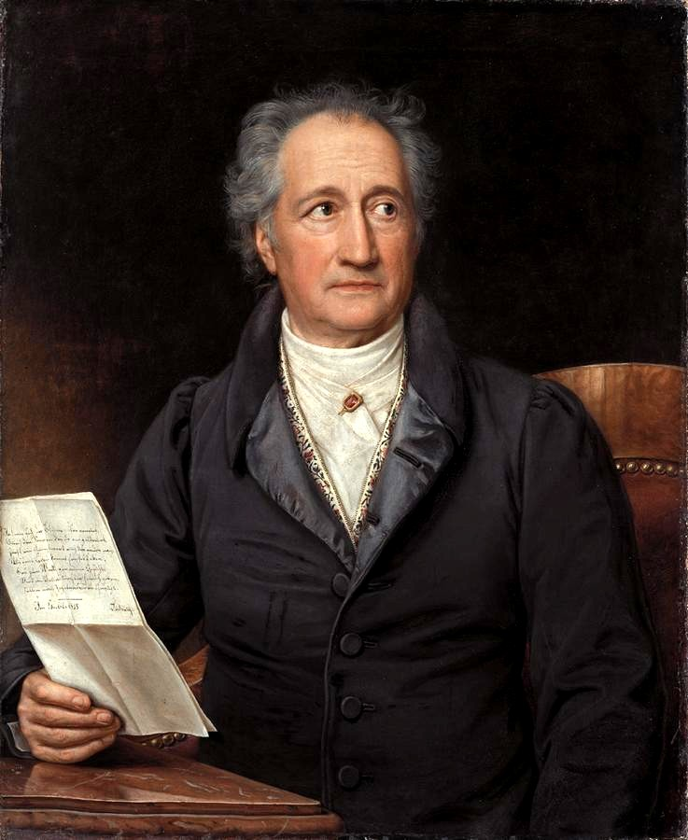
The ‘Expectancy Effect’
"Treat people as if they were what they ought to be and you help them to become what they are capable of being."
Johann Wolfgang von Goethe

Slide 9
The Behaviour Plan – Classwide
3 Parts:
Rules
Rewards
Sanctions
Benefits:
Promotes consistency.
Protects the rights of students.
Proactive, not reactive.
Provides ‘fire-proofing’ against hot emotions.
Provides clarity.
Helps get parental support.

Slide 10
The Individual
Behaviour Plan
Possible Components:
Handling Advice
Time Out Card
Report Card
Positive Handling Plan
Behaviour Contract
Individualised rewards & sanctions
Adult support
Restorative meetings with staff
1:1 problem solving conference

Slide 11
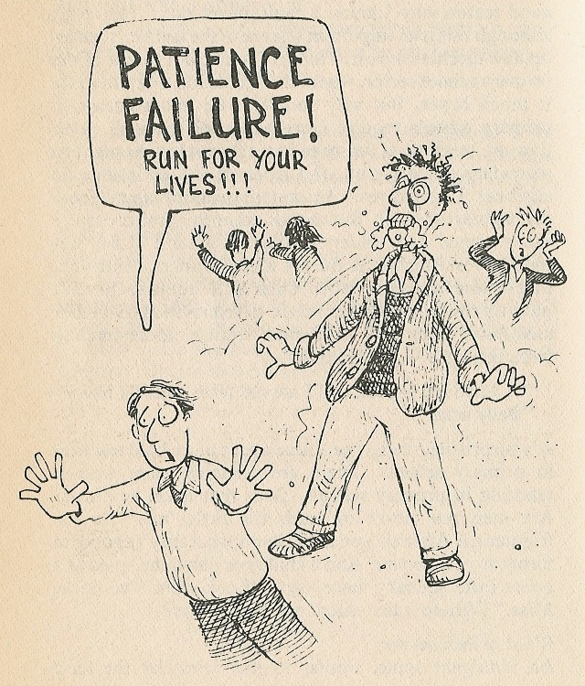
Keeping The Plates Spinning.
Be proactive
‘Relaxed vigilance’.
Scanning & Circulating.

Slide 12
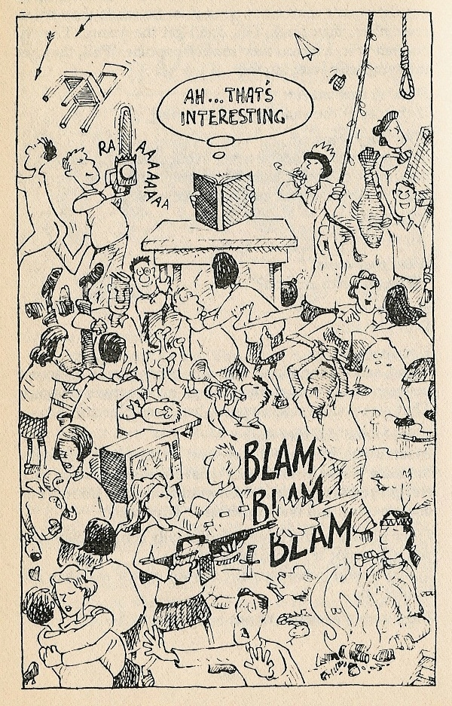
Tackling
Off-task
Behaviour
Consistency

Slide 13
Intervention Continuum
Indirect
Direct
Sanctions
Least
Severe
Most
Severe

Slide 14
Indirect Intervention
The ‘Look’.
Mention name whilst teaching.
Ignore (planned ignoring).
Proximity praise.
Proximity control.
Eye contact.
Immediate acknowledgement as soon as the student is back on task.

Slide 15
Intervention Continuum
Indirect
Direct
Sanctions
Least
Severe
Most
Severe

Slide 16
The Refocusing Technique
(+ Refusal Test)

Slide 17
1) State what you want:
‘I need you to get on with your work, thanks.’
2) Take on board their replies, then repeat (like a ‘broken record’).
3) If the student still argues /refuses, let
him/her know that they will be choosing a
corrective action / sanction. Give the
preferred choice last.
‘I really don’t want to have to give you a detention, so I need you to get on with your work, thank-you.’
  4) Test the refusal:
  ‘Let me just check - are you refusing to follow instructions from a
  member of staff?’

Slide 18
Intervention Continuum
Indirect
Direct
Sanctions
Least
Severe
Most
Severe

Slide 19
Sanctions
Must be given in a calm, matter-of-fact manner.
Must be planned and consistent, not reactive.
Do not have to be severe to be effective.
Must be appropriate for your students.
Remember:
Provide an ‘escape mechanism’ for students who are in crisis and want to talk.
Some students will require Individualised Behaviour Plans.
Warning:
Do not work in isolation and need to be balanced
with positive support.
Short-term gain only.
Do not fix behaviours, only repress them.

Slide 20

Prevention & Management
Of Crisis Situations

Slide 21
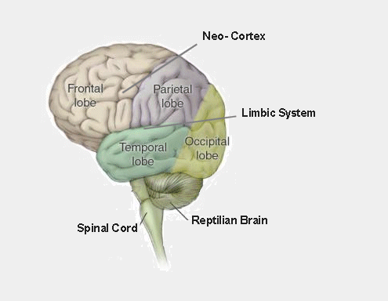
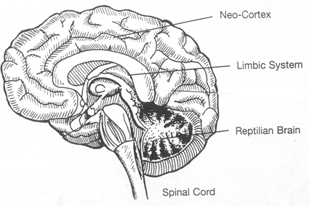
The Triune Brain
REFLECTING PLANNING
HIGHER ORDER THINKING
FIGHT, FLIGHT,
FLOCK, FREEZE
AUTOMATIC
PHYSIOLOGICAL FUNCTIONING
Notes:
The brain evolved to help us survive.
REPTILIAN BRAIN:
It’s entire aim is to survive (self preservation) – doesn’t consider others (thus reptiles are solitary creatures).
The first stages of brain evolution produced the ‘reptilian brain’ – in humans areas of the brain associated with the cerebellum, medulla oblongata – which manage our physiological functions such as oxygenation, digestion, elimination, heart rate, blood pressure, muscle tome, automatic motor actions etc. Includes the amygdala – responsible for fight/flight.
LIMBIC / PALEOMAMMALIAN BRAIN:
More socially oriented (mammals found they survived better and were more effective in social groups).
Next we see the development of areas responsible for simple emotional states. In humans that area corresponds to the limbic system which manages primitive emotional arousal and triggers the action of the ‘reptilian brain’ to produce fight or flight responses.
NEO-CORTEX / NEO-MAMMALIAN BRAIN:
Human brain.
The neo-cortex – the ‘grey matter’ - manages higher-order thinking. This is the area of the brain that deserts us when the challenges in the classroom begin to exceed our coping resources. The brain we used on the INSET day is not the brain we use in the classroom!
If we perceive a situation as in some way a ‘threat’, the action of the neo-cortex is depressed, the limbic system is aroused and messages are re-routed to the reptilian brain provoking a physical response. Under threat our brain re-routes to produce primitive survival responses.

Slide 22
Stages Of A Crisis
Escalation
Vulnerable
Immediate
anxiety
Specific
triggers
Crisis
Deflation
Emotional
exhaustion
Personal
anxiety
level
Return to
personal
anxiety
level
Action: Diversion, Support, Reassurance, Choices Possible need for physical intervention.
Action: Diversion, Support, Reassurance, Choices.
Action: Diversion, Support, Reassurance
Action: Support, Reassurance Monitoring.
Action: Support, Reassurance Monitoring.
40 mins – 24 hours

Slide 23
Body Language - Helpful Responses
A non threatening stance is characterised by:
Social distance.
Sideways stance, step back.
Intermittent eye contact .
Relaxed body posture.
Palms open.

Slide 24
The Most Helpful Response To Approaching a Student in Crisis
“I can see something’s happened.”
“I’m here to help.”
“Come and lets…”
Remember - if we do this right, we have taken control, provided clarity and an escape route for the student and shown empathy. We have also clarified the situation for bystanders.

Slide 25
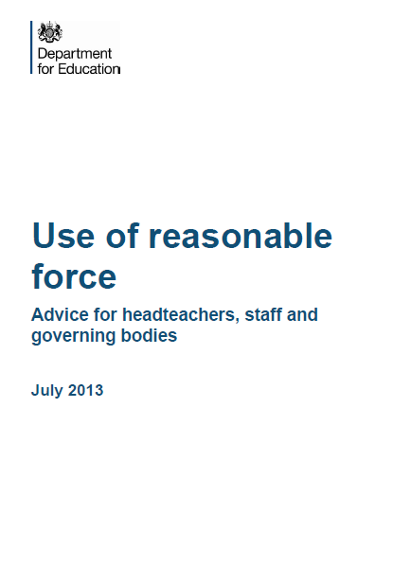
Latest Guidance
(July 2013)

Slide 26
Legal Defence
As a general rule nobody has the right to touch, move, hold or contain another person.
However, people with a duty of care operate in exceptional circumstances where it is sometimes necessary to act outside the norm.
The best legal defence would be to show that any actions taken were:
in the child’s BEST INTEREST
REASONABLE
PROPORTIONATE
ABSOLUTELY NECESSARY

