Slide 1
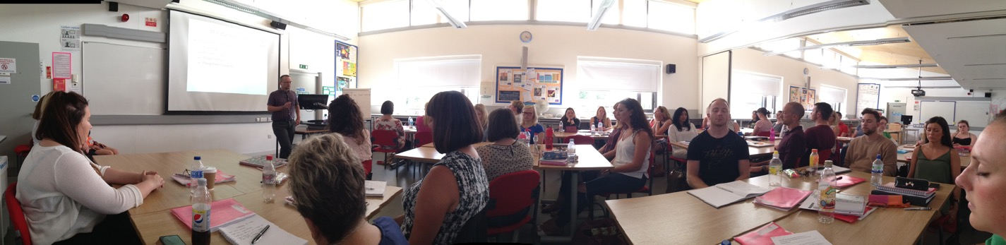
Teacher mental Well-being
Dean Howes
Teaching Fellow
Mindfulness, Wellbeing, Coaching and mentoring

Slide 2

The Centre for Lifelong Learning
Westwood Campus

Slide 3
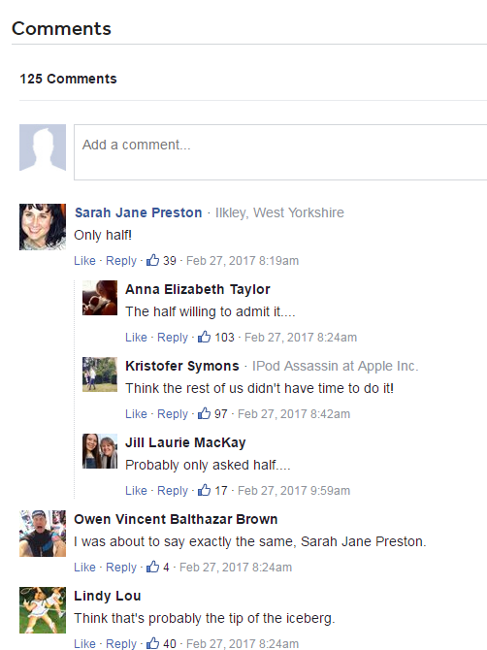
Teacher mental wellbeing
TES, 2017
45% of teachers said that their mental health was “poor” or “very poor”
15% reported taking medication because of the stresses of their work

Slide 4
Teacher mental wellbeing
Kevin Courtney, General Secretary of the National Union of Teachers (April 2017)
“Workloads, brought about through endless assessment, performance related pay and Ofsted, are creating a toxic environment in schools, leading to many teachers leaving the profession through stress and exhaustion.”

Slide 5
Teacher mental wellbeing
Kevin Courtney, General Secretary of the National Union of Teachers (April 2017)
“The findings of the most recent Department for Education workload survey revealed average weekly working time for all classroom teachers and middle leaders at an unacceptable and unsustainable 54.4 hours.”

Slide 6
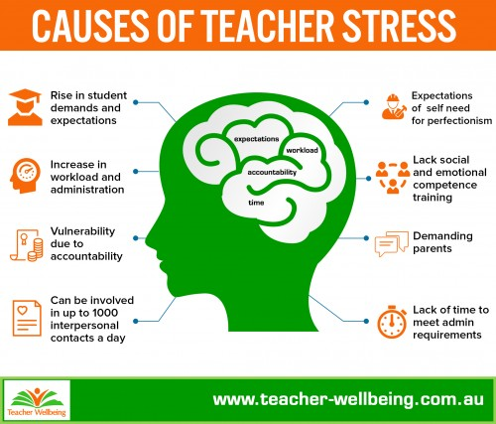
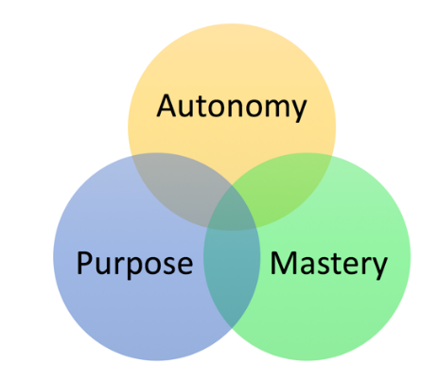
Teacher mental wellbeing

Slide 7
Teacher mental wellbeing
Factors associated with poor mental health
Judgement
Agenda
Non acceptance
Rumination
Worry
Non-compassion
Lack of purpose/holistic visioning
Focus on procedures rather than experience
Focus on outcome rather than performance
Lack of physical, intellectual, emotional, social stimulation
Experience of negative emotions (especially frustration)
Non-expression of authentic emotions
…

Slide 8
Teacher mental wellbeing
Teacher
Pupil
Teacher – Pupil interactions

Slide 9

Teacher mental wellbeing

Slide 10
Teacher mental wellbeing
Factors associated with good mental health
Non judgement
Non agenda
Acceptance (self and other)
Connecting with the awe and wonder of experience
A focus upon the present moment
Compassion (self and other)
Embodiment, flow
Focus upon experience
Focus on performance
Physical, intellectual, emotional, social stimulation
Experience of positive emotions (especially appreciation)
*Authentic expression of actual and ‘checked’ emotion
…

Slide 11
Teacher mental wellbeing
Teacher
Pupil
Teacher – Pupil interactions

Slide 12
Teacher mental wellbeing
Stress
High arousal (high Heart Rate)
Resilience
Positive
Emotions
Negative
Emotions
Low Performance
Cortisol
High Performance
DHEA
Stress
Low arousal (low Heart Rate)
Resilience

Slide 13
Teacher mental wellbeing
Factors associated with good mental health
Non judgement
Non agenda
Acceptance (self and other)
Connecting with the awe and wonder of experience
A focus upon the present moment
Compassion (self and other)
Embodiment, flow
Focus upon experience
Focus on performance
Physical, intellectual, emotional, social stimulation
Experience of positive emotions (especially appreciation)
*Authentic expression of actual and ‘checked’ emotion
…
Qualities of a mindful experience (Kabat-Zinn, 2013)

Slide 14
Teacher mental wellbeing
Modern Mindfulness
Secular
Biological, psychological underpinnings
Mind, body, emotions
Inside-out approach
Can be a mental health wellbeing technique OR a deeper personal journey
Increasingly applied in education
Foundational practice include mindful breathing, the body scan and non-attachment techniques

Slide 15
conclusions
Teacher mental wellbeing now recognised as important
We know a lot about why teachers and teaching environments are vulnerable
There are many techniques, projects, initiative and programmes designed to help
Mindfulness is one that seems to underpin the others
There are issues about whether all techniques are too focused upon the individual as opposed to wider structural problems

Slide 16
conclusions
Kathryn Lovewell (National Teacher Enquiry Network Easter 2013 newsletter)
Teaching at its best arises from healthy teachers who are well rested, open minded, clear thinking and compassionate towards the challenges of learning. A Mindful teacher is fully present, able to support and encourage whilst simultaneously challenge their students to reach beyond expectations or self doubt. Relaxed teachers are flexible teachers. Flexible teachers are more likely to be resilient.

Slide 17
conclusions
Further information
Dean.Howes@warwick.ac.uk
https://www.educationsupportpartnership.org.uk/sites/default/files/resources/looking_after_teacher_wellbeing.pdf
https://www.theguardian.com/teacher-network/2016/jun/05/teachers-five-ways-to-boost-mental-health-mindfulness
https://greatergood.berkeley.edu/article/item/seven_ways_mindfulness_can_help_teachers
“Happy Teachers Change the World” by Katherine Weare and Thich Nhat Hanh (2017)

Slide 18
Thank you
Are there any questions?

