Slide 1
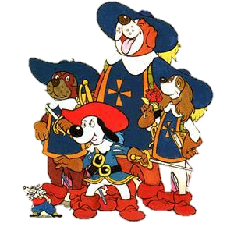

All for One, and One Note for all Warwick Partnership Conference 18 June 2020

Slide 2
PDP journey so far
Roll out OneNote Create support
2016-2018
Mahara Used
01
03
05
Iterative Refinements implemented for 2020/21
02
04
Summer 2018
Change of module lead – alternatives considered
Refined 2019/20
Notes:
What like? Monthly hour – say 2-3 pm, then subject 3-4 to do tasks, get work in shape to facilitate TF work Consideration – RP tasks – thematic (Task 1 Teacher Philosophy) – Task 2 (Around Prevent/Safeguarding – upload certificate of safeguarding completion by Oct half term) – Task 3 – Planning – Term 4 Assessment – Term 5 ? – Term 6 Pupil Progression

Slide 3
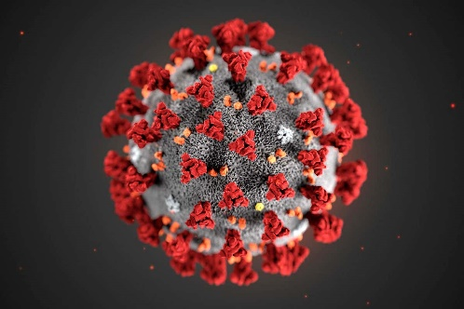
What I have changed
01
02
03
04
Mahara to
OneNote
Exemplar work to trainees
Instant Feedback on OneNote
Support
Online or available as an application
Accessible via phone/tablet
SSO) (Single Site Logon)
Pushed out to all
Feedback – very beneficial
Pointer for trainees who are unsure where to start
Easier access to marking work
Speeds up the process
More of a dialogue
Face to face support
School Context (SM/PM)
Using trainee “specialists” as support
Challenge of feedback (Trainees don’t know what it was)

Slide 4
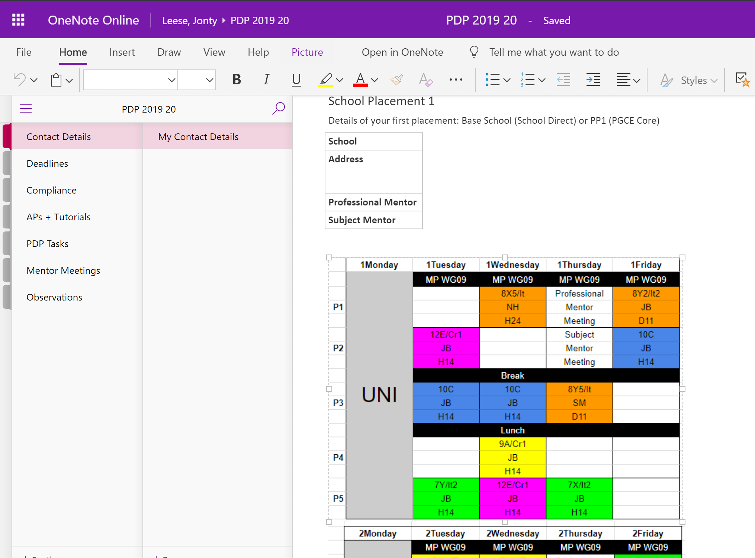
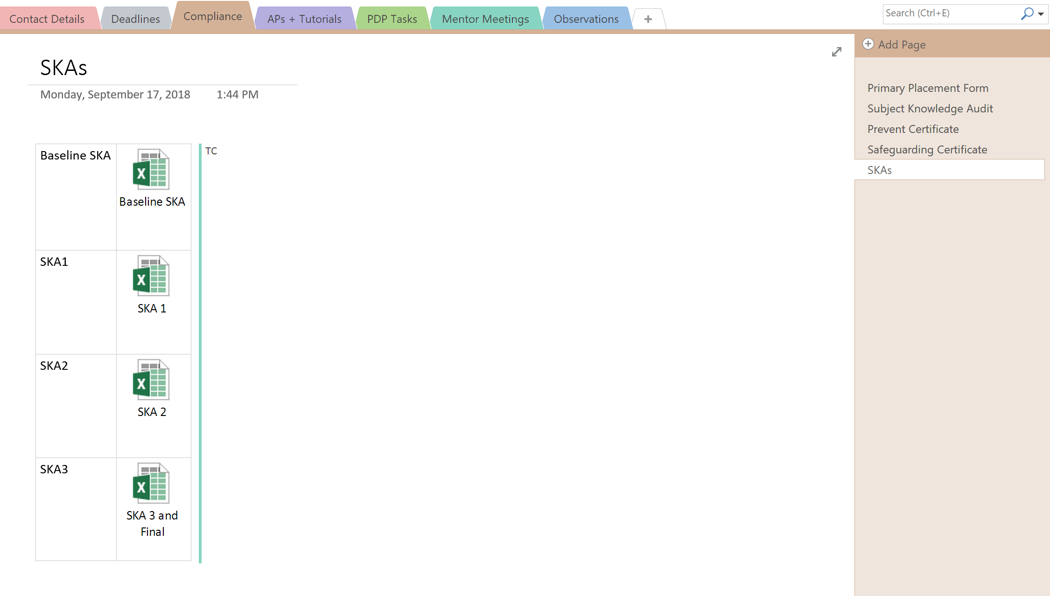
Exemplar (Online, Installed App)

Slide 5
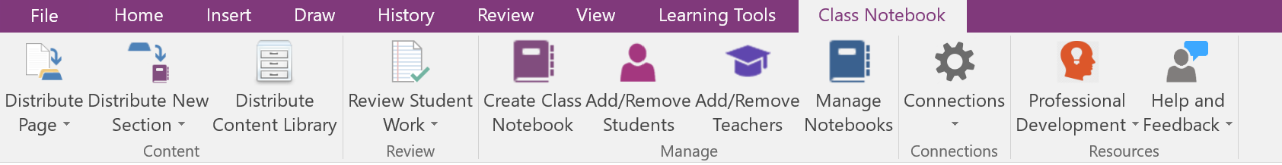
Class Notebook: What it is

Slide 6
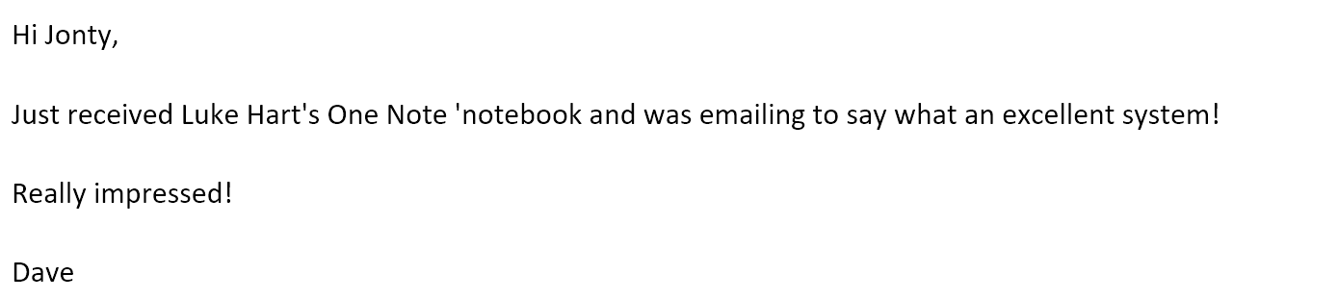
Why use it
Mahara feedback

Slide 7
What my expectations are:
6 PDP tasks
Mentor Meetings Selection of Observations
Compliance
Primary Placement Form
Prevent, Safeguarding
Subject Knowledge Audit
Tutorials
AP forms

Slide 8
Collaboration
Me (Administrator)
PM (Personal Moderator)
PSS (Compliance etc)

Slide 9
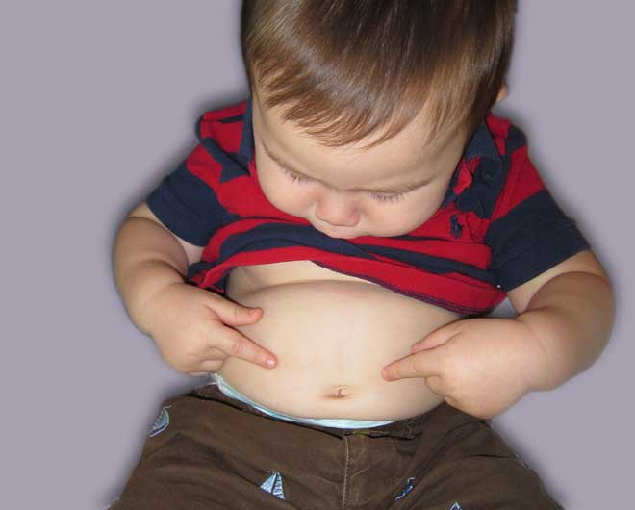

No naval gazing but outward focussed
Notes:
PDP being an awareness of the bigger picture, not navel gazing

Slide 10
What are the tasks? (May be tweaked for 2020-21)
Time | Title | University coverage | Notes
Term 1 Half term 1 | Task 1: Teaching Philosophy | Induction Week 48 and 49
Term 1 Half term 2 | Task 2: From observations in your school, what does good behaviour management look like in your subject? | Week 7
Term 2 Half term 1 | Task 3: Implications of the cross phase conference or Integrating TEL into my subject teaching | Week 16/Week 19 | There are 2 titles to choose from
Term 2 Half term 2 | Task 4: Teaching all students in an inclusive style | Week 25
Term 3 Half term 1 | Task 5: Evidence Bundle (Progress over time) | Week 29 onwards
Term 3 Half term 2 | Task 6: What are your pastoral responsibilities as a tutor? | Week 34
 | Task 7: (Revisit your Teaching Philosophy) - this will be discussed at your viva
Task 5: Teaching in challenging circumstances

Slide 11
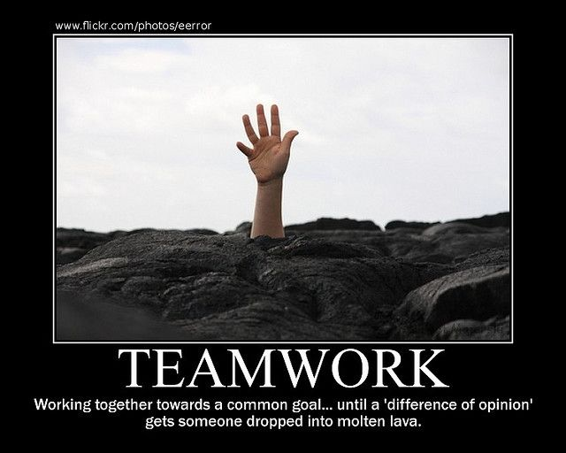
Notes:
Not what we’re after

Slide 12
PDP: What is required:
450-550 words (/- 10% of 500)
Links to Teachers’ Standards
2 suitable references (Harvard Style)
Behaviour Management (Dix)( Hattie)
Inclusive style (Subject link), SEND dept
Ideally not TES articles, motivational poster quotes

Slide 13
Exemplar Tasks (WAGOLL) (500 words)
What is your teaching philosophy? How has this originated and can you evaluate how your educational touchstones will impact on the teacher you aspire to be?
‘Education is the kindling of a flame not, the filling of a vessel’ (Socrates). In my eyes, to teach is to inspire, to cultivate, to motivate. I want to facilitate engaging debates and challenging discussions, letting lessons respond and change if an exciting idea is explored.
I want to inspire gifted and talented students to aim even higher by setting ‘high expectations which inspire, motivate and challenge pupils’ (TS1). Teaching standard 1 is all about challenging students and stretching their abilities, regardless of their backgrounds. As someone who attended a poor secondary school in a mainly working class town, this is important to me. I was a high achiever in my secondary school, but did not feel pushed to my potential. A part of this was uninspiring teachers, and the general lack of aspiration among students. As a teacher I want to ‘promote the value of scholarship’ (TS3) by showing my enthusiasm for computing and inspiring students to think about where they want their paths to lead. I want to fuel passion, not just for computing, but for every subject; all knowledge is good.
Increasing female participation in Computing after KS3 is important to me; there were barely any females on my undergraduate Computer Science course. Even in my limited time thus far at Finham Park, it is clear that Computing continues to attract more boys, with only a few girls continuing the subject at A-level. The Higher Education Statistics Agency (2018) found that in the 2016/17 academic year, 81% of Computer Science students at university were male. What is the reason for this stark contrast? Microsoft (2018) found that young women had misconceptions about STEM careers and lacked female STEM role models. As a female in Computing, I hope to inspire the girls I teach to break social norms and challenge stereotypes.
The right personality traits are important to become a good teacher: ‘What the teacher is, is more important than what he teaches’ (Karl Menninger). After evaluating my own traits, I find myself to have a lot of honesty, compassion, integrity and gratitude. It is not just my role to be a student’s more knowledgeable other (Vygotsky, 1980), but also a mentor, a role model, somebody they can trust. In part two the Teaching Standards, it says as a teacher I should ‘treat students with dignity, building relationships rooted in mutual respect’ (Department for Education, 2013). It is important to recognise that whatever a child’s background, they are entitled to receive a high standard of education that will equip them with the right mindset and skills to become an asset to society.
Teaching standards 1, 3 and part two.
References
Higher Education Statistics Agency (2018). Higher Education Student Statistics: UK, 2016/17.
Microsoft (2018). Closing the STEM gap. [online] Available at: https://query.prod.cms.rt.microsoft.com/cms/api/am/binary/RE1UMWz [Accessed 19 Sep. 2018].
Vygotsky, L.S., 1980. Mind in society: The development of higher psychological processes. Harvard university press.
Department for Education (2013). Teachers’ Standards. Department for Education.

