Slide 1
PGCE Secondary Programme: Core and SD
Key updates and developments
Andy Hind, Alison Morgan and Secondary Team

Slide 2
Overview
Vision and Strategic Priorities 2020-2023
Highlights from 2020/19
Developments: 2020/21
Course start changes for 2020
Partnership - Georgina Newton
MA in Professional Education

Slide 3

Vision and Mission Statement
Vision:
To be the first choice for teacher education, contributing to the supply and retention of intellectually curious teachers, with an outstanding national and international reputation for research informed academic practice, thought leadership and professional excellence. To continue the long history of teacher education at Warwick where generations of teachers change the lives of the children and young people they teach.

Slide 4
CTE Principles - we are committed to ensure:
partnership is at the heart of how programmes are developed and delivered;
Warwick Teacher Values are embedded within all programmes;
the ITE curriculum is inclusive, promotes creativity, innovation and critical thinking, incorporates 21st century technologies and is explicit about intent, implementation and impact on learning and learners;
we create a community of evidence-based research-informed practitioners and an environment of knowledge exchange, utilising school expertise; the critical thinking skills our trainee teachers acquire equip them to lead dynamic learning environments;
quality assurance processes hold our partnership to account;
peer dialogue on practice informs how our teachers develop their practice;
student evaluation and robust self-assessment inform how we develop our programmes;
we deliver resources effectively to ensure financial efficiency and stability.

Slide 5
CTE Strategic Priorities 2020-2023
Ensure 2020-23 Centre recruitment targets are realistic and achievable and built into the 5-year plan.
Adapt our approach to delivering programmes to ensure resources are used to best effect.
Express and communicate to all stakeholders the curriculum intent, implementation and impact of each programme.
Articulate the distinctiveness of the PGCE Core programmes to grow Secondary Core PGCE student recruitment numbers to achieve 5-year plan target.
Grow the PGCEi and MA student recruitment numbers to achieve 5-year plan target.
Develop the research-informed element of all CTE and Partners’ teaching practice.
Establish the MA modular programme.
Establish the Warwick Teacher Values as underpinning our PGCE curriculum.
Grow existing SD Alliances to ensure each ‘hub’ is sustainable.
Explore ways of diversification to mitigate financial risk, for example through SCITT partnership provision.

Slide 6
Highlights from 2019-20
Successful recruitment (289 in cohort)
Increase in subject based teaching
Positive feedback from Ofsted pilot of the new inspection framework
Surviving the pandemic

Slide 7
Challenges in 2019-20
Surviving the pandemic
  Moving teaching, assessment and support online
  QTS assessment
New course leadership
Preparing for the new ITT curriculum and inspection framework
External examiner recruitment

Slide 8
External Examiner Feedback:
Strengths 2018-19
Supportive culture aimed at ensuring retention and successful completion of QTS (Outcomes for trainees). This was evident both at the university and whilst students were on their school based training.
Level of support offered by the Teaching Fellows for students who are struggling in school
Mentor training offered by the university
Communication between university and schools
The subject sessions were seen to be very useful and students clearly gained much from the way that these have ben set out this year.
Trainees were well prepared to discuss specific aspects of their subject pedagogy and practice.
Trainees spoke highly of their experience of placements in a range of partnership schools.

Slide 9
External Examiner changes
Our thanks to Ciro Genovese and Marcelo Giovanelli who completed their term of office.
Welcome to:
Adrian Warhurst – University of Leicester
Amanda Brougham – Birmingham City University
Michael Fletcher – Canterbury Christ Church University

Slide 10
Developments for 2020/21
Reflective Practice module renamed as Professional Enquiry on both Primary and Secondary programmes.
Professional Enquiry assignment revised to an annotated bibliography to support the development of critical engagement with research.
Explicit links between University content, school placement and assessment through programme model.
Partnership development – exploring more resource effective ways to support partnership and quality assurance in disrupted schools.
Warwick Teacher Values: Social Justice, Intellectual Curiosity and Creativity

Slide 11
Programme Outline 2020-2021
Integrating the Warwick Teacher Values
Developing a coherent curriculum that maps with the ITT Core Content Framework
Communicating the curriculum with partners

Slide 12
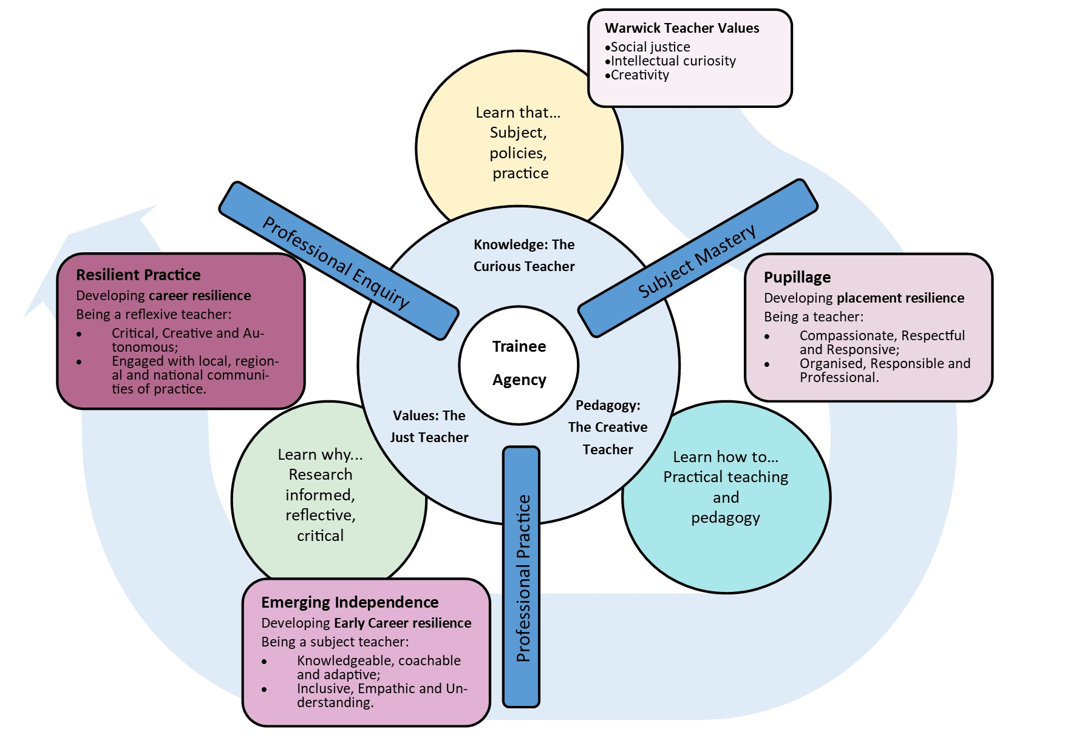

Slide 13
Strands | Threads | Phase 1: Pupillage |  | Phase 2: Emerging independence | Phase 3: Resilient Practice
Trainee journey | Understanding self | How I view teaching and learning |  | My emerging teacher identify | How I influence others through leadership
 | Understanding context | The school context |  | Different school contexts and education policy | Adapting to change
The Just Teacher | Managing classrooms | Establishing routines Setting expectations |  | Handling challenging interactions | Relationships with disaffected pupils
 | Inclusive teaching | Equality policies and practices |  | Creating an inclusive classroom | Developing Inclusive pedagogies
 | Supporting individuals | Introduction to complex learning needs |  | Adapting teaching | Closing learning gaps
The Curious Teacher | How children learn | Introduction to learning theory |  | Implications of learning theory | Using multiple lenses to critique practice
 | Subject pedagogies | Introduction to Issues in subject teaching |  | Understanding issues in subject teaching | Resolving issues in subject teaching
 | Evidence informed practice | Introduction to education research |  | Application of evidence to teaching | Critical evaluation of research and theory
The Creative Teacher | Planning for learning | Lesson planning |  | Planning learning sequences | Curriculum Design
 | Learning technologies | Presentation technology |  | Technology enhanced learning | Creative use of technology
 | Pedagogy | Introduction to pedagogy |  | Adapting pedagogies | Radical pedagogies
Teaching practice | Trainee | Observing practice | Early teaching | Independent teaching | Leading learning
 |  | Co-planning | Lesson planning | Planning sequences of lessons | Adapting the curriculum
 | Mentor | Modelling | Live feedback | Instructional coaching
 |  | Establishing targets | Live feedback | Co-constructed targets | Trainee self-directed targets

Slide 14
 |  | Phase 1: Pupillage | Phase 2: Developing independence | Phase 3: Gaining Autonomy
The Just Teacher | Managing classrooms | Establishing routines Setting expectations | Handling challenging interactions | Relationships with disaffected pupils | End Goal Adaptable teaching Resilient behaviour management Recognition of individual learners’ needs Awareness of different contexts (the world around me) Being a prepared leader
 |  | Adopting existing routines | De-escalating conflict | Understanding challenging behaviour
 |  | School policies for behavior management | Developing resilience | Working through relational issues
 |  | Applying policies to people | Situational awareness and scanning
 | Inclusive teaching | Equality policies and practices | Creating an inclusive classroom | Developing Inclusive pedagogies
 |  | Equalities Act | revisit/ develop theory | Wider context, feeding into policy
 |  | British Values | introduce different lenses | Epistomology- viewpoints/biases
 |  | Ofsted framework | apply policy into practice | Globalisation-global issues
 |  | KCSIE |  | Neoliberalism and post-truth
 |  |  |  | Multiple lenses
 |  |  |  | Developing criticality : critical literacy, digital literacy
 |  |  |  | Revisit Teaching Philosophy
 |  |  |  | Own Agency, empowerment
 | Supporting individuals | Introduction to complex learning needs | Adapting teaching
 |  | Introduction to SEND | inclusion conference
 |  |  | Hard to reach children
Subject studies | Professional Enquiry

Slide 15
 |  | Phase 1: Pupillage | Phase 2: Developing independence | Phase 3: Gaining Autonomy
The Curious Teacher | How children learn | Introduction to learning theory | Implications of learning theory | Using multiple lenses to critique practice | End Goal Emerging subject leadership Awareness of the complexity of the wider curriculum Able to make persuasive evidence informed decisions about practice Understanding the limitations of research and theory
 |  | Neuroscience and learning | Using learning theory to plan for learning | Recognising the limitations of learning theories
 |  | Constructivist views of learning | Adapting teaching in the light of implications of learning theories | Teaching informed by multiple learning theories
 |  | Developmental models of learning | Understanding barriers to learning
 | Subject pedagogies | Introduction to Issues in subject teaching | Understanding issues in subject teaching | Resolving issues in subject teaching
 |  | Recognising personal epistemologies | Adapting teaching to address subject specific issues | Innovative responses to issues in the subject discipline.
 |  | Subject specific issues | Evidence informed planning and teaching on the subject discipline. | Interdisciplinary connections.
 |  | Introduction to research in the subject discipline | Developing teaching sequences | Developing subject leadership
 |  | Introduction to curriculum planning in the subject
 | Evidence informed practice | Introduction to education research | Application of evidence to teaching | Critical evaluation of research evidence
 |  | Education research paradigms, RCTs, Meta-studies and effect size, qualitative methodologies | Implications of research for teaching | Strengths and limitations of different methodologies
 |  | How to access research findings | Implications of research for policy and curriculum design | Developing positionality in relation to research
 |  | Asking critical questions of research | Employing research evidence in critical incidents. | Forming persuasive evidence informed arguments for practice
Subject studies | Professional Enquiry

Slide 16
 |  | Phase 1: Pupillage | Phase 2: Developing independence | Phase 3: Gaining Autonomy
The Creative Teacher | Planning for learning | Lesson planning | Planning learning sequences | Curriculum Design | End Goal
 |  | An introduction to lesson planning | Developing sequences of lessons | An introduction to curriculum design
 |  | Structuring lessons for learning | Adapting teaching in response to AfL | Whole school curriculum
 | Learning technologies | Communication technology | Technology enhanced learning | Creative use of technology
 |  | Using technology to communicate subject knowledge | Using technology to enhance learning | Future classrooms
 | Pedagogy | Introduction to pedagogy | Adapting pedagogies | Radical pedagogies
 |  | Introduction to subject pedagogy | Adapting teaching to meet the needs of different learners | An introduction to radical pedagogies
 |  |  |  | Developing creativity and problem solving in the subject.
Subject studies | Professional Enquiry

Slide 17
Strands | Threads | Phase 1: Pupillage |  | Phase 2: Developing independence | Phase 3: Gaining Autonomy
Teaching practice | Trainee | Observing practice | Early teaching | Independent teaching | Leading learning
 |  | What learning looks like
 |  | Impact of teacher on subject | Lesson planning | Planning sequences of lessons | Adapting the curriculum
 |  | Team teaching, team planning culture
 | Mentor | Modelling | Collaboration with trainee | Supporting establishment in second placement
 |  | Establishing targets | Live feedback | Instructional coaching
 |  | CCF instruction TS3,4 & 7 |  | Co-constructed targets | Trainee self-directed targets
 |  |  | Scaffolded lesson observation form
Touchpoint 1 – assesses expectations of professionalism. Focusses on preamble and part 2 of Teachers’ Standards.
Touchpoint 2 – assesses level of support needed to plan and teach for gateway to coaching model.
CEDP Assessment – Trainee, mentor and tutor review of WADS..
Touchpoint 2b – checks sustained independence in new setting to confirm gateway to coaching model.
Off track pathway |  |  | Intervention plan | Half termly touchpoints 2c, d etc. | Return to track
 |  |  | Allocation of intervention tutor | Placement termination – action plan and course extension

Slide 18
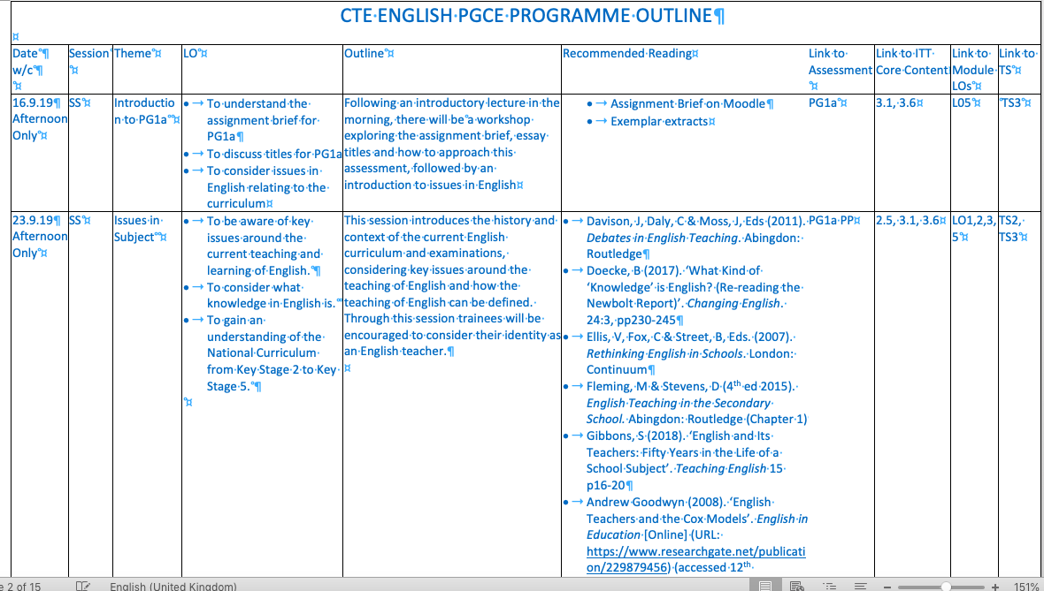

Slide 19
New Ofsted inspection Framework for ITE
Current proposed framework under evaluation of consultation period:
to introduce two key judgement areas only: the new ‘quality of education and training’ judgement will replace the current ‘outcomes for trainees’ and ‘quality of training across the partnership’ judgements
to apply a new methodology for gathering evidence during an inspection
a one-stage model of inspection
to introduce a short and longer telephone call with ITE partnership representatives
spring and summer term inspections only

Slide 20
Changes to course start 2020
Deferred start date 14th September allow:
  Space for schools to establish return to work
  Extended recruitment period
  ID and document checking with social distancing measures
Merged induction and course start to accommodate:
  Flexibility in placement starts (attachment as well as placements)
  Limited campus space – online teaching in first half term
  Blend of synchronous and asynchronous teaching

Slide 21
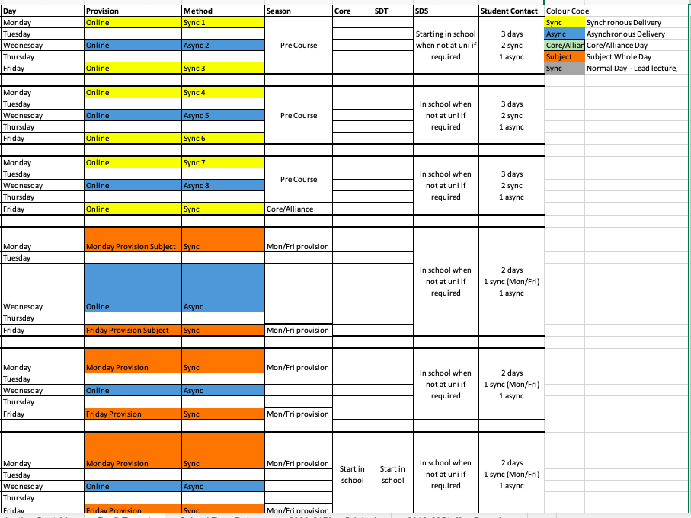

Slide 22
Flexibility for Autumn 2020
We are mindful of the challenges for schools in September and are working on flexible models to accommodate:
Delayed starts to placement (SD flexible, Core earliest from September 28th );
Attachments to schools where trainees have limited access to school site;
Varied experience including supporting and online roles, working with smaller groups etc.
Some early start trainees (e.g. SDS);
Additional university input for late starting trainees.

Slide 23
Flexibility for Autumn 2020
Remote working settling in and moderation visits to reduce physical visits to schools;
Link tutors attached to schools rather than trainees to support partnership working;
Additional personal tutor support for trainees.

Slide 24
Recruitment 2020/21
Hybrid year: UCAS and DfE Apply
Review of marketing strategy and support for SD partners to target more effective online approaches.

Slide 25
Accepted offers (June 14th)
Mondays |  | 19/20
English | 30 | 52
Drama | 4 | 7
Maths | 18 | 15
Computer Science | 8 | 7
Geography | 7 | 17
Music | 2 | 4
MFL | 14 | 15
TOTAL | 83 | 117
Fridays |  | 19/20
Biology | 21 | 16
Chemistry | 9 | 13
Physics | 4 | 4
PE (incl. EBACC) | 27 | 26
History | 20 | 25
RE | 3 | 8
Art & Design | 9 | 8
TOTAL | 93 | 100

Slide 26
Partnership: enhancements
10 x Alliance Review Meetings for School Direct leads
    “very useful”
    “helpful to review more than just the data”
    “gives us feedback that we wouldn’t otherwise receive”
    “good to work with a University that is so pro-active about improving partnership”
    “excellent professional dialogue”
    “useful for my report to Governors”

Slide 27
Chance to review and develop strategy on
    Cross-phase Leadership and Quality of School Direct for all trainees
    Marketing activities to promote ITE
    Trainee support models (interventions)
    NQT support
    Coherence of delivery

Slide 28

Whole -school
Mentor activities are integrated whole-school as part of the CPD programme
Senior Leadership Teams acknowledge the complexities of ITE and liaise with and support the teaching school very effectively
Teaching Schools have a wide range of offers, not limited to ITE and these bring alternative revenue and sustainability
IT infrastructure is strong and trainees are provided with a new laptop
Marketing is creative, multi-faceted and effective, incorporating websites, social media, printed matter, face to face events.

Slide 29

Trainee
experience
Coherence is being achieved where Professional Studies is aligned with school-based ITE
Mentor “tea and toast” sessions to enable sharing of best practice and buddying
Flexibility is offered to trainees who need it (e.g. for PG studies at pinch points)

Slide 30

Pro-active moderation of partner school placements
  Settling in visits
  Regular meetings with all mentors (termly or half-termly)
Close relationship with placement schools to ensure good tracking and support
ITE evening event for whole alliance at some point in the year
The significant challenges associated with making our aspirations a reality are creatively and optimistically acknowledged and overcome

Slide 31
MA Professional Education
New for 2020/21
The MA is now available to anyone with a UK PGCE with QTS within the last 5 years (not just Warwick alumni).
The new Postgraduate Recognition of Prior Learning (RPL) Programme provides a way for colleagues who completed their PGCE more than 5 years ago to exchange their work-based learning for 90 CTE credits – so as to join the MA Professional Education.
The RPL Programme will run each year from May – October.
The first stage of the MA Professional Education has been redesigned with a stronger focus on practitioner research, with two new modules:
  Research in Professional Practice (20 credits) to run Jan - April
  Ethics Portfolio to run May – June (10 credits) of Year 1.

Slide 32
MA Professional Education
A small selection of current MA research studies with a Secondary focus:
How do A-Level History students perceive 'Britishness'? A qualitative analysis of student interviews on British history and national identity
What do students and educators consider makes a positive male role model for boys' engagement and how do male educators alter their gendered performance as teachers in order to fit this role? A series of surveys, interviews and observations of KS3 students and teachers in urban secondary schools.
Survival of the fittest: A case study from a system leaders perspective on the changing landscapes within Teaching Schools, in a maintained context.
To what extent does embedding learning help students to be able to recall information in the Geography classroom?

Slide 33
Q and A
Contact me:
Andy Hind
Head of Secondary Teacher Education
T: +44 (0) 24765 22297
E: Andrew.Hind@warwick.ac.uk
Centre for Teacher Education | University of Warwick | Coventry | CV4 8EE | UK

