Slide 1

Place-based methods for knowing your school better: Lessons from the MA Professional Education for mentors and established teachers

Slide 2
Place-based methods for knowing your school better: Lessons from the MA Professional Education for mentors and established teachers
Why place and what is a place?

Slide 3
Place-based methods and wellbeing
5 ways to wellbeing
Connect
Be active
Take notice
Learn (find out something new)
Give

Slide 4
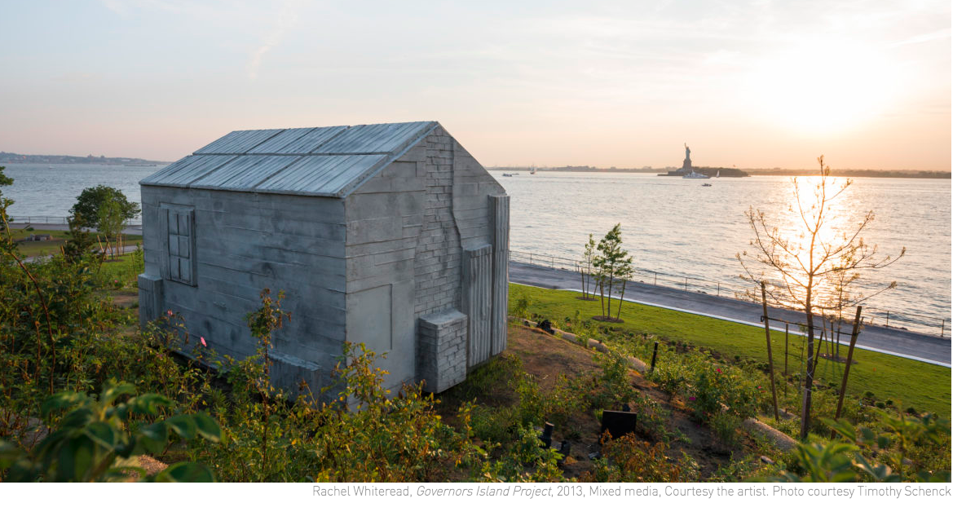
Why place and what is a place?
“Inhabited space transcends geometric space” (Gaston Bachelard, The Poetics of Space

Slide 5
Why place and what is a place?
Thomson, P. and Hall, C., 2016. Place-based methods for researching schools. Bloomsbury Publishing
Give 5 useful pointers from Tim Creswell:
And Doreen Massey
A material location
A locale (surroundings)
A sense (of place)
Located in space and time
A landscape
Places are entangled in ‘stretched out relations’
Places are not equal – they are positioned differently
Places are ‘thrown together- - not a thing but a constellation, a coming together of trajectories

Slide 6
Why place and what is a place?
Ingold, T., 2016. Lines: a brief history. Routledge.
We occupy spaces but inhabit places

Slide 7
Place and School?
Activity 1:
Draw a school

Slide 8
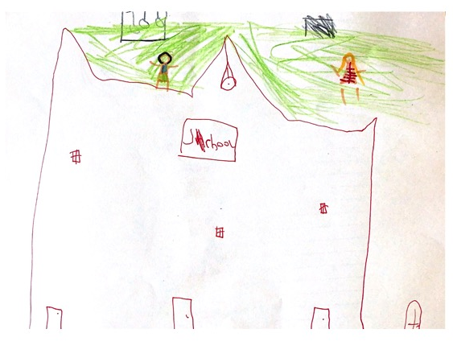
Place and School
Activity 2:
Draw your school

Slide 9
Place and School
“Schools are not mere buildings or fixed containers, but physical places shaped by people and their actions, and are subject to interpretation and the meaning-making processes of those who inhabit these spaces”.
Fataar, A. and Rinquest, E. (2019) ‘Turning space into place: The place-making practices of school girls in the informal spaces of their high school’, Research in Education, 104(1), pp. 24–42. doi: 10.1177/0034523718791920.

Slide 10
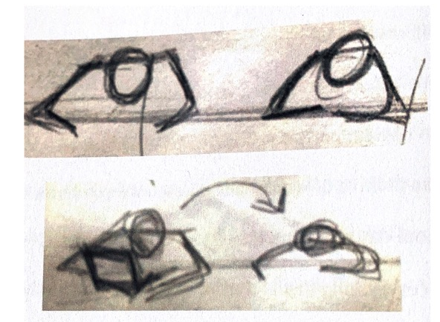
Place and school
Thomson, P. and Hall, C., 2016. Place-based methods for researching schools. Bloomsbury Publishing
When we think of a school we think generically but when we think of our school we think specifically.
Ingold, T. and Vergunst, J.L. eds., 2008. Ways of walking: Ethnography and practice on foot. Ashgate Publishing, Ltd..
We know things (and ourselves) by wandering about with them.
Place is not static

Slide 11
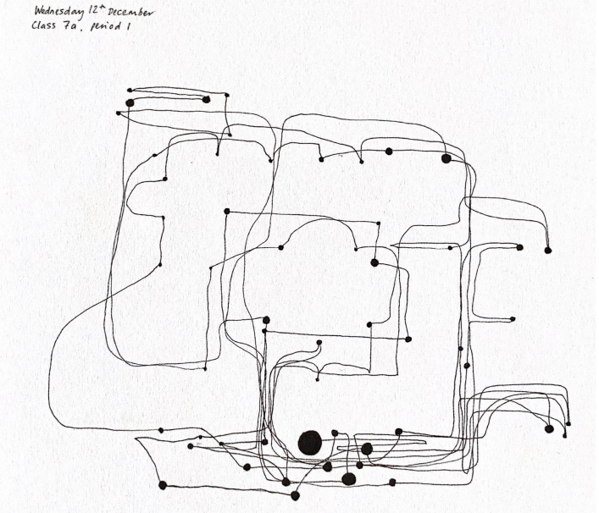
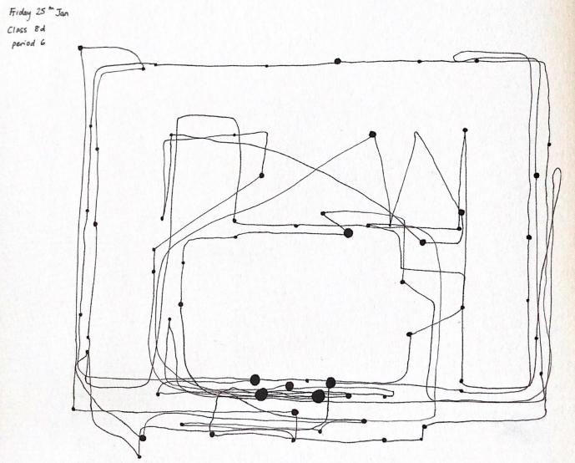
Place is not static

Slide 12
Place is not static
Youdell, D. and Armstrong, F., 2011. A politics beyond subjects: The affective choreographies and smooth spaces of schooling. Emotion, Space and Society, 4(3), pp.144-150.
School has its choreography that one must be caught up in
Not aligning to the choreography – not findings one’s place in it impacts one’s sense of belonging.
Place requires attachment
Augé, M., 1995. Non-places: Introduction to an Anthropology of Supermodernity. verso.

Slide 13
A sense of place requires attachment
Terrazas-Carrillo, E.C., Hong, J.Y. and Pace, T.M., 2014. Adjusting to new places: International student adjustment and place attachment. Journal of College Student Development, 55(7), pp.693-706.
Finding of a place ‘conducive to positive social, cultural or personal interactions…’. It is an indicator of longer term resilience and academic success.
Johnson, M.K., Crosnoe, R. and Elder Jr, G.H., 2001. Students' attachment and academic engagement: The role of race and ethnicity. Sociology of education, pp.318-340.
Varying levels of place attachment found across racial groups in US Middle Schools. School attachment has an ‘affective’ component – the ‘extent to which students ”feel” that they are embedded in and part of their social communities.
Fleury‐Bahi, G. and Marcouyeux, A., 2010. Place evaluation and self‐esteem at school: the mediated effect of place identification. Educational Studies, 36(1), pp.85-93.
Self esteem is connected to secure place attachment. Belonging in a geographic place leads to belonging in a sociospatial category.

Slide 14
What is place-making?
Creates meaningful public spaces that become ‘places’ for the community that inhabits them.
Created through interactions between town planners, architects, artists, business leaders, workers, residents, social providers etc.
Becoming more important in regards to regenerations of high streets etc.
Increasingly informed by research that sees a causal link between healthy spaces, communities and people.
A sense of a space being place = well-being.

Slide 15
Place-based methods and wellbeing
5 ways to wellbeing
Connect
Be active
Take notice
Learn (find out something new)
Give

Slide 16
Therapeutic Photography
“Therapeutic Photography is the name for photo-based activities that are self-initiated and conducted by oneself (or as part of an organized group or project), but where no formal therapy is taking place and no therapist or counsellor needs to be involved”. https://phototherapy-centre.com/therapeutic-photography/
https://phototherapy-centre.com/who-is-doing-what-where/#Therapeutic-Photography
Tourigny, L. and Naydenova, I., 2020. Using Therapeutic Photography Techniques to Increase the Wellbeing of College Students. Journal of Counseling and Psychology, 3(1), p.4.
https://digitalcommons.gardner-webb.edu/cgi/viewcontent.cgi?article=1022&context=jcp

Slide 17
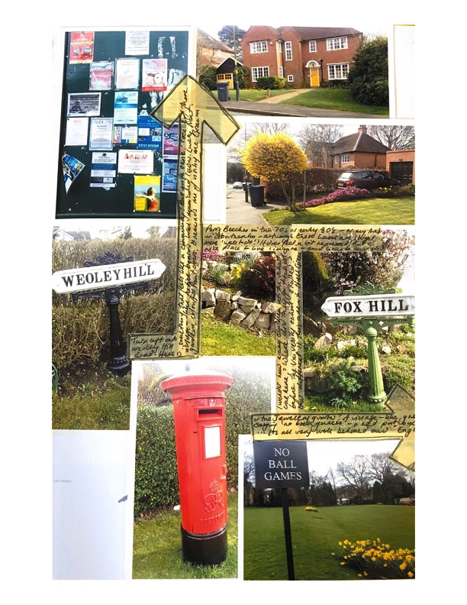
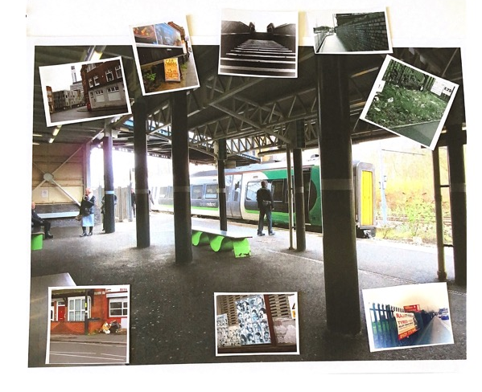
Activity 3 – Go for a walk (e.g. catchment area)
Be active – take notice - learn

Slide 18
Drawing – Walking - Photography
Alison Clark (2001) How to listen to very young children: The mosaic approach, Child Care in Practice, 7:4, 333-341, DOI: 10.1080/13575270108415344
https://0-www-tandfonline-com.pugwash.lib.warwick.ac.uk/doi/abs/10.1080/13575270108415344
Michelle Newman, Andree Woodcock & Philip Dunham (2006) ‘Playtime in the Borderlands’: Children's Representations of School, Gender and Bullying through Photographs and Interviews, Children's Geographies, 4:3, 289-302, DOI: 10.1080/14733280601005617
Dónal O Donoghue (2007) ‘James always hangs out here’: making space for place in studying masculinities at school, Visual Studies, 22:1, 62-73, DOI: 10.1080/14725860601167218

Slide 19
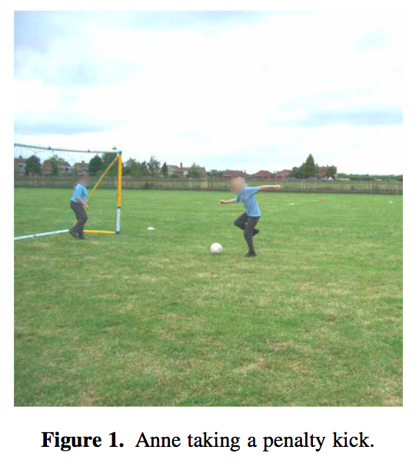
Drawing – Walking - Photography
Michelle Newman, Andree Woodcock & Philip Dunham (2006) ‘Playtime in the Borderlands’: Children's Representations of School, Gender and Bullying through Photographs and Interviews, Children's Geographies, 4:3, 289-302, DOI: 10.1080/14733280601005617

Slide 20
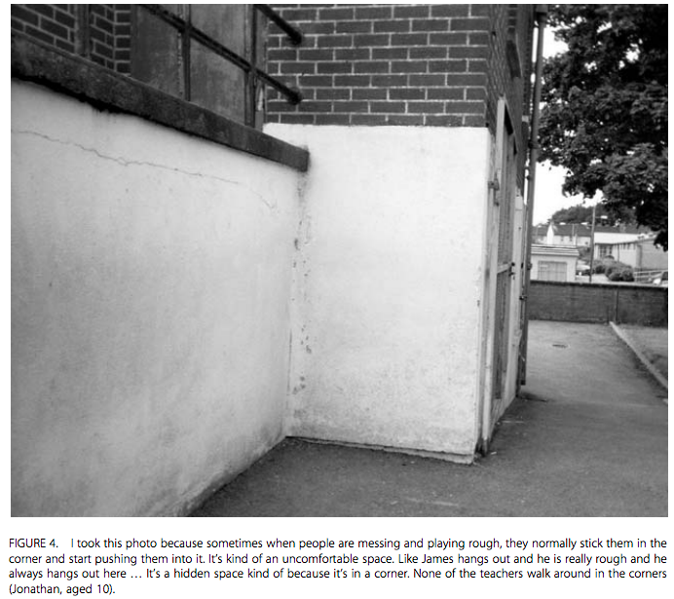
Drawing – Walking - Photography
Dónal O Donoghue (2007) ‘James always hangs out here’: making space for place in studying masculinities at school, Visual Studies, 22:1, 62-73, DOI: 10.1080/14725860601167218

Slide 21
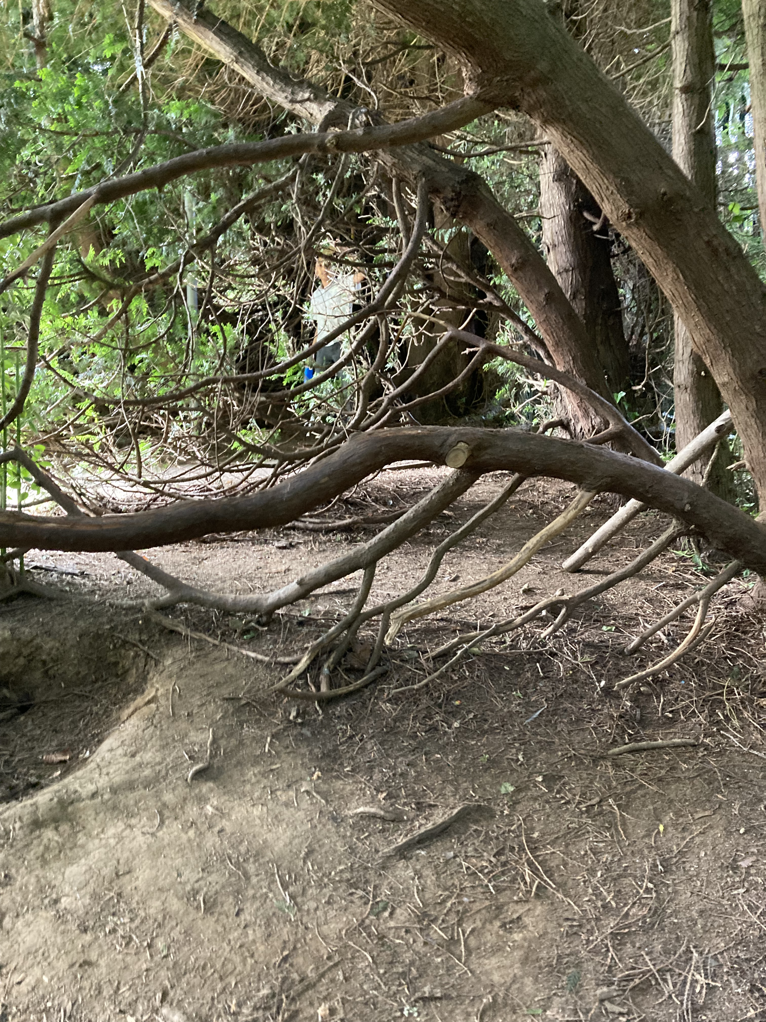
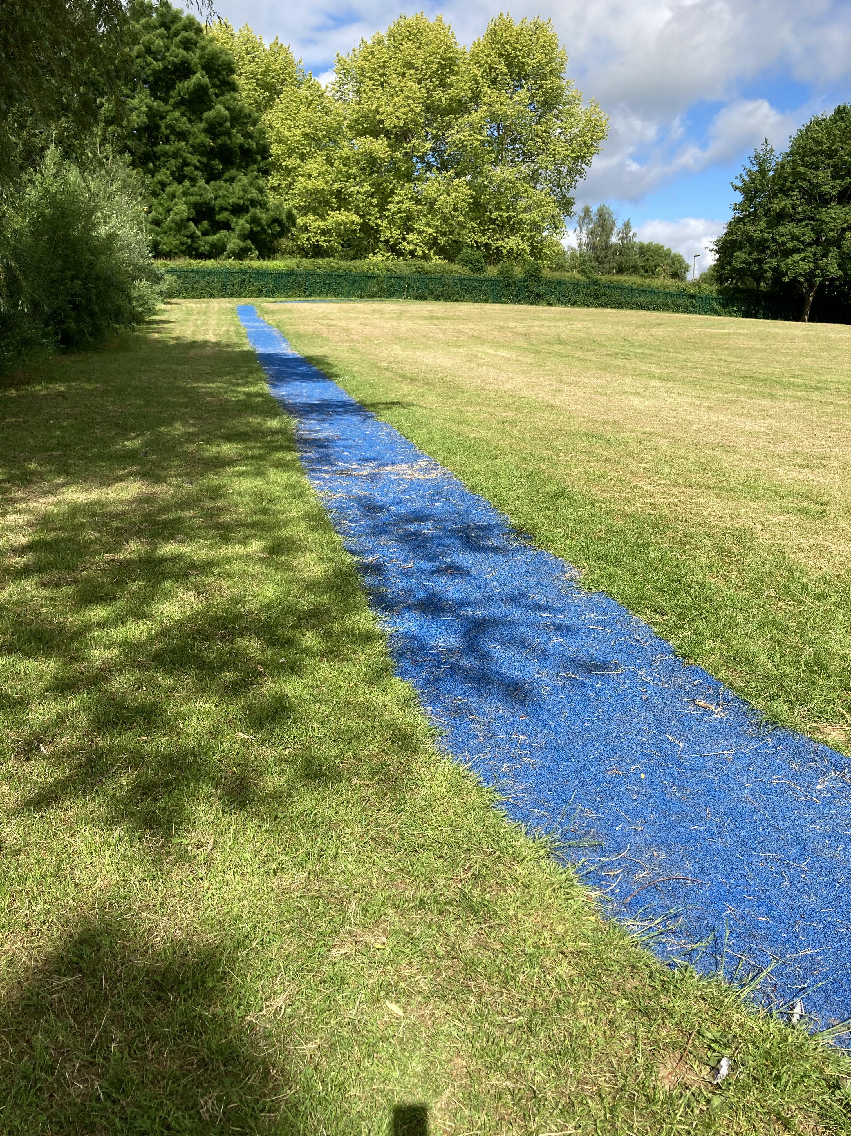
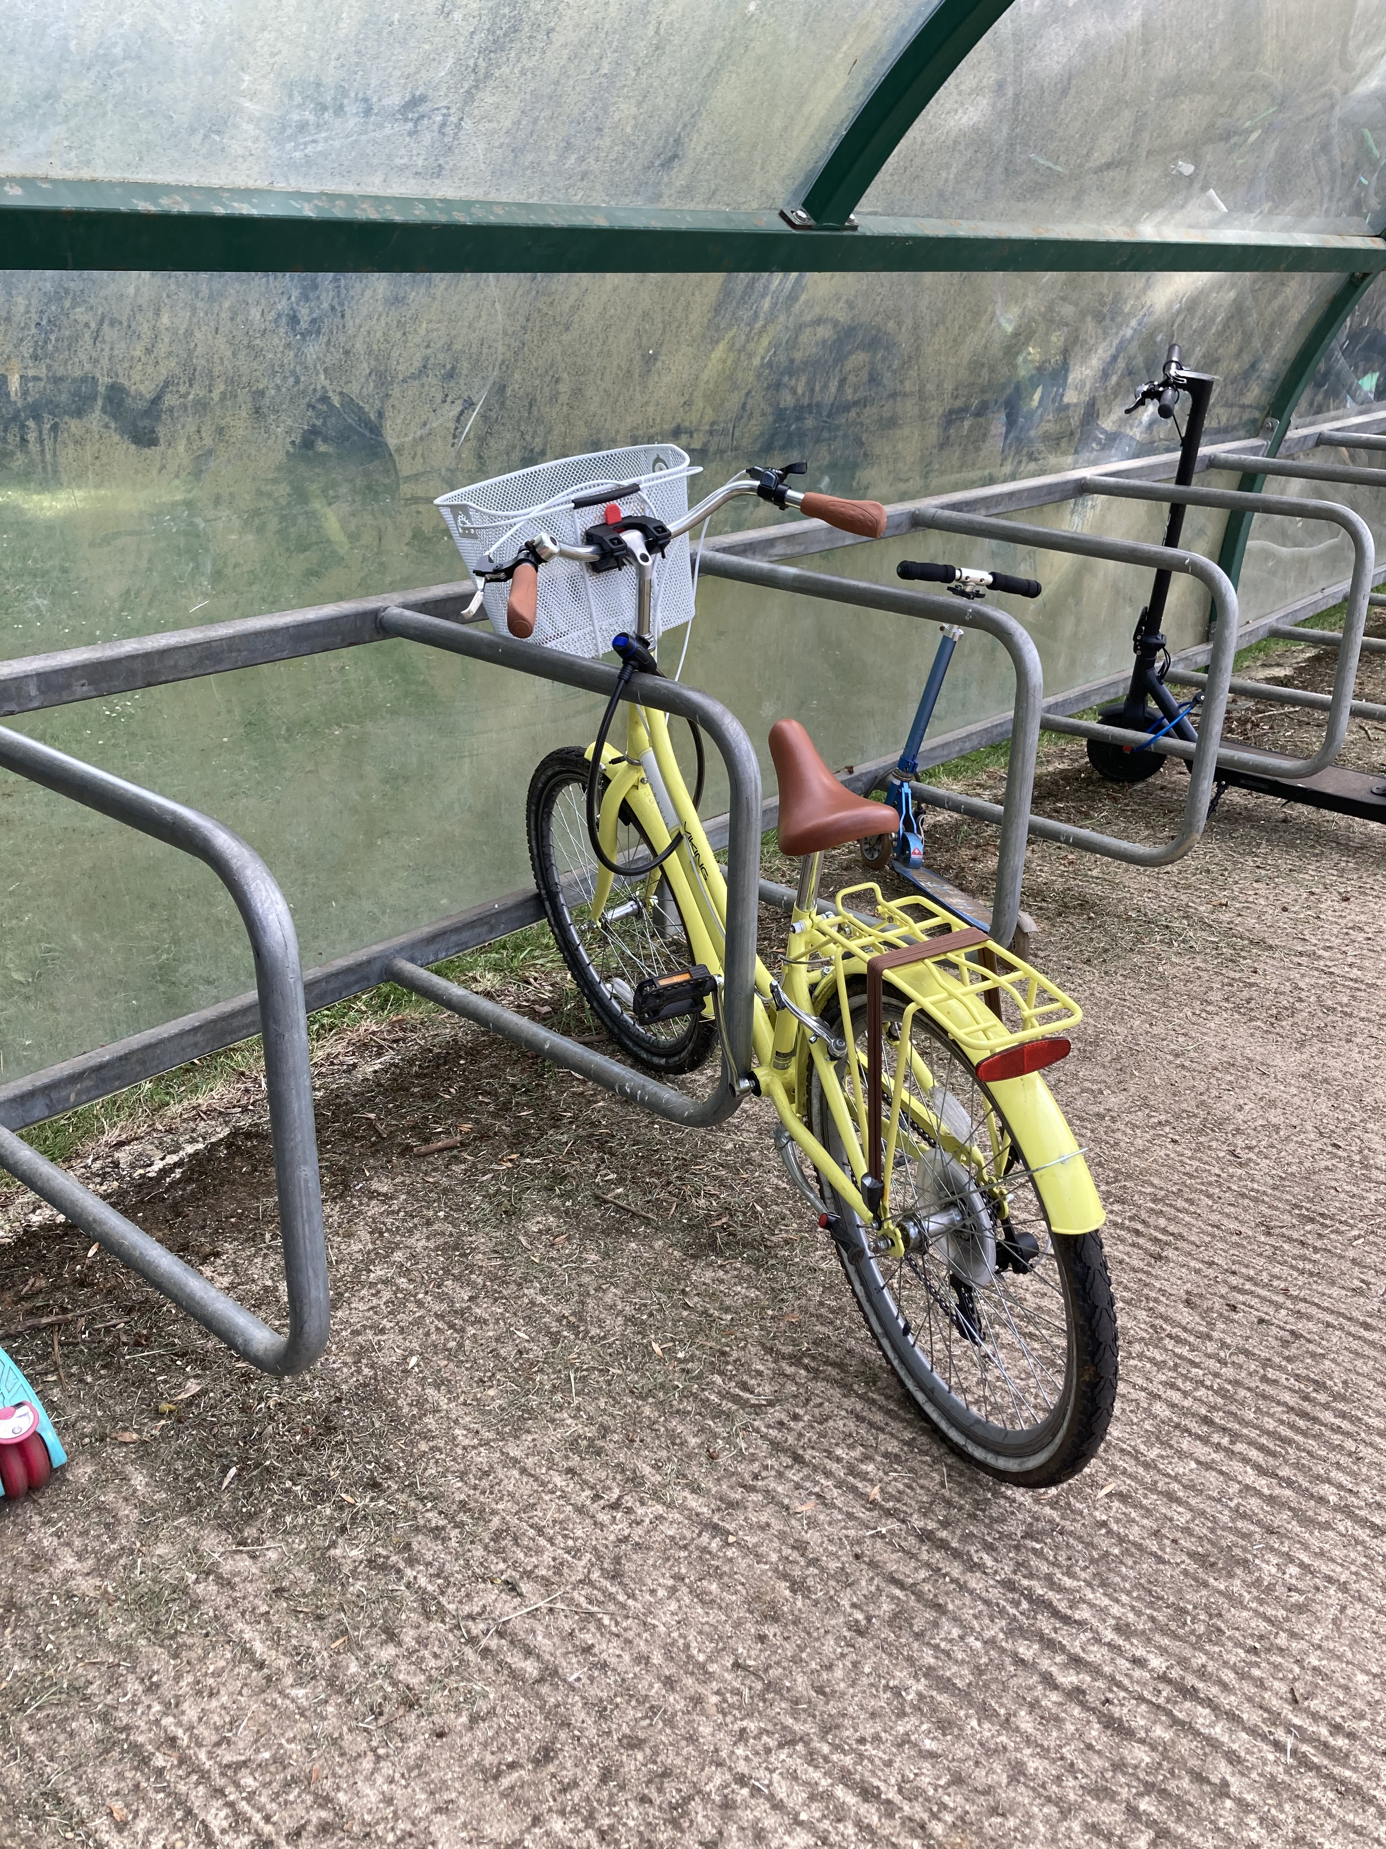
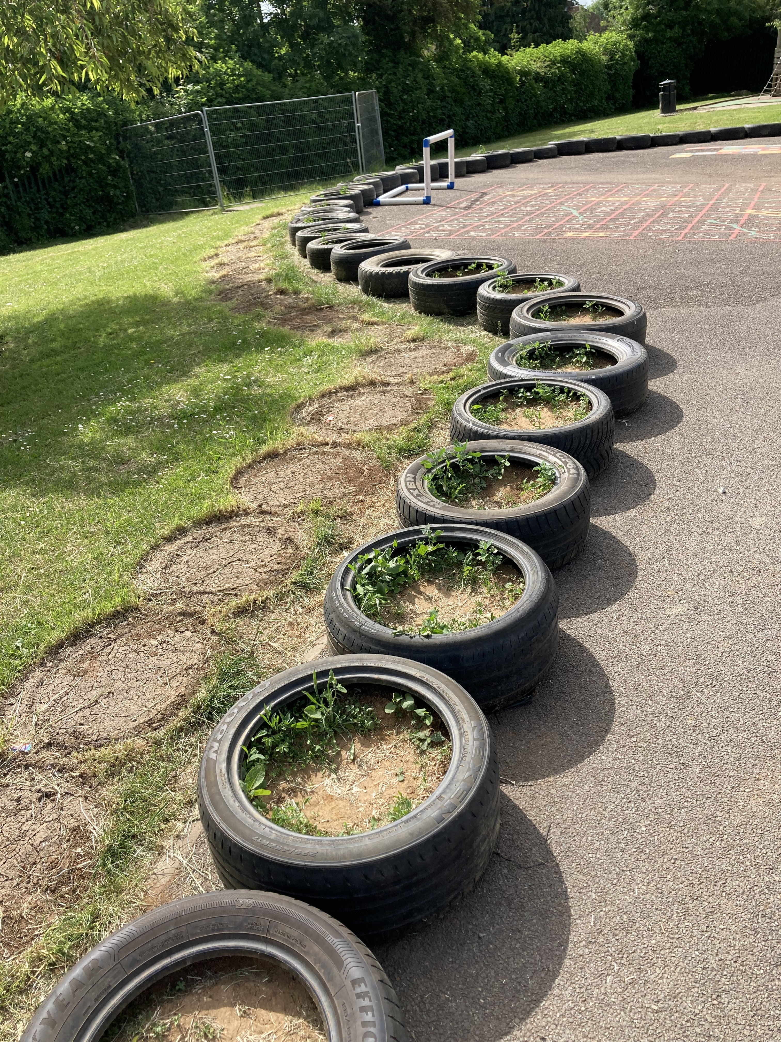
Exploring experiences in place over time
Walking as a participatory, performative and mobile method. Presenter(s): Maggie O'Neill and Tracey Reynolds https://www.ncrm.ac.uk/resources/online/all/?main&id=20713
Clark, A. and Emmel, N., 2010. Realities toolkit# 13: Using walking interviews. ESRC National Centre for Research Methods. http://eprints. ncrm. ac. uk/1323/1/13-toolkit-walking-interviews. pdf.

Slide 22
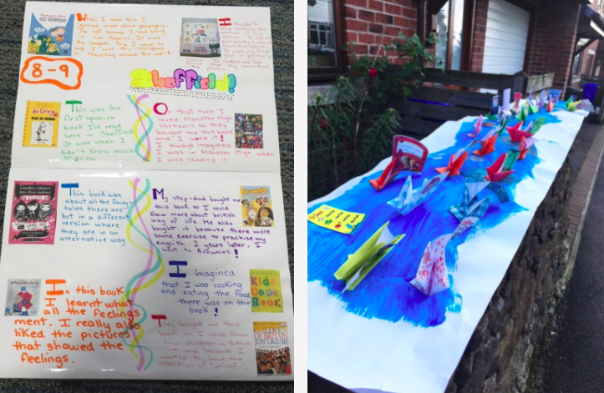
Exploring experiences in place over time
Rivers of reading – adapted from Pam Burnard’s work on ‘Rivers of Experience’ in music education
Sabine Little (2021) Rivers of multilingual reading: exploring biliteracy experiences among 8-13-year old heritage language readers, Journal of Multilingual and Multicultural Development, DOI: 10.1080/01434632.2021.1882472
Cliff Hodges, G. 2010. “Rivers of Reading: Using Critical Incident Collages to Learn About Adolescent Readers and Their Readership.” English in Education 44 (3): 181–200. doi:10.1111/j.1754-8845.2010.01072.x. [Taylor & Francis Online],
https://www.multilingualism-in-schools.net/rivers-of-reading/

Slide 23
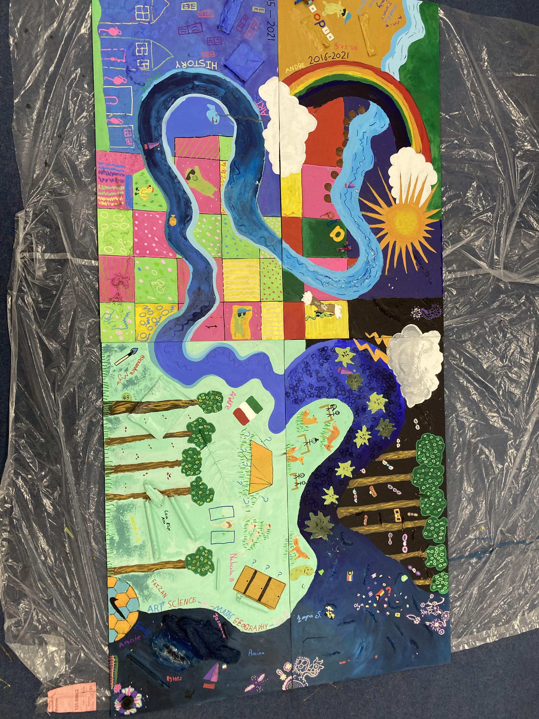
Exploring experiences in place over time
Connect – Be Active – Take Notice – Learn - Give

Slide 24
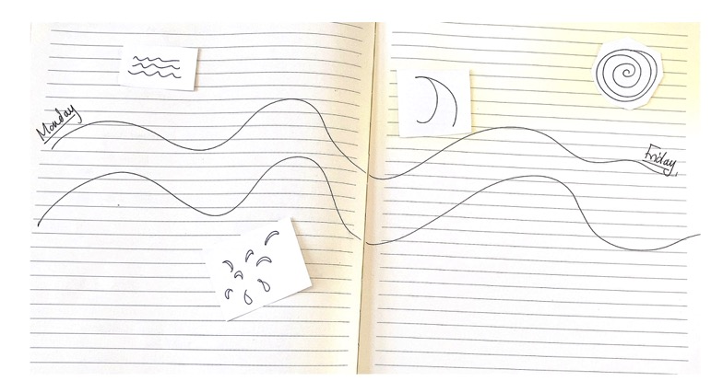
Activity 4 – Draw a river

Slide 25
Examples of place-based projects - Photography

Slide 26
Other place-based ideas
Photos of spaces in and around school that are a significant part of my every-day.
Photos of spaces in and around school where I feel unsure of my position.
Photographs of people in school who support me.
A map of my interactions in a lesson using GPDS.
Choose a topic to discuss and go for a wandering walk with a colleague - see where you end up and what you talk about (you can vary it by one person talking for 5 mins whilst the other directs the route and then swapping etc.)
Take a picture of yourself and your classroom everyday at the end of school for four weeks. What do you observe.
Recreate an incident that has happened in school as a photograph (group activity)
Sit outside the school at the end of the school day and note what you observe.
Ask a student to photograph a lesson – what do they record that you don’t see?

