Slide 1
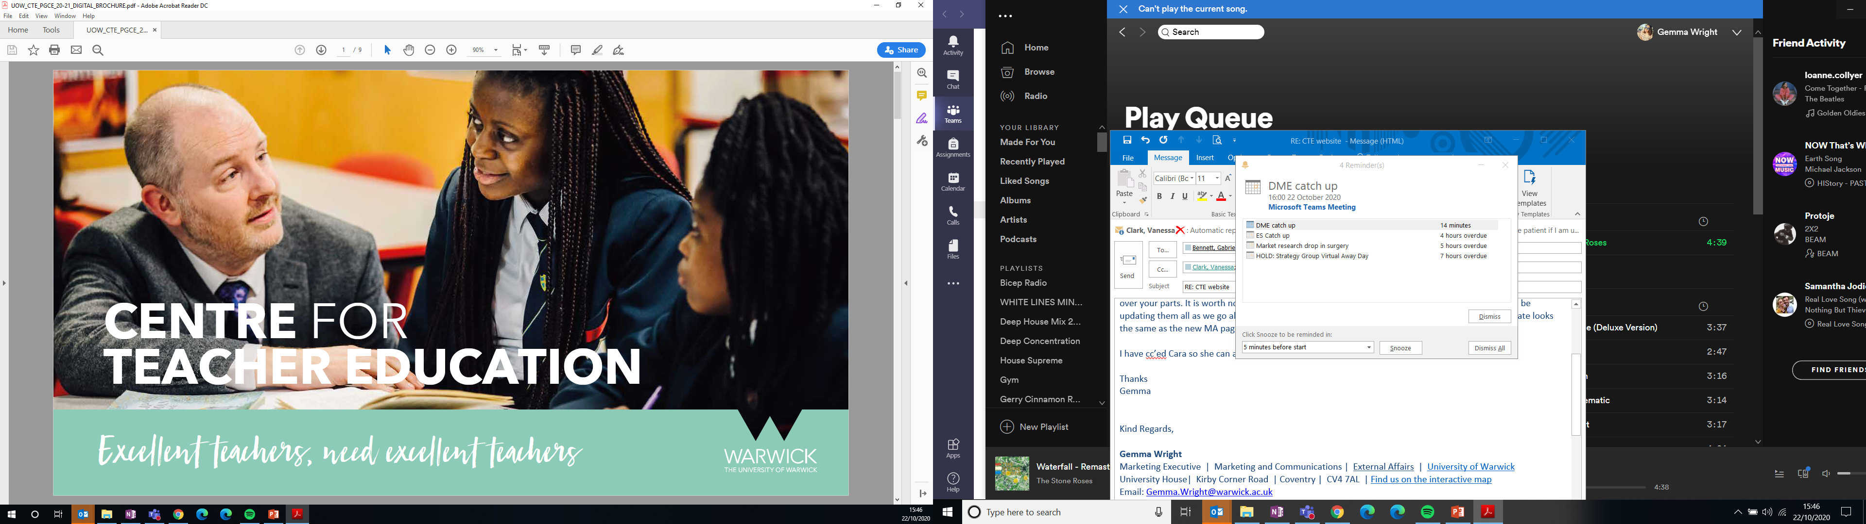
Partnership Conference Summer 2022
Teacher Education at Warwick- Our Five Year Strategy

Slide 2

STRATEGY REFRESH
Our objective:
VISION & AMBITION
VISION & AMBITION
STRENGTHEN & ENHANCE
Create a 5-year
strategy that enables
the department to
achieve our vision and ambition for the discipline of Teacher Education at Warwick.
Where staff expertise and professional programmes are effectively integrated to create a model where research underpins the need for multi-skilled Teacher Educators.
Present plans that strengthen and enhance
the longstanding core values and reputation of Teacher Education at Warwick.

Slide 3

97%
STRATEGIC STRENGTHS
PRIMARY
OUTSTANDING & GOOD FINAL GRADES
Regional, National and International Impact and the department’s contribution to Warwick’s Widening Participation intent
Reputation and history of Teacher Education at Warwick
Inclusive and values driven curriculum where our Warwick Teacher Values of social justice, intellectual curiosity and creativity underpin all that we do
Intersectionality with partnership schools; a co-delivered and co-constructed curriculum
Knowledge and experience of pedagogy, including
work-based learning
Subject and school sector expertise
Robust set of data informs annual self-evaluation to inform continuous improvement
2019-2020

Slide 4
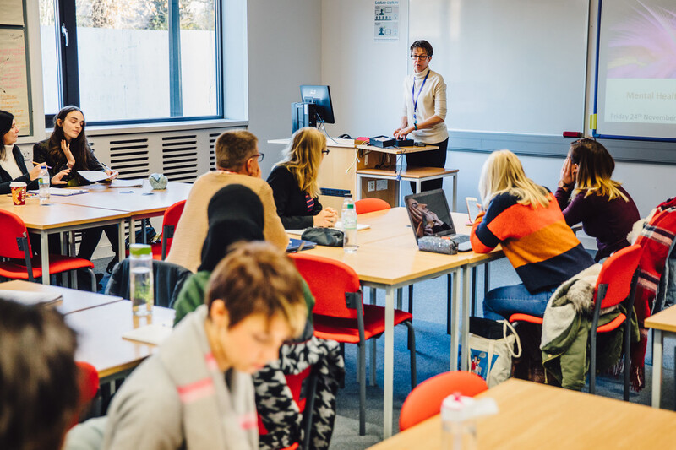
STRATEGIC PRIORITIES | 2021 - 2026
Respond to the changes and evolution of teacher education
Be the very best teacher educators: values driven curriculum
Deliver transformational teaching and learning: develop our digital distinctiveness
Build and maintain an environment in which staff and students flourish
Increase and disseminate our wider educational impact on a regional, national and international level
Achieve sustainable target recruitment numbers

Slide 5
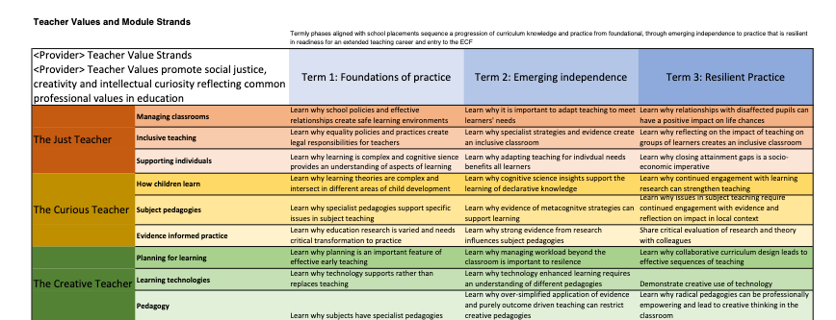
AN AMBITIOUS CURRICULUM
Built on the Warwick Teacher Values
Social Justice, Curiosity and Creativity
Adds a ‘Learn why...’ strand to deepen the CCF focus on Learn That… and Learn How to…

Slide 6
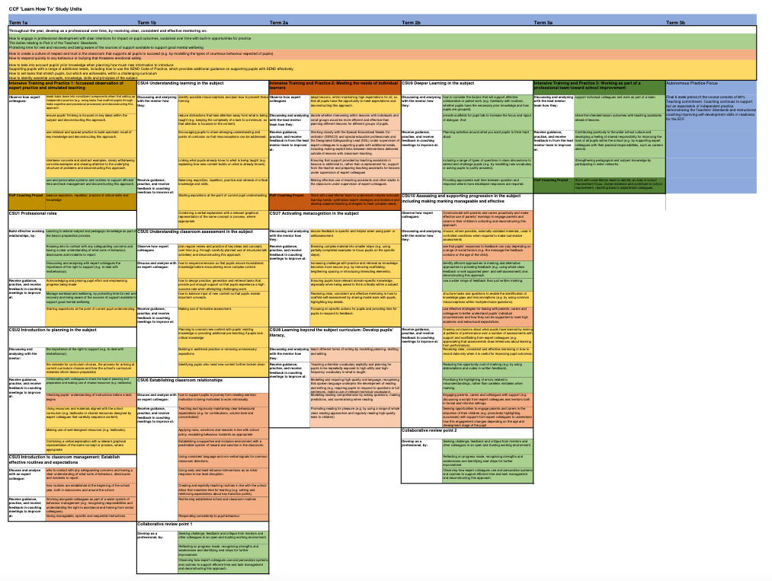
AN INTEGRATED CURRICULUM
CCF elements integrated by theme across subject specialist and
whole course sessions and ITaPs and structured training activities
Combining the best of university and school-based training in a coherent programme
Extension focus in conference events – Research in Action, Inclusion, Green Space and Partnership
Re-designed assessments to strengthen authenticity to practice and integration of academic and professional training elements.

Slide 7
TEACHER EDUCATION AT WARWICK IN 2026
An accredited provider (2024) with recruitment across our partnership year on year (circa 450)
Recognition in the sector and across our partnership for a strong values led approach to ITE that develops just, curious and creative teachers
Engagement in close to practice research in teacher education by CTE staff, including collaborative research with other departments and dissemination of this research nationally and internationally
Growing numbers in wider regional partnerships, including teacher recruitment ‘cold spots’
Greater use of technology/digital teaching and learning

Slide 8
TEACHER EDUCATION AT WARWICK IN 2026
cont.
An expansion of our portfolio: Establish the International QTS (pilot 2022-23) alongside the International PGCE
MA in Professional Education: Greater conversion of PGCE students (past and present), school-based mentors and middle leaders to the MA
Professionalisation of the school mentor/coach role in line with national frameworks, alongside recognition in the partnership and nationally for high quality mentoring and coaching development through teacher education
Exemplify the department's non-financial gains on educational outcomes and school improvement

Slide 9

INCREASE AND DISSEMINATE OUR WIDER EDUCATIONAL IMPACT
Extensive non-financial value:
-school improvement and educational outcomes in the locality and region
-contribution to Warwick’s reputation in the Education Sector and our partner communities
We contribute significantly to the Teacher Supply challenge in the country as well the Government’s ‘levelling up agenda’ for the education system; working towards achieving a great education for every child, whatever their background and wherever they live in the country.
CTE commit to collating and publishing this annually
Notes:
KATE START AGAIN

Slide 10

QUESTIONS
AND DISCUSSION
www.warwick.ac.uk/cte

