Slide 1
Supporting your Trainee’s Academic Development
Dr Alison Morgan
Deputy Head of Secondary PGCE

Slide 2
This session will…
Outline the PG modules for the PGCE
Provide information on the two modules and assignments
Identify how the university is supporting trainees
Identify how schools can support trainees

Slide 3

PGCE Route Map 2021-22

Slide 4


PG Assessment Structure
“Subject
Studies”
EP929
30 CATS (7)
“Professional Enquiry”
IE9J1
30 CATS (7)
“Professional Practice”
EP918
30 CATS (6)
PG1 | PG2 | PDP | Qualification
 |  |  | PGCE with QTS
Honours Level |  |  | PCE with QTS
 | Honours Level |  | PCE with QTS
 |  |  | PGCert Ed Studies

Slide 5
PG2a
Introduced during September
Submission: 4th October
PG1a
Introduced w/c 4th October
Submission: 10th January
PG1b
Introduced: w/c 9th May
Submission: 6th June; Presentation: 6th June – 30th June
PG2b
Introduced: w/c 3rd January
Submission: 25th April

Slide 6
Module PG1: Subject Studies
PG1a
Essay – 3000 words
(80%)
Deadline:
10th January 2022
PG1b
Academic Poster
(20%)
Deadline:
6th June 2022

Slide 7
Module Breakdown – PG1
ALL ASSESSED ELEMENTS OF THE MODULE MUST BE PASSED
PG1a 3000 word essay examining an educational issue related to subject or the teaching of subject. (80%)
PG1b Academic poster examining an aspect of teaching, as applied to the subject specialism. (20%)

Slide 8
PG1a Titles
Subject | Essay title
Maths | Exploring Maths anxiety and implications for Mathematics teachers; How can teachers improve the teaching of problem solving to meet the demands of the National Curriculum for Mathematics? Exploring the gender gap in Mathematics; Exploring a current issue in Mathematics.
Art | Where have all the boys gone? Critical reflections on the gender gap in Art and Design at Key Stages 4 and 5. To what extent does the Art and Design curriculum reflect the diversity of students in schools? Critical reflections on assessment in Art and Design.
Drama | What has been the impact of removing the national curriculum for Drama from Secondary schools? Critical reflections on the impact curriculum reforms have had on Drama teaching and assessment (with a focus on KS4) 'Process' and 'Issue Based' Drama are redundant in the contemporary Drama classroom. Discuss. Exploring a current issue in Drama (e.g. creating accessible spaces for all learners)
Music | How Severe is the Decline in Music education in our Schools? How successfully does Music cater for the needs of students with (Autism)? Current issues in the effectiveness of practical work as a method of teaching and learning in secondary school Music education.
English | Issues and challenges in the teaching of English at KS3 and/or KS4. ‘Male, Pale & Stale’: Decolonising the English Curriculum The power of reading: redefining reading in secondary schools. “Reading the World”: the value of teaching critical literacy in an era of fake news.
History | Is history an effective tool for improving whole school literacy? Critical reflection on the teaching of sensitive and controversial issues in history. Exploring to what extent the history curriculum reflects diversity and inclusivity.
Geography | Exploring the teaching of contested concepts and current issues in Geography. How important is fieldwork and out of classroom experience in the teaching of Geography? The teaching of a ‘sense of place’ and its importance in modern Geography teaching. The impact of Curriculum Reform on Geography teaching.
RE | In an increasingly secular society there is no place for RE in the school curriculum. Critical reflections on the teaching of sensitive and controversial issues in RE. Critical reflections on assessment in RE.
PE | There is an expectation that pupils are active in school PE yet activity levels in PE lessons are generally low. PE teachers express ‘fitness for life’ philosophies yet their lessons reflect ‘fitness for performance’ practices. Explore the notion of inclusion in practical PE lessons

Slide 9
PG1a Titles
Computer Science | Exploring the impact of GCSE Reforms on Computer Science; Exploring the barriers to success in Computer Science Exploring the gender gap in Computer Science; Exploring a current issue in Computer Science.
Science | What is the purpose of science education in secondary schools? What is effective practical science? What is the role for inquiry in science? And what does effective scientific inquiry look like? How do students' ideas develop in science?
MFL | Critical reflections on the use of the Target Language in the MFL classroom. An inquiry into the decline in the uptake of MFL at GCSE and A Level. To what extent is it an advantage for students that Modern Foreign Languages are taught at Key Stage 2 and what impact does it have on the teaching and learning of languages at secondary school? Exploring EAL speakers and their language acquisition in the MFL classroom. Exploring SEND learners and their learning of a modern foreign language.

Slide 10
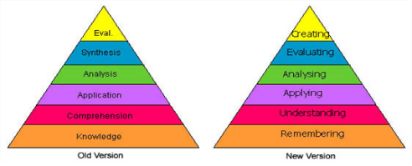
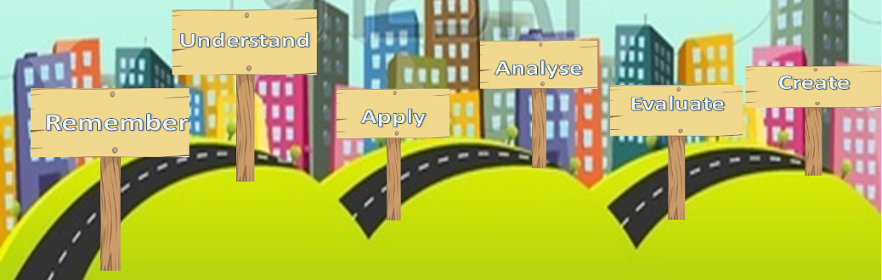
Bloom’s Taxonomy as a Method for Developing Critical Thinking and Independent Learning
C. L. Davison Student Number: 1523171
1. Remember
6. Create
Johnson and Johnson (1999) explore what constitutes cooperative learning and how it can be successful. They identify five elements of cooperative learning:
Positive interdependence
Individual accountability
Face to face promotive interaction
Social skills
Group processing
By synthesizing Johnsons and Johnsons’ research on cooperative learning with the
resources created based on Bloom’s Taxonomy, some of the previously faced
difficulties could be mitigated creating an environment promoting critical thinking
and learning.
Bloom’s Taxonomy was created in 1956 with the intention of supporting teachers to classify the ‘intended behaviour of students.’ (Bloom 1956, p. 12) and as a way of monitoring or ‘obtaining evidence on the extent to which the desired and intended behaviours have be learned by the student.’ (Bloom 1956, p. 13).
In order to ensure the success of developing critical thinking skills the students need a greater focus on individual accountability and group processing in their cooperative learning. Students should evaluate the effectiveness of their group and be expected to demonstrate their own development of skills .
In 2001 Bloom’s Taxonomy was revised, changing the original noun form into verbs and swapping the top two levels so that ‘Creating’ previously known as ‘Synthesis’ is now at the top level. (Stobaugh, 2013)
5. Evaluate
The sentence starters alone are not enough to ensure high level questioning; this must be coupled with regular teacher reinforcement about what is meant by the term ‘analyse’ or ‘evaluate.’ It is also necessary to bear in mind that critical questioning is a skill that develops over time which can be supported by resources and modelled by teachers but it cannot be taught.
What went well:
Students were able to identify, even after the first week of using the resources, which card they thought they should be using, and consequently at which point in their learning journey they were.
Problems encountered:
Perhaps the clearest problem encountered was that the use of the cards involved a large amount of group work, creating questions to pose to each other. As in inevitable in a group work situation, there were occasions where not all students were on task and consequently not engaging in developing their critical thinking skills.
Bloom’s Taxonomy is an excellent way of tracking students’ learning, developing their critical thinking skills and creating self-aware learners, but this can only be accomplished if students are fully engaged in the lesson activities and therefore the learning process.
2. Understand
After initial research, understanding as to how Bloom’s Taxonomy could be used in the targeted setting was required.
In September 2015 the schools introduced a sixth form and there has been agreement and frustration across subjects that the students are ill prepared for A-level education as, up until that point very little independent learning and thinking has been required of them.
Stobaugh (2013) explains that ‘increasing the level of critical-thinking skills in any program raises the level of rigor’(p.5)and this is where Bloom’s taxonomy can come into play in the classroom. It can be used:
As a tool to support critical thinking
To track progression
Examine the level of thinking and questioning in a classroom.
Lesson Journey
Each card relates to each of the levels of learning on the revised version of Bloom’s Taxonomy
Apply
I can use my knowledge in new situations.
Key Words
Apply
How would you show your understanding of…..?
What examples can you find to show…..?
How would you use what you have learned to develop…..?
What questions would you ask in an interview with…..?
Could this have happened in …..?
What would happen if …..?
3. Apply
The card used should link to the lesson journey, reinforcing students’ self awareness of their learning process.
With this in mind, two resources were created to implement critical thinking, based on the theory of Bloom’s Taxonomy, in the classroom. The first was the ‘lesson journey.’ The teacher is able to use this to reflect on their own lesson during the planning process, to ensure that they are providing a activities that challenge the pupils and move their thinking forward. It is also used as a way to encouraging the pupils to become more aware of their learning. They can track their own progress and their learning journey through the lesson, becoming aware that they have mastered a skill if they are able to complete the evaluation activity at the end of the lesson.
The second resource created was a pack of six double sided Bloom’s questioning cards.
“I can” statement on the front of each card supports students in understanding what each level of the Taxonomy, and consequently their learning, involves.
Key words on the front of the card and the question starters on the back of the card support students in developing their critical thinking skills.
4. Analyse
The Lesson Journey and Question Cards were trialled with a year 8 set 4 (of 5) class containing 22 students over a series of four lessons in which they were studying a Shakespeare play. The cards were used to support a variety of questioning activities.
Students found it easy to create low level ‘Remember’ questions to test their partner as a lesson starter.
Very successful in using their cards to create higher level analysis questions in a hot-seating activity to examine character in the play.
Many students struggled to create analysis questions based on an extract from a scene and, on occasion, were using the sentence starters on the ‘Analyse’ card but still creating low level ‘Understand’ or ‘Remember’ questions.
Administer
Apply
Associate
Connect
Construct
Correlate
Develop
Dramatise
Examine
Illustrate
Interpret
Interview
Plan
Solve
Teach
Use
Front
Back
References: Bloom, B., et al., ed. (1956). Taxonomy of Educational Objectives: The Classification of Educational Goals. New York: David McKay Company, Inc.
Johnson, D., Johnson, R. (1999). Making Cooperative Learning Work. [Online]. (URL http://0-eds.b.ebscohost.com.pugwash.lib.warwick.ac.uk/eds/pdfviewer/pdfviewer?sid=763bf7c4-064d-4b90-91aa- b4be5b6a2c7%40sessionmgr114&vid=1&hid=127). Theory Into Practice, 38(2). (Accessed on 28 November 2015)
Stobaugh, R. (2013). Assessing Critical Thinking in Middle and High Schools: Meeting the Common Core. New York: Routledge.

Slide 11
Module PG2: Professional Enquiry
PG2a
Formative Essay – 1000 words
(0%)
Deadline:
4th October 2021
PG2b
Annotated Bibliography & Critical Reflection – 4000 words
(100%)
Deadline:
25th April 2022
Notes:
Professional Enquiry has replaced RP

Slide 12
Module Breakdown – PG2
All postgraduate work is marked out of 100 against M-level marking criteria
PG2a
1000 word essay comprising two annotated bibliography citations on two learning theory texts and a comparison.
NOT for credit – feedback only, intended to help identify specific needs regarding M-level study.
NB. Writing for Social Sciences is different to other disciplines so we strongly encourage everyone to attempt this work.

Slide 13
Module Breakdown – PG2
ALL ASSESSED ELEMENTS OF THE MODULE MUST BE PASSED
4000 word essay comprising two parts:
  1. Annotated bibliography (2,000 words)
  2. Critical reflections (2,000 words)
Trainees identify a research question, critical incident or issue within their practice; this would need to relate to one or more of the Teachers’ Standards (DfE, 2011). (100%)

Slide 14
PG2b: Annotated Bibliography
The task would involve a critical summary and evaluation of eight sources on the chosen theme or topic. These could include:
  DfE or Ofsted policy or research documents
  EEF meta-studies
  Peer-reviewed journal articles
  Books from academic publishers
Following an introduction (250 words) outlining the area of focus and rationale, approx. 250 words would be written on each source, including:
  Overview of key argument
  Strengths and limitations
  Analysis of methodology
  Links to other sources
Conclusion (250 words) articulating an overall evaluation and position on the selected sources.

Slide 15
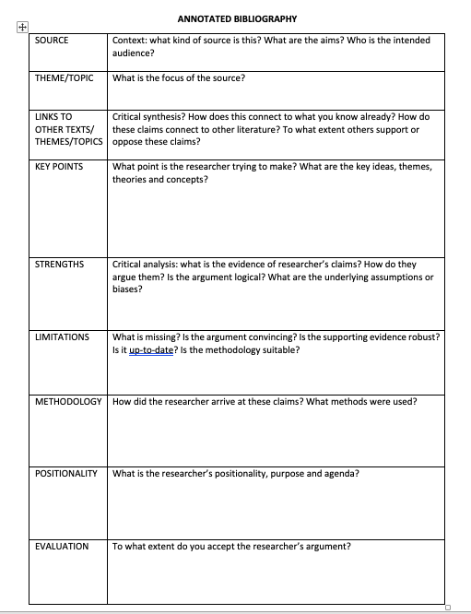
Notes:
.

Slide 16
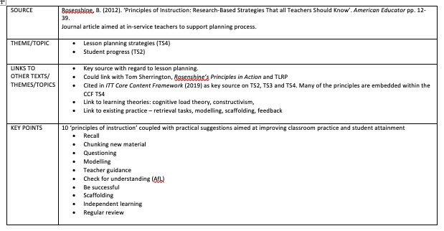
Notes:
Not everything will fit in the AB entry but it is best practice to make this as complete as possible, so that it can be explored in more detail in the second part of the assignment.

Slide 17
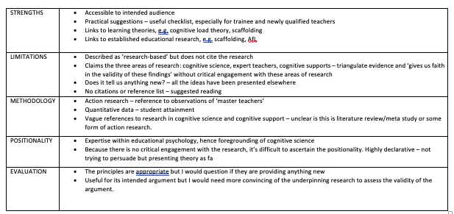

Slide 18
Annotated Bibliography entry
Aimed at in-service teachers, Rosenshine’s journal article offers practical approaches to ten ‘principles of instruction’ designed to improve classroom practice and maximise attainment (p. 12). Shaped around Rosenshine’s expertise in educational psychology, with a focus on cognitive science and cognitive support, as well as evidence from ‘master teachers’, these accessible principles have proven popular within education resulting in spin off books, such as Tom Sherrington’s (2019) Rosenshine’s Principles in Action. Perhaps, more significantly, this article is cited three times in the DfE (2019) ITT Core Content Framework as recommended reading in relation to Teachers’ Standards two, three and four (pp. 35, 37, 39), evidence of its high regard within current educational policy.
Notes:
The challenge is to write in a succinct and focused way, ensuring that nothing is wasted.

Slide 19
Annotated Bibliography entry
Whilst the strengths of the article lie in its accessibility to its intended audience, practical suggestions and links to established learning theories, such as constructivism, the underpinning evidence is lacking. The commentary regarding the methodology used is vague, although there is reference to action research comprising observations of expert teachers and quantitative analysis of attainment data. This lack of substantiating evidence is a key limitation to the article and, whilst the suggested readings are to be welcomed, the lack of in-text citations and reference list result in a weakened argument. The declarative style leads the reader to assume these principles are empirical truths rather than being convinced by a well-argued commentary.
Overall, a useful practical tool for trainee and newly-qualified teachers but lacking in academic rigour. (238 words)

Slide 20
PG2b: Critical Reflections
Including all the sources explored in the annotated bibliography and a reflective model, the task would be to evaluate own practice in line with theory in response to the research question, critical incident or issue identified in the annotated bibliography.
Trainees could compare their experience across both placements or focus on one placement.
The reflections must be underpinned by reference to academic sources.
Trainees will be encouraged to reflect regularly in Professional Enquiry sessions and mentor meetings and a range of models will be used with them throughout the year which will serve to make them both familiar and comfortable with the process of critical reflection.

Slide 21
Critical Reflection Example
The differing approaches to end of unit assessments undertaken by my two school placements has enabled me to compare practices in line with Black and Wiliam (1998) and Hattie and Timperley (2007) who argue that the awarding of a mark or grade on student work detracts from the engagement with formative feedback. It is indeed the case that, following an assessment on The Tempest, year seven students in School A focused almost exclusively on their mark rather than the detailed feedback I had given them. In contrast, year eight students in School B took their time to read the comments I had written in response to their creative writing task and I was then able to use this in a follow-up lesson. These experiences have led me to conclude that Black and Wiliam (1998) and Hattie and Timperley (2007) are correct in their dismissal of the use of grades; however, the year eight students in School B were accustomed to this approach, as it had been embedded from year seven and, according to my subject mentor, they were originally unhappy about the lack of grade. Therefore, this would seem to suggest that, whilst the removal of a grade as part of assessment feedback facilitates greater engagement, it requires time to embed.
Notes:
Synthesis – higher level of critical engagement, evaluative. Skilful evaluation, perceptive commentary, balanced critical understanding A/B

Slide 22
PGCE Classification
Calculated from the mean average mark across modules PG1 and PG2
70+ % Distinction
60+ % Merit
50+ % Pass
< 50 % Fail at M-level
(may pass at H-level)

Slide 23
Resubmission
One chance to resubmit each piece of failed work at M-level
Tutorial / intervention support to work through feedback
Pass second time around is capped at 50%
Failure second time will be reconsidered at H-level
Work is not “officially” failed until Exam Board, from then trainees have one year to resubmit (note: possible delay to QTS)

Slide 24
Master’s Marking Criteria
Grade | Comprehension | Analysis | Critique | Presentation
A*/A (Mark of 80 or above = A*; 70 -79 = A) | A wide range of relevant sources, which are well understood, are skilfully and concisely deployed to support arguments. Demonstrates a highly developed understanding of relevant concepts, theories and/or research methodologies. | Recognises the demands of the question providing a well-focused, relevant answer. Sets sources and viewpoints in a wide context and makes a comprehensive assessment of issues involved. High levels of ability to analyse, identify relevant issues, synthesise and apply knowledge and concepts. Relevant theories/theoretical models are applied to deepen understanding of the links between theory and practice. | Skilful evaluation which synthesises both the literature and personal perspectives in response to the question. Demonstrates a balanced critical understanding of the issues. Some originality of thought and creativity. Displays critical awareness of methodological and theoretical considerations. | Material is very well-organised and the structure complements the content. A high level of written communication with very few errors of spelling, grammar and syntax. Points are comprehensively and appropriately substantiated. Mastery of referencing conventions with very few errors or omissions.
B (Mark of 60 - 69) | Sound and thorough grasp of relevant concepts, theories and/or research methodologies which are well-summarised. The work is supported by references to a good range of relevant sources which are used in a relevant way. | Recognises the demands of the question providing a focused, relevant answer. Sets sources and viewpoints in context. A good ability to analyse, identifying useful points synthesise and apply knowledge and concepts. Application of theories/theoretical models in a relevant way to answer to the question. | Perceptive commentary on evidence and materials used in response to the question. Able to make appropriate critical points. Displays awareness of methodological and theoretical considerations. | Well-structured work displaying attention to the logic and development of the piece. A clear written style. Spelling, grammar and syntax are generally good. Points are consistently and appropriately substantiated. Most features of the referencing system are used correctly.
C (Mark of 50 - 59) Pass Mark 50 | An adequate range of relevant source materials is used. Understanding of main concepts, theories and/or research methodologies is fair but lacks depth and/or breadth. There may be some gaps or areas of confusion. | The response to the question addresses basic requirements and there may be some irrelevant material. The attempt at analysis, synthesis and application of knowledge and concepts is competent but lacks depth and breadth. Limited use and understanding of theoretical models. | Sensible commentary on evidence and materials used throughout, in response to the question. Limited critical reflection. | A generally satisfactory overall structure although it may lack balance in parts or fail to integrate some material. An adequate written style which is not impaired by the occasional errors of spelling, grammar and/or syntax. Generally appropriately substantiated. The recommended referencing system is used but with some errors and omissions.
D (Mark of 40 – 49) | Some evidence of relevant reading. Understanding of the subject matter is limited. The work displays major gaps in knowledge, serious misconceptions and/or factual inaccuracies. | Introduction of basic concepts and effort made to relate them to the demands of the question which have been only partially understood, leading to irrelevant material. No sustained analysis, mainly descriptive with and an inability to apply knowledge and synthesise material. Very limited reference to theoretical models. | Some sensible comment is made. Uncritical commentary. | Weak structure. Expression of ideas is sometimes confused or unclear. Communication may also be impaired by errors of spelling, grammar and/or syntax. Lacking appropriate substantiation. Referencing marred by frequent errors and omissions.
E (Mark below 40) | Few relevant sources used. Serious gaps and/or errors in knowledge and understanding. | The question may have been ignored or badly misunderstood, and there is much irrelevance. Superficial treatment of the topic much of which is descriptive. Lacks appropriate critical or theoretical framework. | The commentary may not be seen as sensible in relation to the question. | Unstructured presentation, lacking coherence. Expression of ideas is poor and may also be impaired by frequent errors of spelling, grammar and/or syntax. Much of the writing is unsubstantiated. The recommended referencing system has not been mastered.

Slide 25
Marking Criteria
Comprehension: Breadth, depth and relevance of appropriate sources, mastery of the subject matter
Analysis: Interpretation of the question, extraction of meaning from sources/data and demonstration of application
Critique: Formulation of argument, critical commentary and reflection on sources/data, evaluation of sources/methodology/opinions/data
Presentation: Structure, SPaG, syntax, referencing, correct use of figure/table captioning, general academic style
Notes:
Trainees to look at marking criteria in HB

Slide 26
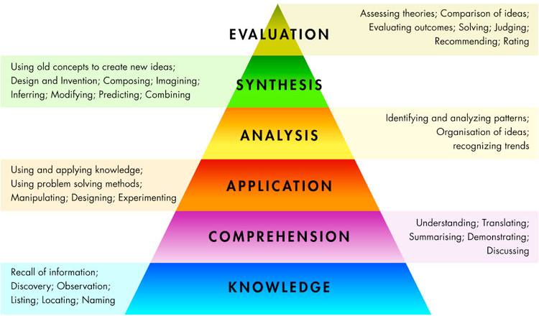
PASS
A/A*
70 % (Distinction)
B
60 % (Merit)
C
50 %
FAIL
D
40 %

Slide 27
Areas of Development for Trainees
Essay writing – social sciences
Academic writing
Accurate writing
Essay structure
Critical analysis
Constructing an argument
Harvard referencing

Slide 28
University Support
Lead lectures
Detailed brief for each assignment
Online resources & workshops
Explicit teaching of subject studies titles
Online skills workshops
1-1 Tutorials
Library sessions
Student Services
Additional PG sessions for core

Slide 29
School Support
Discuss essay plans in mentor meetings
Encourage a critical mindset
Encourage them to reflect critically on their practice – how it links to theory
Subject specific and other resources resources – journal articles, CPD materials, websites
Support with time management – time and space to study
Mock poster presentation
Proof reading!

Slide 30
Proof reading
The University considers it acceptable for proof-readers to identify, but not make corrections to:
  common typographical, spelling or punctuation errors;
  formatting and layout errors and inconsistencies such as page numbers, line spacing, font size, headers and footers;
  grammatical and syntactical errors and anomalies;
  lexical repetition or omissions; sections of text where the meaning is ambiguous; minor formatting errors in referencing (for consistency and order);
  errors in the labelling of diagrams, charts and figures.
proofreading

Slide 31
Proof reading
The University does not consider it acceptable practice for proof-readers to amend existing content – whether through addition or reduction and, in particular, it prohibits proof-readers to:
  Rewrite content where meaning is ambiguous;
  Add to existing content;
  Alter argument or logic where faulty; Re-arrange or re-order sentences to enhance structure or argument;
  Implement or alter a referencing system or add to references;
  Check or correct facts, data calculations, formulae or equations;
  Translate text drafted by students, noting that this does not prohibit translation of source material as long as it is properly referenced.

Slide 32
How can we support you to support them?

Slide 33
Claim | Compare | Contrast
Piaget’s theory: | Both theories see cognitive development as sequential and progressive. They both place emphasis on developmental stages and agree that adults have a role in structuring, or introducing the child to new ways of thinking | Piaget sees the role of the child’s maturational status as significant, and places great emphasis on individual cognitive development. Vygotsky, however, sees development as being far more ‘social’, placing considerably more emphasis on the role of adults and older peers in ‘bringing-on’ the child’s learning.
Piaget studied children from infancy to adolescence using methods such as naturalistic observation and clinical interviews. His approach gave rise to the following ideas: Maturational readiness is critical – the teachers role is to arrange the curriculum to fit the child Children are naturally curious and learn best from discovering things for themselves He thought interaction was useful in exposing children to more mature ways of thinking, but thought it to be of less importance than self-discovery
Vygotsky’s theory:
Vygotsky emphasised the role of the social context of learning. He thought the following was particularly significant: language plays a key role in pushing the child forward Teachers can actively intervene in learning rather than wait for a child to be ready – he called this the Zone of Proximal development Knowledge develops ‘spirally’, so a child can understand anything at some level, providing it is presented in an appropriate way
Review (argument) | What seems to be clear from both these theories is that there is a role for the adult in structuring learning, though there is some disagreement as to how important maturation is in that process. When examining the role of writing frames a clear implication from these theories is...
Notes:
Developing criticality

Slide 34
Critical Literacy & Positionality (Campbell, 1998, p, 99)
What prior knowledge might help to make meaning out of this article?
What do you know of the context in which this article was written? (Both in relation to the journal or book and to the wider educational context.)
How is the writer positioning her/himself in the article?
How is the writer using her/his positioning in the article to position you as the reader?
What is your position before and after reading the article?
Campbell, B. (1998). ‘Modelling Critical Literacy in Teacher Education’. In Bradshaw, D. Ed. Knowledge of Texts: Theory and Practice in Critical Literacy. Melbourne: Language Australia.
Notes:
Ask students to identify what I am doing in relation to these questions when delivering the lecture

Slide 35
Thank you
a.j.morgan@warwick.ac.uk

