Slide 1



Professor Sonia Blandford,
CEO and Founder Achievement for All
Every Child Included in Education
21st June 2018

Slide 2
Building The Core I Can. I Do. I Have. I Am.
Our three priority drivers for change are:
One in five children and young people do not achieve expected outcomes due to the disadvantage, needs or challenges they experience
Social mobility is impeded by poverty; one in six children live in poverty in the UK
Development of adults and services that support children and young people is fundamental to changing society.

Slide 3
A broken social elevator? (OECD, 2018)
The picture in the UK
People’s economic status is closely related to that of their parents.
This means it could take 5 generations for children born into a family at the bottom of the income distribution to reach the mean average- slightly longer than the OECD average.
Notes:
BUT both of the following figures are better than OECD averages:
In the UK, the study found only about a fifth of the children of low-income families went on to become high earners.
Almost three-quarters of the children of graduates in the UK went to university - compared with a fifth of children from low-income families.

Slide 4
Social mobility- issues in the UK
Difficult school to work transitions for young people from less advantaged backgrounds.
13% of young people are NEET in the UK, close to the OECD average, but much higher than in the Nordic countries- with better social mobility.
Low skills levels- one of the main reasons for joblessness-40% of NEETs in the UK have not completed upper secondary education.

Slide 5
Social mobility- the solutions for the UK
Education: Upskill the workforce- by greater investment in life long learning for low skilled workers- to improve job quality and productivity
Jobs: Better regulation of jobs- E.g. increase job security for zero hours employment contracts
Housing: support geographical mobility of workers to higher productivity regions
Notes:
From A broken social elevator? (UK country report)

Slide 6
Social mobility in the 1940’s
My father was a market gardener at that time and because of Dutch imports was not doing too well. The government therefore paid for my education and keep, also giving me a cheque for £72 for my spending money. In return I was required to teach in Essex for one year once I had qualified.
(Mosaic, 2013 : Celebrating 65 years of teacher training & education at Warwick; 1948 – 1978)

Slide 7
Every Child Included -manifesto priorities
Promote kindness and wellbeing in education, business and third sector settings, where every child and young person is included every day,
Further investment across all phases of education, beginning with the early years that results in a socially and culturally relevant curriculum.
Greater focus on teachers as professional learners through recruitment, retention, and professional development that includes an enhanced understanding of the way disadvantaged and vulnerable children learn
Reduce children and young people being excluded in education by:
increasing responsibility for children at risk of exclusion through cross-agency collaboration and
closing the gap for SEND
Increased recognition of parents, carers and wider communities, valuing all parents and carers as crucial partners in the improvement of learning and life chances for every child.
Notes:
In response –AfA have developed the manifesto

Slide 8
Priority one- to deliver kindness and wellbeing we must:
Ensure kindness and wellbeing are embedded in the early years, school and post-16 culture and curriculum.
Recognise that education professionals need support, training and access to expert advice.
Increase awareness of the social and emotional difficulties experienced by children looked after.
Provide access to a multilayered service for every child,

Slide 9
Priority two- using funding wisely
Charities such as the Youth Sports Trust make an enormous difference to the wider outcomes of all children and young people.
Sporting activities can improve physical and mental health, boost the development of social skills and assist with the learning of movement and coordination.
In 2015/16, the Youth Sports Trust found that 93% of the young people on its alumni panel believed that participation had increased or greatly increased their life skills
Notes:
Also mention the need for a relevant curriculum

Slide 10
Priority three- greater focus on teachers as professional learners
Provide all entrants to the teaching profession with a single career framework
Move away from a single training session
Ensure all teachers and leaders participate in funded continuing professional development (CPD) that is regular, relevant and evidence-based
Focus on what works to improve outcomes for every child
Introduce Chartered Teacher Status
Provide focused support for teachers in disadvantaged areas

Slide 11
Priority four-reducing exclusion in education
Increase responsibility for children at risk of exclusion
Close the gap for SEND

Slide 12
Priority five- to grow every child’s potential to learn, we must:
Engage with parents and carers as valued partners.
Value the role of parent and teacher organisations.
Develop parent carer engagement to underpin the government’s Opportunity Areas.
Implement approaches and activities that engage parents, carers and children in meaningful conversations with teachers and leaders.
Provide appropriate coaching for parents and carers.

Slide 13

Working with schools…
Leadership
Teaching & Learning
Parent & Carer Engagement
The Whole Child
Wider outcomes & opportunities
Notes:
Introduce the Achievement for All programme- history, what is it etc.

Slide 14

And a focus on culture. For schools -increasing aspirations, access and achievement -may involve changing the internal culture…
Is there a positive culture in our schools for children from less advantaged families, those with special educational needs and other learners vulnerable to underachievement?

Slide 15
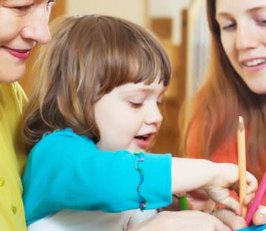
Defining Core Strength
I Can. I Do. I Have. I Am.
Core strength can be described in this context as the confidence and ability to learn, develop and participate in society.
Children and young people experiencing disadvantage and underachievement often lack confidence, find learning challenging, develop differently and may have limited participation in society.
Underlying factors, or needs, may be cognitive, physical, emotional or social; each are manifest in a fundamental lack of progress of the child or young person when compared to their peers.

Slide 16
Building core strengths
Aspiration, ‘I can’: the grit and resilience that makes perseverance in the face of challenge a ‘lived practice’ of children and young people, understanding and supporting learning, building ambition and goal-focused behaviour.
Access, ‘I do: developing independence in learning and self-development in children and young people leading to an understanding and ownership of their responsibility for their own ongoing life-long journey of learning and development.
Attainment, ‘I have’: attaining the grade – ‘I have passed’
Achievement, ‘I am’: the internalisation of learning and success, the ‘feel good’ factor of learning that grows from within, equipping children and young people to understand what they know and how to learn.
Notes:
In partnership with the education, business and third sectors, AfA3As implements bespoke whole-setting, school and college programmes focused on building the core in all children and young people:

Slide 17
In the classroom it means raising aspirations by…
Having high expectations about what learners can achieve.
Enabling pupils to have confidence in their competencies
Enabling pupils to meet challenges and gain access to learning, thus believing that they can succeed.
Focussing on attitudes, confidence, parental aspiration, motivation and school and teacher aspiration.
(Blandford et al. 2011)

Slide 18
And enabling all pupils to access learning by focussing on …
Behaviour
Participation in wider school life
Parent or carer engagement
Developing positive relationships with others
Attendance
(Blandford et al. 2011)

Slide 19
And we know…
The importance of the interaction between the teacher and the pupil in the development of positive behaviours for learning….
Where
Classroom management is defined as the actions teachers take to create environments that support both academic and social/emotional learning
(Evertson and Weinstein, 2013)

Slide 20
For educators this means responsive instruction showing they:
are available for support and instruction
are willing to take the learner’s perspective on work problems
are willing to support the learner’s competencies
will challenge the child to be active and responsible in choosing, planning, executing and evaluating the activity and its outcomes.

Slide 21
A case study: what having aspirations means
One year 7 pupil arrived at Lyng Hall school in Coventry with a statement of SEND. He had speech and language difficulties and was making slow progress. The consensus from the professionals supporting him was that he should go to a special school. Now having successfully completed university and taking his PGCE, he’s a teacher in a school in the West Midlands.

Slide 22
Reflection: Developing Aspiration
Reflect on all the ways you show the children and young people you teach that you have high aspirations for them?
How could you do this better?

Slide 23
Scaffolding: A fundamental pedagogy
Scaffolding- supporting the child, to help them build on their previous knowledge and learn new information, in order to achieve the intended outcome of the activity (based on the Vygotskian concept of the zone of proximal development (ZPD).
General techniques associated with scaffolding- questioning, prompting, praising, confirming, pointing things out to children and modeling.

Slide 24
Reflection: How do you………
Question pupils to advance their learning?
Prompt pupils to advance their learning?
Praise pupils to advance their learning?
Notes:
How do you currently do this? And how could you do it better? (and consider how aspirations are linked)
Long term- teachers can develop a list of the most appropriate ways to ask questions/give prompts and praise pupils

Slide 25
And effective assessment….
Collecting the right data
Analysing the data
Setting meaningful targets
Involving parents/carers in their children’s learning
Planning
Implementing
Monitoring and evaluating
Effective and efficient use of ICT
Notes:
THIS MEANS : knowing where pupils are in their learning- where they are going and -how to get there.

Slide 26
Conduct effective progress meetings
Teaching and Learning
How to close
the gap
Identify and support any child with additional needs
Use effective feedback
Develop literacy and language across the curriculum
Develop numeracy and maths across the curriculum

Slide 27

What works? Parents and carers as partners
Notes:
And engaging parents-how do you do this as a school? Could you do it better?

Slide 28
Engaging parents and carers
A key factor in the development of a school ‘learning’ community is the extent to which parents are engaged in their children’s learning.
Parental engagement in children’s learning has a very distinct and far-reaching effect on their outcomes.
Recent research across OECD countries and economies showed the greater confidence and motivation of children whose parents had high expectations for their learning and achievement
(Schleicher, 2014).

Slide 29
Effective engagement with parents and carers is based on 4 strong foundational blocks
A welcoming environment
Effective preparation
Quality Communication
Sensitive facilitation

Slide 30
At school this moves to a Partnership Partnership with Parents Engagement of Parents Liaison with Parents
Notes:
And schools that are getting it right and involving parents and carers –work in PARTNERSHIP

Slide 31

The Achievement for All structured conversation: a model for all schools?
is an integral element within the wider Achievement for All programme.
has been a key success for schools in raising the aspirations and achievement of disadvantaged and vulnerable learners

Slide 32
And for children and young people with SEN: Parents and carers views are central
Local authorities must have regard to…
the views, wishes and feelings of the child or young person, and the child’s parents
the importance of the child or young person, and the child’s parents, participating as fully as possible in decisions, and being provided with the information and support necessary to enable participation in those decisions
the need to support the child or young person, and the child’s parents, in order to facilitate the development of the child or young person and to help them achieve the best possible educational and other outcomes, preparing them effectively for adulthood
(SEND Code of Practice 0-25, 2015: 19)

Slide 33
Engaging parents: What the teachers say
“Pupils are being listened to and have opportunity to express their aspirations more clearly. They are given more one-to-one time with their teacher.”
“Our culture of engagement and aspiration has improved, and so lessons are more focused and behaviour is better, which also benefits other pupils”
“Achievement for All has helped us focus on aspirational outcomes. Planning for SEND children is now more parent- and pupil-centred.”

Slide 34
Engaging parents: What the parents say
“Knowing a teacher can see the same problem with my child as I do and we both try and solve and help my child together.”
“M has been gaining confidence over the course of our involvement in Achievement for All. As a result of this, we’re now seeing academic improvements, particularly in reading and writing.”
“My child has been encouraged to improve academically without being made to feel that he’s bad at everything.”

Slide 35
Engaging parents: What the pupils say
“Getting my parents involved with my work has been good. That’s a big thing for me.”

Slide 36
Parent and carer engagement:
Schools need to consider how they…
currently involve parents and carers in the school
engage parents and carers in their child’s learning
improve strategies for ‘hard to reach’ parents and carers
train teachers/ staff in structured conversations
Feed the outcomes from structured conversations into what happens in the classroom

Slide 37
Parent and carer engagement: How could you do this better?
Some examples:
Family learning day/afternoon Lots of activities for parents and children to engage in – you can often “catch” them during this time
Home visits for all children (regardless of year group) as they start at school (very successful as a starting point)
Back to school evenings for different subjects or a term for KS3 parents. Very effective – very rewarding.
How could you better engage parents and carers in their child’s learning?
Notes:
The idea is to develop a framework for improving parent and carer engagement in their child’s learning across the school.

Slide 38
A child’s education: getting the best for children
Increased attainment at age 11- good early years and primary school experience and better home learning environment (HLE)
Increased attainment at age 16- out of school enrichment activities and reading at home
Increased attainment at age 17- (4 or more AS Levels)-attending any pre-school, but particularly quality, good teachers, academic enrichment activity at home (e.g. reading, visits to museums)
Increased attainment at age 18 (3 or more A Levels)-attending a secondary school rated outstanding by Ofsted and academic enrichment activities at home
Notes:
In April 2015, the Sutton Trust published its Social Mobility Index with the following 5 indicators- performance of disadvantaged children and young people in: 1)EY tests; 2)KS2 tests; 3) GCSEs 4) progression to university and 5) progression to the professions.
The research presented on this slide is from Toth, Sylva and Sammons (2015)Subject to Background: What promotes better achievement of bright but disadvantaged students?, London: Sutton Trust (and could be applied across the board for all children, especially if schools apply aspiration, access and achievement to ALL pupils –reflecting the Achievement for All approach)
Young people also need good careers advice, guidance and information- this should start in primary school and be part of the culture of the school. Too many young people from poor families do not study the right subjects (facilitating subjects) at A Level to get into a particular degree course at University. They often make the wrong choice at GCSE level; they also lack aspiration and motivation-the right advice early on would make a difference (they could make an informed choice)

Slide 39
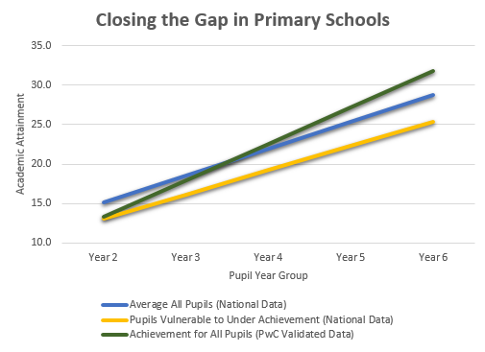
Impact of Achievement for All: Evidence (PwC, 2016)

Slide 40
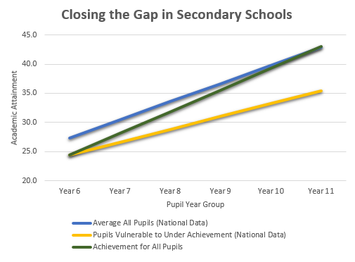
Impact: Evidence (PwC, 2016)

Slide 41

No one is born to fail ………..
Notes:
Discuss key messages from Blandford, S. Born to Fail? social mobility, a working class view, Woodbridge, John Catt.2017. Available from: https://www.amazon.co.uk/Books-Sonia-Blandford/s?ie=UTF8&page=1&rh=n%3A266239%2Cp_27%3ASonia%20Blandford

Slide 42


Slide 43
https://youtu.be/WXuTRPP3MXI
Notes:
Achievement for All film

Slide 44

Thank you
Professor Sonia Blandford,
CEO and Founder
Achievement for All
Achievement for All is a registered charity. No. 1142154.
Registered in England and Wales as Achievement for All (3As) Ltd. No. 07528857

