Slide 1
Blogging for impact and reputation
Abigail Ball, Senior Academic Technologist
Centre for Teacher Education, University of Warwick

Slide 2
Why blog?
Personal reflection
Community building
Disseminate good practice
Demonstrate active participation in and engagement with the wider teaching community
Build a portfolio
Practice using educational technology
Engage with the public, your peers and students (Farmer, 2006)
Encourage discussion (comments feature)

Slide 3
Why blog?
Gain confidence and facility in your writing
Write about your subject/research area in a less formal medium (Kirkup, 2010)
Use as a stepping stone for publication (e.g. microblog, blog post, conference presentation, journal article)
Communicate and learn about research
Comment on other peoples’ research
  Not necessarily within your published area (Higher Education Network Blog, 2013)
Provide a discussion board for niche/new topics
  Engage in critical debate at the edge of your discipline
  Perhaps on a topic that would not be accepted in mainstream journals

Slide 4
Examples
https://blogs.warwick.ac.uk/wjett/
https://www.belmas.org.uk/BELMAS-Blog
https://thesiswhisperer.com/
https://medium.com/@Write4Research
https://lthechat.com/
http://blogs.lse.ac.uk/impactofsocialsciences/2017/05/31/introducing-the-impact-of-lse-blogs-project/

Slide 5
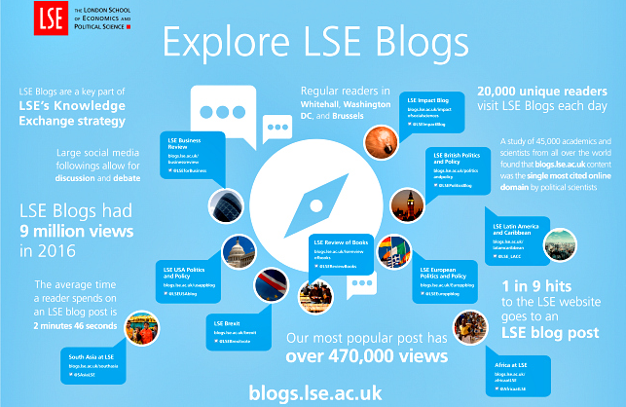

Slide 6
Benefits
Conversational scholarship can make scholarly work accessible and accountable to non academics (Gregg, 2006)
  Informal essay format and straightforward reporting styles of writing
  Less intrusive referencing (if any)
Academics are professionals engaged in CPD of a professional ‘self’ which blogging promotes (Lovink, 2008)
Increase in citations (Shema, Bar-Ilan and Thelwall, 2014)
  Citation indices (e.g. Google Scholar) rank publications by citations (Thelwall, Haustein, Lariviere and Sugimoto, 2013)
  Altmetrics (counts of citations) more rapid with social media

Slide 7
Issues
Focus on monographs and publications in peer-reviewed journals for career advancement and the REF
Subjective style contradicts objectivity of published peer-reviewed journals
  Less academically rigorous
Institutional conformity
  Think carefully about where you host your blog(s) and what you write
  Create a separate social media account for contentious issues
Most academics are blogging for professional peers, rather than for the general public

Slide 8
On what topics?
Anything really…
  Academic cultural critique (Thomson and Mewburn, 2013)
    Comments and reflections on funding; higher education policy or academic life
  Academic practice (Saper, 2006)
    Information and/or self-help advice
    Technical, teaching and careers advice
  Your research or practice
    How you’ve undertaken research
    Impact of research on your practice
  An area of research/practice that interests you
  Your experiences/reflections

Slide 9
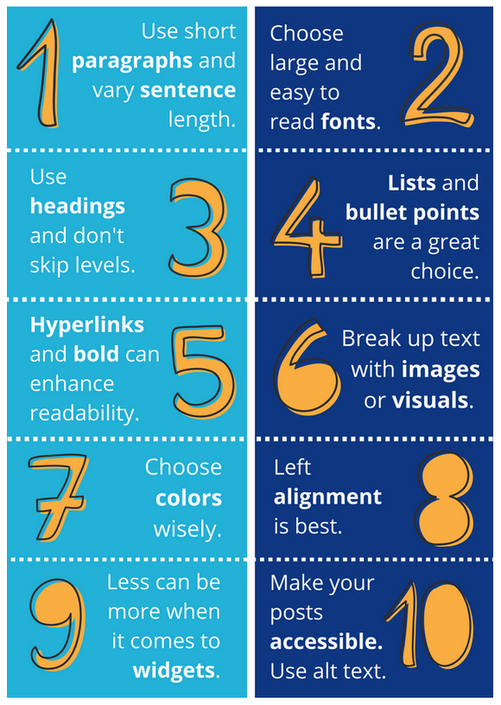
General blogging guidance
Morris (2018)

Slide 10
General blogging guidance
Write about something you enjoy
  If you are interested in a particular topic, chances are someone else will be too
Be consistent
  Studies have shown that consistent blogging can lead to higher subscription rates than erratic blogging
Give yourself time to write; don’t over commit
Gaining a following takes time
Use catchy titles - simple, powerful, useful and bold
Choose smaller topics with a targeted audience
Edit, edit and edit again

Slide 11
WJETT
https://blogs.warwick.ac.uk/wjett/
https://warwick.ac.uk/fac/soc/cte/students-partners/academictechnology/wjettblog/
500 words
Send to Kate Mawson/Abi Ball for uploading
  K.Mawson@warwick.ac.uk
  A.Ball.1@warwick.ac.uk

Slide 12
Resources
http://blog.impactstory.org/wp-content/uploads/2015/01/impact_challenge_ebook_links.pdf
https://warwick.ac.uk/fac/soc/cte/students-partners/academictechnology/multiauthorblog/
https://www.hamilton.edu/documents/Writing%20Academic%20Blogs.pdf
https://www.theedublogger.com/2018/01/22/10-tips-for-making-your-blog-posts-easier-to-read/
https://www.ucu.org.uk/academicfreedom
https://warwick.ac.uk/services/externalaffairs/marketing/digital/social/policy/

