Slide 1

Primary and Early Years New Mentor Training Mark Harris and Jen Rowan-Lancaster

Slide 2
Outline of session…
Roles and Responsibilities
Moderation-Link Tutor Visit
Key Placement Resources and Assessment of Placement

Slide 3
1. Roles and Responsibilities

Slide 4

The Warwick Partnership
School Mentors
Pupil progress
Trainee development
Class teachers
Moderation-Link Tutors
Uni tutors (personal/subject)

Slide 5
Ofsted – key strengths
The partnership’s strong emphasis on the impact of teaching on pupils’ progress and learning. Trainees are acutely aware of their accountability for pupils’ achievement and progress over time.
The impressive range of specifically detailed partnership documentation, which provides a meticulous focus on the teachers’ standards. This shared and well-understood information enables the partnership to track accurately the progress of individual trainees, evaluate the quality of their work and provide detailed steps for continued development.

Slide 6
Exceptionally high expectations of trainees, which drive ambitious levels of challenge supported by expertly crafted training.
The partnership has a clear and ambitious vision for sustained excellence and is clearly focused on further improving high-quality provision and outcomes for trainees and pupils in schools.
The partnership’s strong drive to sustain and further develop the highest quality provision possible. All improvements are informed by a systematic and scrupulous analysis of internal and externally validated information.

Slide 7
What are the roles of the class teacher and mentor? How might they be different? How do they overlap? What are the benefits of having a designated mentor?

Slide 8
Roles and responsibilities
CLASS TEACHER critical, supportive friend
MENTOR manages training/assessment
MODERATING LINK TUTOR (MLT)QA role
PRIMARY/EY PARTNERSHIP LEAD | Monitors progress of whole cohort Additional layer of support for schools and trainees if required QA of M-LT support and school provision
share specific class info
supported, guided planning
on-going, informal support and feedback
may participate in assessment
Oversees/facilitates training
Weekly mentor meeting
Manages weekly observation of teaching
Liaises with LT & writes profiles
Regular contact with trainee – weekly email
1 school visit
Reviews and submits profiles
Notes:
Class Teacher:
daily point of contact for the trainee
consistently models at least good, if not outstanding, professional practice and teaching
models and supports planning
offers informal feedback
delivers school-based training programme
contribute to the interim and termly assessments of the trainee’s progress
meets weekly with the mentor and the trainee as necessary
School Mentor:
Oversees trainees’ development on school placement
Monitors the trainee’s individual targets during weekly meetings (recorded in Training Plan)
Maintains direct contact with Moderation-Link Tutor and raises any concerns with them during placement as soon as necessary
Is responsible for final assessment of the trainee’s progress
Checks the trainee’s planning and assessment file
Arranges weekly observation (as a minimum) with written feedback. This may include observation by the class teacher or subject leaders
Use Warwick Assessment Descriptors formatively throughout placement to promote trainee’s progress
Conduct a joint observation/feedback with the Link Tutor
Attends mentor development sessions
Considers implications of trainee’s ISP where appropriate and review as appropriate
Moderation Link Tutor:
Makes two visits to the school on to carry out joint lesson observations with the mentor
Moderate mentor assessment and placement training
Regularly review the trainee’s teaching files and training plan
Support the development and review of any action plans considered necessary for the trainee

Slide 9
Reflection activity…
Think back to any experiences you have had where you have been mentored yourself.
Discuss in groups what makes a good mentor/less effective mentor
Consider the attributes/behaviour that a good mentor/bad mentor might demonstrate

Slide 10
Trainee comments about their mentors
My mentor made all the difference – she was JUST GREAT! | My mentor encouraged me by always identifying the positives first. | Thank you for being there when I really struggled. | My mentor really encouraged me to try new things and be creative in my approach.
My mentor was fantastic at picking me up after a bad lesson. | My mentor developed my practice by being challenging and believing in me. | My mentor believed in me, even when I didn’t believe in myself. | My mentor was a source of brilliant, practical advice.

Slide 11
Trainees emphasised the importance of the following:
Having regular meetings
Time for incidental chats
The value of your encouragement and positivity, especially when they are feeling ‘low’ or have had a weak lesson
The importance of providing accurate, supportive feedback with ‘next steps’ so they can implement the changes to improve their practice
Help using the WADs to ensure that everyone is clear about their progress and what they have to do next

Slide 12

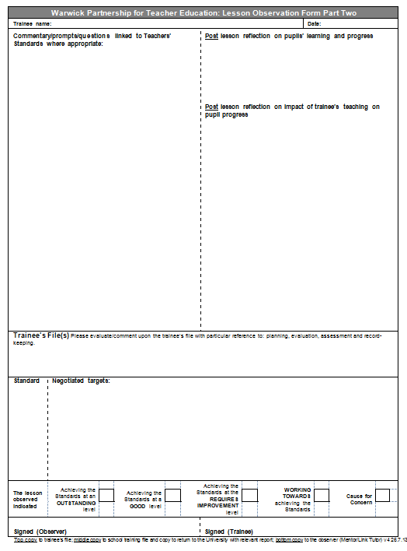
Summary of school-based support (minimum):
On-going informal support
1 mentor meeting per week
1 formal observation with written/oral feedback per week (inc targets)
MLT Visits

Slide 13
2. The Moderation Link-Tutor Visit

Slide 14
M-LT visit
Quality Assurance through:
Approx. ½ hour joint observation of teaching
Discussion with Mentor – overview of placement
Review of Placement File and Training Plan
Observation of Mentor giving feedback
Discussion with Trainee
Notes:
Primary: obs into/main teach and some groupwork

Slide 15
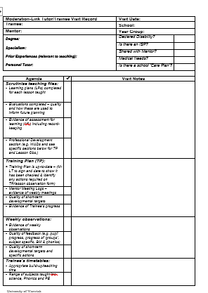
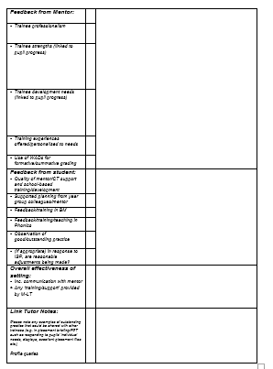
What do M-LTs look for on their visit?

Slide 16
3. Key Placement Resources and Assessment of Placement

Slide 17
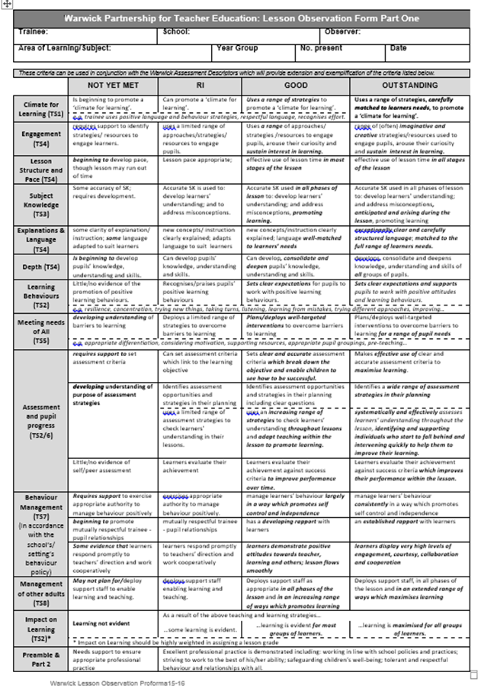
Lesson Observation Form
Front sheet of LO form:
Lesson assessment descriptors (LADs)
Highlight best fit for each of the criteria
Impact on learning is key and is highly weighted => this informs lesson grade
Consistently high levels of professionalism are expected

Slide 18
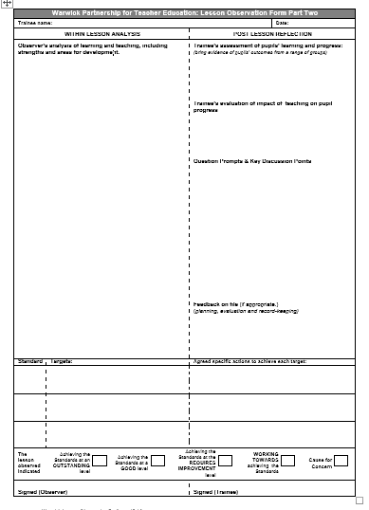
Within lesson analysis:
Focus on impact on learning as opposed to narrative on lesson
Link to Teacher Standards
Some mentors adopt a WWW/EBI approach
Record key points of trainee’s evaluation of the lesson
Key questions to inform professional discussion

Slide 19
Lesson Feedback …
When is lesson feedback most effective?
Targets are clear and specific and broken down into clear, achievable actions.
Trainees are actively involved in the discussion
‘share’ feedback rather than ‘give’ feedback.
Trainees are encouraged to evaluate their own lessons in reference to pupil progress
Teachers’ Standards are referred to orally as well as in writing e.g. Let’s think about TS4: Planning well structured lessons...what did you think about the length of time children were kept on the carpet before moving to the independent task?
There is a clear focus for the lesson observation that is informed by previous targets.

Slide 20
Coaching behaviours
Push:
Solving someone’s problem for them
Pull:
Helping someone to solve their own problem

Slide 21
Push
DIRECTIVE COACHING BEHAVIOURS
Instructing
Giving advice
Offering guidance
Giving feedback
Making suggestions
Summarising
Paraphrasing
Reflecting
Asking questions that raise awareness
Listening to understand
Pull
NON-DIRECTIVE COACHING BEHAVIOURS

Slide 22
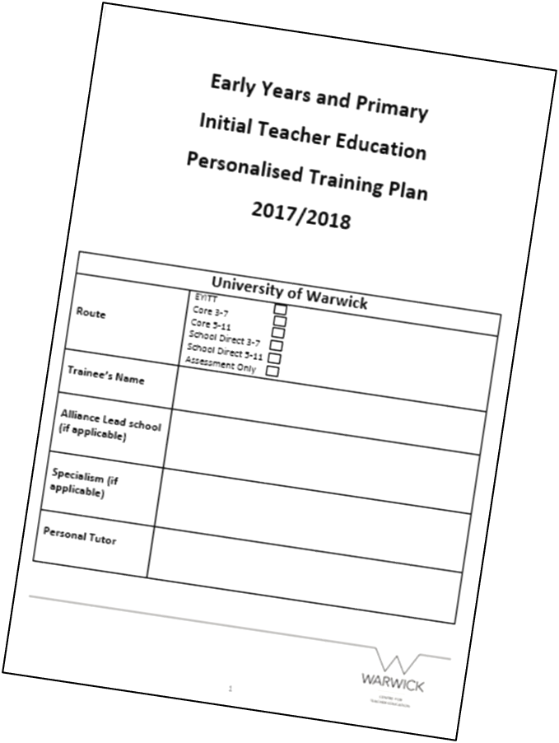
Training Plan
Aims of the training plan:
To support trainees’ self-management of their professional development over the PGCE programme, including target-setting and review of progress against these targets.
To facilitate mentor engagement with a trainee’s development over the whole PGCE programme, including target-setting and review of progress against these targets.

Slide 23
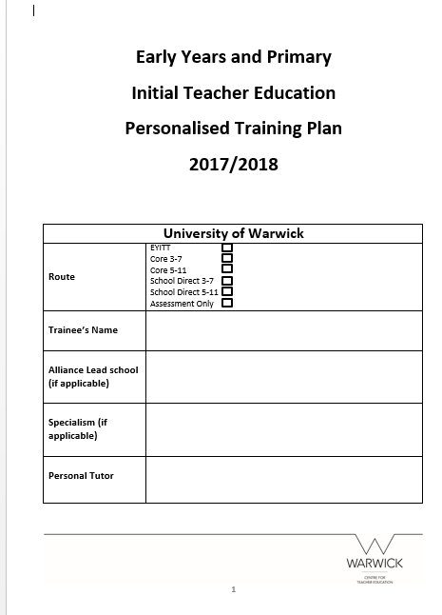
Weekly Mentor Meeting Log
- Trainees will complete the mentor meeting logs during their weekly meeting with their mentor.
- It is the trainee’s responsibility to keep their Training Plan up to date; at your weekly meeting please initial it to confirm targets have been met/addressed.
- Targets should not just replicate lesson observation targets – can also include more practical things e.g. observing subject specialists, speaking to SENCO,

Slide 24
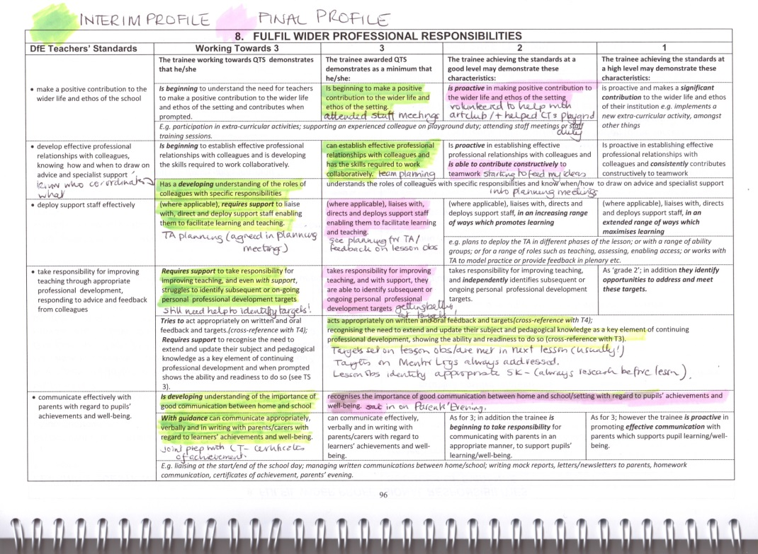
Warwick Assessment Descriptors (WADs)
Trainees to assess their own progress using the WADs.
Mentors to use the WADs to inform judgements for interim/final profiles.
They will start a new set of WADs on PP4.

Slide 25
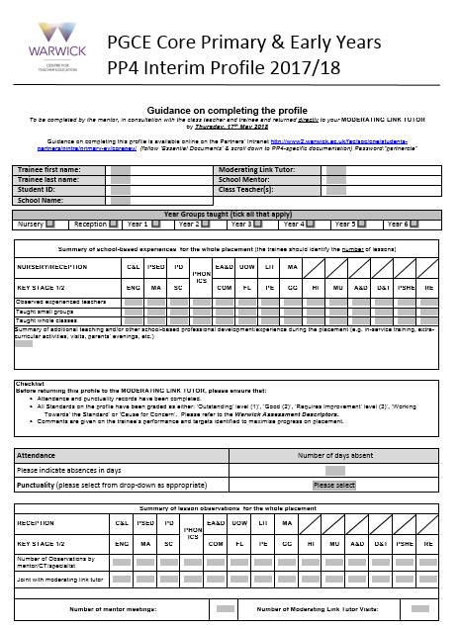
Assessment Profiles
Mentors to write interim and final profiles in collaboration with class teacher and trainee.
Interim: Completed part way though - formative opportunity for assessment
Final Profile: Completed at the end of the placement.
Both profiles require mentors to make judgements against the Teachers’ Standards.

Slide 26
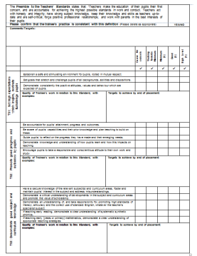
Process for Submitting Profiles
Mentor
Moderation-Link Tutor
Providing challenging developmental targets
Moderation of the judgements
LT will submit the Profile

Slide 27
Supporting trainees with declared disabilities
All trainees who have disclosed a disability are encouraged to complete an Individual Support Plan (ISP) to specify any ‘reasonable adjustments’ which will support their successful completion of the PGCE.
We recommend that trainees share their ISP and disability disclosure with school in order to facilitate adjustments, although it is ultimately a trainee’s decision whether or not to disclose a disability and to share the ISP.

Slide 28
Trainees are welcome to request an early school-based meeting between a university tutor, the trainee and Mentor, to discuss in more detail the practicalities, responsibilities and expectations with reference to the reasonable adjustments identified in the ISP.
Risk assessment for trainees’ medical needs
Where trainees have a medical need/health issue which requires a risk assessment and/or the trainee to have access to medication in school, the school will be made aware of this in advance of the placement, to ensure that appropriate steps/safe storage of medicines can be agreed.

Slide 29
Progress on Placement – doesn’t look like this
High level (1)
Good level (2)
Min level (3)
Not achieving Standards
(WT)
Start Term 1 Term 2 Term 3

Slide 30
Peaks and Troughs – not necessarily ‘over-grading’
High level
Good level
Min level
Not achieving Standards

Slide 31
What to do if a trainee is struggling…
In the event of concerns about a struggling trainee, please contact your Moderation Link Tutor - as soon as possible - who will be prompt to support you.
An action plan can be implemented to support a trainee whose progress is limited.
Please raise concerns as early as possible so the university can support.
Further information can be found in the mentor guide.

Slide 32

Please complete the brief evaluation that will help to inform next year’s programme.
Any questions?

