Slide 1
Warwick Partnership Conference
June 2018
Engagement, Motivation and Empowerment:
Implications for Future Learners
Brittany Wright
Prof Des Hewitt
University of Warwick
d.m.hewitt@warwick.ac.uk
Notes:
BW

Slide 2
The session
Introduction (BW)
Fully Functioning Human Being (BW)
Motivational profiles: external to internal continuum (Deci and Ryan) (DH)
Discussion
Notes:
BW

Slide 3
Overview
Carl Rogers
Ed Deci and Jim Ryan
Notes:
BW

Slide 4
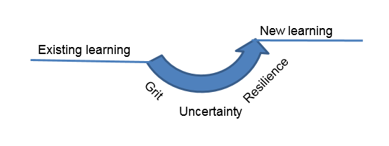
Productive challenge
Notes:
DH

Slide 5
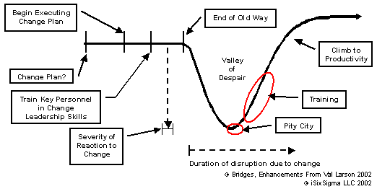
Notes:
DH

Slide 6
Future learner
Self-regulated: taking ownership of learning
Able to deal with uncertainty: emotionally, socially and cognitively
Interdependent, rather than independent
Problem solving
Problem finding
Problem framing
Problem solving
Problem reflection
Notes:
DH

Slide 7
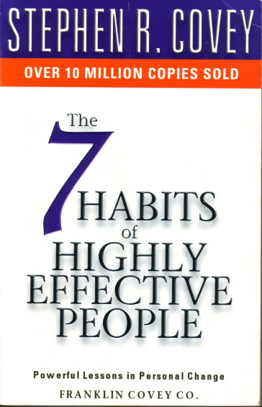
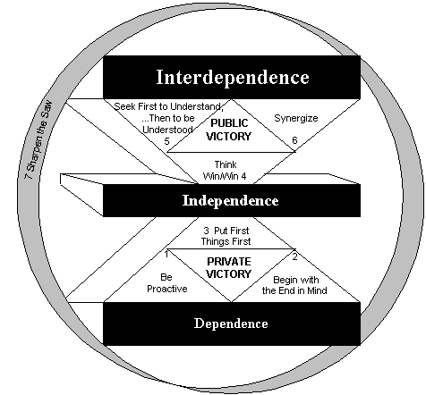
Notes:
DH

Slide 8
Carl Rogers
Person-Centred Psychology
Notes:
BW

Slide 9
The person-centred approach
All people have the potential to be unique, fully-functioning human beings, in perfect harmony with their environment.
Internal locus of control
External locus of control
Conditions of worth are placed on an individual
An individual is treated with unconditional positive regard
An individual is incongruent (they don’t match up to their ‘ideal self’)
An individual is congruent

Slide 10

The Fully Functioning Person
Rogers (1967) believed that the fully functioning person is:
Open to experience (the opposite of defensiveness)
Likely to live in the moment
Able to trust their own gut reactions to guide them in life
Pupils, teachers, trainees:
Suffering as a result of incongruence, placing self-worth on external validation (positive or negative), behaving erratically, etc
Embraces learning experiences, appreciates the day-to-day moments of school, knows, trusts and honours their own self, etc
Vs
Notes:
BW

Slide 11
Practical implications
In order to consider the potential of a person-centred approach in school, we need to ‘look around’
Home/family
Peer relationships
Home/family
?
Data
?
Performance
What conditions of worth are placed on teachers?
What conditions of worth are placed on pupils?
Can we move from an external to an internal locus of control?

Slide 12
Practical implications
Values here refers to ‘core qualities’ or underlying character traits – see Seligman’s Values in Action website for more detail
Key reflection questions:
How far are pupils and staff able to honour their values in school?
What conditions of worth are placed on pupils, staff, trainees? Are these tied to our perception of them as people?
How can unconditional positive regard work in practice?
These principles fit easily into pastoral provision, but how can we embed them in the very fabric of teaching and learning?
This is not the same as ‘liking’ someone – it is a practical reflection of the fact that you value that they are a human being with the potential and capacity to grow and change. It doesn’t mean that you let people get away with anything (despite what you might read on Twitter!)

Slide 13
Ed Deci and Jim Ryan
Self-Determination theory
Notes:
DH

Slide 14
Motivation/ Protective factors
Connected: we are intrinsically social;
Autonomous: we are in control;
Personal development: we need to grow
Deci, E. L. and Ryan, R. M. (1985). Intrinsic motivation and self-determination in human behavior. New York: Plenum Press
Notes:
DH

Slide 15
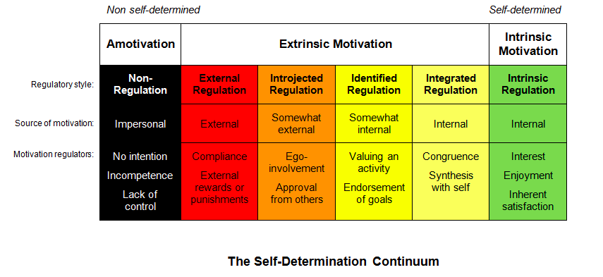
The continuum of motivation
Notes:
DH

Slide 16
Reality check
Can we claim to be wholly motivated by intrinsic motivation?
Is there ever a pupil or teacher who is entirely amotivated or needing entirely external regulation?
Most learners and professionals will have different motivation profiles in different subjects and even at different times
Notes:
DH

Slide 17
Assessment for motivation AfM!
How do we know levels of motivation and engagement for a lesson/ activity?
  What learners do
  What learners say
  What learners value
Questions identify the levels of motivation and engagement
Planning for purposeful and motivating learning responds to what we know about motivation in learners
Notes:
DH

Slide 18
Moving along the continuum of Internal and external regulation of motivation/ learning
Can you change your own and others motivation?
Moving towards autonomy and self-regulation
Pupils Trainees Teachers Mentors
Understanding motivation and how we can change this
Developing awareness of our own motivation and the factors which impact on it
Internal: what is it in the learning which influences our motivation (how, who, what, why we are learning x)
External: what in our lives outside the activity influences motivation (physical, emotional etc well-being)
Notes:
DH

Slide 19
Implications for practice
Education reflects society, but it can also shape it
Moving from compliance to empowerment
The learning gap: passive to active, disempowered to empowered
Praise for effort
Planning for motivation: the curriculum and performance management
How can you include progression for motivation in learning?
Notes:
BW

Slide 20
Discussion
Introduction (BW)
A Fully Functioning Human Being (BW)
B Motivational profiles: external to internal continuum (Deci and Ryan) (DH)
Conclusion
Notes:
BW

