Slide 1
Supporting your Trainee’s Academic Development
Dr Alison Morgan
Deputy Head of Secondary PGCE

Slide 2

PGCE Route Map 2018-19

Slide 3


PG Assessment Structure
“Subject
Studies”
EP929
30 CATS (7)
“Reflective
Practice”
IE9J1
30 CATS (7)
“Professional Practice”
EP918
30 CATS (6)
PG1 | PG2 | PDP | Qualification
 |  |  | PGCE with QTS
Honours Level |  |  | PCE with QTS
 | Honours Level |  | PCE with QTS
 |  |  | PGCert Ed Studies

Slide 4
PG2a
Introduced during Induction August/September
Submission: 16th September
PG1a
Introduced w/c 17th September
Submission: 6th January
PG1b
Introduced: w/c 29th April
Submission: 2nd June; Presentation: 3rd – 27th June
PG2b
Introduced: w/c 19th November
Submission: 28th April

Slide 5
Module PG1: Subject Studies
PG1a
Essay – 4000 words
(80%)
Deadline:
6th January 2019
PG1b
Academic Poster
(20%)
Deadline:
2nd June 2019
(Presented during viva)

Slide 6
Module Breakdown – PG1
ALL ASSESSED ELEMENTS OF THE MODULE MUST BE PASSED
PG1a 4000 word essay examining an educational issue related to subject or the teaching of subject. (80%)
PG1b Academic poster examining an aspect of teaching, as applied to the subject specialism.
To be presented during the viva. (20%)

Slide 7
PG1a Titles
How does gender setting in PE affect participation and behaviour?
Does Drama result in inclusion or isolation for SEN students?
How does the new GCSE English disadvantage students with autism?
Should Drama have its own National Curriculum?
An evaluation of the strengths and weaknesses of the recent changes to assessment of practical science at GCSE.
The value of mixed-ability teaching in English
The implications of the new curriculum on the teaching and learning of Geography
To what extent is “cultural capital” a barrier to studying History in Secondary Schools for white working class students?
The decline in languages in UK schools does not help equip our young people for a future in the globalised world. What can be done?
Is Religious Education still relevant in Modern Britain?
The barriers to learning mathematics and overcoming the fear of numbers
Investigating the low uptake of Science by female students in post-compulsory education

Slide 8
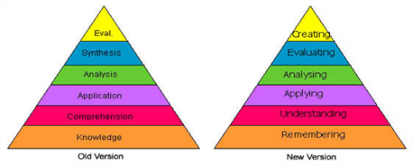
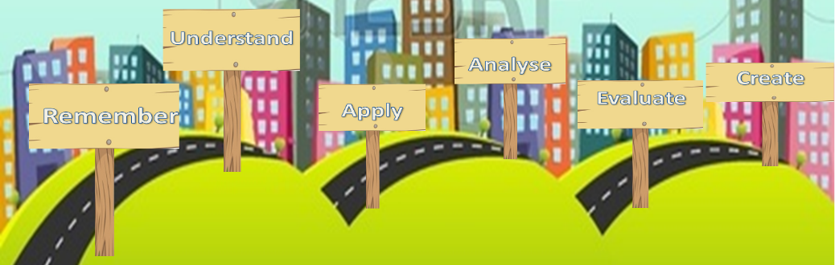
Bloom’s Taxonomy as a Method for Developing Critical Thinking and Independent Learning
C. L. Davison Student Number: 1523171
1. Remember
6. Create
Johnson and Johnson (1999) explore what constitutes cooperative learning and how it can be successful. They identify five elements of cooperative learning:
Positive interdependence
Individual accountability
Face to face promotive interaction
Social skills
Group processing
By synthesizing Johnsons and Johnsons’ research on cooperative learning with the
resources created based on Bloom’s Taxonomy, some of the previously faced
difficulties could be mitigated creating an environment promoting critical thinking
and learning.
Bloom’s Taxonomy was created in 1956 with the intention of supporting teachers to classify the ‘intended behaviour of students.’ (Bloom 1956, p. 12) and as a way of monitoring or ‘obtaining evidence on the extent to which the desired and intended behaviours have be learned by the student.’ (Bloom 1956, p. 13).
In order to ensure the success of developing critical thinking skills the students need a greater focus on individual accountability and group processing in their cooperative learning. Students should evaluate the effectiveness of their group and be expected to demonstrate their own development of skills .
In 2001 Bloom’s Taxonomy was revised, changing the original noun form into verbs and swapping the top two levels so that ‘Creating’ previously known as ‘Synthesis’ is now at the top level. (Stobaugh, 2013)
5. Evaluate
The sentence starters alone are not enough to ensure high level questioning; this must be coupled with regular teacher reinforcement about what is meant by the term ‘analyse’ or ‘evaluate.’ It is also necessary to bear in mind that critical questioning is a skill that develops over time which can be supported by resources and modelled by teachers but it cannot be taught.
What went well:
Students were able to identify, even after the first week of using the resources, which card they thought they should be using, and consequently at which point in their learning journey they were.
Problems encountered:
Perhaps the clearest problem encountered was that the use of the cards involved a large amount of group work, creating questions to pose to each other. As in inevitable in a group work situation, there were occasions where not all students were on task and consequently not engaging in developing their critical thinking skills.
Bloom’s Taxonomy is an excellent way of tracking students’ learning, developing their critical thinking skills and creating self-aware learners, but this can only be accomplished if students are fully engaged in the lesson activities and therefore the learning process.
2. Understand
After initial research, understanding as to how Bloom’s Taxonomy could be used in the targeted setting was required.
In September 2015 the schools introduced a sixth form and there has been agreement and frustration across subjects that the students are ill prepared for A-level education as, up until that point very little independent learning and thinking has been required of them.
Stobaugh (2013) explains that ‘increasing the level of critical-thinking skills in any program raises the level of rigor’(p.5)and this is where Bloom’s taxonomy can come into play in the classroom. It can be used:
As a tool to support critical thinking
To track progression
Examine the level of thinking and questioning in a classroom.
Lesson Journey
Each card relates to each of the levels of learning on the revised version of Bloom’s Taxonomy
Apply
I can use my knowledge in new situations.
Key Words
Apply
How would you show your understanding of…..?
What examples can you find to show…..?
How would you use what you have learned to develop…..?
What questions would you ask in an interview with…..?
Could this have happened in …..?
What would happen if …..?
3. Apply
The card used should link to the lesson journey, reinforcing students’ self awareness of their learning process.
With this in mind, two resources were created to implement critical thinking, based on the theory of Bloom’s Taxonomy, in the classroom. The first was the ‘lesson journey.’ The teacher is able to use this to reflect on their own lesson during the planning process, to ensure that they are providing a activities that challenge the pupils and move their thinking forward. It is also used as a way to encouraging the pupils to become more aware of their learning. They can track their own progress and their learning journey through the lesson, becoming aware that they have mastered a skill if they are able to complete the evaluation activity at the end of the lesson.
The second resource created was a pack of six double sided Bloom’s questioning cards.
“I can” statement on the front of each card supports students in understanding what each level of the Taxonomy, and consequently their learning, involves.
Key words on the front of the card and the question starters on the back of the card support students in developing their critical thinking skills.
4. Analyse
The Lesson Journey and Question Cards were trialled with a year 8 set 4 (of 5) class containing 22 students over a series of four lessons in which they were studying a Shakespeare play. The cards were used to support a variety of questioning activities.
Students found it easy to create low level ‘Remember’ questions to test their partner as a lesson starter.
Very successful in using their cards to create higher level analysis questions in a hot-seating activity to examine character in the play.
Many students struggled to create analysis questions based on an extract from a scene and, on occasion, were using the sentence starters on the ‘Analyse’ card but still creating low level ‘Understand’ or ‘Remember’ questions.
Administer
Apply
Associate
Connect
Construct
Correlate
Develop
Dramatise
Examine
Illustrate
Interpret
Interview
Plan
Solve
Teach
Use
Front
Back
References: Bloom, B., et al., ed. (1956). Taxonomy of Educational Objectives: The Classification of Educational Goals. New York: David McKay Company, Inc.
Johnson, D., Johnson, R. (1999). Making Cooperative Learning Work. [Online]. (URL http://0-eds.b.ebscohost.com.pugwash.lib.warwick.ac.uk/eds/pdfviewer/pdfviewer?sid=763bf7c4-064d-4b90-91aa- b4be5b6a2c7%40sessionmgr114&vid=1&hid=127). Theory Into Practice, 38(2). (Accessed on 28 November 2015)
Stobaugh, R. (2013). Assessing Critical Thinking in Middle and High Schools: Meeting the Common Core. New York: Routledge.

Slide 9
Module PG2: Reflective Practice
PG2a
Formative Essay – 1000 words
(0%)
Deadline:
16th September 2018
PG2b
Essay – 5000 words
(100%)
Deadline:
28th April 2019

Slide 10
Module Breakdown – PG2
All postgraduate work is marked out of 100 against M-level marking criteria
PG2a 1000 word essay examining cognitive development and theories of learning.
NOT for credit – feedback only, intended to help identify specific needs regarding M-level study.
NB. Writing for Social Sciences is different to other disciplines so we strongly encourage everyone to attempt this work.

Slide 11
Module Breakdown – PG2
ALL ASSESSED ELEMENTS OF THE MODULE MUST BE PASSED
PG2b 5000 word essay examining one of the Teachers’ Standards in detail, with reference to theory, policy and practice.
There is a comparative aspect to this assignment, contrasting the chosen standard across both placements and reflecting on trainee’s own development. (100%)

Slide 12
PG2 Titles
Critical Reflections on…
  differentiation in secondary schools and how it affects gifted and talented students
  the Effective use of Feedback in the Classroom
  in-school summative assessment and life after levels
  the Use of Mobile Phones in the Classroom
  establishing High Expectations: how to inspire, motivate and challenge pup
  to what extent Behaviour for Learning is more effective than the Reward and Sanction System at School
  how ICT is used within a classroom to bring about effective learning

Slide 13

PGCE Classification
Calculated from the mean average
mark across modules PG1 and PG2
70+ % Distinction
60+ % Merit
50+ % Pass
< 50 % Fail at M-level
(may pass at H-level)

Slide 14
Resubmission
One chance to resubmit each piece of failed work at M-level
Tutorial / intervention support to work through feedback
Pass second time around is capped at 50%
Failure second time will be reconsidered at H-level
Work is not “officially” failed until Exam Board, from then trainees have one year to resubmit (note: possible delay to QTS)

Slide 15
Master’s Marking Criteria
Grade | Comprehension | Analysis | Critique | Presentation
A*/A (Mark of 80 or above = A*; 70 -79 = A) | A wide range of relevant sources, which are well understood, are skilfully and concisely deployed to support arguments. Demonstrates a highly developed understanding of relevant concepts, theories and/or research methodologies. | Recognises the demands of the question providing a well-focused, relevant answer. Sets sources and viewpoints in a wide context and makes a comprehensive assessment of issues involved. High levels of ability to analyse, identify relevant issues, synthesise and apply knowledge and concepts. Relevant theories/theoretical models are applied to deepen understanding of the links between theory and practice. | Skilful evaluation which synthesises both the literature and personal perspectives in response to the question. Demonstrates a balanced critical understanding of the issues. Some originality of thought and creativity. Displays critical awareness of methodological and theoretical considerations. | Material is very well-organised and the structure complements the content. A high level of written communication with very few errors of spelling, grammar and syntax. Points are comprehensively and appropriately substantiated. Mastery of referencing conventions with very few errors or omissions.
B (Mark of 60 - 69) | Sound and thorough grasp of relevant concepts, theories and/or research methodologies which are well-summarised. The work is supported by references to a good range of relevant sources which are used in a relevant way. | Recognises the demands of the question providing a focused, relevant answer. Sets sources and viewpoints in context. A good ability to analyse, identifying useful points synthesise and apply knowledge and concepts. Application of theories/theoretical models in a relevant way to answer to the question. | Perceptive commentary on evidence and materials used in response to the question. Able to make appropriate critical points. Displays awareness of methodological and theoretical considerations. | Well-structured work displaying attention to the logic and development of the piece. A clear written style. Spelling, grammar and syntax are generally good. Points are consistently and appropriately substantiated. Most features of the referencing system are used correctly.
C (Mark of 50 - 59) Pass Mark 50 | An adequate range of relevant source materials is used. Understanding of main concepts, theories and/or research methodologies is fair but lacks depth and/or breadth. There may be some gaps or areas of confusion. | The response to the question addresses basic requirements and there may be some irrelevant material. The attempt at analysis, synthesis and application of knowledge and concepts is competent but lacks depth and breadth. Limited use and understanding of theoretical models. | Sensible commentary on evidence and materials used throughout, in response to the question. Limited critical reflection. | A generally satisfactory overall structure although it may lack balance in parts or fail to integrate some material. An adequate written style which is not impaired by the occasional errors of spelling, grammar and/or syntax. Generally appropriately substantiated. The recommended referencing system is used but with some errors and omissions.
D (Mark of 40 – 49) | Some evidence of relevant reading. Understanding of the subject matter is limited. The work displays major gaps in knowledge, serious misconceptions and/or factual inaccuracies. | Introduction of basic concepts and effort made to relate them to the demands of the question which have been only partially understood, leading to irrelevant material. No sustained analysis, mainly descriptive with and an inability to apply knowledge and synthesise material. Very limited reference to theoretical models. | Some sensible comment is made. Uncritical commentary. | Weak structure. Expression of ideas is sometimes confused or unclear. Communication may also be impaired by errors of spelling, grammar and/or syntax. Lacking appropriate substantiation. Referencing marred by frequent errors and omissions.
E (Mark below 40) | Few relevant sources used. Serious gaps and/or errors in knowledge and understanding. | The question may have been ignored or badly misunderstood, and there is much irrelevance. Superficial treatment of the topic much of which is descriptive. Lacks appropriate critical or theoretical framework. | The commentary may not be seen as sensible in relation to the question. | Unstructured presentation, lacking coherence. Expression of ideas is poor and may also be impaired by frequent errors of spelling, grammar and/or syntax. Much of the writing is unsubstantiated. The recommended referencing system has not been mastered.

Slide 16
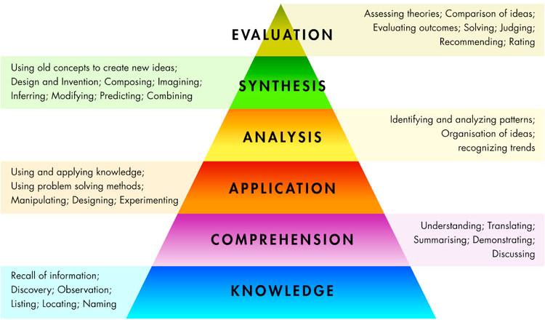
PASS
A/A*
70 % (Distinction)
B
60 % (Merit)
C
50 %
FAIL
D
40 %

Slide 17
Areas of Development for Trainees
Essay writing – social sciences
Academic writing
Accurate writing
Essay structure
Critical analysis
Constructing an argument
Harvard referencing

Slide 18
University Support
Lead lectures
Detailed brief for each assignment
Online resources
Workshops
1-1 Tutorials
Library sessions
Student Services

Slide 19
School Support
Discuss essay plans in mentor meetings
Provide resources – school policies, data, etc
Subject specific resources – journal articles, CPD materials, websites
Support with time management – time and space to study
Mock poster presentation
Proof reading!

Slide 20
Proof reading
The University considers it acceptable for proof-readers to identify, but not make corrections to:
  common typographical, spelling or punctuation errors;
  formatting and layout errors and inconsistencies such as page numbers, line spacing, font size, headers and footers;
  grammatical and syntactical errors and anomalies;
  lexical repetition or omissions; sections of text where the meaning is ambiguous; minor formatting errors in referencing (for consistency and order);
  errors in the labelling of diagrams, charts and figures.
proofreading

Slide 21
Proof reading
The University does not consider it acceptable practice for proof-readers to amend existing content – whether through addition or reduction and, in particular, it prohibits proof-readers to:
  Rewrite content where meaning is ambiguous;
  Add to existing content;
  Alter argument or logic where faulty; Re-arrange or re-order sentences to enhance structure or argument;
  Implement or alter a referencing system or add to references;
  Check or correct facts, data calculations, formulae or equations;
  Translate text drafted by students, noting that this does not prohibit translation of source material as long as it is properly referenced.

Slide 22
How can we support you to support them?

Slide 23
Introduction (Maths)
This paper discusses the implications of current theories of cognitive development on mathematics education. Research in this area has, to some extent, accepted constructivist theories as suitable for exploring how mathematics learning takes place and how best to support students’ cognitive development. This is not to say that other theories, including behaviourism, do not have a role to play; however, it seems that mathematics education has focused less on researching the latter and has left studies adopting a behaviourist approach to other areas such as psychology. Consequently, the main focus here is on constructivist approaches that have influenced the teaching and learning of mathematics After a discussion contrasting behaviourist and constructivist theories in the next section, this paper proceeds consider the work of two constructivist theorists – Piaget and Vygotsky – whose work has shaped the way mathematics is taught nowadays.
Notes:
Red – signposting
Oramge – will need to support this later in essay
Green – beginning to establish argument
Blue - rationale

Slide 24
Theory: Multiple Intelligences (Music)
The way in which we digest, store and use information is said to vary dramatically from one person to another. For many people, there is no one way to which we learn. These ideas form the basis of Howard Gardner’s theory of ‘multiple intelligences’ (MI). Gardner’s studies bring to light the idea that people do not have a ‘general intelligence’; a term coined by Thurstone and Spearman when developing the IQ theory, but are defined by several intelligences. Gardener (1983, 1993) identifies nine main types of intelligences; two of these can be closely linked to Music and are vital in the teaching and learning of the subject.
‘Musical/Rhythmic Intelligence’ is simply and fundamentally the appreciation and understanding of music. Individuals with this intelligence will think in sounds, rhythm and patterns and will have a particular gift for producing music. It is likely they will have a natural ear for sound, for example, they will quickly be able to understand the tonality of a piece of music (major or minor tones) and associate this with a particular emotion.
Notes:
Red- knowledge/ understanding
Green – application
Around a C grade – rogue ; in line 4

Slide 25
Piaget’s Maturational Theory (PE)
Piaget distinctly expressed the need for developmentally appropriate education which is consistent with an individual’s physical and cognitive abilities. Therefore, in a PE lesson, a teacher would not introduce the complex theoretical concepts and definitions of the circulatory system or respiratory system to a year 7 group. Instead, the teacher would teach this to an older group, as they are said to have reached an appropriate stage of cognitive development. Furthermore, developmentally appropriate activities exist to help, not hinder children’s cognitive development. With reference to the Formal Operational stage, a PE teacher could present students with a proposed problem, allowing them to plan an organised approach to solving the problem in small groups. The importance of children being active in learning activities is another important message which can be taken from the Piaget’s constructivist learning theory. Therefore, instead of adopting a didactic teaching approach, a PE teacher could utilise the guided discovery approach when teaching tactics. For example, instead of dictating to pupils which tactics they should select and apply in a competitive game of netball, the teacher could first allow pupils to actively experiment with their own ideas, allowing them to interact with their environment. Although Piaget’s theory is well-known within the field of education, it has also been subject to much criticism for underestimating children’s abilities (Miller 2011). A child’s developmental stage is not solely restricted to an individual’s age as individual’s progress at different rates (Berk 2004). Moreover, Piaget has also received criticism for failing to consider the social nature of cognitive development.
Notes:
Red – knowledge/understanding
Green – application and analysis
Purple – evaluation
B grade. Evaluation not fully developed

Slide 26
Gardner vs Bandura (English)
Gardner has made the case for a wider array of ways to assess students, arguing that ‘the broad spectrum of students… would be better served if disciplines could be… assessed through a variety of means’ (Gardner 1991b, p.13)[…] While the application of MI theory into classroom practice can go some way to increasing student attainment, it does not make students aware of the academic standards that are expected of them. This could be addressed by applying Albert Bandura’s social learning theory. In contrast to Gardner, Bandura calls for a more teacher-centred approach , claiming that children learn by mimicking others (Bratcher 2012). If we apply this to a school context, this would translate to children learning by mimicking the teacher. If we take this to be true, then it places far greater emphasis on teacher instruction. Suzanne Bratcher (2012) has cited the importance of modelling when it comes to teaching writing, arguing that it helps students better understand 'the writer's process of thinking and questioning and decision making' (Bratcher 2004, p.177). Taking Bratcher’s findings further, one finds multiple ways to apply Bandura’s theory […]
Notes:
Red – knowledge
Green – application and analysis
Purple – evaluation, synthesis

Slide 27
Conclusion (History)
To conclude, it is possible to see in this study the formative contributions of these theories to the field in terms of child development, cognitive function and pedagogy. Yet, naturally one model is seemingly better suited to the practice of History teaching, particularly Vygotsky’s social-cultural theory. The main tenet of the theory centres on the interactional relationship between teacher and student, which compliments the increasingly collaborative nature of the historical discipline itself. The sense of shared learning that can be wholly student-centred not only piques the interests of the individuals, but also allows for the careful fostering and support of the student’s thinking. Whilst this might be a heavy task to carry out for whole lessons, it is possible to differentiate instruction that responds to the needs of the learner and pushes them to the edge of the proximal zone of development. Through careful mediation, students may become confident in the use of their own knowledge and begin to eventually exercise independent thought, which can be attested to in my observation of this practice in schools. Within this framework, scaffolding acts as practical and effective pedagogical device to facilitate the learning process.
Notes:
Red – summary of key points. Good use of tentative language
Purple - argument supported by understanding
Green – application which supports argument
NB ‘compliments’ not ‘complements’

Slide 28
Thank you
Any questions?

