Slide 1
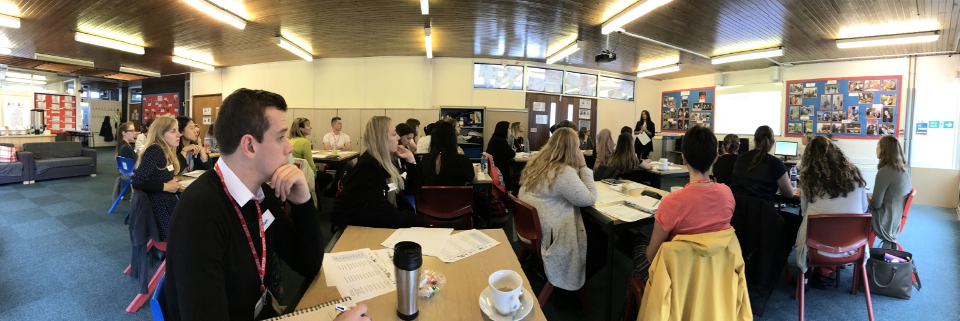
Primary Update
Professor Des Hewitt
June 2018

Slide 2
Overview
Headlines of last year - national context and horizon scanning
Recruitment figures - accepted offers
Feedback from OFSTED review: developing a broad and balanced ITT curriculum
Main changes to calendar/programme/assessment for 18/19
Expectations and guarantees - trainee, school and university
Working in partnership – professional development for mentors

Slide 3






How are we doing?
Over
200
98%
Warwick teachers employed in local schools from 16/17
said staff are good at explaining things¹
95%
of our 16/17
trainees received
“Outstanding” or
“Good”
Staff are
enthusiastic about what they are teaching¹
(96%)
595
96%
schools
in partnership with Warwick
felt encouraged to ask questions or make
contributions in
taught sessions¹
¹ PTES Survey 2017

Slide 4
Thank you..
… to all our staff
… to all our mentors
… to all our students
… to all our schools
Promotions:
four senior teaching fellowships,
one professorial teaching fellowship

Slide 5
Headlines
New OFSTED ITT Inspection Handbook September 2018
New QAA code of practice for Learning, Teaching and Assessment
No sign of primary bursaries
Induction: moving to two-year period
OFSTED/ HMI focus on broad and balanced curriculum

Slide 6
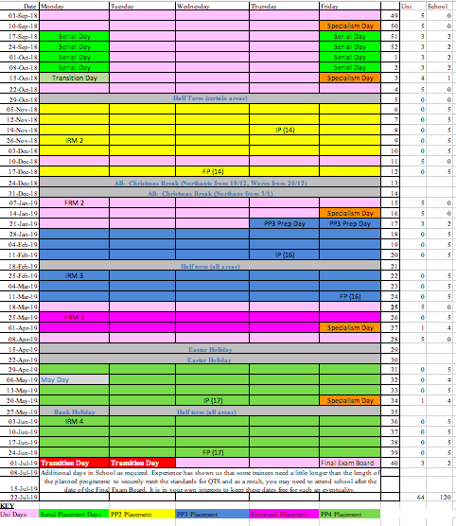
PG Primary Core 2018-19

Slide 7
Recruitment: Primary core
Primary Core 3-7 (16) and 5-11 (60): Accepted offers 76
Predicted numbers by the end of July between 80-90
EYITT: Accepted offers 1
Predicted numbers by the end of July between 1-6

Slide 8
Primary SD
Accepted offers: across all locations 63
Predicted accepted offers by the end of July 70-80
Coventry: currently 41 students, but this is likely to be nearer to 50 by the end of July
Derby: currently 15 students, but we know that this is already 18 pending accepted offers being processed, so predict around 20 by the end of July
London: currently 7 students, but likely to be higher, possible between 10-15 primary students by the end of July.

Slide 9
Feedback from OFSTED review
Self-Evaluation Document should go beyond compliance to express the uniquely distinctive aspects of provision
CTE should lead on building a more integrated school, ITT and PD curriculum – with strong disciplinary elements
Primary should explore how it can develop a broad and balanced ITT programme whilst considering what of the current elements should be retained, dropped or enhanced;

Slide 10
Opportunity for developing a 30 credit PG Award for mentors (p-t over 2/3 years) with patch-quilt assessment approach
Build platinum/ supported model of SD partnership, incorporating research as a key requirement.

Slide 11
Main changes to 2018-19
Calendar/programme/assessment
Primary Core: KG
Primary School Direct: SH
EYITT: KW

Slide 12
SD Model: an excellent training for all trainees
Outstanding training provision by schools across a Teaching School Alliance/Multi Academy Trust
Fully supports compliance and legal obligation in ITT:
Maximizes outcomes for students/ trainees:
Contributes actively to the development of excellence across the Warwick ITT Partnership and Teacher Education
Truly collaborative planning, teaching and assessment of the QTS aspects of the PGCE and, where agreed in advance, the academic aspects
Provides high quality Alliance professional development programme for trainees alongside the PGCE– quality assured by university and lead alliance
Takes active role in recruitment of trainees/ students in liaison with CTE marketing and recruitment team
Makes all arrangements for main and complementary/ additional placements: including identifying placements for trainees who have to move school.

Slide 13
Personalisation for trainee needs and support for trainees is sensitive and helps them do well on placement
Works effectively with CTE administrators to provide timely information for instance for placement profiles, evaluations;
Ensures all mentors in Alliance/schools have access to professional development as agreed
Actively contributes to the central University PGCE provision (Lecture/Careers/Conferences/teaching/ blended learning etc)
Takes an active role in the Warwick Partnership beyond the Alliance provision
Ensures commitment to evidence and research-based practice through active participation in the Warwick Schools Research Network
High quality Pre- and Post-course engagement with applicants/alumni, engaging with CTE post-course support as appropriate

Slide 14
Working in partnership
Ensuring all mentors are appropriately trained:
Annual professional development:
face to face,
cluster and
blended learning for mentors
Transferable skills in coaching and mentoring;
Less information-giving, more professional development for mentors

