Slide 1
PGCE Secondary Programme: Core and SD
Key updates and developments
Paul Taylor-McCartney and Secondary Team

Slide 2
Overview
CTE/Secondary PGCE: highlights from 2016/17
Expectations – university and alliances
Ways to engage – working in partnership
Recruitment - accepted offers across pathways and subjects
Key Revisions to programme for 18/19
Developments: 2019 and beyond

Slide 3

Vision and Strategic Priorities
Vision:
To be the first choice for teacher education. Strongly contribute to teacher supply, school improvement in our local & regional communities, with an outstanding national & international reputation for academic & professional excellence.
University of Warwick Partnership mission:
To create expert teachers & innovation in teacher education which makes a lasting difference in children's & young people’s lives.
Longer-term Strategic Priorities (2016 - 20):
Contribute to improved standards of teaching in schools and raising student attainment.
Academic Plan: to be research-led.
Supply and retention of high-calibre teachers.
Equality of Opportunity and Improvement through Social Mobility.
Innovation in Teaching and Learning.
Investment in staff.

Slide 4
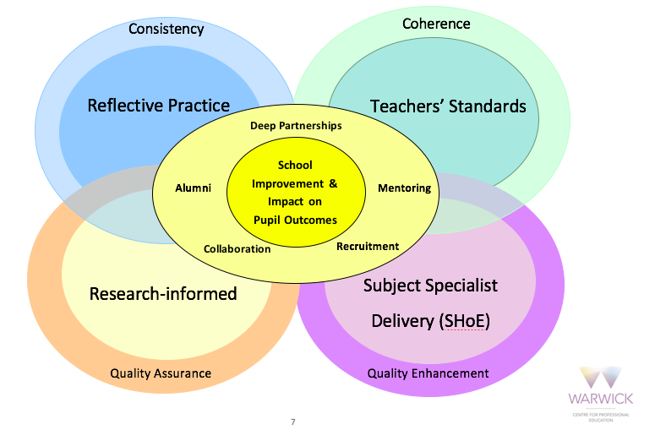

Slide 5
PGCE Secondary : Modules
30 CATS (Subject Studies) – LV 7
30 CATS (Reflective Practice) – LV 7
30 CATS (Professional Practice) – LV 6
Assessment: A mixture of M-Level assignments and ongoing assessment against the National Teachers’ Standards
Recommendation for QTS

Slide 6

Secondary PGCE - distinctive features
and developments
Continued focus on school improvement and pupil progress: 70 percent of 16/17 responding trainees secured a teaching role in local schools, with 99% gaining employment as teachers across all regions.
Working more closely with academic departments, including English, Life Sciences, Theatre Studies, Philosophy, MFL, Film Studies.
T and L: interdisciplinary context of both Higher Education and teaching. Revised content: teacher presence, cross-subject teaching, tracking pupil progress, restorative justice, Behaviour for Learning, Inclusion conference, Research in Action Conference, TEL in the classroom, character education, cultural sensitivity, Pre KS3, Post-16/UG provision and alternative placements (SEND).

Slide 7
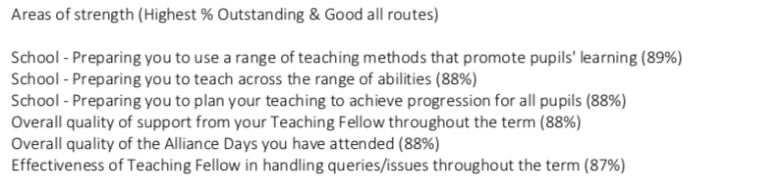
Combined
Areas of Strength

Slide 8
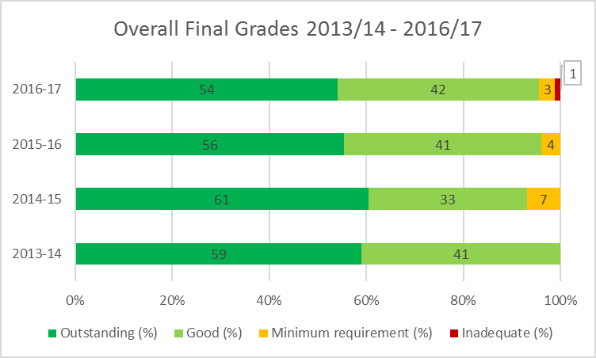
Outcomes: Final TS grades

Slide 9
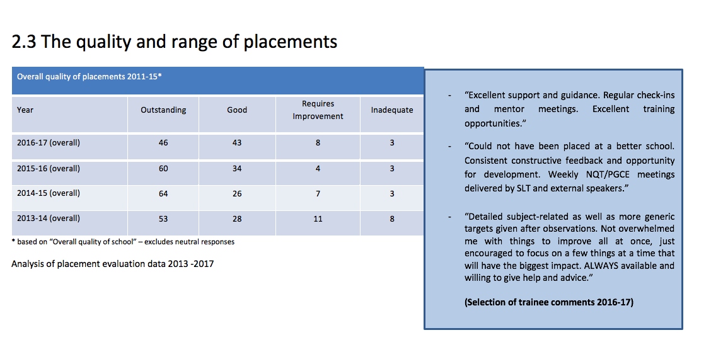
Placements: Mentoring

Slide 10
CTE’s
Honorary Appointments
(Secondary PGCE)
Honorary Teaching Fellows
Matt Connor-Hemming
Julie Edwards
Aidan Jenkins
Ann Rayns
Ann Dudgeon

Slide 11
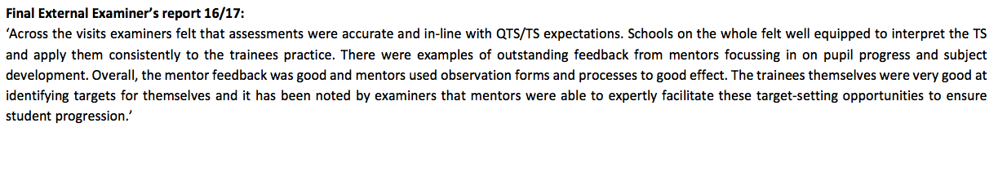
External Examiner visits:
2016-17

Slide 12
Completion: 2016-17
90 percent completed course (usually 94%) with full PGCE (QTS), PCE (QTS) or PGCES (non-QTS)
Non-subject or pathway specific
Can we do more to develop/teach trainees to be resilient? Develop the ‘bounce-back’ principle many in our profession demonstrate every day and we encourage young people to demonstrate in our schools …

Slide 13
Expectations: University
Commitment to delivering the highest quality provision
Dedicated team of academics and qualified teachers
Highly responsive staff assigned to a single cluster of schools (4 regions)
Extensive support for each trainee (personal tutor/Teaching Fellow), PG sessions, Reflective Practice and Subject with Individual Support Plans for those registered with disability services

Slide 14
Working together to support new schools/mentors and moderate judgments
Regular and meaningful communication - Bulletins (Trainee (weekly), Mentoring Matters (SMs) and Partnership Bulletins (PMs/ITE leads) (bi weekly)
Joint moderation of trainee performance (against all TS)
Stage 1 and Stage 2 Interventions for Core (support for SD) (Grade 3 and 4 trainees)

Slide 15
Expectations: Alliances
Quality assure and enhance mentoring and assessment practices across your schools
Organise content for Alliance Days for SD (+ Optional days/End of Year Review) (Link: JL)
Support your subject depts in contributing to Subject Hubs: 6 x full days and 6 x 0.5 subject days across year (AM)
Collate and deliver Assessment Point data on time
Organise all SD complementary placements for all trainees in your Alliance (ensure contrasting settings)

Slide 16
Partnership: ways to engage
Programme contributions (PS, PG, Subject Hubs, Careers Focus Days)
Partnership Lunch and WaSP meetings schedule – 1 per term throughout 18-19
Autumn: Thursday 6th December (1 to 4 pm)
Spring: Thursday 11th March (1 to 4 pm)
Summer: Thursday 4th July (1 to 4 pm)
Conference attendance/input:
‘Research in Action’ (Monday 17th December) ‘Inclusion’ (Friday 15th March)
‘Partnership’ (Thursday 20th June)

Slide 17
Training: non-PGCE courses
Assessment Only (QTS) – VA/GN
WinS (UG students gaining school experience) - WH
MA in Professional Education (Upgrades)

Slide 18
Developments for 2018/19
Disaggregated programme: 18 subjects across two days (Mondays and Fridays) – more personalised – quality following expansion
More focus on developing trainee’s M-level subject pedagogical knowledge (SPK) led by CTE specialists (ST3:Enhanced provision)
Explicit links between learning and assessments, (PG/MA and more direction/time allowed on PDP tasks, H level)
Revisions to sessional content, particularly Reflective Practice
Partnership development/impact – nurturing new providers and capturing impact of alumni

Slide 19
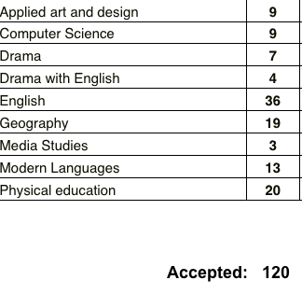
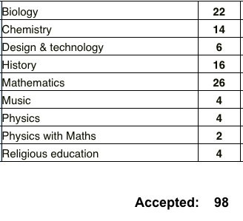
Accepted offers (June 15th)
Mondays
Fridays
Mondays:

Slide 20


1 - Principles of practice - Loughran considers his principles for Teacher Education
2 - Developing fundamental Practices of Teacher Education - Korthagen, Loughran, & Russell draw on practice from their respective countries to develop a series of principles
3 - A pedagogy for ITE in England - Philpott draws on on work from overseas including 7 below to consider it for ITE in England
4 - Preparing reflective teachers - Zeichner provides an overview of literature regarding different teaching approaches to use in ITE
5 - Practicing what I preach - Loughran reflects on making his own reflective practice explicit to help develop reflective teachers
6 - Effective Reflective Practice - Loughran examines reflective practice in Teacher Education
7 - Linking theory and practice - Korthagen & Kessels look in depth at different approaches to linking theory and practice
8 - Teaching Prospective teachers about learning to think like a teacher - Crow & Berry consider what their principles of teacher education look like in practice

Slide 21
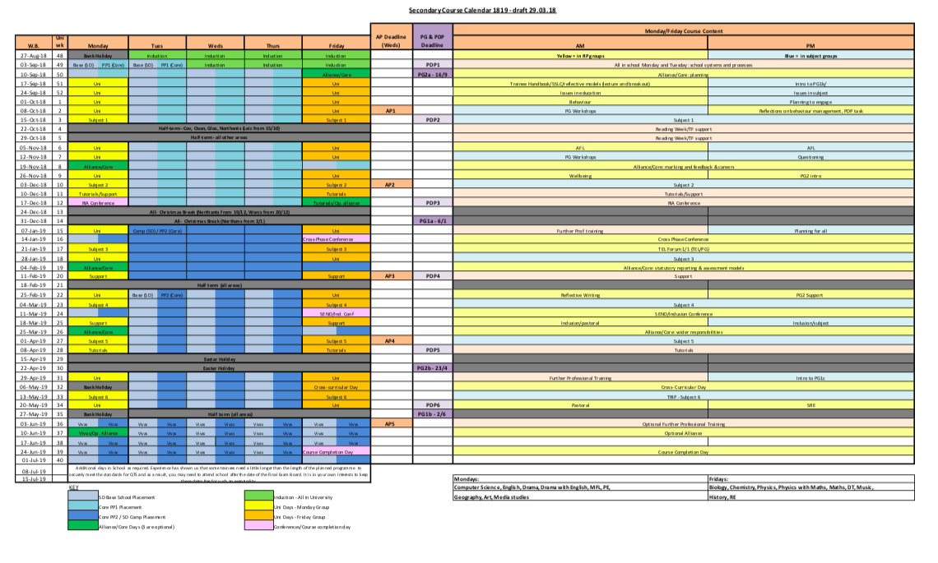
Secondary Programme Calendar – 18/19

Slide 22
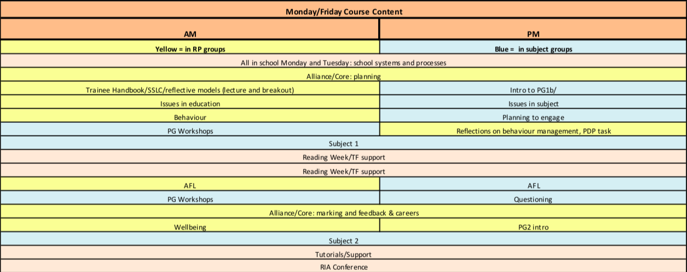
University: Weekly content

Slide 23
2019 and beyond …
14 subjects (Core and SD) delivered by in-house specialists: developing our distinctive character
Defining our SD provision - Platinum and Supported models
Ofsted preparations - maintaining ‘Oustanding’
Launching apprenticeships - UG and PG (replace SDS)
Strengthening QTS - longer phase of training
Developing an active research culture at CTE and a School Research Network - (KM) @WJETTblog https://blogs.warwick.ac.uk/wjett/
Safeguarding – ‘red line’ committee - (RC)
Launch new Warwick SD ‘hubs’ in areas of need
PGCEi in Thailand, UAE, India and Switzerland – (NM)

Slide 24
Q and A
Contact me:
Paul Taylor-McCartney
Head of Secondary Teacher Education
t: +44 (0)24 7652 2297
m: 07876 877904
E: P.C.Taylor.1@warwick.ac.uk
Centre for Teacher Education | University of Warwick | Coventry | CV4 8EE | UK

