Slide 1

Mentor Training – New PMs Paul Taylor-McCartney (Head of Secondary ITE) Honorary Teaching Fellows Julie Edwards (Myton School) and Aidan Jenkins (President Kennedy School)

Slide 2
Aims
To understand the roles and responsibilities of the Warwick Professional Mentor.
To explore the responsibilities related to PM provision.
To consider reflections made by two experienced Professional Mentors (Aidan Jenkins and Julie Edwards).

Slide 3
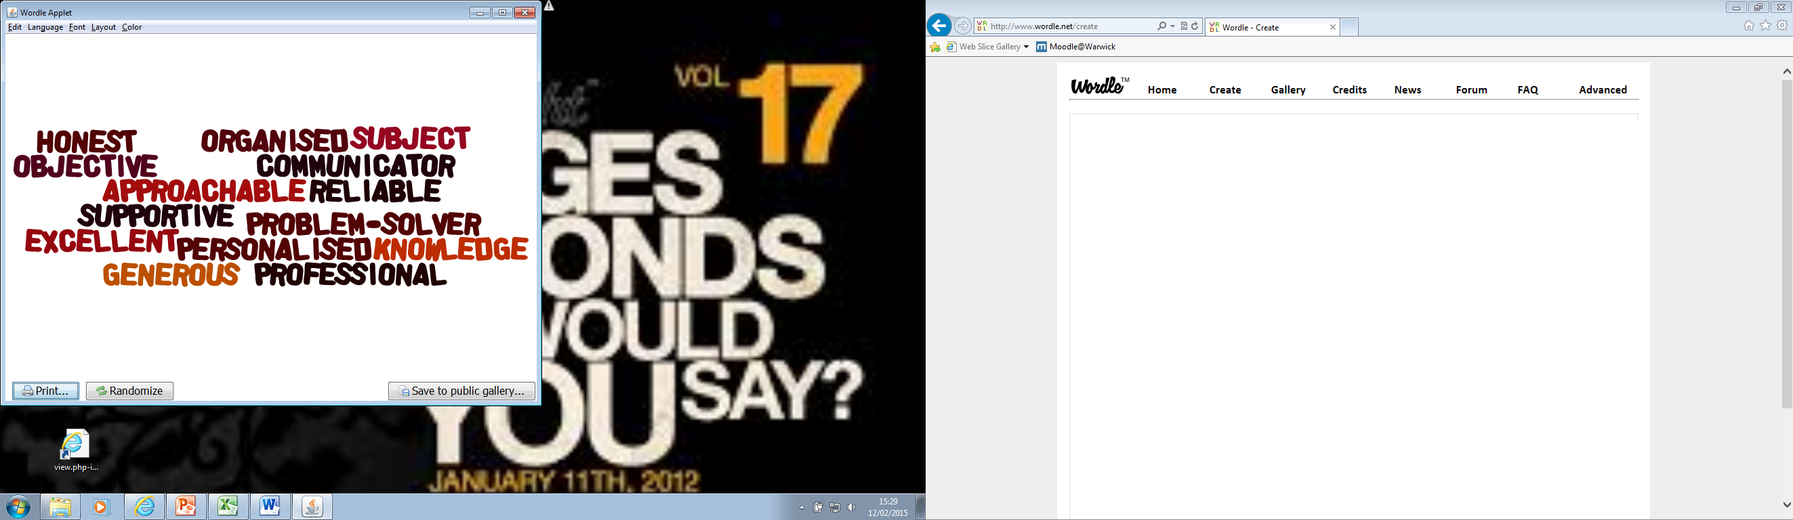
Mentors … What do trainees say about them?
Notes:
Some of the things trainees say. We have annual awards – 1 SM and 1PM award – nominated by trainees and eachother – award ceremony in Oct

Slide 4
Mentoring as a broad concept is changing,
and is increasingly being ‘associated with collaboration...
working together and not just working with’
Lofthouse 2015
National Standards for school-based initial teacher training (ITT) mentors
July 2016.
“A mentor is a suitably-experienced teacher who
has formal responsibility to work collaboratively within the
ITT partnership to help ensure the trainee receives the
highest-quality training”.
Notes:
The process is becoming more formalised, with expectations and standards as the routes into teaching diversify – at the centre of this however is always the Subject mentor – the key to the successful outcomes for a trainee – that does not mean you become friends – a professional relationship.

Slide 5

It is a ‘moral imperative’ – Timperley (2015)
Notes:
How will this support/ guide your practice - self – audit – selection process – competencies -

Slide 6
Standard 1 - Personal qualities: Establish trusting relationships, modelling high standards of practice, and empathising with the challenges a trainee faces.
Standard 2 – Teaching Support: Trainees to develop their teaching practice in order to set high expectations and to meet the needs of all pupils.
Standard 3 – Professionalism: Induct the trainee into professional norms and values, helping them to understand the importance of the role and responsibilities of teachers in society.
Standard 4 – Self-development: Working in partnership to continue to develop their own professional knowledge, skills and understanding and invest time in developing a good working relationship within relevant ITT partnerships.
Mentors should use the standards to:
• understand what is expected of them and see that it is a manageable role;
• enable self-evaluation of practice and help identify areas for further improvement;
• support the delivery of the training plan; and
• induct trainees into the school and the profession
Notes:
Have a look through and discuss – these should be absolutely used to select/self select your readiness to be a SM/PM

Slide 7
SMs Subject knowledge (TS3)
We aim to create outstanding subject teachers not just general teachers – the SM’s role in this is vital.
Your SMs need to remain engaged with up to date knowledge and subject pedagogy.
We will of course do sessions at university and trainees will be informed of new and interesting pedagogic research in their areas, but your SMs need to support and challenge their thinking.
Notes:
Carter review – TS 3 – should always be a target for standard 3 – PCK – Will – Subject at Warwick – Hub days

Slide 8
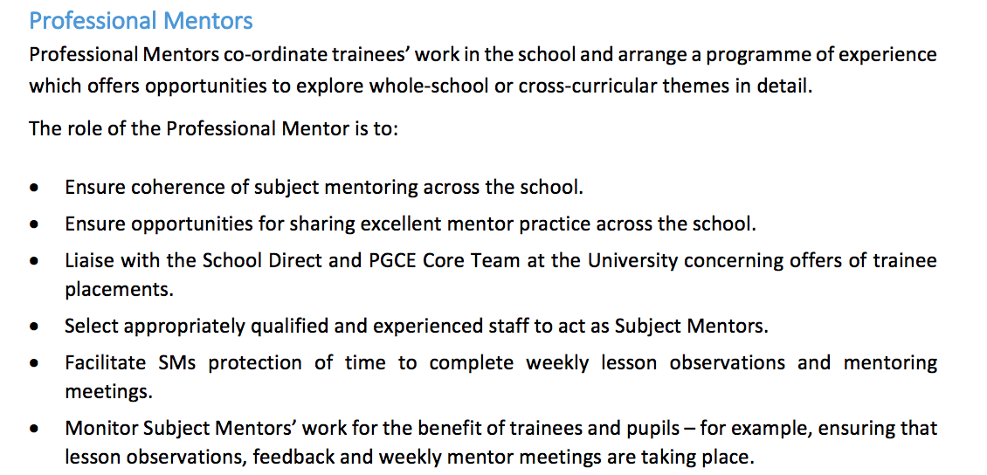
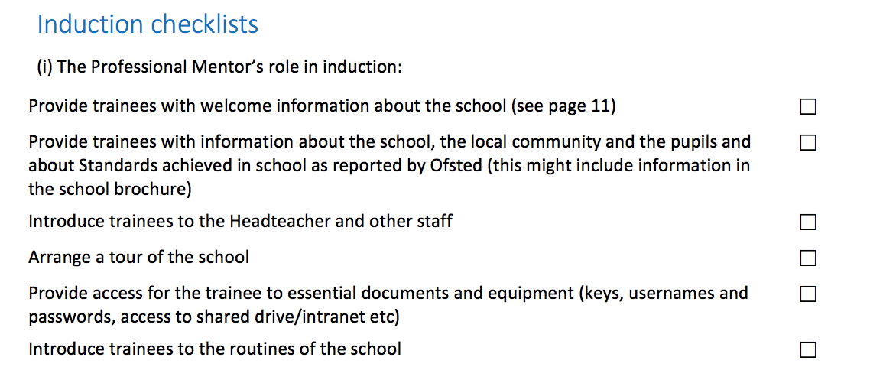
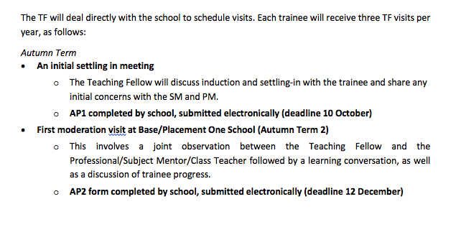
Partnership Handbook 18-19

Slide 9
Expectations : PMs
Handbook – consult Partnership Handbook - mentoring lead (KH)
1 PM per school, 1 SM per trainee (not per subject!)
Ensure trainees receive at least one formal lesson observation per week – followed by ‘learning conversation’
Attend one day of training per year (some can take place out in Alliances - more bespoke) – September PP1/Base and December PP2/Complementary
Meet with your trainees each week/fortnight – create an in-school CPD programme around key themes/topics (university-driven), for them to access
Collate, check and submit APs – ensure Assessment Point forms (5 in total) are completed and sent to CTE on time. Personally sign off Part 2 of TS (Personal and Professional Conduct)

Slide 10
Expectations : cont’d
Ensure assigned SMs hold regular mentor meetings with a trainee – minimum one hour per week and timetabled – (often difficult for SDS – so before/after school)
Encourage trainees to fully commit to attending all school CPD/university days – not optional!
Support trainees in securing Primary Placements (5 days across year)
Oversee school and dept Inductions (Core: PP1, PP2 SD: Base and Comp)
To design and review own interventions if SD, and support university staff for underperforming Core trainees – all triggered by poor performance at an AP
To commit to joint observations with SMs and University tutors – accuracy of assessment is vital – the visiting tutor is a personal tutor, but 3 moderation visits per year are also used to moderate school staff judgments

Slide 11
Training Record (School)
For every Trainee, the School must maintain a training folder or file (electronic), in which are stored the following documents:
Copies of any prior assessments e.g. AP forms
A copy of the trainee’s timetable
Copies of the day by day timetable, observations, pupil tracking, meetings, opportunities to review progress
Copies of all lesson observations made by Mentors and University Teaching Fellows
Copies of the log of Weekly Mentor-Trainee Meetings
Copies of correspondence and memoranda relating to the Trainee
Access to Trainee’s PDP (invited by trainee – share secret URL)
Notes:
Need to be capturing these types of activity – folder/ e-folder – partic helpful for interventions – you run SD we run CORE – paper trails crucial if we want people off course. Accountability measure – competence – it is important that we have the ability to remove people as we really don’t want them affective pupil outcomes.
Email correspondence – professional – realistic times – Case study – 10.30 at night for the next day - tracking emails. – fitness to practice, continuation of registration committee.

Slide 12
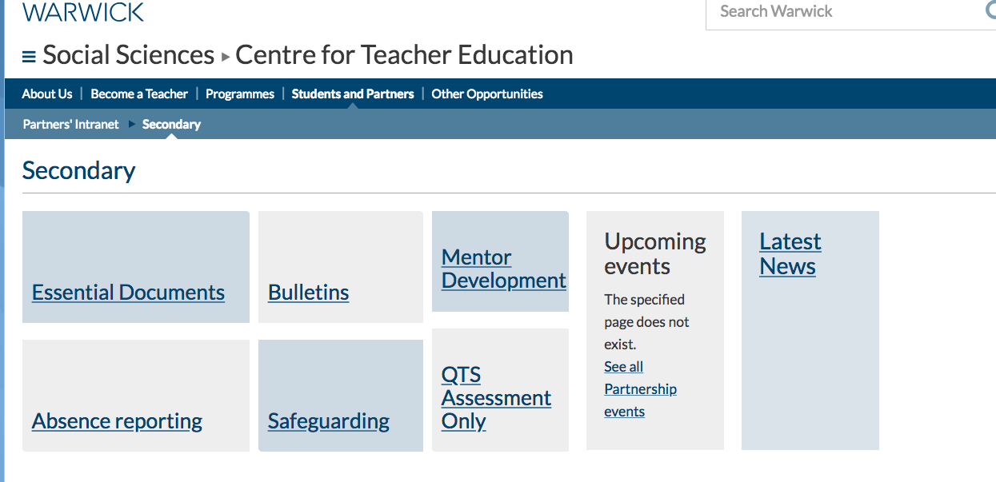
CTE’s Online Resource https://warwick.ac.uk/fac/soc/cte/students-partners/pintra/secondary/

Slide 13
Half Term | Where placement takes place | % of 4 days teaching | No of lessons based on 5 lessons per day
Autumn term 1 | Base School (SD)/PP1 (Core) | Observations and targeted reflections, some small group teaching or team teaching. Up to 70% of a teacher’s timetable | 13
Autumn term 2 | Base School (SD)/PP1 (Core) | Teaching Up to 40% of a teacher’s timetable | 7
Spring term 1 | Complementary Placement/PP2 | Observations and targeted reflections, some teaching or team teaching. Up to 70% (comprising 40% teaching) | 7
Spring term 2 | Base School (SD) PP2 (Core) | Observations and targeted reflections, some teaching or team teaching. Up to 60% of a teacher’s timetable | 11
Summer term 1 | Base School (SD) PP2 (Core) | Up to 70% | 13
Summer term 2 | Base School (SD) PP2 (Core) | Up to 70% Up to 90% (SDS)* | 13 16
* There is no provision at Warwick on Fridays for the last half term, so trainees are in school 5 days a week.
Notes:
Escalation of teaching – differentiate for routes – observation booklet – lesson plan template – with evaluation
Observation all year round – developing examination of practice – it takes a long time for trainees to be able to de-construct a teacher’s craft.

Slide 14
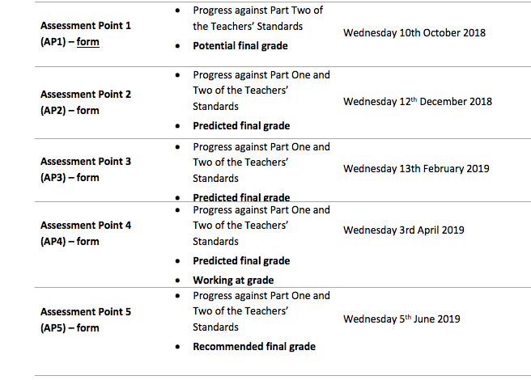
Tracking and Developing Progress
There are five main assessment points during the year, when trainee progress is
monitored and targets are set. The main details are as follows:
Notes:
Look at the 2 examples – statements need to reflect grades. Part 2 needs to be good/outstanding by the end of the course.

Slide 15
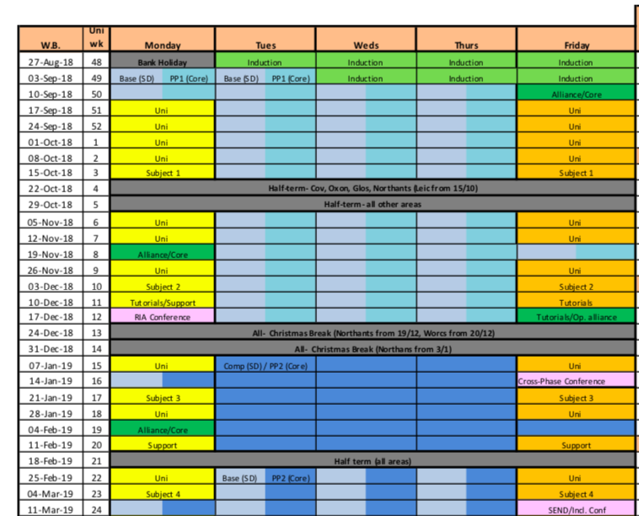
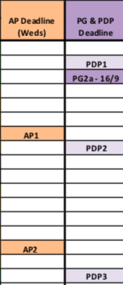
Aligning School CPD and University Provision

Slide 16
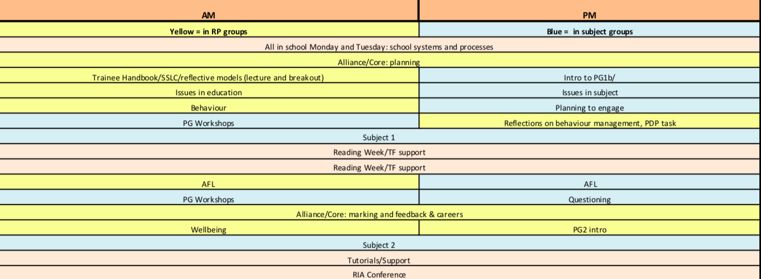
Aligning School CPD and University sessions (Autumn)

Slide 17
Professional Reflection
Trainee Slide
“Unless teachers develop the practice of critical reflection, they stay trapped in unexamined judgments, interpretations, assumptions, and expectations.
(Larrivee, 2000).
Notes:
Trainee presenatiton

Slide 18




Trainee slide
Purposeful reflection into Reflective practice
Notes:
We introduced the essence of reflective practice –

Slide 19

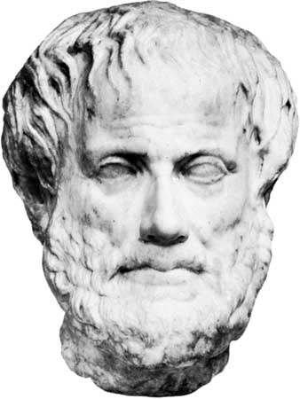
The successful mentor
Notes:
Can break down teaching expertise and combine it with theory

Slide 20
Stages of training matched to stages of learning
L e a r n I n g c o n v e r s a t I o n
Requires
improvement
developing
Good
Outstanding
Survival
Consolidation
Renewal
Maturity
Awareness of these stages of development
means support is appropriate and
beneficial to the trainee
Notes:
If you match where you think the trainee is in terms of the stages of learning it helps to shape the learning conversation.

Slide 21
Mentoring Conversations
Initial priority could be given to the Trainee’s self-reflection in order to ascertain the Trainee’s stage of development and an appropriate approach.
Tips for developing Reflective Practice in Learning Conversations
prompt the Trainee with questions
about the lesson
about the learning experience for the pupils
Open discussion with a question around pupil progress, perhaps?
avoid preconceived ideas
what you thought was a weakness may be a strength
and vice versa!
Notes:
Developing through learning conversations – 80 – 20 – reflective practice – questions not opinions – weight towards strengths – balance your critism – don’t tell them. Don’t change for TF visits – we come to see the same conversation – how you prompt the trainee to self reflective and developmental through your guidance
Steps of trainees experience

Slide 22
Opportunities to Engage
Termly Partnership Lunches, followed by Warwick and Secondary Partnership meetings
SD Alliance Days: opportunities to work closely with trainees in your Alliance, developing their potential though topical/thematic CPD.
Subject Hubs of Excellence: subject-specific content, co-designed and co-delivered by school departments, Warwick teaching fellows and Warwick academics.
Opportunities for experienced mentors to ‘buddy’ with new mentors coming into the Warwick partnership for the first time.
Research in Action Conference: share your action research projects with trainees, outlining ways in with engagement with PG-level reading and research has informed your department and school practice.
Careers Days: come to the Centre and conduct a series of one to one mock interviews with members of the cohort, or even offer advice and guidance on how to draft that winning application.
Partnership Conference – opportunity to contribute to delivery and learn best practice in mentoring and ITE activity: 20th June 2019.
Professional Studies lectures/seminars: present on a particular topic or theme (see calendar) aligned with your school’s or your own professional interests. Past highlights have included: SEND and Progress 8.

Slide 23
And finally …
Any further questions?
Contact me at the Centre:
Kate Hamer
Mentoring lead
kate.hamer@warwick.ac.uk

