Slide 1
Why do teachers quit and what can we do to keep them?
A tale of two pilots
Georgina Newton BA PGCE MA SFHEA

Slide 2
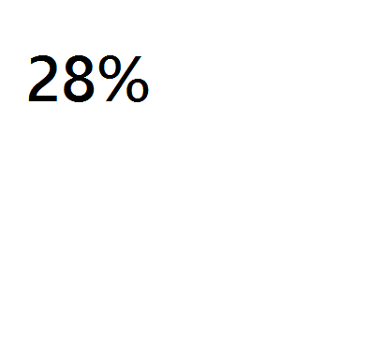
Findings
Already quit
Intend to quit
Intend to remain
What could have retained them?
What could cause teachers to want to remain?

Slide 3
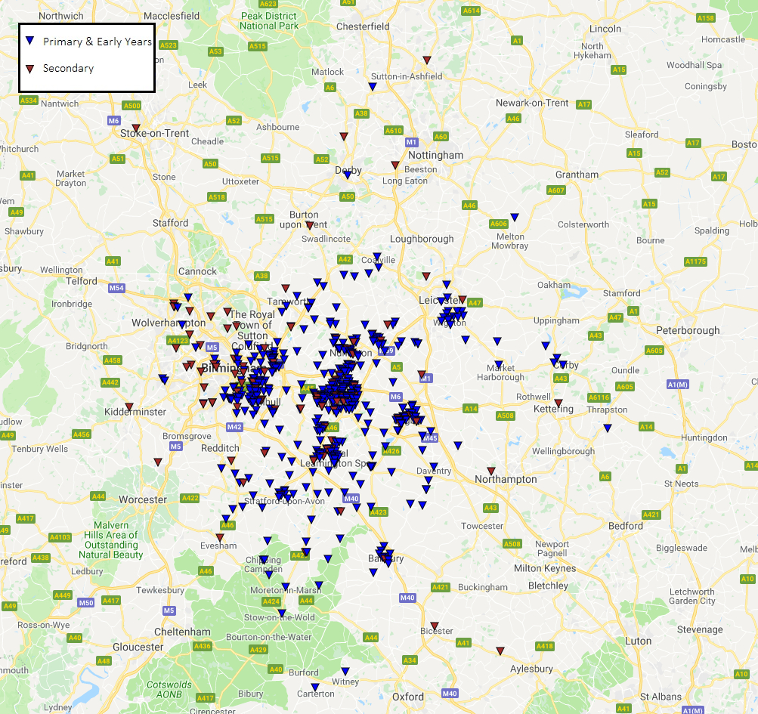

Slide 4



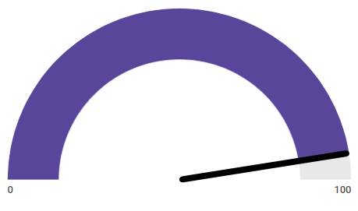


How are we doing?
Over
300
98%
Warwick teachers employed in local schools from 16/17
said staff are good at explaining things¹
95%
of our 16/17
trainees received
“Outstanding” or
“Good”
Staff are
enthusiastic about what they are teaching¹
(96%)
595
96%
schools
in partnership with Warwick
felt encouraged to ask questions or make
contributions in
taught sessions¹
¹ PTES Survey 2017

Slide 5
Of those who’d already quit
Their reasons for quitting were:
Workload (78%), disillusionment (48%)
Notes:
When asked for details about what contributed to the desire to leave, there was a distinction between “push” forces – making them want to actively leave teaching
And “pull” forces, attracting them to other professions. In the USA, pull forces have been noted to be becoming stronger, but in the UK, although on the increase, they seem relatively slight.
However, the words used most frequently by interviewees to describe the things pushing them out of teaching are as follows:

Slide 6
They could have been retained if:
They had received more recognition for their work (55%)
They had had more positive relationships with senior staff (32%)
Working hours were more flexible/could be reduced (29%)
Student behaviour was better (25%)
There was more consultation (23%)
A sabbatical/career break were available (19%)
Notes:
So we see that teachers felt unappreciated and that if that had been remedied effectively they might have remained
They want more positive relationships with senior leaders (could be connected to praise and recognition)
A significant number want more flexibility in working hours or a sabbatical/career break
And how much longer could they have stayed if these actions had taken place ….

Slide 7
How many years longer could they have stayed?
Notes:
And over 80% could have stayed in teaching for 2 or more years with 30+ % over 7 years.
Next I needed to find out about the teachers at risk of quitting in the next 2 years
…

Slide 8
What about those at risk of quitting in the next 2 years?
86% are female
52% aged 30-39
96% felt positive or very positive about teaching on entry to the profession
Notes:
And what was their level of experience

Slide 9
Experience level in years
Notes:
They have varying experience levels, in fact, you can see that the proportions are almost equal of those intending to quit in their first five years, years 6to 10 and 11 to 15.
If the hypotheses about teacher effectiveness being maximised by the 5th to 8th year of teaching hold true, a significant proportion of these teachers may have given up before they become highly effective.
This also speaks against previous thinking that teachers tend to remain committed for up to 12 years, when career restlessness sets in and attrition becomes more pronounced.
What were their reasons for wanting to leave

Slide 10
Their reasons for feeling like this are:
87% workload
60% disillusioned
56% management expectations too high
53% government policies
36% family/personal commitments
24% attracted by alternative careers (over half = better pay)
Notes:
And what actions could be taken to see them remain in the profession?

Slide 11
They could be retained if:
They received more praise and recognition for their work (51%)
“not just token gestures”
Pay progression was better (40%)
Working hours were more flexible (33%)
Student behaviour was better, there was more consultation, relationships with senior staff were better (20%)
Notes:
When asked where they would like more praise and recognition from, interview respondents pointed at the media, government and leadership teams
They talked about “bashing teachers” and ever-increasing management expectations
Increasingly they felt that teaching was falling behind other professions – in stature and pay
“You need SLT who are around the corridors, getting their sleeves rolled up, people with a much higher public profile, there .. for you to talk to and who you feel would actually listen”. Mr. O
One teacher says the main reason she left was that she “felt that nobody understood”.

