Slide 1
Teacher resilience and retention
Dr George Madine
Warwick and Schools Mentoring and Partnership Conference
21st June 2018

Slide 2
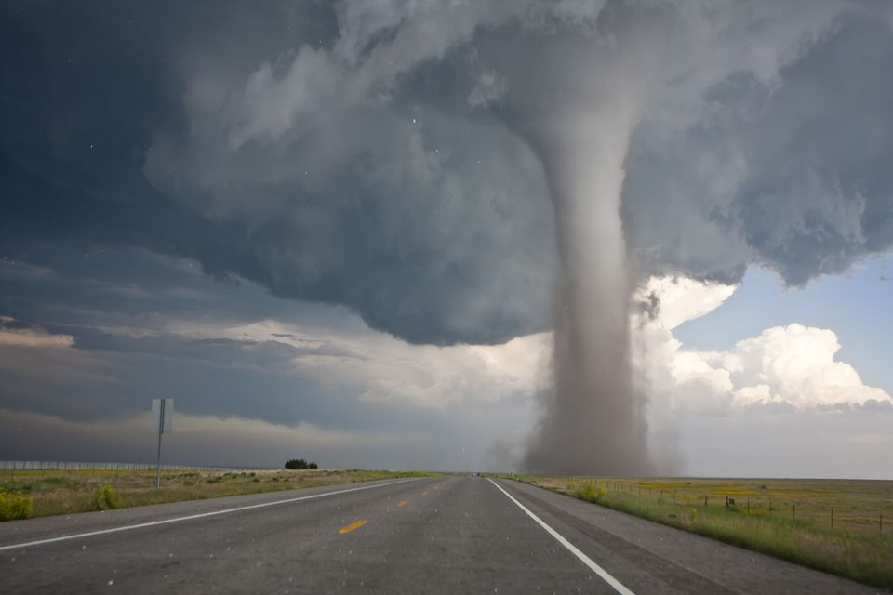
What I am not going to talk about

Slide 3
I am responsible for the retention element of the Bradford Recruitment and Retention project
cost

Slide 4
What is the retention problem?
Wastage is the number of teachers leaving the profession
Wastage rate was 10.5% of all teachers; the number of new entrants over the same period was only 10.0%
shortfall of 2700 teachers nationally
The numbers are skewed, in that Primary leavers were 10.2% of all teachers versus 10.8% for Secondary leavers: in other words the problem is greater in Secondary schools.
Shortage was unevenly distributed across subjects, with Maths, Science and English having the greatest number of unfilled vacancies.
Highest deprivation has relatively higher rates of wastage.
July 2017 DfE Annual update on workforce numbers

Slide 5
As part of the project we surveyed all 5929 teachers in Bradford
1421 Survey responses
906 Written response why teachers leave current school / the teaching profession
150 follow up interviews for detailed clarification

Slide 6
We found three key phases of retention
All with different set of solutions
‘buffet of solutions’

Slide 7
Source: School Workforce in England: November 2016, SFR 25/2017, 22 June 2017, Department for Education

Slide 8
Particularly interested in how the resilience of new recruits into teaching affected wastage
Resilience originates in the coping literature for stress
Resilience is a set of learnt behaviours to enhance coping
Used a purpose built resilience measure

Slide 9
Resilience of teachers versus NQTs

Slide 11
NQTs – correlation between resilience and intent to leave school / profession
Correlations
 |  | Resilience | Leave.school | Leave.profession
Resilience | Pearson Correlation | 1 | -.453** | -.566**
 | Sig. (2-tailed) |  | .000 | .000
 | N | 95 | 95 | 95
Leave.school | Pearson Correlation | -.453** | 1 | .415**
 | Sig. (2-tailed) | .000 |  | .000
 | N | 95 | 95 | 95
Leave.profession | Pearson Correlation | -.566** | .415** | 1
 | Sig. (2-tailed) | .000 | .000
 | N | 95 | 95 | 95
**. Correlation is significant at the 0.01 level (2-tailed).

Slide 12
If we can increase the resilience of NQTs we can reduce wastage
address their specific areas of low resilience

Slide 13
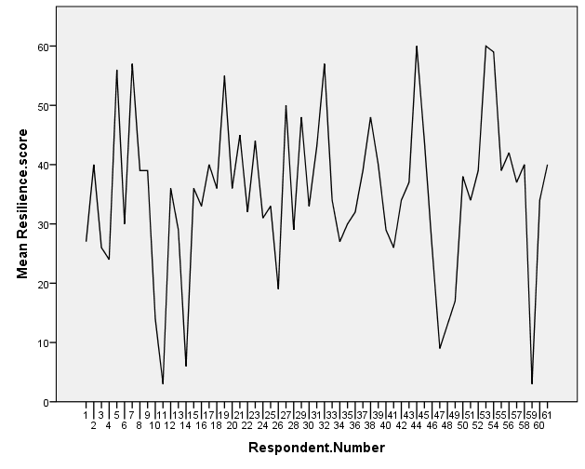
The resilience scores of entrants to Bradford SCITT
Average trainee score
Trainees scoring below this line would typically struggle with the pressures of teaching

Slide 14
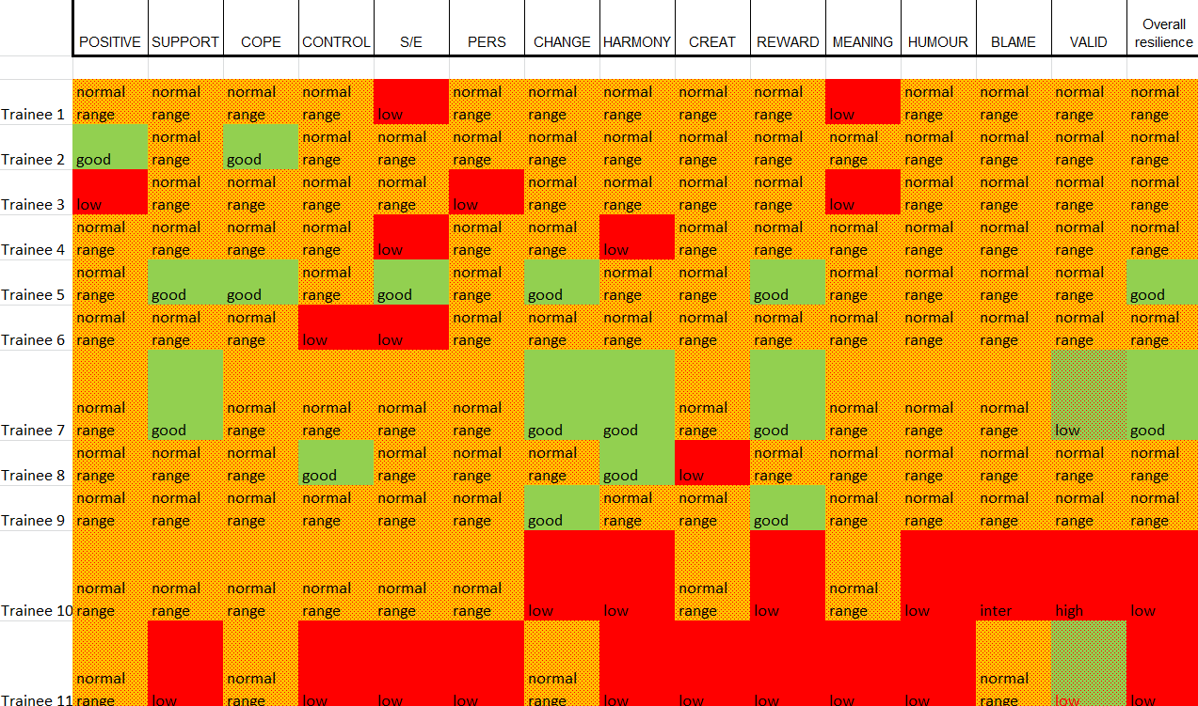
Traffic light profile for each teacher trainee

Slide 15
Approached Bradford University
Can we screen all graduates, who leave without a job, to be a teacher?

Slide 16
Have a measure that determines who will not just survive but thrive in teaching
Now picking only teacher trainees who are resilient i.e. who will stay in teaching
Across all subjects

Slide 17
27% of male teachers are second career teachers
15% of female teachers are second career
Over 70% say that they always wanted to be a teacher
1 in 6 teachers got into teaching ‘by accident’

Slide 18
Second phase teachers

Slide 19
Relative age of teachers

Slide 20
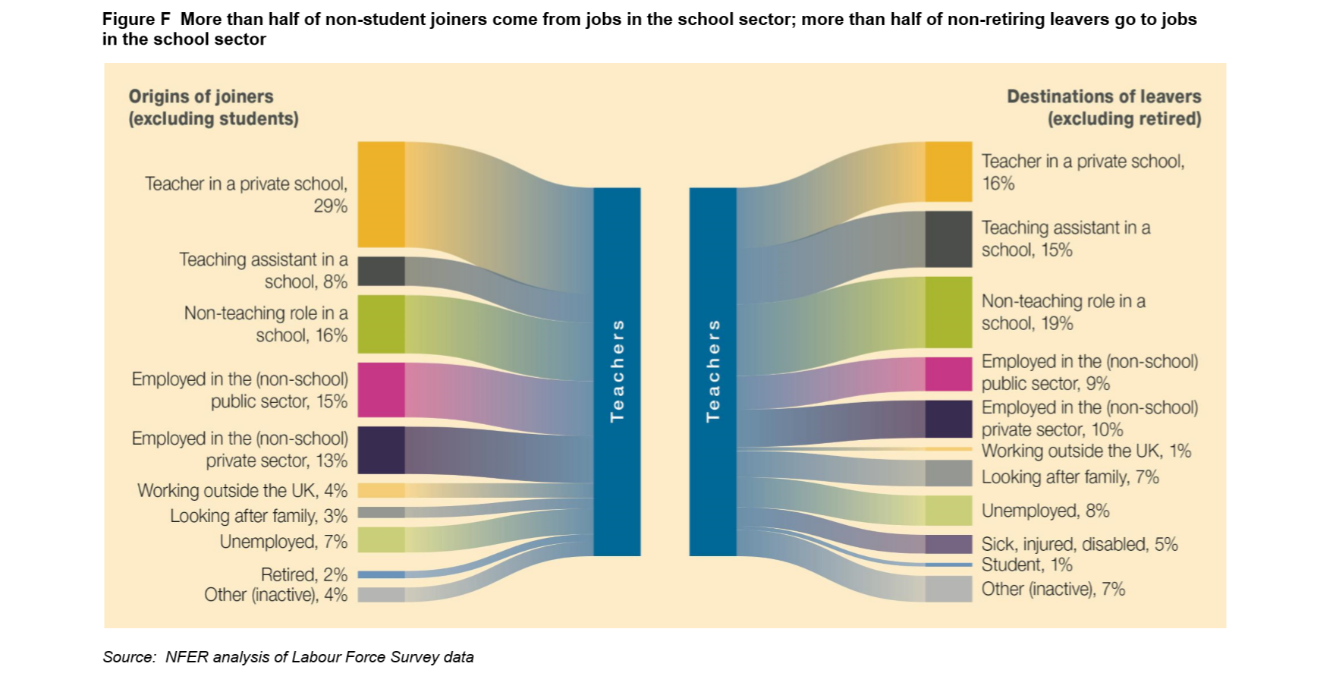
Where teachers go when they leave teaching

Slide 21
Part time / Job share
Issues with accountability, who is responsible for what?
training days and transfer of information
finding a suitable person to match the complementary loss of hours i.e. the ‘other’ half
cost, the anecdotal cost of two part time staff making up 1 FTE was estimated at 1.2 times the cost of the FTE post
The number of part time jobs is falling

Slide 22
Third phase

Slide 23
Resilience by age in Bradford teachers split by gender

Slide 24
Belief that you have support

Slide 25
Relative ability to accept change, based on the Bradford retention survey

Slide 26
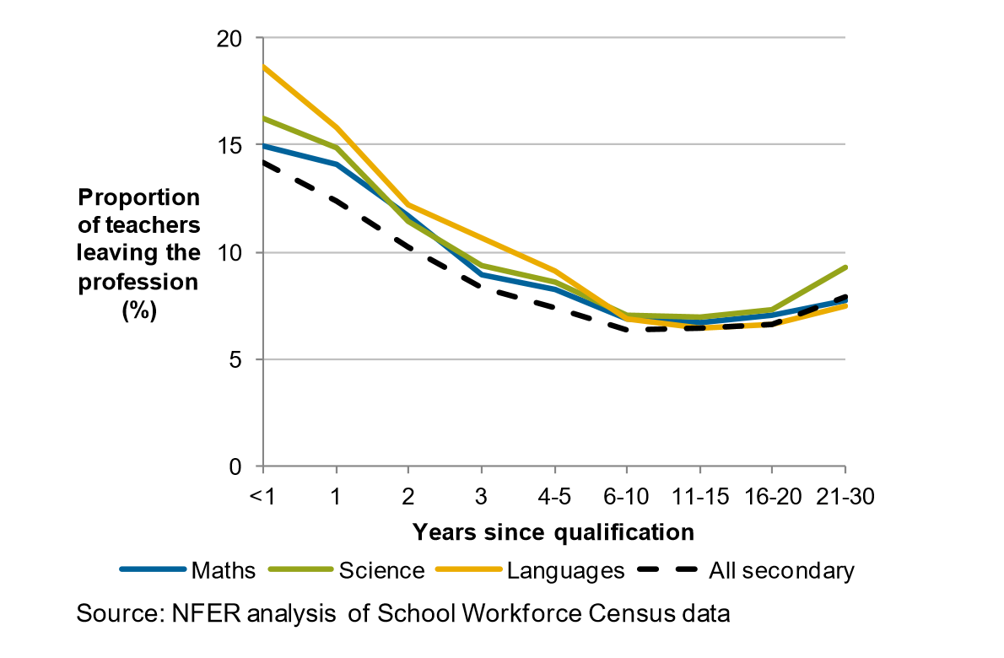
The proportion of teachers that leave teaching versus years of experience
Slight increase in leavers after 16-20 years teaching, more pronounced in Science teachers

Slide 27
The ‘love boat’
Neutralise by normalise

Slide 28
Summary
Resilient recruits
Partnership with Universities and colleges
Catch second career teachers earlier
The selfie generation
Part time / job share
Make it easier for returners
Older teachers

Slide 29

george@drgeorgemadine.co.uk
Tel: 07983 276186

