Slide 1
Mentor Training – New SMs Kate Hamer (Lead in mentoring Secondary ITE) Lindsay James (Caludon Castle school and outstanding subject mentor)
A mentor is a suitably-experienced teacher who has formal responsibility to work collaboratively within the ITT partnership to help ensure the trainee receives the highest-quality training”.

Slide 2
Aims
To understand the roles and responsibilities of the Warwick Subject Mentor.
To explore the ingredients required to be an effective subject mentor.
To consider what you want from the mentoring role.

Slide 3
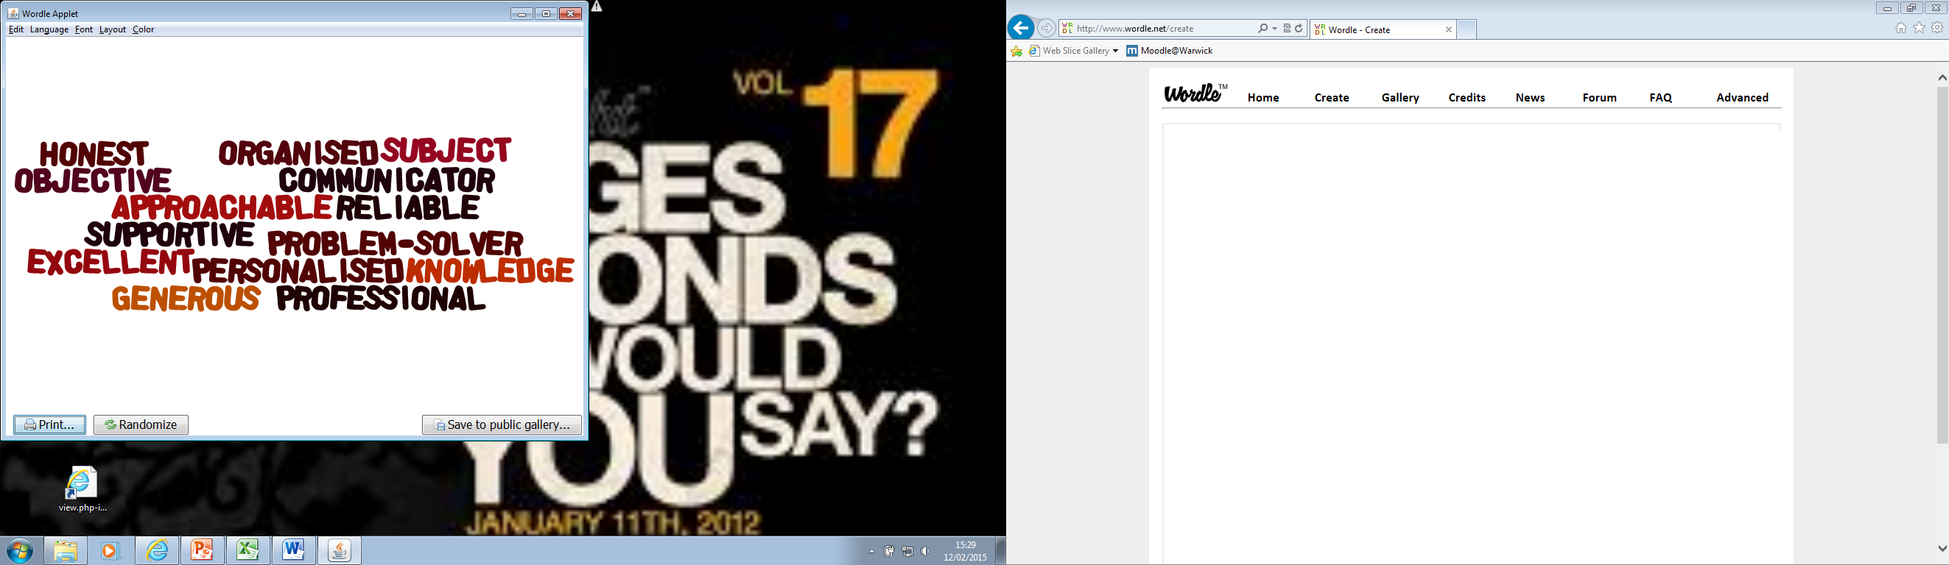
Mentors … What do trainees say about you?
Notes:
Some of the things trainees say. We have annual awards – 1 SM and 1PM award – nominated by trainees and eachother – award ceremony in Oct

Slide 4

Trainee
Mentor
Teaching fellow
Class teachers
Pupils
Theory
and research
Professional mentor
Family and friends
Reflective practice tutor
Fellow trainees
School colleagues
Notes:
All these will guide and shape the trainee however at the centre of this is the trainee/mentor relationship. This is the most important relationship for the trainee. It might not be the most important thing on your to do this and that needs to be carefiully handled and balanced for the trainee.

Slide 5

Notes:
How will this support/ guide your practice - self – audit – selection process – competencies -

Slide 6
Standard 1 - Personal qualities: Establish trusting relationships, modelling high standards of practice, and empathising with the challenges a trainee faces.
Standard 2 – Teaching Support: Trainees to develop their teaching practice in order to set high expectations and to meet the needs of all pupils.
Standard 3 – Professionalism: Induct the trainee into professional norms and values, helping them to understand the importance of the role and responsibilities of teachers in society.
Standard 4 – Self-development: Working in partnership to continue to develop their own professional knowledge, skills and understanding and invest time in developing a good working relationship within relevant ITT partnerships.
Mentors should use the standards to:
• understand what is expected of them and see that it is a manageable role;
• enable self-evaluation of practice and help identify areas for further improvement;
• support the delivery of the training plan; and
• induct trainees into the school and the profession
Notes:
Have a look through and discuss – these should be absolutely used to select/self select your readiness to be a SM/PM
The key is how you model professionalism – and that might need rexamining within your own philosophy as we get somewhat bogged down by the day to day demands – one of the first tasks trainees do is examine their philosophy of the teacher they want to be. Compassionate, curious, honest, respectful – moral and intellectual virtues or values. It would be interest may be to revisit our own philosophy and hope they go beyond resilience, perseverance and determination. What do we want to model for the trainees – an environment that requires resilience or one that invites curiosity, reasoning and reflection.

Slide 7
Lindsay James – Caludon Castle

Slide 8

Ingredients of an Expert Mentor
Approachable
Adaptable
Compassionate / Personable
A ‘Guide’
Reflective
Courageous

Slide 9

However…one size does not fit all!

Slide 10

Case Study A – The ‘Resistant’ One
Characteristics
Approach
Disengaged during feedback
Agrees with everything you say!
Aggressive questioning
Disinclined to make suggested changes to lesson plans
Encourage self reflection through questioning during feedback.
Give a clear set of targets that are measurable – this means that they have to follow through with actioning them – not just agreeing at the time.
Don’t be scared to have a courageous conversation with them about their attitude – never forget that you are the expert!
Set strict deadlines for suggested changes to be made.
Be a coach – often the resister will need to be ‘coached’ into a different way of thinking – be patient: they will have an opinion that they need to voice – listen to it, acknowledge it and guide them to alternative points of view.

Slide 11

Case Study B – The ‘Disorganised’ One
Characteristics
Approach
Start small – can you help them create a systematic approach towards their training year.
Don’t let them take on too much – ensure that they are on top of their workload before they take on additional tasks.
Put the emphasis on them to make notes during mentor meetings / feedback – this way they have no excuse for forgetting anything.
Give them an area to keep their belongings/paperwork in - it is their responsibility to keep this area tidy.
Set strict time boundaries – i.e. if they have a lesson after lunch, set an expectation of what time you want them to go to the classroom.
Flustered
Agrees to everything…good intentions
Often misses a deadline
Doesn’t make notes
Messy!
Always in a rush when there has been plenty of time.

Slide 12

Case Study C – The ‘Needy’ One
Characteristics
Approach
Need for constant reassurance
‘flitting’ about
Emails out of work hours
Unable to find positives in their lessons
Asking for additional mentor meetings
Demonstrate that you are compassionate person and be willing to reassure them. They will need this when they are in their survival stage!
At the same time, they need boundaries…we are all busy – you need to ensure that you look after yourself as well as time. Have set time slots to see them in during school hours and limit the hours you are willing to communicate with them in the evening/weekend.
Have feedback rules – they have to come up with at least one ‘what went well’ and one ‘even better if’. Start small and build them up – they will soon be recognising their strengths and growing in confidence.

Slide 13

Case Study D – The ‘Laid Back’ One
Characteristics
Approach
Outwardly calm
Leaves tasks to the last minute
Slow to implement suggested changes
Can sometimes struggle with behaviour
Short regular check in’s to make sure that they are update with their tasks throughout the week.
‘Triangulate’ with them – ensure you are on top of all of their university tasks and deadlines and make they are building in time to complete them on top of their school commitments.
Short deadlines – if changes need to be made then make sure they have to send them back to you quickly i.e 24 hour turnaround
Make sure that they are aware of school expectations for behaviour. If the ‘laid back’ attitude creeps into the classroom then it can lead to lesson disruption. Support them to have structures in place.

Slide 14

Of course, you could end up with an amalgamation of them all…
And you might just need to mix up the layers of your cake!
Contact: stjamesl@caludoncastle.co.uk

Slide 15
Stages of training matched to stages of learning Helps to explain the trainee’s actions and reactions
Survival
Consolidation
Renewal
Maturity
Awareness of these stages of development
means support is appropriate and
beneficial to the trainee
Notes:
Explain that this is a framework representing the development of BSTs.
During AP1 they are likely to be in the first two stages – many will display some aspects of each stage
Some will jump over the ‘survival’ stage quickly, others wont. However we must not give up on them – we must give them time to develop
I wont dwell on these however when you receive the PPTs after the conference there are additional slides to support how you might guide a trainee through these stages. What is important is quickly understanding which stage they are at in order to provide the most effective support. You may find that at points they dip. A core trainee going into second placement, may well go back into survival mode.

Slide 16
Survival
Characteristics (of a trainee in this stage of development)
Coping – day by day
Self – completely self focused
Blame – the context, the children
Confusion – no clear rules and routines
Script – keeping to script – not aware of children’s lack of engagement
Doubts –
‘Can I get to the end of the week?’
‘Can I really do this day after day?’
Mentoring (skills and training used by the mentor)
Clear guidance
Specific suggestions
Sharing resources
Multiple options
‘Try this – if it doesn’t work, then try this
‘This is what I would use – you try it and then we’ll talk’

Slide 17
Consolidation
Characteristics
Implementing rules and routines
Beginning to question –
‘Should I try it this way?’
Focusing on individuals and groups – but not yet managing all the children,
e.g. SEN, G&T, EAL, etc.
Mentoring
Encouraging the trainee to have a go – being there to support them
Joint exploration and teaching
Exchanging ideas and exploring resources
Encouraging them to talk to other trainees and colleagues
Reviewing documentation and children’s specific needs

Slide 18
Renewal
Characteristics
Routines now embedded – but sometimes boring!
Mastering a range of strategies
Self-critical - striving to improve
Self-motivated – offering suggestions – designing resources, organising after-school clubs,
Questioning –
‘Do you think I should….?’
‘I’m not sure that works for me’
Mentoring > coaching
Listening
Questioning
Allowing them to take chances, make mistakes and reflect on what might have worked
Letting them explore beyond the classroom and the school

Slide 19
Maturity
Characteristics
Developing own beliefs, teaching style and strategies
Asking deeper questions –
‘How can I …….’
‘I’m not sure that’s the best
solution for….’
Exploring wider examples, opportunities, views, etc.
Rearranging the classroom
Coaching
Use of coaching conversations
‘What would you like to achieve
this week?’
‘What areas/targets would you
like to work on this week?’
‘Why do you think that worked?’

Slide 20
Role of the Subject mentor
Expectations of the role
Not expected of the role
Induct trainee into the department, including departmental resources/exam specs/SEN/grpings etc.
Explain whole school and departmental policies including behaviour and improvement plan
Provide a balanced timetable
Complete a weekly formal observation using the LOP followed by a POD
Complete a one hour weekly trainee-mentor meeting aligned on the timetable. – trainee completes the form for this.
Maintain a training record across the placement
Complete all assessment points using the WADs – 5 across the year.
Liaise with the complementary(SD) or second placement(core) subject mentor for a smooth transition
That trainees will replicate the job you do
Take on a tutor group
Do a daily/weekly duty
Do all your marking for you
Write school reports
Respond to emails late a night (for the next day)
Notes:
All these do happen and these are the things that cause tension – a over zealous mentor changing lesson plans late a night for the trainee who is teaching it the next day. Giving the trainee a set of exam papers to mark, expecting trainees to write the reports for the class they have taught all year. Trainees are learning their craft so sampling these activities are excellent, alongside how you complete them – even in a non-sustainable way – the trainee might be able to help here through research and peer reflection on processes. We know there are challengesin teaching around workload however if we consider how we are modelling professionalism is it resilience and dtermination we want trainees to focus on?

Slide 21
Provide a balanced timetable
Half Term | Where placement takes place | % of 4 days teaching | No of lessons based on 5 lessons per day
Autumn term 1 | Base School (SD)/PP1 (Core) | Observations and targeted reflections, some small group teaching or team teaching. Up to 70% of a teacher’s timetable | 13
Autumn term 2 | Base School (SD)/PP1 (Core) | Teaching Up to 40% of a teacher’s timetable | 7
Spring term 1 | Complementary Placement/PP2 | Observations and targeted reflections, some teaching or team teaching. Up to 70% (comprising 40% teaching) | 7
Spring term 2 | Base School (SD) PP2 (Core) | Observations and targeted reflections, some teaching or team teaching. Up to 60% of a teacher’s timetable | 11
Summer term 1 | Base School (SD) PP2 (Core) | Up to 70% | 13
Summer term 2 | Base School (SD) PP2 (Core) | Up to 70% Up to 90% (SDS)* | 13 16
Of 13 the trainee teaches 7
Of 13 the trainee teaches 11
Of 13 the trainee teaches 13
* There is no provision at Warwick on Fridays for the last half term, so trainees are in school 5 days a week.
Notes:
Escalation of teaching – differentiate for routes – observation booklet – lesson plan template – with evaluation
Observation all year round – developing examination of practice – it takes a long time for trainees to be able to de-construct a teacher’s craft.

Slide 22
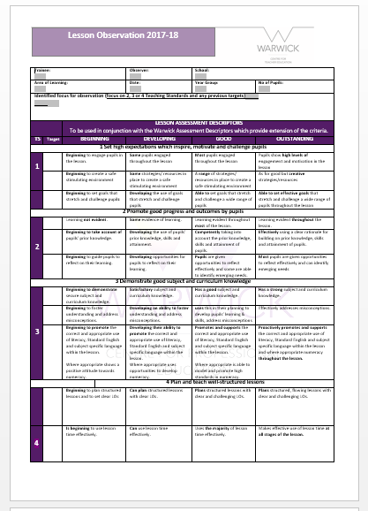
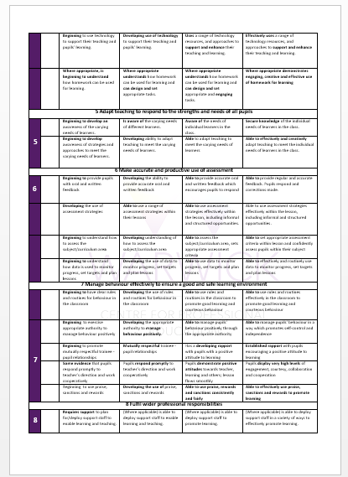
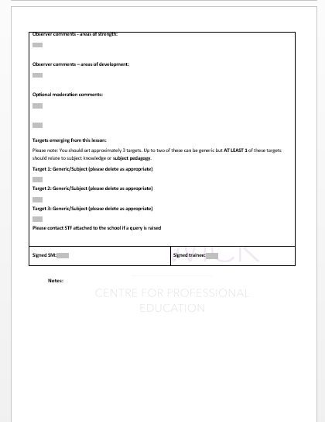
Key role is subject development
Knowledge and pedagogy
Complete a weekly formal observation using the LOP followed by a POD

Slide 23
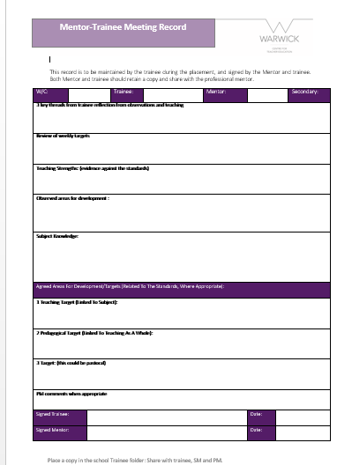
Complete a one hour weekly trainee-mentor meeting
aligned on the timetable.
trainee completes the form for this.
This is the opportunity to reflect:
“Unless teachers develop the practice of critical reflection,
they stay trapped in unexamined judgments, interpretations,
assumptions, and expectations.
(Larrivee, 2000).
Reflective practice module
Notes:
Trainees undertake a reflective [ractivce modelue where they reflect on professional practice in different ways – through their own practice, through others’ case studies/narratives, through research, through observations – as mentors we need to coach for trainee refelction through questioning and model this in our own practice. Ideas might include trainees reflect on your lesson. You teaching their lesson plan and reflecting on what worked and what did not. You planning a lesson nad trainees teacjing this and so on. Be creative outside of the formal observation. Allow the trainee to fail.

Slide 24
Training Record (School)
For every Trainee, the School must maintain a training folder or file (electronic), in which are stored the following documents:
Copies of any prior assessments e.g. AP forms
A copy of the trainee’s timetable
Copies of the day by day timetable, observations, pupil tracking, meetings, opportunities to review progress
Copies of all lesson observations made by Mentors and University Teaching Fellows
Copies of the log of Weekly Mentor-Trainee Meetings
Copies of correspondence and memoranda relating to the Trainee
Access to Trainee’s PDP (invited by trainee – share secret URL)
Maintain a training record across the placement
Notes:
Need to be capturing these types of activity – folder/ e-folder – partic helpful for interventions – you run SD we run CORE – paper trails crucial if we want people off course. Accountability measure – competence – it is important that we have the ability to remove people as we really don’t want them affective pupil outcomes.
Email correspondence – professional – realistic times – Case study – 10.30 at night for the next day - tracking emails. – fitness to practice, continuation of registration committee.

Slide 25
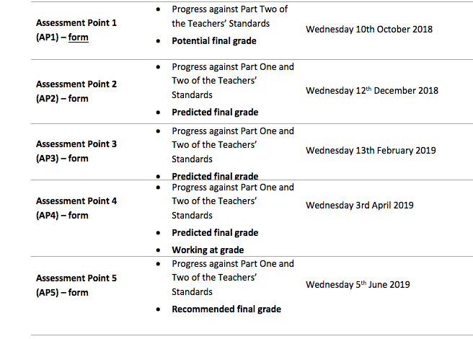
Tracking and Developing Progress
There are five main assessment points during the year, when trainee progress is
monitored and targets are set. The main details are as follows:
USING THE WADS
Notes:
Look at the 2 examples – statements need to reflect grades. Part 2 needs to be good/outstanding by the end of the course.

Slide 26
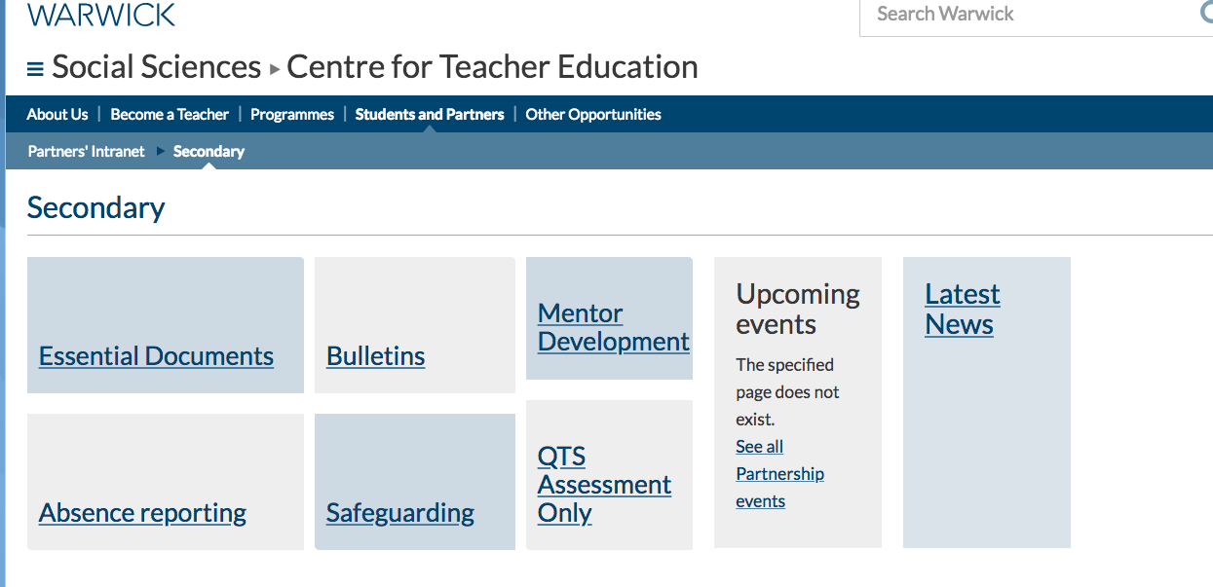
CTE’s Online Resource https://warwick.ac.uk/fac/soc/cte/students-partners/pintra/secondary/

Slide 27
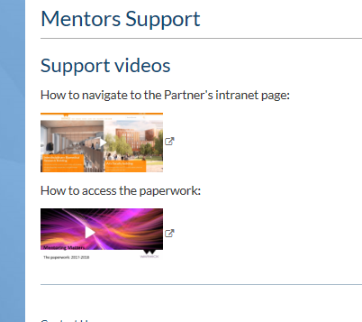
Podcast to take you through the paperwork

Slide 28

What do you hope to get from being a mentor?
Notes:
This might be a good starting point to consider – what is/was your philosophy. What are you modelling in your own classroom with your pupils and therefore the trainee. What do you want to get from this year. You may end up with quite a list.

Slide 29
A mediocre mentor gives feedback
A good mentor creates dialogue
A great mentor facilitates a learning conversation
S Walton, Head of Warwickshire School Improvement Services uses the term “coaching with edge” (Beere, 2013)
to describe a conversation containing critical challenge which promotes honest self-reflection

Slide 30
Socrates was an exponent of deep questioning, and critical debate.
Applying this principle to coaching where the coach is truly curious
and does not already know the answer has been shown to
provide superlative results (Bell, 2013)
Successful coaching extracts the best out of individuals on
both sides of the dialogue (Gallwey, 2009)
and therefore results in reciprocal benefit (Cohen, 2011).
Mentoring as a broad concept is changing, and is increasingly being
‘associated with collaboration...working together and not just working with’
Lofthouse 2015
“owning the change” is the most important hallmark for
the [train]ee (Garver, 2008)

Slide 31
Encourage experimentation and creativity
Like success, failure is many things to many people.
With Positive Mental Attitude, failure is a learning experience, a rung on the ladder, a plateau at which to get your thoughts in order and prepare to try again.’
W. Clement Stone.
Some models have moved beyond goal-setting and focus upon experiencing the
richness of learning that comes from experimenting, reflecting and analysing (Megginson, 2012)

Slide 32
Transformational learning
Mentoring at its best ………..
……is about becoming open to possibilities and perspectives
by critically reflecting on one’s experiences together

Slide 33
Thankyou for choosing
to be a mentor
Any questions: kate.hamer@warwick.ac.uk

