Slide 1


Preparing Trainees to Plan
Fundamentals of planning for trainees in the early stages of training.
Emerging issues as trainees gain in confidence with planning.
Planning for the more confident trainees
When is a plan not a plan? Moving forward into the NQT year (strong planning principles for a long and successful career).
Stacy Howe.
Lead Practitioner in English and accredited Specialist Leader in Education.
Notes:
Short sharp

Slide 2
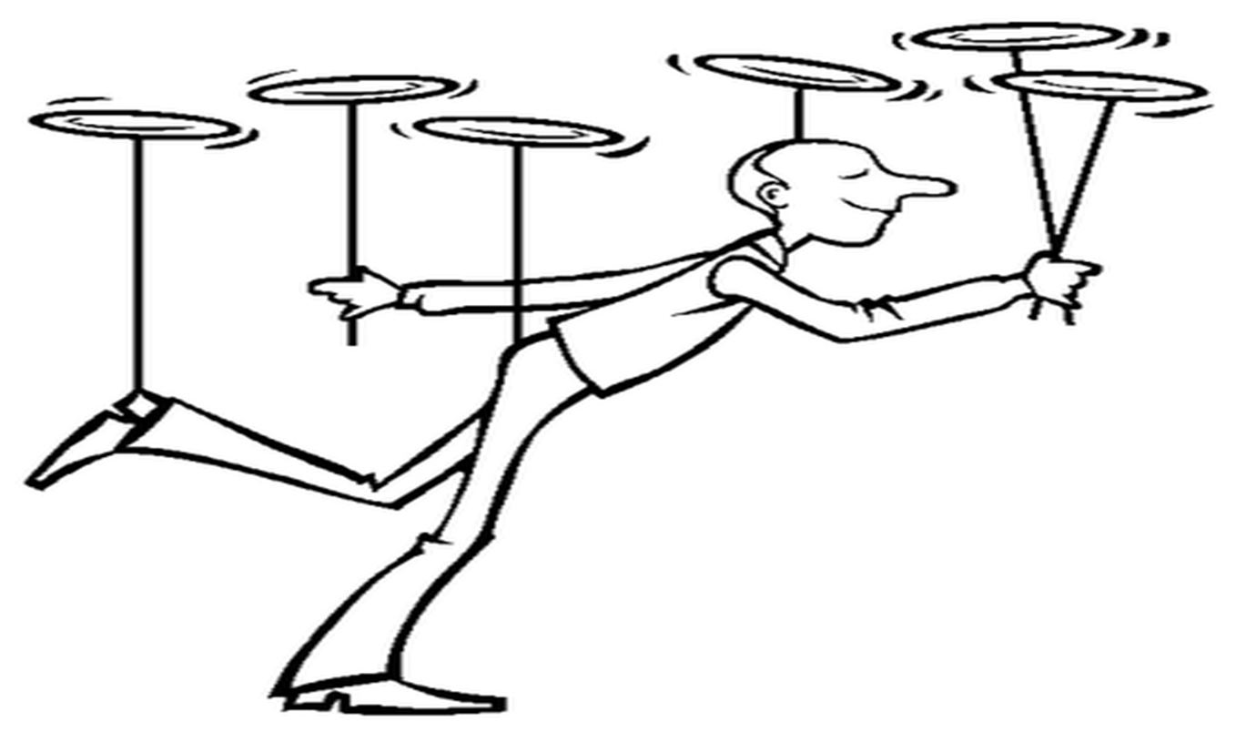

Just like spinning plates takes
Discipline
Practice
Experience
Motivation
Resilience
So too, does planning!
In September, our trainees often feel like this.

Slide 3


Stretch/
Challenge
Engagement
Assessment
Learning routines
AFL
Differentiation
Organisation?
And that’s not including Subject Knowledge, wider school involvement, tutor roles, and parental contact.

Slide 4
Engagement
Stretch/
Challenge
Assessment
Learning routines
AFL
Differentiation
Subject Knowledge
Organisation.
Not all plates can be spun at once.
Start with the basics of planning and then build from there.

Slide 5
Stretch/
Challenge
Engagement
Assessment
Learning routines
Differentiation
AFL
Subject Knowledge
Organisation.
Greens are our non-negotiables.
Ambers will follow on once basics are established.
Reds come with confidence/knowledge of classes.

Slide 6

If we were to predict the ‘Usual Suspects’ of issues with planning for trainees, what are they?

Slide 7
The Usual Suspects
Pitch- too low or high
Expectation
Lack of detail
A series of tasks
Incoherence
Teacher led
Creative but purposeless
Pace

Slide 8
So how do we enable our trainees to plan lessons at the start of their training year?
Notes:
So how do they link? How are they different?

Slide 9

Plan
Teach
Reflect

Slide 10
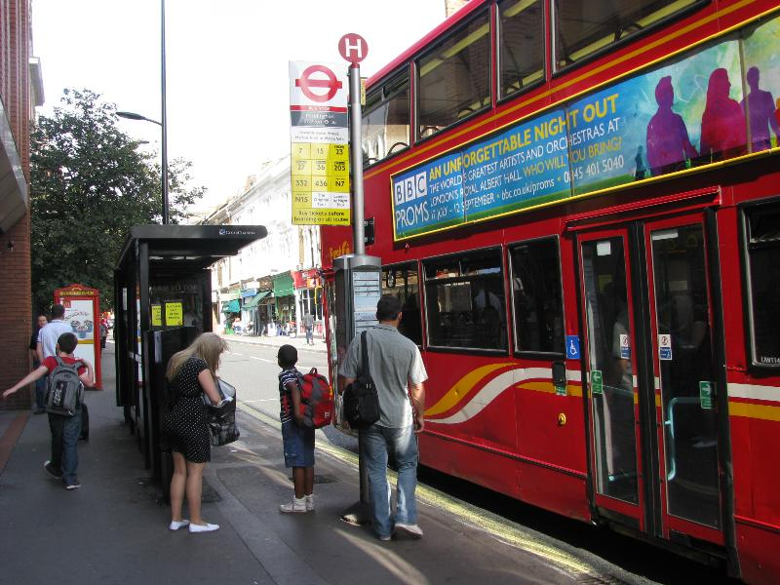
It all begins with understanding the journey of learning.

Slide 11
It all begins with understanding the journey of learning.
What do the pupils already know?
Where is the destination of the learning?
What ‘stops’ are available for them to get off at?

Slide 12
It all begins with understanding the journey of learning.
What do the pupils already know?
Where is the destination of the learning?
What ‘stops’ are available for them to get off at?
Prior Knowledge. Pitch of the lesson.
Learning Objective (Skill/Knowledge)
Learning Outcomes
(Measuring Progress)

Slide 13
How do we get trainees to explore the journey?
Joint-planning with SM and other colleagues.
Observing colleagues, focusing on the journey.
Looking at progression across exercise books
Understanding Skills (Blooms/SOLO).
Plan a week ahead so they plan series of lessons, not lessons in isolation.
Reflection.

Slide 14
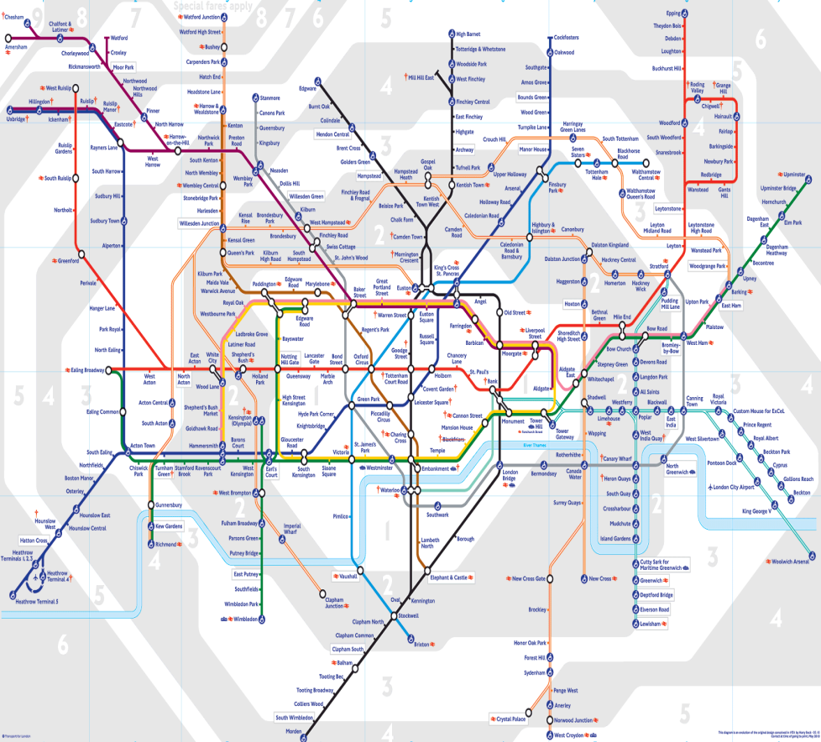
But, they must appreciate a journey goes beyond a lesson…
How does this fit into the scheme of work?
How does this fit into the long term plan for the year?
How does this fit into the journey from KS3 to GCSE examinations?

Slide 15
What should trainees do with Schemes of Work?
Understand the summative assessment: what is the end destination? What skills/knowledge are needed to enable success in it?
Track how key skills are developing across weeks
Consider: To what extent is this suitable for my class? Do they need it all? Is there anything to add?
Encourage trainees to think a half term ahead!

Slide 16
How do we get trainees to engage with the whole journey?
Exploring and adapting schemes of work.
Meeting with KS3 and KS4 leads (if possible) to talk through the curriculum rationale.
Asking trainees to plan a scheme of work (post Christmas)

Slide 17

Routines, not Behaviour Management.
Getting to know pupils
Seating Plan
Starts/Ends
Feedback
Rewards system
School policies
Consistency is key!

Slide 18

Subject/Curriculum Knowledge
Career long target
How are our trainees preparing for schemes of work/lessons?
Have they quality assured their resources for literacy?
Have they planned their questions for each lesson? Which skill is it? Which ability pupil is it best matched to?
Do they know how this is being assessed and how to be successful?
Be half a term ahead!

Slide 19
What issues can emerge as the year progresses?
Notes:
So how do they link? How are they different?

Slide 20

Inconsistency
Lack of reflection
Work/life balance
Rigidly adhering to lesson plans
The impact of a complementary placement
Poor planning/organisation

Slide 21
Inconsistency: Changing routines/stale seating plan/'safe’ lessons
Lack of reflection: Not evaluating as routine/being unwilling to take on feedback.
Work/life balance: Trying to reinvent the wheel
Rigidly adhering to lesson plans: Playing it safe/unwilling to ‘read the room’.
The impact of a complementary placement: Change of style/expectations/mentor
Poor planning/organisation: plans are not detailed/loose. Plans are being sent late the night before.

Slide 22
How do we address these issues?
Insist on new seating plans every half term and monitor the ratio for praise/sanction
Encourage trainees to create the agenda for the mentor meeting. What do they want to reflect on?
Insist that all mentor meetings begin with a reflection on a key group/lesson.
Encourage collaborative work with other colleagues.
More focus on AFL- ‘Read the room’. Emotions/attitudes of the pupils: what is this telling them? What can they do about it?
Reflection of complementary placement: lessons, progress, transference.
In the initial stages, planning is sent a week ahead and quality assured by you as mentor.

Slide 23
How do we encourage more confident trainees?
Notes:
So how do they link? How are they different?

Slide 24

Let go of the reins a little…
Allow them to more fully adapt schemes of work, rather than using them as a crutch.
Encourage creativity in the style of delivery: how can the pupils lead more on learning? How can they take risks in their planning?

Slide 25

Encouraging them to be like water…
If it is on the lesson plan, is it mandatory?
Adaptable
Reshapes
Reacts to surroundings
If it is not on the lesson plan, does that mean it does not matter?

Slide 26
How do we know they are NQT Ready?
Notes:
So how do they link? How are they different?

Slide 27

How do we know they are NQT Ready?
Sense of Balance
Individual Ethos
Engrained Reflection
Direction
Presence
Ownership
Notes:
So how do they link? How are they different?

