Slide 1
How to address the workload challenge and thrive Deborah Roberts and Georgina Newton
Sustainable Teaching
Notes:
GN

Slide 2
Objectives
To understand the policy position on workload
To evaluate trainee workload initiatives
University
School
To prioritise individual action to address our own workload issues
Notes:
GN - 5

Slide 3

The Guardian, 22nd March 2016
Notes:
DR: Responses to research and surveys that implicate workload as a factor in teachers leaving the profession.
The same is also true for trainees.
2014: Govt initiated a ‘Workload Challenge’ survey; ran for about 1 month on the TES website.
2015: Workload Challenge: Analysis of teacher consultation responses Research report February 2015

Slide 4



Why?
AIM: to ensure quality provision enabling pupil progress, whilst developing the skills of new entrants to the profession in a sustainable and manageable way.
Notes:
DR

Slide 5

Notes:
GN – 10
On a scale of 1-5
How successfully do you think you’re managing your workload to enable a work/life balance?
Personal manifesto

Slide 6
Some introductions
Who are you and what’s your role?
Notes:
GN - 5

Slide 7
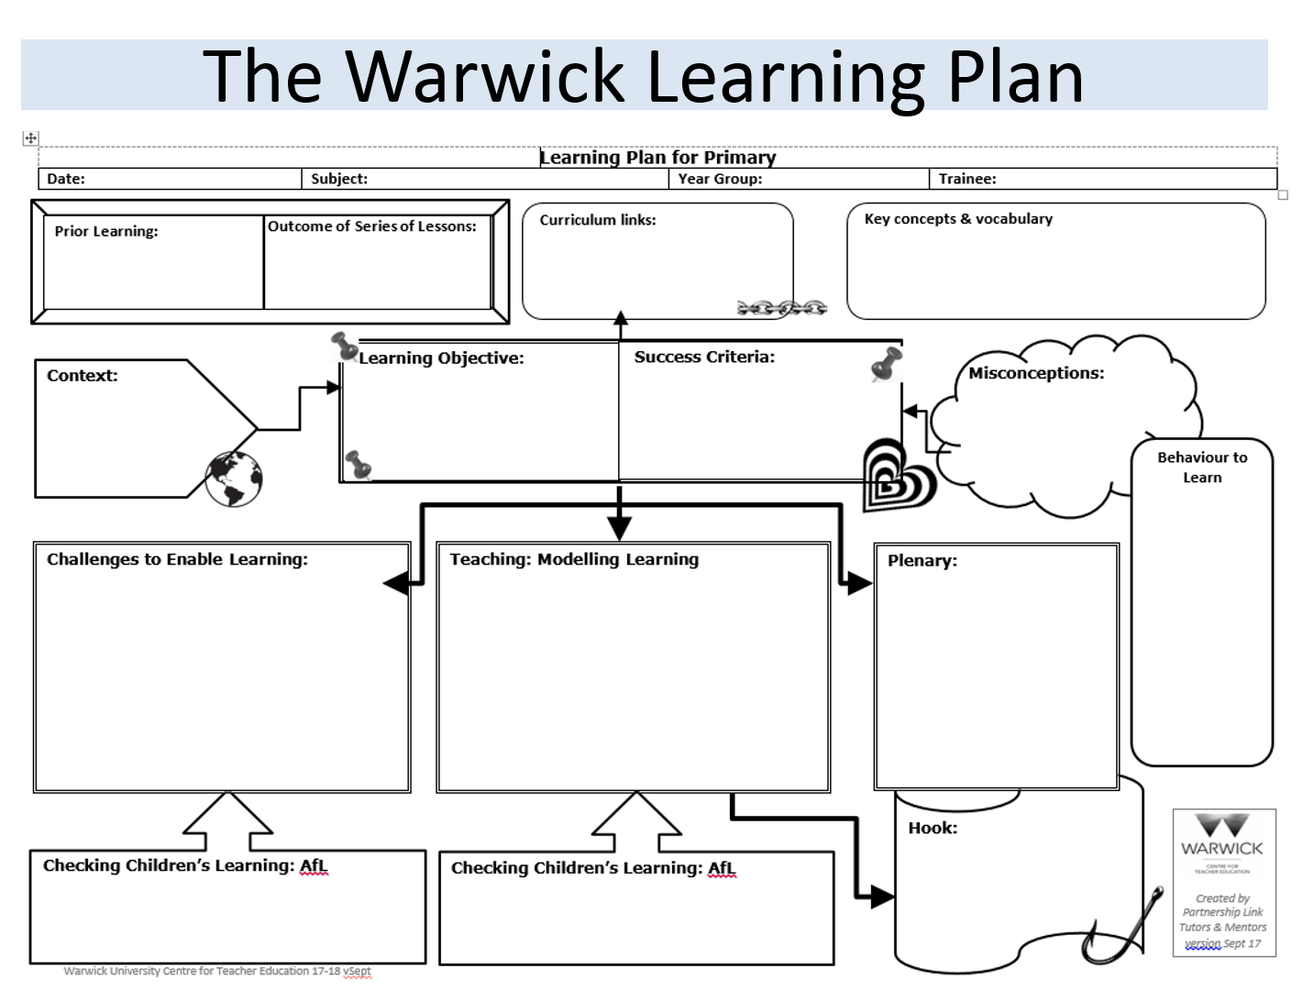



Reducing workload: Primary
University
Awareness raising
Lean lesson planning
School
consultation
Mentor training
Well-being
Programme review
Embedding guidance
Notes:
DR - 7
Mention IATL bid/project

Slide 8
Reducing workload: Secondary
6
tasks of 500 words each
36
sub-headings of the Teachers’ Standards to upload evidence for
Notes:
GN – 3
Reduction in PDP requirements
Reduction in tasks for taught sessions
Guidance in handbook is more thorough

Slide 9
Reducing workload: Secondary
No requirement for these unassessed tasks
12
Subject studies and reflective practice tasks
Notes:
GN – 3
Reduction in PDP requirements
Reduction in tasks for taught sessions
Guidance in handbook is more thorough

Slide 10
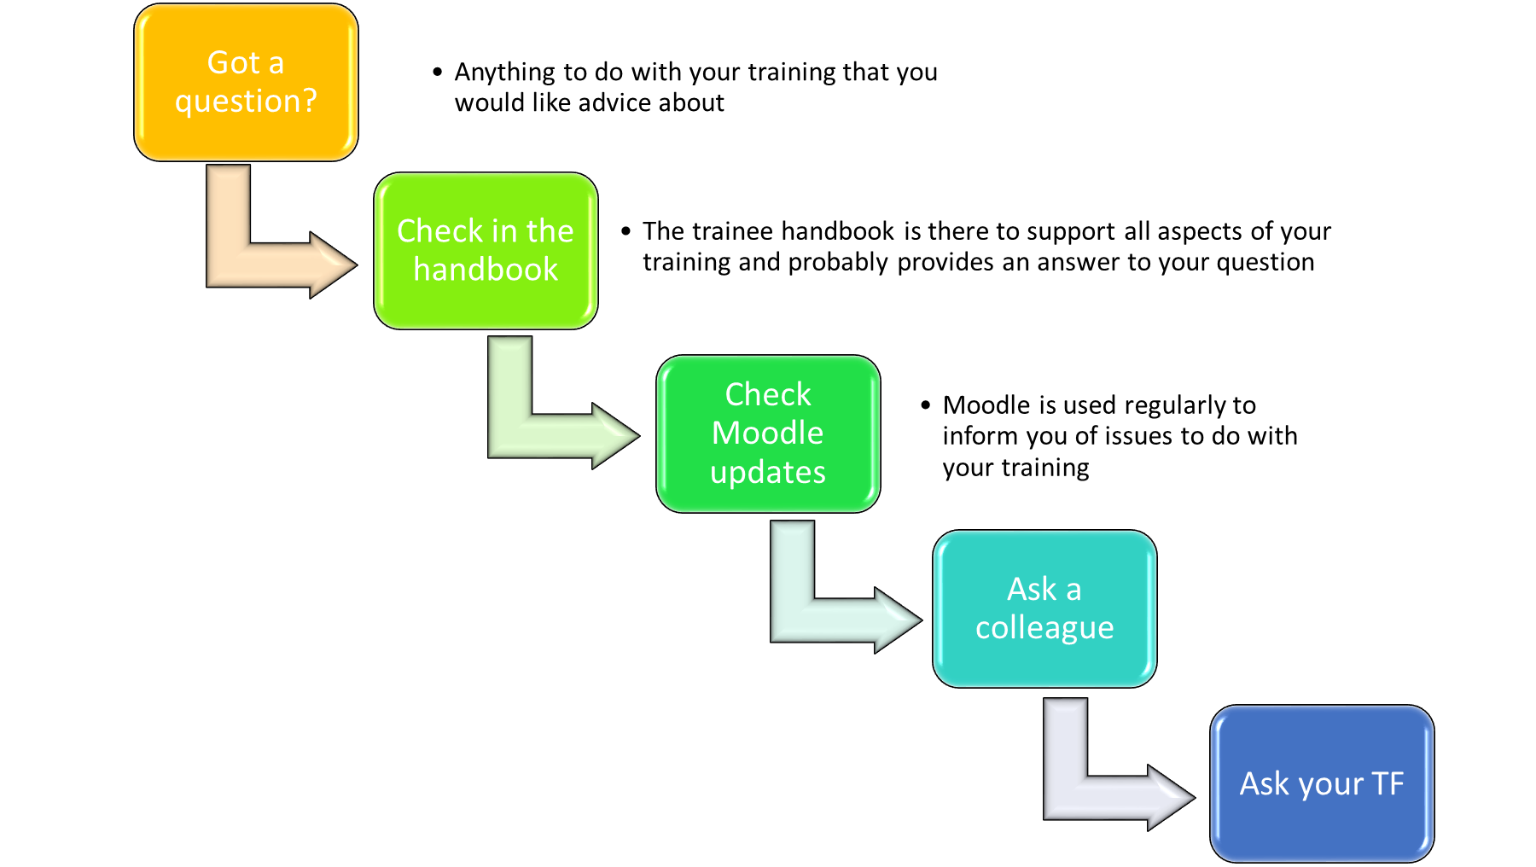
Page 25 of HB

Slide 11
How effective are these methods?
Do we need to make other changes?
At school?
Notes:
DR- 8

Slide 12
Notes:
GN - 10
Personal manifesto

Slide 13
Objectives met?
To understand the policy position on workload
To evaluate trainee workload initiatives
University
School
To prioritise individual action to address our own workload issues

