Slide 1

The Mentoring and Partnership Conference: Design Thinking
Dr Bo Kelestyn FHEA & Dr Robert O’Toole NTF
bo.kelestyn@warwick.ac.uk
robert.o-toole@warwick.ac.uk

Slide 2


Slide 3
About us
Interdisciplinary Design Thinking module
Former Warwick students
Specialise in digital innovation
Passionate about student experience

Slide 4
Design Thinking – intro
What is design thinking?
Why should you care?

Slide 5
Design Thinking – what is it?
= a way of finding human needs and creating new solutions using the tools and mindsets of design practitioners
= methodology for innovating routinely
= human centered design

Slide 6

Design Thinking – creativity

Slide 7

30 Circles Challenge
3 minutes
Turn as many circles into recognisable objects as possible
Notes:
This is a standard IDEO practice to get your creativity revved up
Test/challenge creativity
How many people said they are not creative, felt uncomfortable, didn’t like the activity, questioned how this was relevant?
How many filled in 10, 15, 20?
Ideas derivative or distinct? Did anyone break the rules?
Fluence vs flexibility – practice to balance coming up with multiple original ideas. How can you practice being creative?

Slide 8
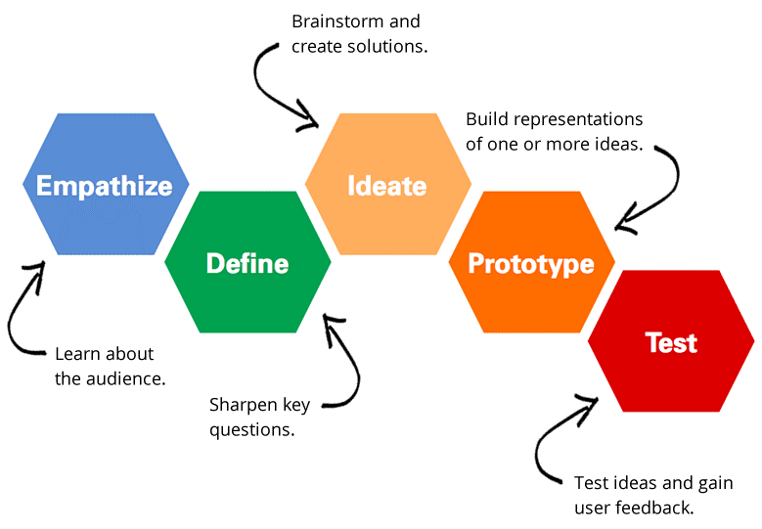
Design Thinking – key steps

Slide 9

Design Thinking – bias
Notes:
Plastic to titanium implant
Source: https://www.wired.co.uk/article/nuvasive-automated-design-spinal-implant-artificial-intelligence
“Humans have preconceived notions about the way something needs to look, but computers don’t – so it’s easier for them to offer original ideas.”

Slide 10

Design Thinking – example

Slide 11
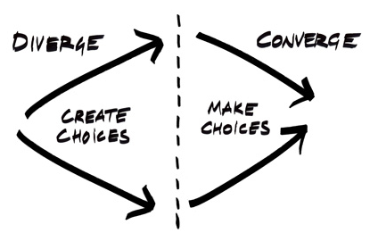
Design Thinking – basics

Slide 12
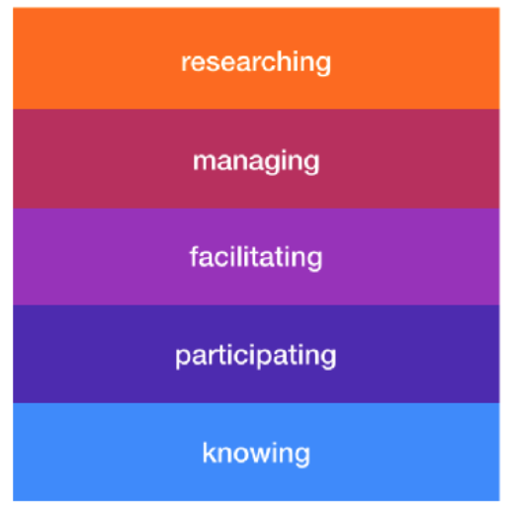
Design thinking – student development
Mindset:
Optimism
Iteration
Creative Confidence
Making
Embracing Ambiguity
Learning from Failure
Skills:
Empathy
Team work
Self awareness
Reflection
Problem solving
Working with complexity
IL029 Capability stack:
Notes:
Link to the IL029 module: https://warwick.ac.uk/fac/cross_fac/iatl/activities/modules/ugmodules/anintroductiontodesignthinkingtheoryandpractice

Slide 13
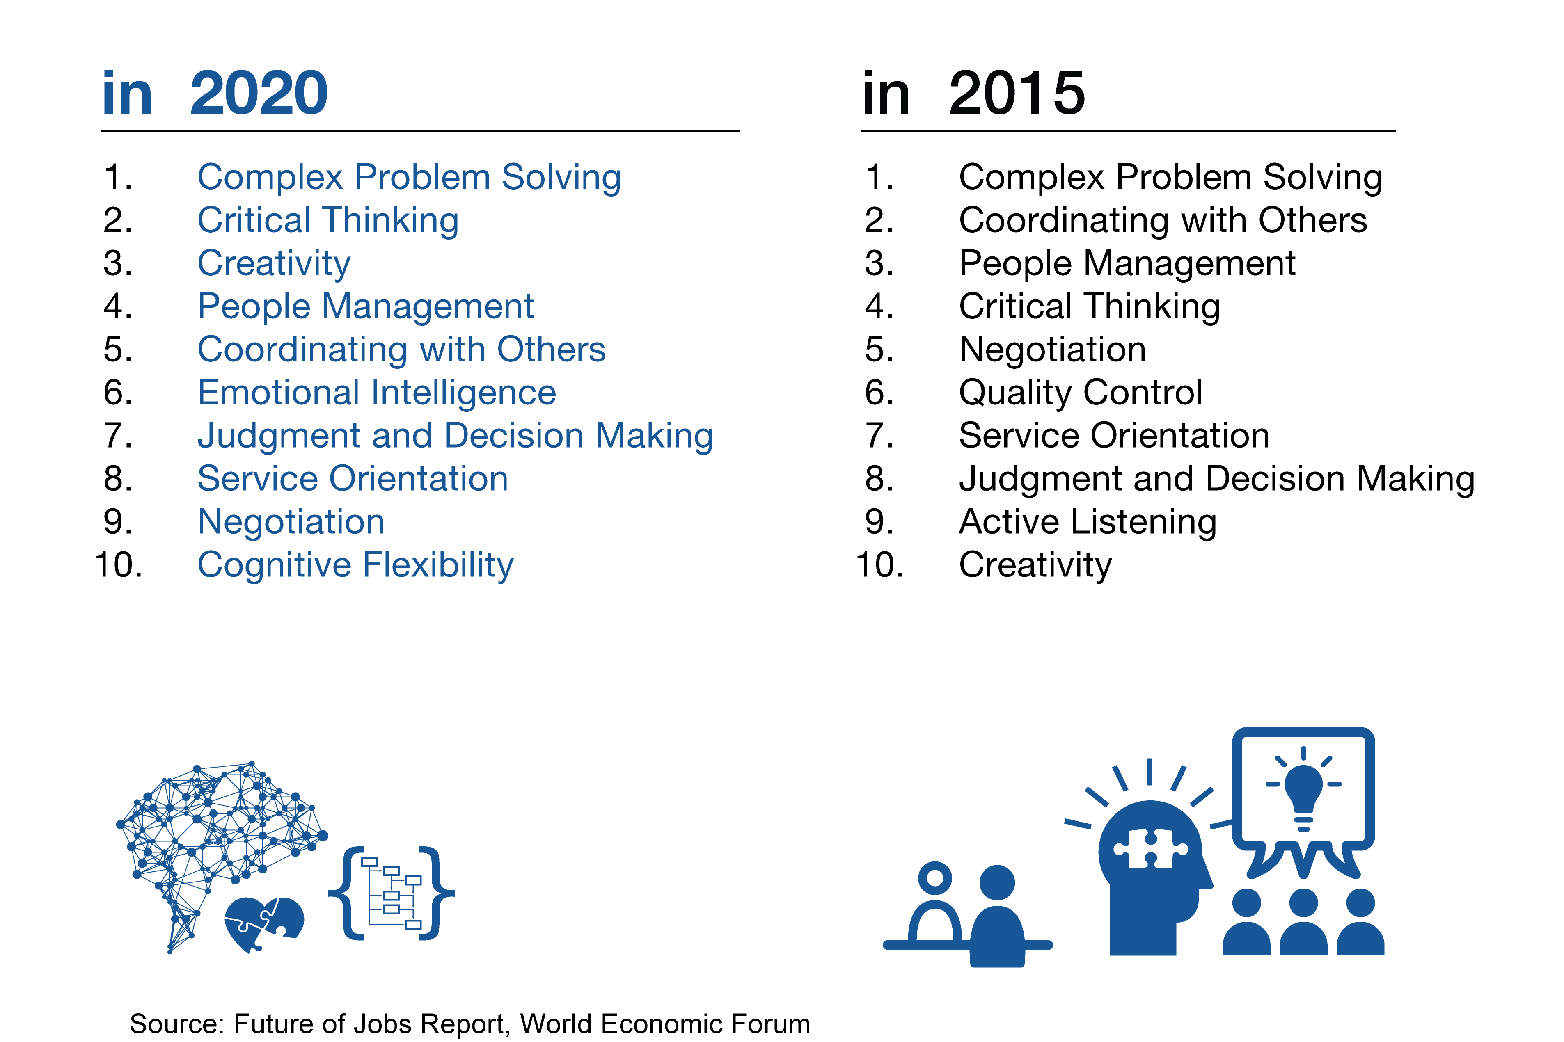
Top 10 skills

Slide 14
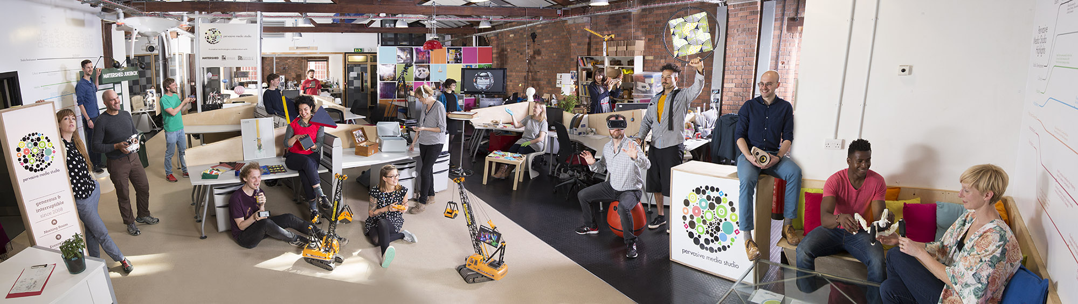
Pervasive Media Studio

Slide 15

Did you know?

Slide 16
Design thinking – Why?
Authentic and collaborative problem solving
Skills and employability development
21st century ready
Challenge existing bias and mindset
Learn empathy and creativity
Applicable to any discipline and career path

Slide 17
The Mentoring and Partnership Conference: Q&A
Dr Bo Kelestyn FHEA & Dr Robert O’Toole NTF
bo.kelestyn@warwick.ac.uk
robert.o-toole@warwick.ac.uk

