Slide 1
PGCE Secondary Programme: Core and SD
Key updates and developments
Alison Morgan and Secondary Team

Slide 2
Overview
Vision and Strategic Priorities 2017-2020
Highlights from 2017/18
Developments: 2019/20
Partnership - Georgina Newton
Alliance days and the role of the ATF – Jonty Leese
Recruitment 2020/21: John Thornby
Supporting trainees and schools – Rachel Cooper
Assessment Only: Vikki Armeson
PGCEi: Nick McKie

Slide 3

Vision and Mission Statement
Vision:
To be the first choice for teacher education. Strongly contribute to teacher supply, school improvement in our local & regional communities, with an outstanding national & international reputation for academic & professional excellence.
University of Warwick Partnership mission:
To create expert teachers & innovation in teacher education which makes a lasting difference in children's & young people’s lives.

Slide 4
CTE Strategic Priorities 2017-2020
Contribute to improved standards of teaching in schools and raising student attainment.
Develop and implement CTE’s academic plan; to be research-active.
Contribute to the supply and retention of high calibre teachers in our partner schools and beyond.
Equality of Opportunity and Improvement through Social Mobility
Innovation in Teaching and Learning
Investment in Staff
To be financially sustainable

Slide 5
Highlights from 2018-19
Reduction of subjects to 18 – higher quality subject provision
Monday/ Friday split – personalised provision
Reshaping of RP sessions
Conferences
Partnership

Slide 6
Challenges in 2018-19
Long-term staff absence
Paul Taylor-McCartney leaving
Breadth and range of trainee issues, leading to increased levels of support
Parity of trainee experience across 18 subjects

Slide 7
External Examiner Report:
2017-18
Overall the quality of teaching was high and in one case Outstanding+. Students are passionate about their subject and clear on how to ensure pupils are making progress. Students who are struggling are well supported by the university and school so that progress in the end is where is ought to be for that student. The school settings are suitable and mentoring is strong with a number of mentors providing high quality feedback and support. The university provides high quality academic input as evidenced through assignments and students comments on quality of university days. A number of Teaching Fellows were singled out by students for their work.

Slide 8
Developments for 2019/20
New Head of Secondary PGCE - Dr Andy Hind
14 subjects across two days – improved subject split
Revised principles for SS – Holly Heshmati to support John Thornby
Revised SS assignment – 3,000 words, selection of titles
Focus on creating reflective practitioners in RP – Kate Hamer and Vikki Armeson to lead on this
Explicit links between University content, school placement and assessment through programme outline
Partnership development/impact – nurturing new providers and capturing impact of alumni

Slide 9
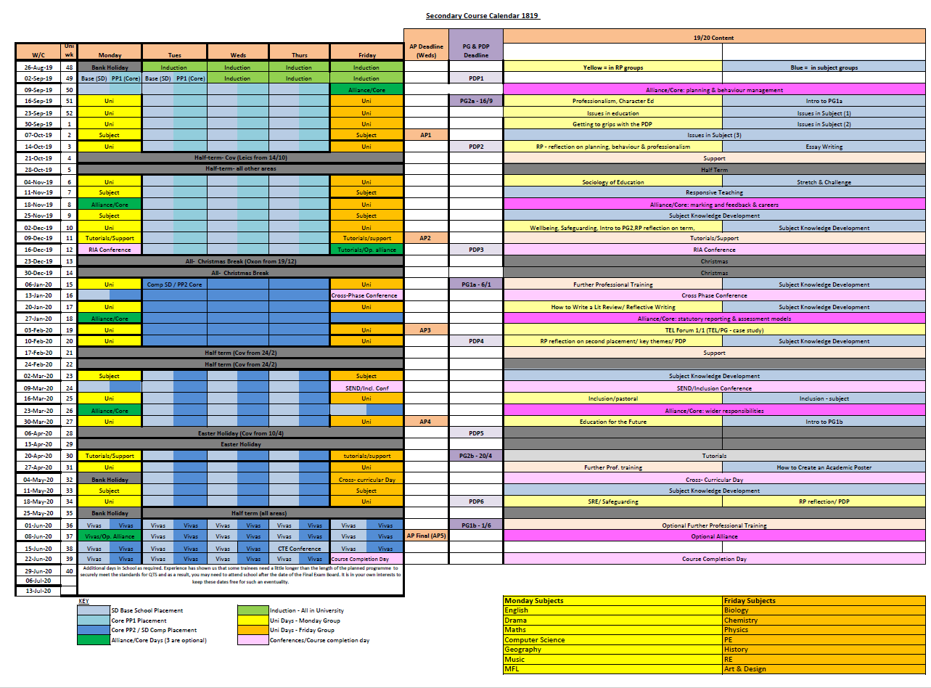

Slide 10
Accepted offers (June 14th)
Mondays
Fridays
English | 52
Drama | 7
Maths | 15
Computer Science | 7
Geography | 17
Music | 4
MFL | 15
TOTAL | 117
Biology | 16
Chemistry | 13
Physics | 4
PE (incl. EBACC) | 26
History | 25
RE | 8
Art & Design | 8
TOTAL | 100

Slide 11
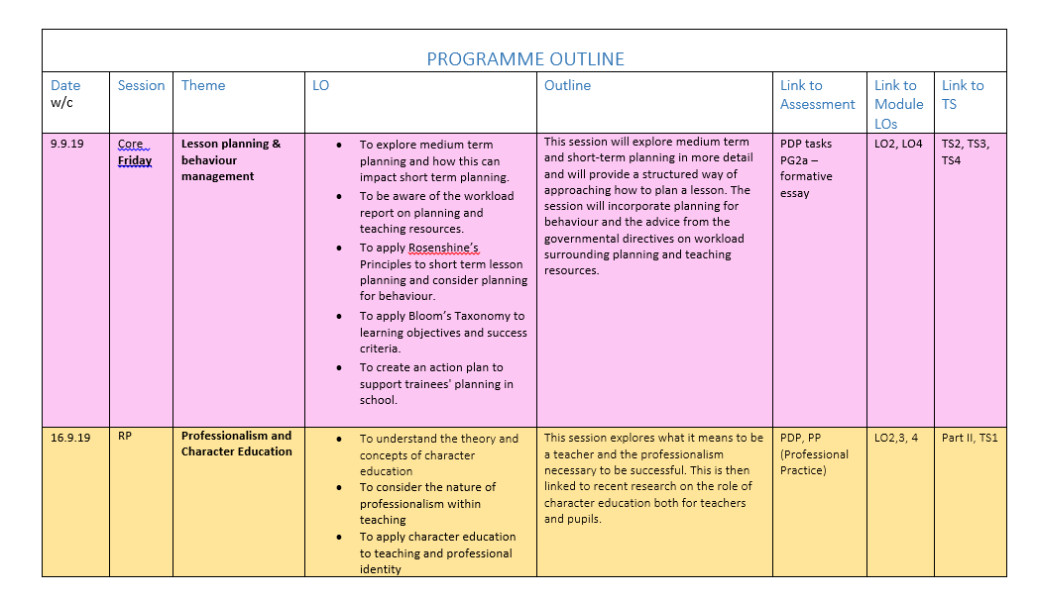
Programme Outline 2019-20

Slide 12
Who’s Who in the Senior Team
Module Lead
Subject Studies: John Thornby
Reflective Practice: Alison Morgan
Professional Practice: Jonty Leese
Programme Lead:
Monday: John Thornby & Georgina Newton
Friday: Alison Morgan & Jonty Leese
Core: Alison Morgan & John Thornby
School Direct: Jonty Leese & Georgina Newton
Partnership Clusters
Lead: Georgina Newton
Reflective Practice groups
Teaching Fellows
Safeguarding & Senior Tutor
Rachel Cooper

Slide 13


PG Assessment Structure
“Subject
Studies”
EP929
30 CATS (7)
“Reflective
Practice”
IE9J1
30 CATS (7)
“Professional Practice”
EP918
30 CATS (6)
PG1 | PG2 | PDP | Qualification
 |  |  | PGCE with QTS
Honours Level |  |  | PCE with QTS
 | Honours Level |  | PCE with QTS
 |  |  | PGCert Ed Studies

Slide 14
Module PG1: Subject Studies
PG1a
Essay – 3000 words
(80%)
Deadline:
7 January 2020
PG1b
Academic Poster
(20%)
Deadline:
1 June 2020

Slide 15
Module PG2: Reflective Practice
PG2a
Formative Essay – 1000 words
(0%)
Deadline:
16 September 2019
PG2b
Essay (5000 words)
(100%)
Deadline:
21 April 2020

Slide 16
Draft Ofsted Framework for ITE
To launch summer 2020
Potential foci:
the content/quality of the ITE curriculum and trainees’ pedagogical preparation
ensuring trainees are prepared well to teach the subject(s) they will be responsible for
ensuring trainees have a suitable workload
mental health of trainees and their preparation to support pupils.
How well are trainees being taught to teach across a range of schools and not just one school or alliance?

Slide 17
Partnership: ways to engage
Programme contributions (RP, PG, Subject , Careers Focus Days, Conferences)
Partnership Lunch and WaSP meetings schedule – 1 per term throughout 19-20
Autumn: Thursday 5th December (1 to 4 pm)
Spring: Thursday 19th March (1 to 4 pm)
Summer: Thursday 2nd July (1 to 4 pm)
Conference attendance/input:
  ‘Research in Action’ (Monday 16th December)
  ‘Cross-Phase Conference (17th January)
  ‘Inclusion’ (Friday 13th March)
  ‘Partnership’ (Thursday 18th June)

Slide 18
Partnership: changes
Working towards a streamlined cross-phase offer for our School Direct Alliances
Moderation Tutor
Personal Tutor
Assessment Profiles 1-5
Not met, met, good, outstanding
Beginning, developing, good, outstanding
What happens in a moderation visit (see handbooks)

Slide 19
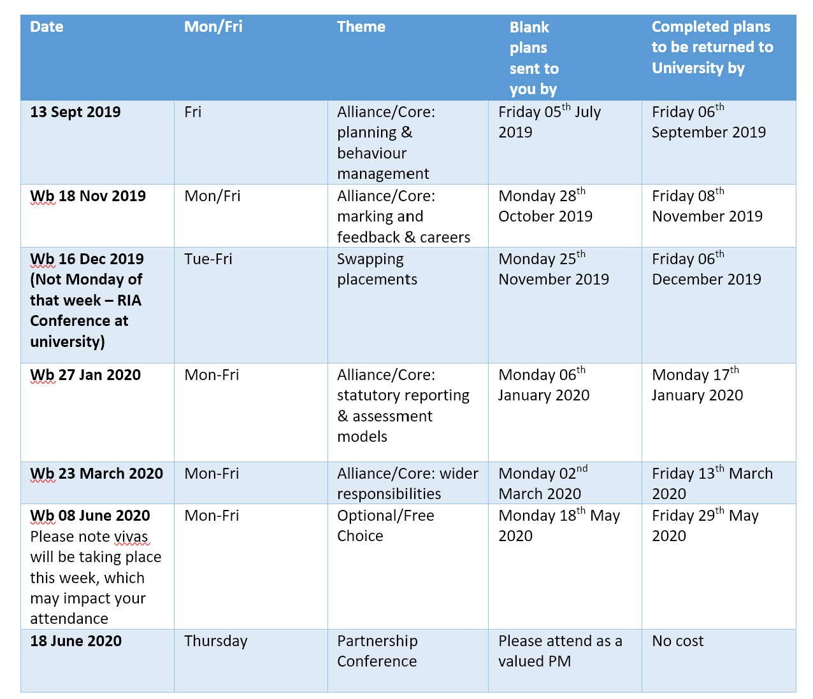
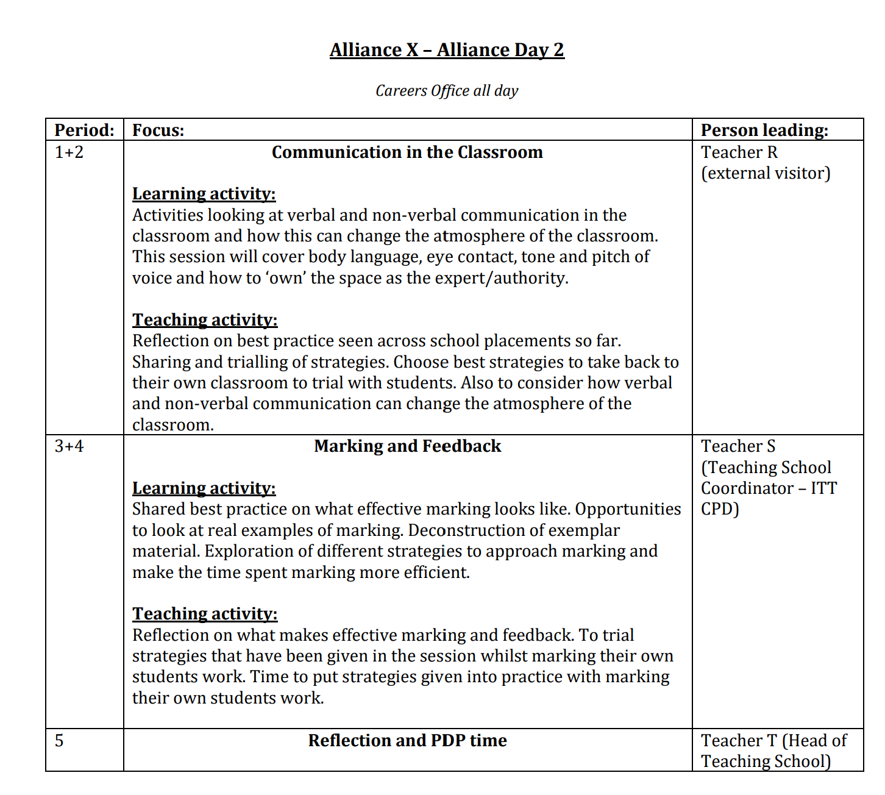
Alliance Days – Jonty Leese
Aligned
Streamlined
Listen
Feedback
Level 7 content
Notes:
Aligned to the course – what you cover, we cover
Streamlined paperwork – happy to receive in a format of your keeping as long as received in advance
I try to come out to alliance days to see what is happening!
Listen – to you – change course, e.g. Mon/Fri delivery day
Feedback – You said last year, you wanted exemplar plans, so I have shared some this year
Sept 13th 2019 – STP

Slide 20
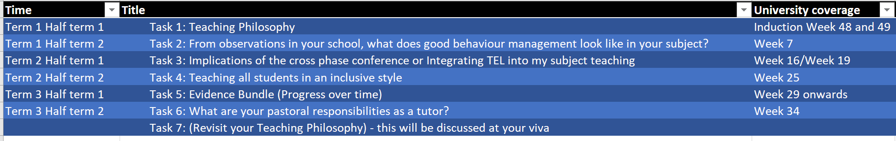
PDP – Jonty Leese
6 tasks – clearly linked to subject around an issue (500 words)
  Time frame – 1 task per term
  Teaching philosophy to "top and tail"
  OneNote
  Designed to be done incrementally, not a rush
  Talk to your trainee about the questions
  Collaborate
  See you at 3:00!

Slide 21
Recruitment – John Thornby
Applications moving: UCAS → Publish
Existing SD partners should already be using this
Lead Schools: Ensure “About your organisation”, “Location” and “Courses” are updated
We do expect some teething problems

Slide 22
Recruitment – John Thornby
DfE have invited us to join the ITE applications methodology forum.
  discuss plans for the development and implementation of the service
  develop a thorough understanding of systems and processes that providers currently use
  forum for providers, which will be a way for the department to share information and updates
  Forum members providing feedback on key policy and design questions.
First meet: 19 September in London (then quarterly)

Slide 23
Recruitment – John Thornby
Change to course entry requirements
  Non-SKE Subjects = relevant related degree
  SKE Subjects = A-level grade B minimum
Rationale:
  ITE moving more strongly toward subject
  Primary Maths (B), PE + EBacc (C)
  Trainee retention and outcomes worse for those who are under-qualified
Advice: Suggest prospective applicants apply early and enter for A-level

Slide 24
Supporting Trainees – Rachel Cooper
Pre-course contact
Individual Support Plans
Dedicated well-being staff
Well-being sessions included within the programme
Well-being lounge
Partnership safeguarding referral
Suitability Panel

Slide 25
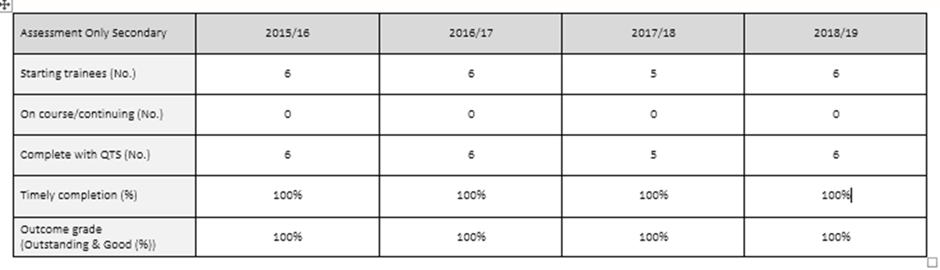
Assessment Only – Vikki Armeson
Data
https://warwick.ac.uk/fac/soc/cte/professionaldevelopment/assessmentonly/

Slide 26
Assessment Only – Vikki Armeson
2018 – 2019
Autumn term - 5 candidates (English, Drama, Health and Social Care, RE, Geography)
Spring term - 1 candidate (History)
Birmingham, Coventry, Daventry, Leicester.
All 6 candidates were recommended for QTS and graded as outstanding. They are all now completing their NQT year.
2019 – 2020
AO programme begins in September, current applicant for Business Studies.
Places are available for Spring 2020.
CTE Assessment Only stall.

Slide 27
Assessment Only – Vikki Armeson
March 2019 - DfE Audit - ITT Provider Assessment Only Visit
This reported that we are fully compliant with DfE requirements. We have actions points to consider which will addressed by the end of July 2019.
We were asked to retain the following:
the succinct and highly specific timeline of experience which shows, in the case of every potential candidate, by every relevant preceding year, each employing school as well as the year groups and secondary subject or primary curriculum areas taught in each of those years;
the concise and specific nature of the partnership agreement;
the brevity and focus of the health and capacity to teach instrument;
the use of a “viva” as part of the secondary final assessment (probing the evidence presented against the Teachers’ Standards).

Slide 28
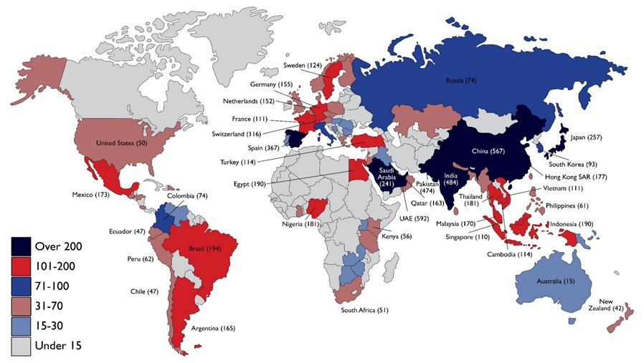
PGCE international- Nick McKie

Slide 29
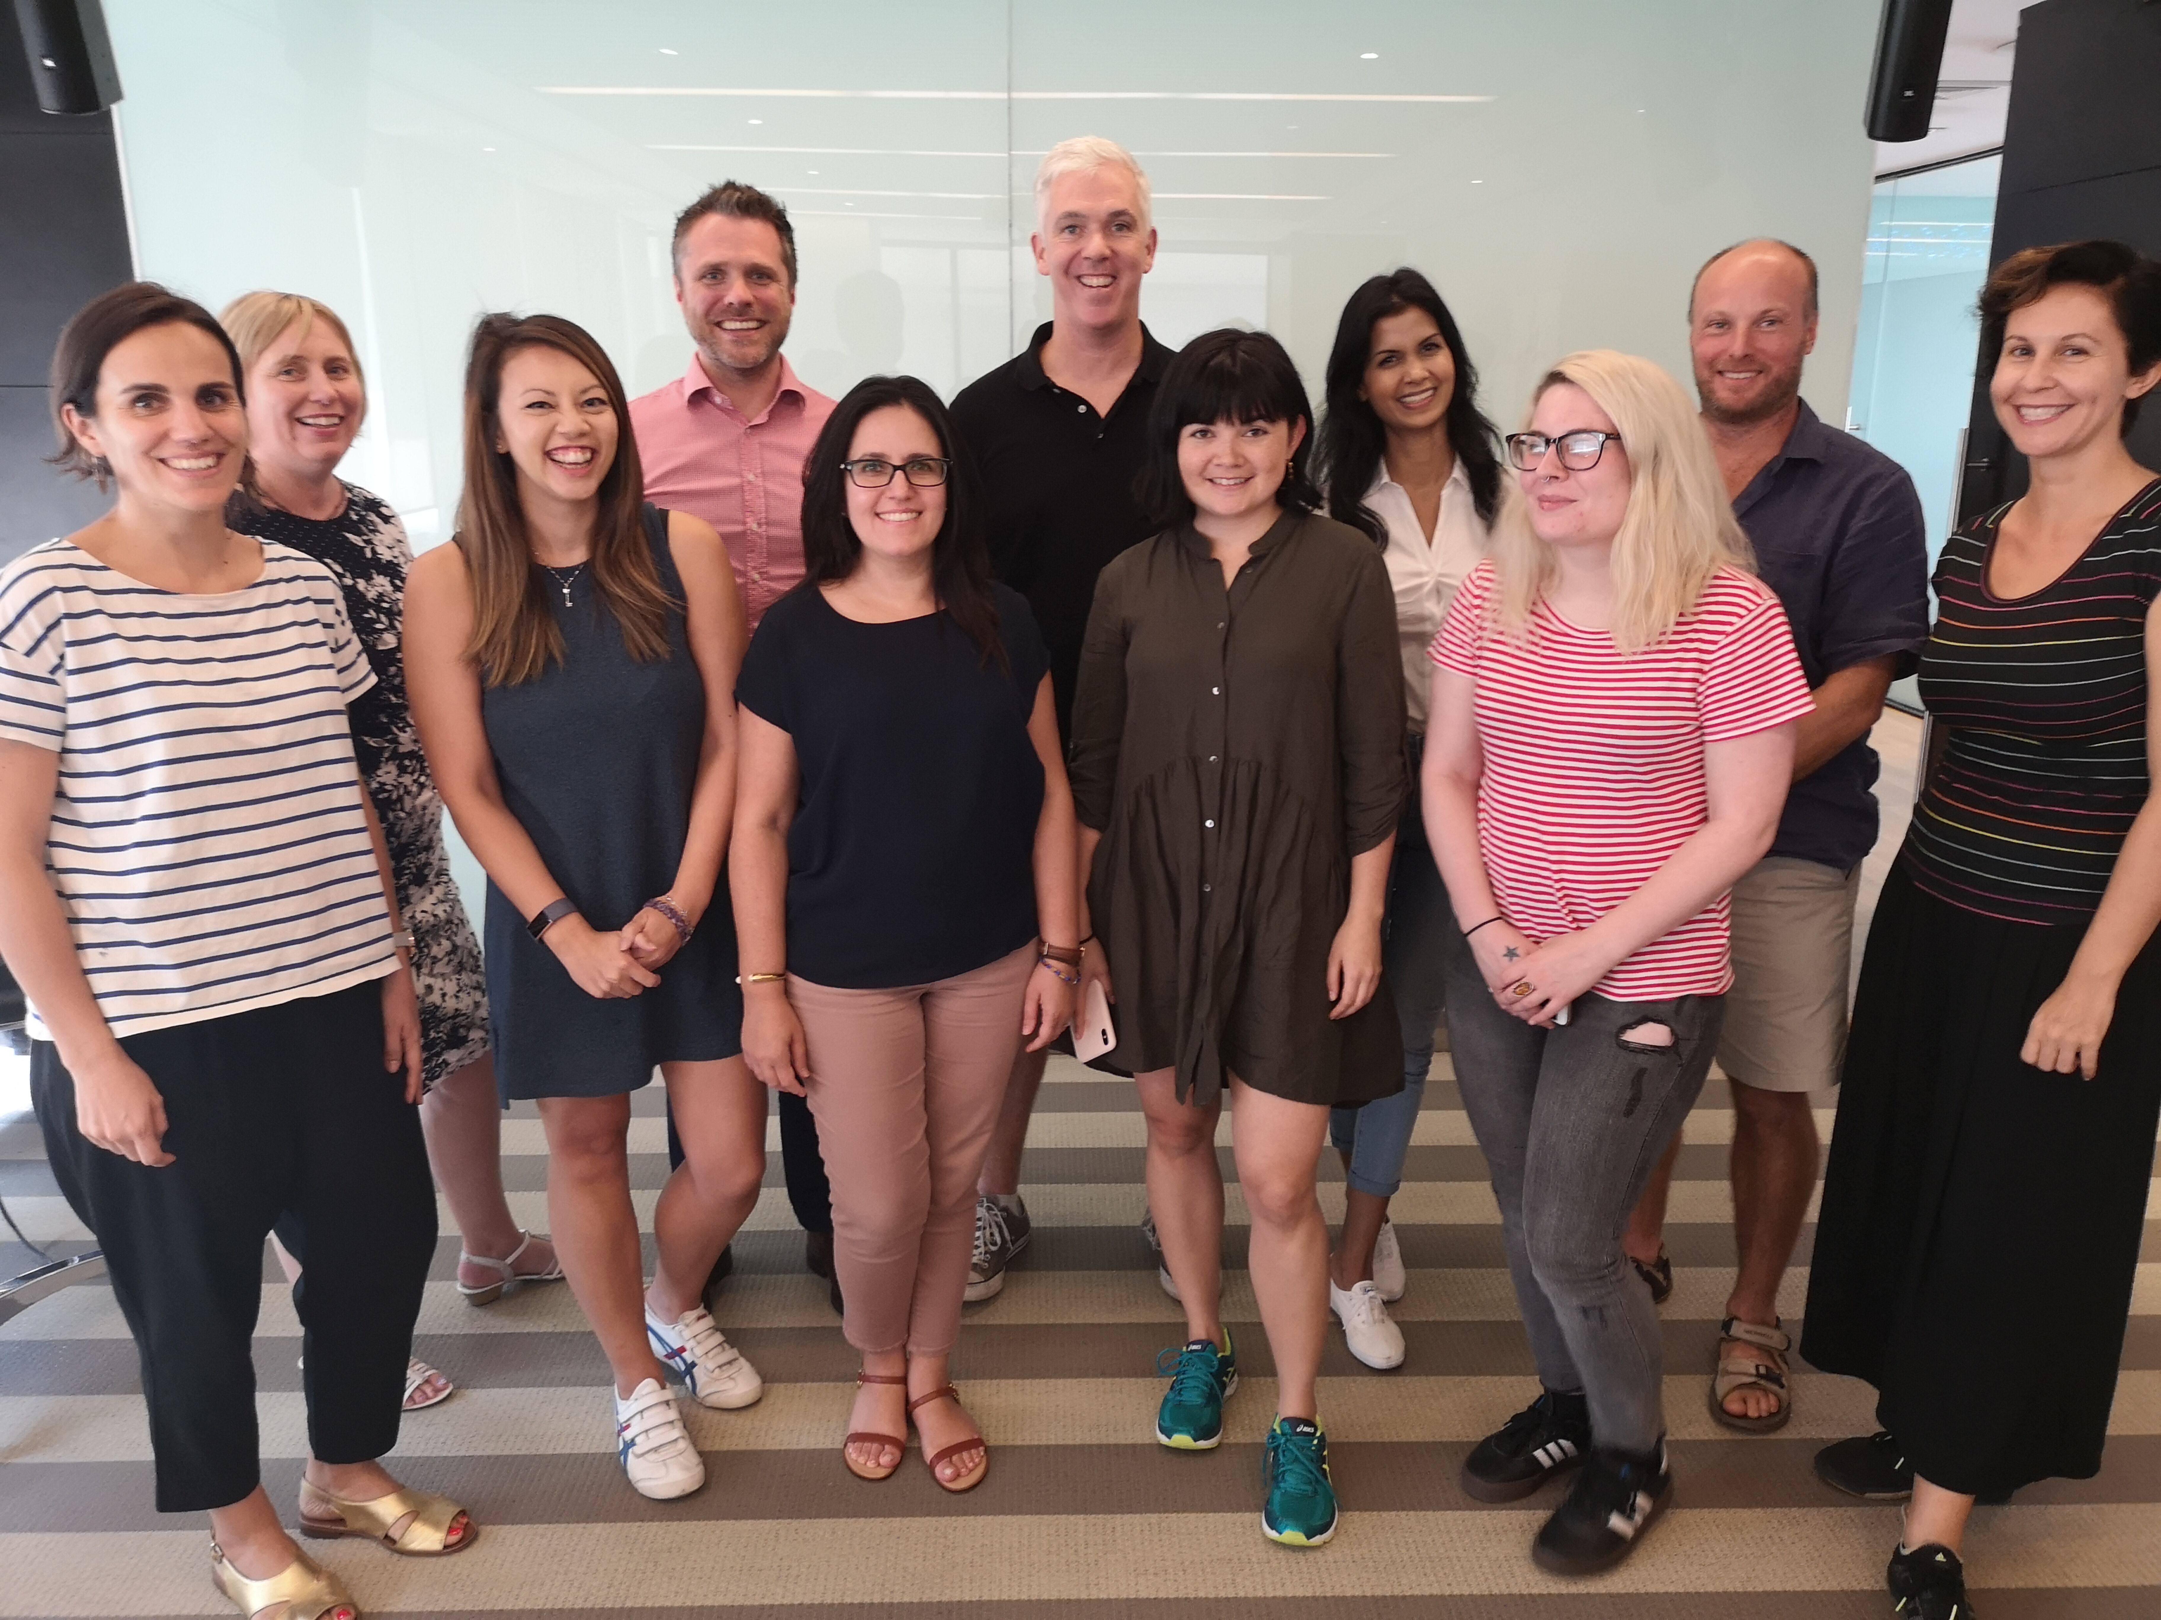
April 2019 PGCEi cohort

Slide 30
MA in Professional Education Update
First year of completion for MA upgrade at CTE
32 dissertations and graduations!
Covering themes such as
  Student and teacher well-being
  Academisation
  Building pupil self-efficacy through engagement in sport
  Oracy
  GCSE reform
  English as a second language
This year’s cohort are coming to the end of research in schools, and next year’s cohort are completing their research training in preparation for beginning their dissertations in the Autumn.
Notes:
We had 32 submissions for dissertation. With a range of dissertation themes ranging across student and teacher well-being, academisation, building pupil self-efficacy through engagement in sport, Oracy, GCSE reform, supporting students with English as a second language to name just a few of them.
This year’s cohort are coming to the end of research in schools, and next year’s cohort are completing their research training in preparation for beginning their dissertations in the Autumn.

Slide 31
Q and A
Contact me:
Alison Morgan
Deputy Head of Secondary Teacher Education
t: +44 (0)24 7652 4417
E: a.j.morgan@warwick.ac.uk
Centre for Teacher Education | University of Warwick | Coventry | CV4 8EE | UK

