Slide 1

Schools Research Network
Dr. John Thornby
john.thornby@warwick.ac.uk

Slide 2

Introductions
Who’s who?

Slide 3
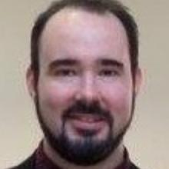
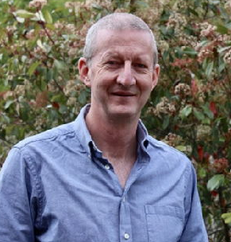
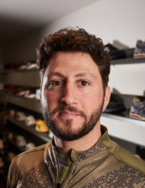
Introductions
Dr. John Thornby
Associate Prof. in CTE Secondary Team
Chair of CTE Schools Research Network
Prof. Des Hewitt
Head of Primary Teacher Education
Research Lead at CTE
Mo Cusworth-Yafai
Shireland Collegiate Academy
Director of the Research School

Slide 4



Session Outline
Recap of Previous Meeting and Updates
(John / Des, 30 secs)
Research Schools (Mo, 30 mins)
Forthcoming Opportunities (John / Des, 5 mins)
Open Discussion / Exploring Common Themes
→ Ideas for Enquiry

Slide 5
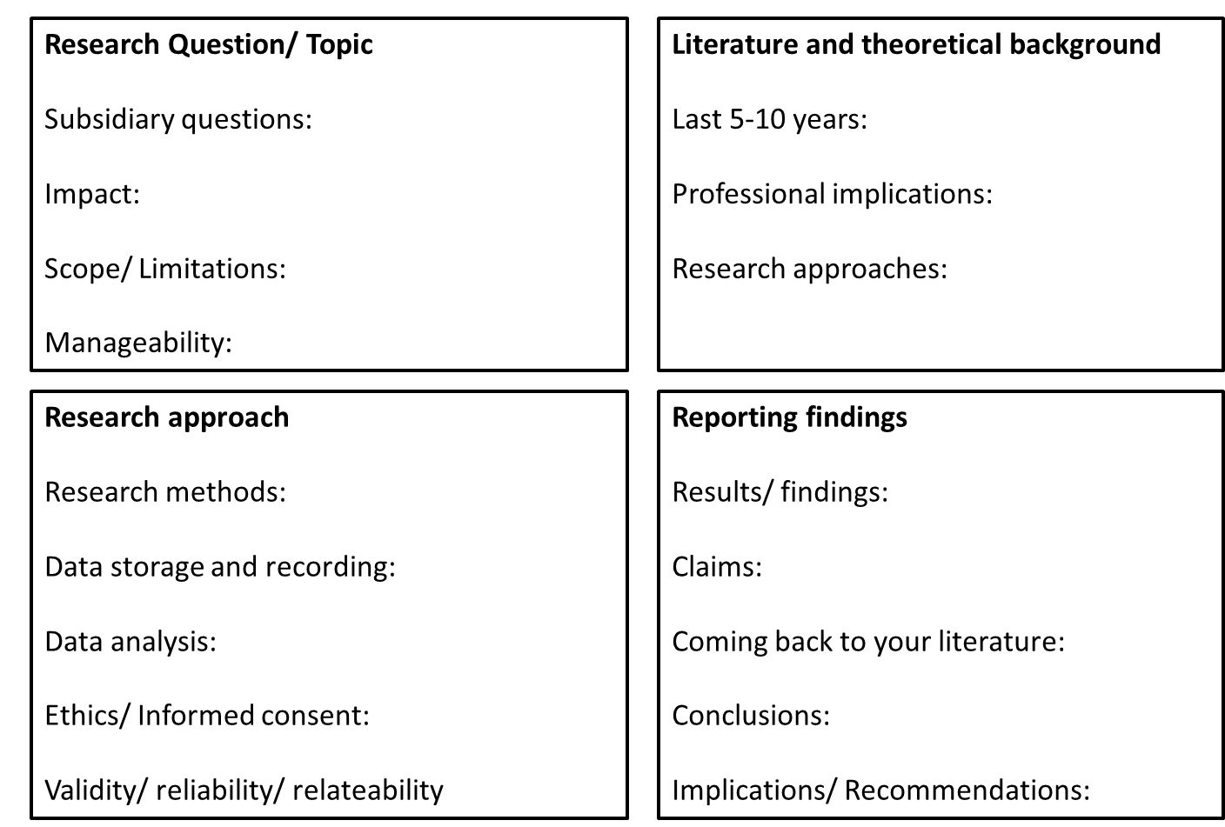
Recap of March Meeting
Explored BERA guidelines for quality criteria in “Close-to-practice” research:
Robust
Rigorous
Consider Methodology
Quantitative isn’t the only way

Slide 6
Over to Mo…

Slide 7
Funding Opportunities @ Warwick
Faculty Research Funding
The Faculty of Social Sciences offers small grants to support collaborative research within the Faculty through workshops, exploration of issues and meetings with external collaborators and international partners.
Research Development Funding (RDF)
The purpose of the University's Research Development Fund is to increase the University's capacity and capability to undertake world-class, innovative and exciting research by providing pump-priming funds. There are two competitive elements to the fund during the academic year:
Strategic Awards - up to £25,000.
Development Awards - no formal limit but usually capped at £3,000. Rolling deadline.
Institute of Advanced Study (IAS)
The IAS offers a range of small funding pots that operate on a rolling deadline:
'Developing Ideas’ - up to £1,500 for speculative meetings or research networks.
'Advancing Grants’ - up to £3,500 to support development of multi-partner research bids
'Delivering Results’ - up to £3,500 for research-related public engagement, impact, project continuation plans and further collaborative initiatives

Slide 8

Warwick Journal of Education – Transforming Teaching
Journal with a practitioner focus
Peer-reviewed
Opportunity to publish pedagogical research or practitioner enquiry
Opportunity to serve as a reviewer and/or editor
Issue 2 coming soon!
http://journals.warwick.ac.uk/index.php/wjett/

Slide 9
Later Today (15:10, OC1.02)
Health and well-being Research opportunity for schools
Prof. Des Hewitt (CTE) & Prof. Vinod Patel (WMS)
Developing a ‘Health passport’: an opportunity to link education in schools and health priorities (both physical and mental).

